Slide 1
COMP 512 Project Presentation
Group 28

Slide 2
Overview
Uses Java RMI, 2 phase locking and passive replication for fault tolerance.
Implements Primary copy + eager approach
  allow at most N – 1 failure on each component
Components
  RepClient
    Sends requests to Primary middleware
    Resends requests on faults, to new chosen Primary middleware
    a background thread dynamically check any dead servers and reconnect

Slide 3
  Middleware
    Uses Jgroups to send state changes and synchronize messages.
    Implements Transaction and Lock Managers.
    Resends requests on faults, to new chosen Primary Resource managers.
    a background thread dynamically check any dead resource managers and reconnect
  Resource Managers
    TransGCResourceManager
      A new base class for all ResourceManagers
      Implements JGroup-related functionalities
      Implements MessageDispatcher Interface
    Flight/Car/Hotel Resource Managers
      Uses Jgroups to send state changes and synchronize messages.

Slide 4
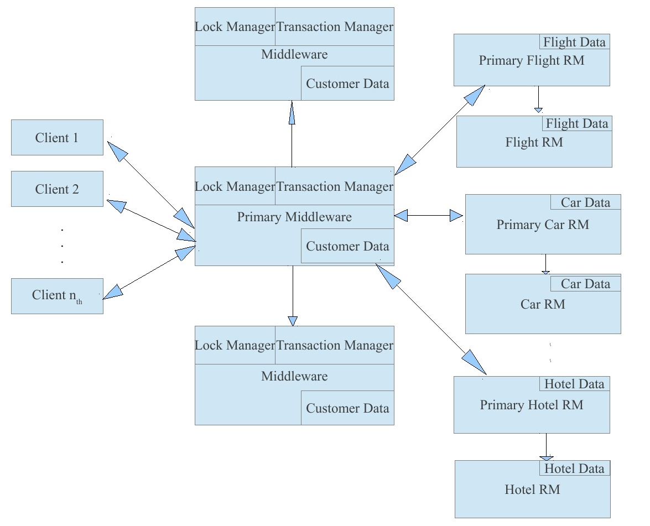

Slide 5
Algorithm
Primary Selection
  Utilizing the view of JGroup
  Coordinator (view[0]) of cluster in JGroup used as primary server
Synchronizing
  For each request at primary servers(Middleware or RMs), it send a state change message to secondary servers.
  On new server join, it sends a sync request to primary server and receives the complete state of primary as a response.

Slide 6
State Changes
Any updates to customer,flight,car,hotel objects multicast the message to other members in the same cluster
Locks at middleware level

Slide 7
Consistency during failures
Failure cases
  crash at Resource managers before/after executing requests.
  crash before executing request at middleware
  crash after executing and before sending the response
  crash after executing at middleware but before sending to RMs.
  crash after executing at primary middleware but before sending to secondary middlewares.

Slide 8
Consistency during failures
During server failure the acting clients (client/middleware) looks for a new primary server(after timeout or connection errors) and resend the requests.
We do need to re-execute requests. So we assign operationIDs to each request and keep a list of operations already performed.
We check for transactionID and operationID to verify if an operation has been already performed.
A thread at acting clients(client/middleware) reconnects with servers which came back up again after failing.

Slide 9
Maintaining consistency during synchronization (new member join)
  If write comes during synchronization, it will be blocked till all the data is synchronized
  If primary middleware fails during synchronization or secondary does not receive the complete state in 10 secs, it will resend the request to a new primary.
  If primary resource managers(Flight/Car/Hotel) fails during synchronization or secondary does not receive the complete state in 5 secs, it will resend the request to a new random resource manager.

