Slide 1
Pasqal workshop
Lecture 2: Analog mode for NAQC

Slide 2
Summary
Analog mode on Neutral Atoms Quantum Computing
Example: Antiferromagnetism modeling
Optimizing pulses

Slide 3
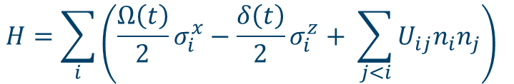
Analog mode on Neutral Atoms Quantum Computing
Global pulses create a tunable global Hamiltonian:
Control of Ω and δ allows for simulation of:
various quantum systems
Computational problems such as optimizations
$$H=\sum_{i}{\left(\frac{Ω\left(t\right)}{2}σ_{i}^{x}−\frac{δ\left(t\right)}{2}σ_{i}^{z}+ \sum_{j<i}{U_{ij}n_{i}n_{j}}\right) }$$

Slide 4
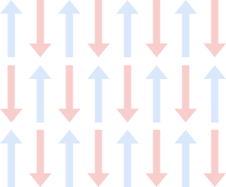
Antiferromagnetism

Slide 5
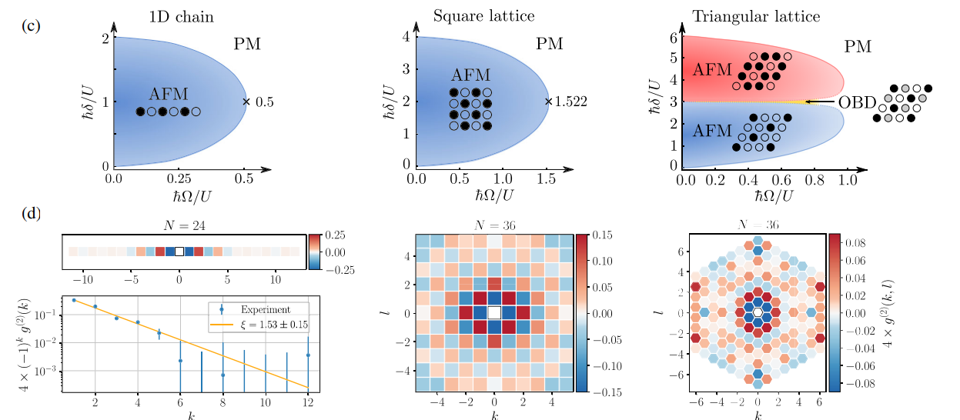
Antiferromagnetism
From Lienhard, Vincent, et al. "Observing the space-and time-dependent growth of correlations in dynamically tuned synthetic Ising models with antiferromagnetic interactions." Physical Review X 8.2 (2018): 021070.

Slide 6
Antiferromagnetism
$$H=\sum_{i}{\left(\frac{Ω\left(t\right)}{2}σ_{i}^{x}−\frac{δ\left(t\right)}{2}σ_{i}^{z}+ \sum_{j<i}{U_{ij}n_{i}n_{j}}\right) }$$
Antiferromagnetism when U > 0.

Slide 7
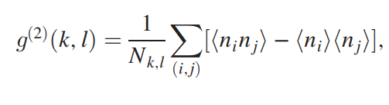
Antiferromagnetism
Spin-spin correlation:

Slide 8
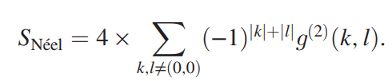
Antiferromagnetism
Néel structure factor
Peaks with the correlation function – maximum for AF state.

Slide 9
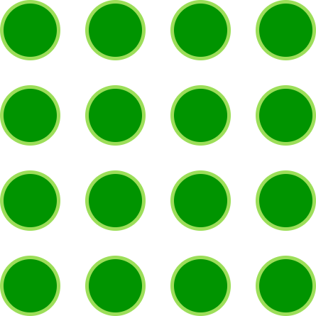
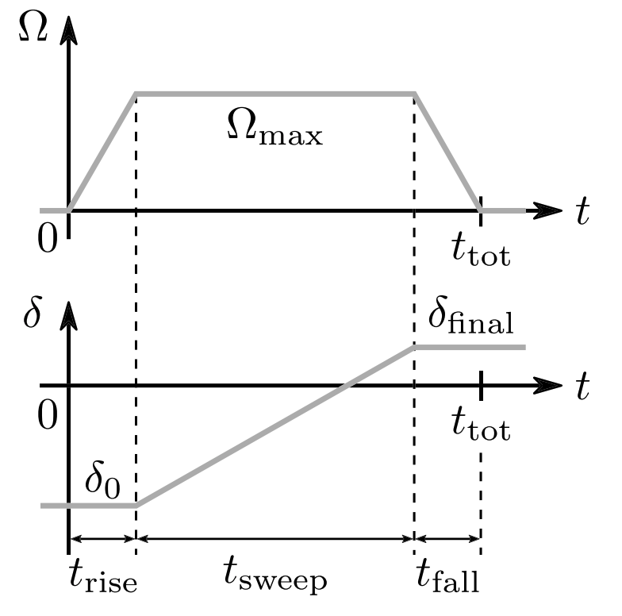
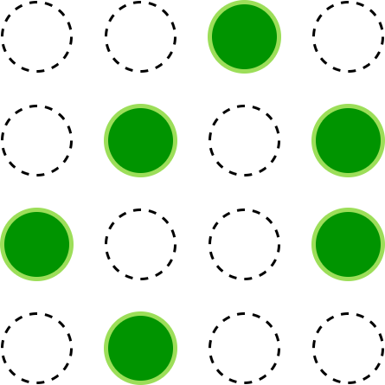
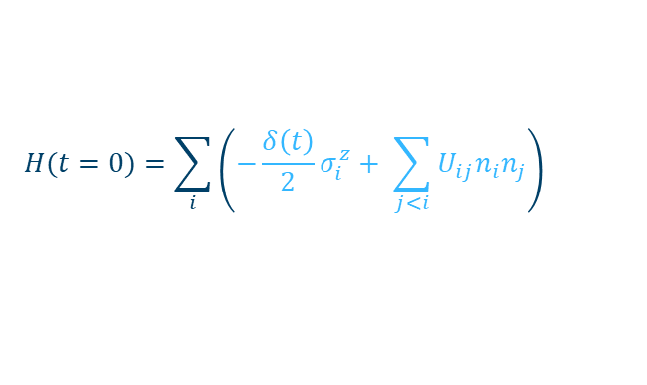
Creating an AF state
$$H(t=0)=\sum_{i}{\left(−\frac{δ\left(t\right)}{2}σ_{i}^{z}+ \sum_{j<i}{U_{ij}n_{i}n_{j}}\right) }$$
All spins in ground state
|0>
|1>

Slide 10
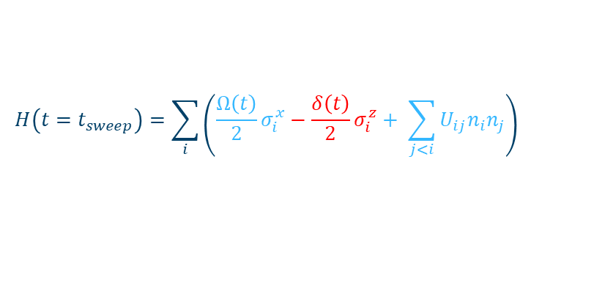
Creating an AF state
$$H\left(t=t_{sweep}\right)=\sum_{i}{\left(\frac{Ω\left(t\right)}{2}σ_{i}^{x}−\frac{δ\left(t\right)}{2}σ_{i}^{z}+ \sum_{j<i}{U_{ij}n_{i}n_{j}}\right) }$$
Fluctuations
States will tend to be anti-correlated
|0>
|1>

Slide 11
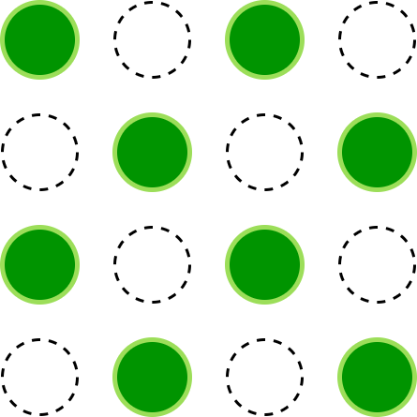
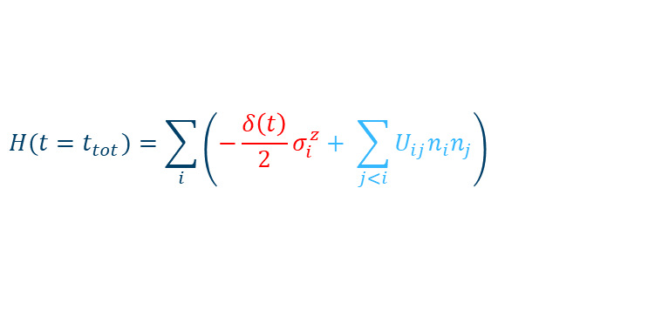
Creating an AF state
$$H(t=t_{tot})=\sum_{i}{\left(−\frac{δ\left(t\right)}{2}σ_{i}^{z}+ \sum_{j<i}{U_{ij}n_{i}n_{j}}\right) }$$
Fully antiferromagnetic
|0>
|1>

Slide 12
Pulser
Let’s code!

Slide 13
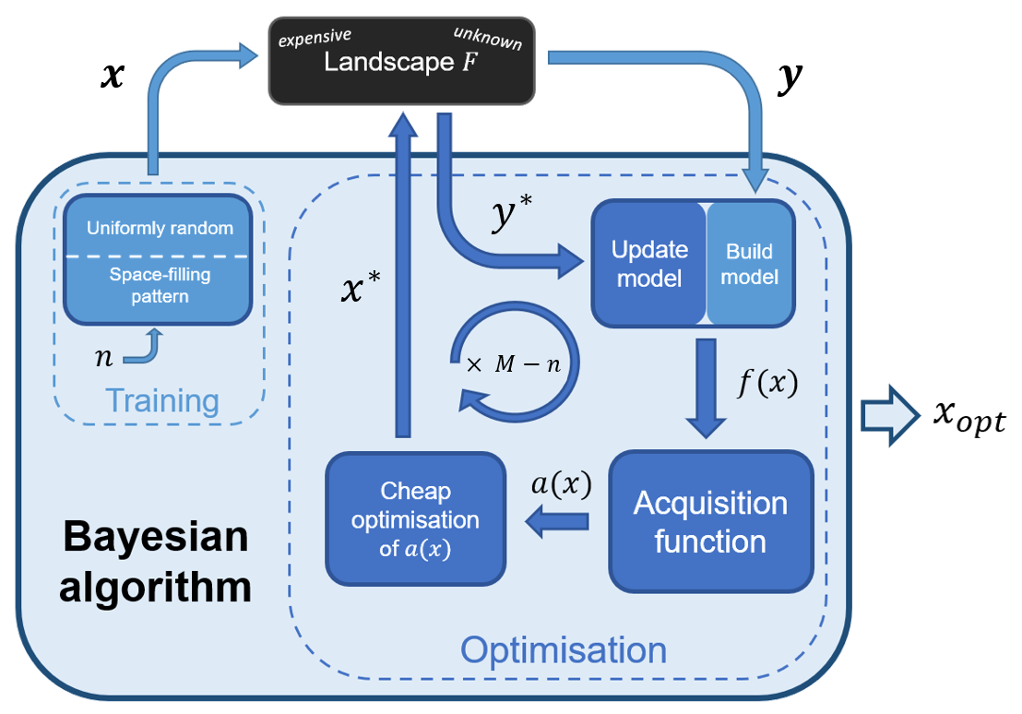
Can we do better?

Slide 14
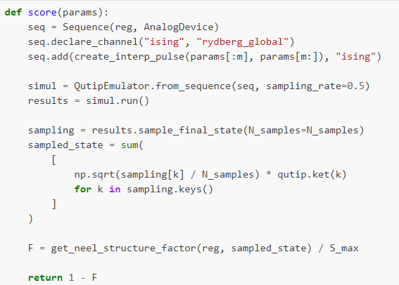
Optimizing pulses
We can assign score to different parameters.
As S_{Néel} should be maximum for the AF state, this will be score ZERO.
Other values will be POSITIVE.

Slide 15
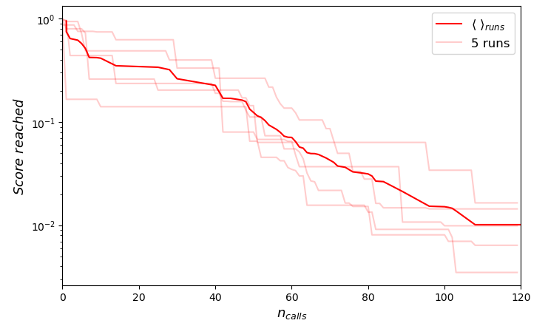
Optimizing pulses
The method is stochastic.

Slide 16
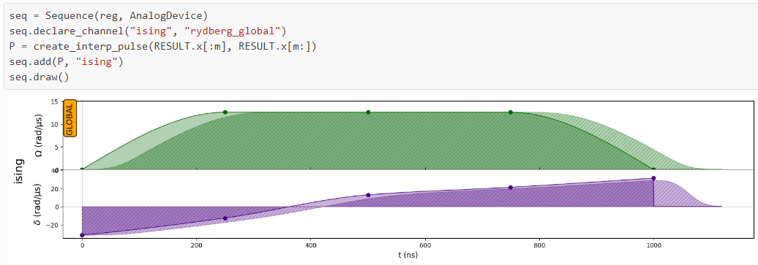
Optimizing pulses
We can create a new interpolated pulse based on the optimal result.

Slide 17
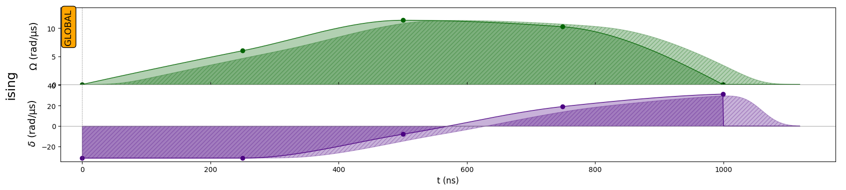
Optimizing pulses
Original
Optimized

Slide 18
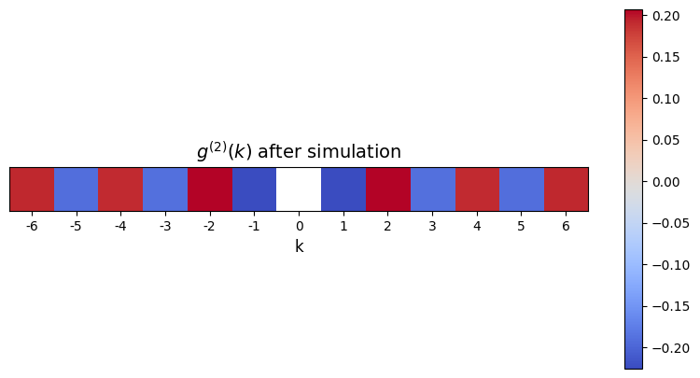
Optimized results

