Slide 1
Quadratic Unconstrained Binary Optimization (QUBO) on NAQC

Slide 2
Table of Contents
Quadratic Unconstrained Binary Optimization (QUBO)
Ising Hamiltonian of NAQC
Combinatorial Quantum Algorithm: Quantum Approximation Optimization Algorithm (QAOA)
Implementation: Solving QUBO using QAOA on NAQC

Slide 3
Quadratic Unconstrained Binary Optimization (QUBO)
QUBO is a combinatorial optimization problem that involves finding optimal configuration of binary variables that minimizes a quadratic objective function.
QUBO can model and solve numerous categories of optimization problems.

Slide 4

QUBO Formulation
Binary vectors $x∈𝔹^{n}$ where $𝔹∈\left\{0, 1\right\}$ and $n>0$ is the length of the vector.
$𝒬∈ℝ^{n×n}$ is a real-valued upper matrix with entries $𝒬_{ij}$ that represent weight of each entry pair $\left(x_{i}, x_{j}\right)$.
The optimization problem involves finding a bitstring that minimizes the quantity $f_{Q}\left(x\right)$.
$$f_{𝒬}\left(x\right)=x^{T}𝒬x$$

Slide 5
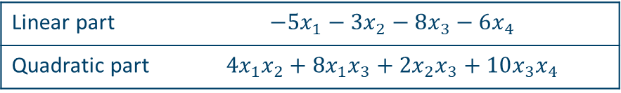

QUBO Intuition
Let us consider an optimization problem,
$$\min{y=−5x_{1}−3x_{2}−8x_{3}−6x_{4}+4x_{1}x_{2}+8x_{1}x_{3}+2x_{2}x_{3}+10x_{3}x_{4}}$$
The problem can be re-written as $$\min{y=\left(\begin{matrix}x_{1} & x_{2} & x_{3} & x_{4}\end{matrix}\right)\left[\begin{matrix}−5 & 2 & 4 & 0 \\ 2 & −3 & 1 & 0 \\ 4 & 1 & −8 & 5 \\ 0 & 0 & 5 & −6\end{matrix}\right]\left[\begin{matrix}x_{1} \\ x_{2} \\ x_{3} \\ x_{4}\end{matrix}\right]}=x^{T}Qx$$
Linear part | $$−5x_{1}−3x_{2}−8x_{3}−6x_{4}$$
Quadratic part | $$4x_{1}x_{2}+8x_{1}x_{3}+2x_{2}x_{3}+10x_{3}x_{4}$$

Slide 6
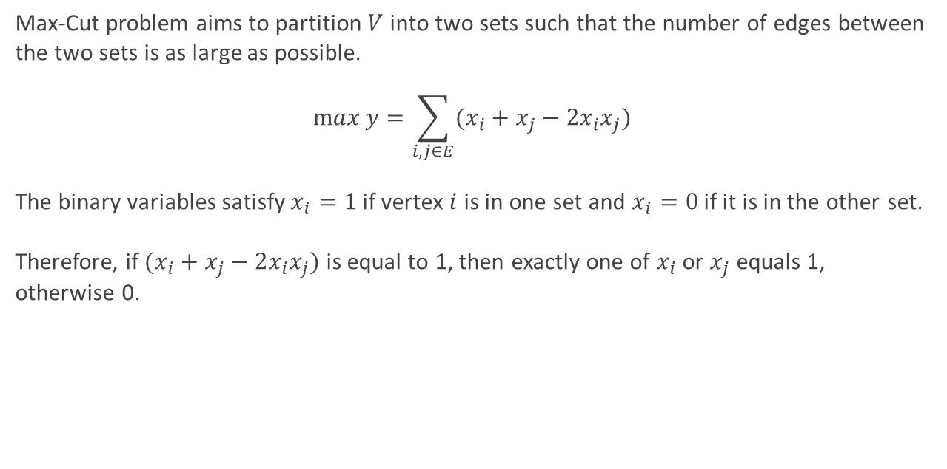
QUBO Example: Max-Cut
Max-Cut problem aims to partition $V$ into two sets such that the number of edges between the two sets is as large as possible.
$$\max{y=\sum_{i, j∈E}{(x_{i}+x_{j}−2x_{i}x_{j})}}$$
The binary variables satisfy $x_{i}=1$ if vertex $i$ is in one set and $x_{i}=0$ if it is in the other set. Therefore, if $(x_{i}+x_{j}−2x_{i}x_{j})$ is equal to 1, then exactly one of $x_{i}$ or $x_{j}$ equals 1, otherwise 0.

Slide 7
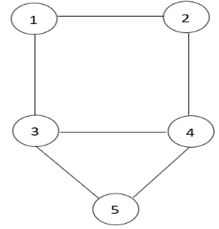
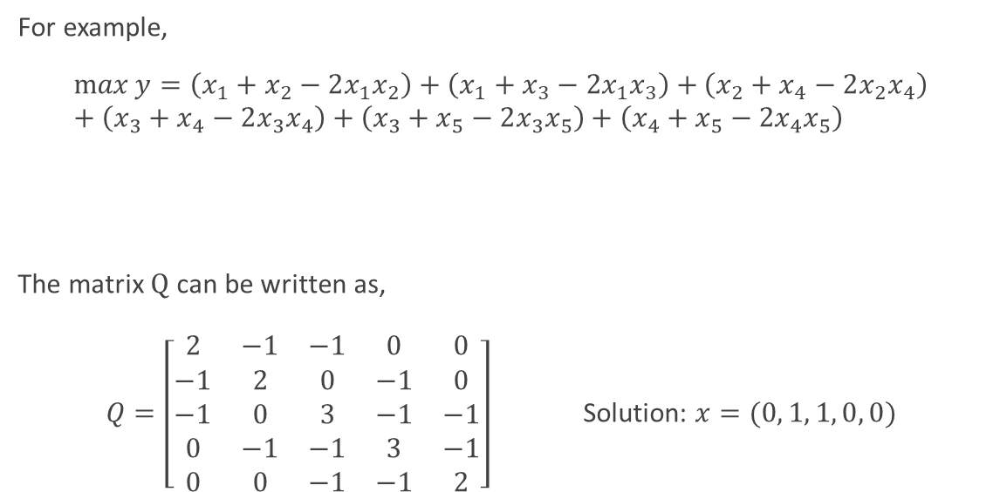
QUBO Example: Max-Cut
For example,
$$\max{y=\left(x_{1}+x_{2}−2x_{1}x_{2}\right)+\left(x_{1}+x_{3}−2x_{1}x_{3}\right)+}\left(x_{2}+x_{4}−2x_{2}x_{4}\right)+\left(x_{3}+x_{4}−2x_{3}x_{4}\right)+\left(x_{3}+x_{5}−2x_{3}x_{5}\right)+\left(x_{4}+x_{5}−2x_{4}x_{5}\right)$$
The matrix $Q$ can be written as,
$Q=\left[\begin{matrix}2 & −1 & −1 & 0 & 0 \\ −1 & 2 & 0 & −1 & 0 \\ −1 & 0 & 3 & −1 & −1 \\ 0 & −1 & −1 & 3 & −1 \\ 0 & 0 & −1 & −1 & 2\end{matrix}\right]$ Solution: $x=(0, 1, 1, 0, 0)$
$$\max{y=2x_{1}+2x_{2}+3x_{3}+3x_{4}+2x_{5}−2x_{1}x_{2}−2x_{1}x_{3}−2x_{2}x_{4}−2x_{3}x_{4}−2x_{3}x_{5}−2x_{4}x_{5}}$$

Slide 8
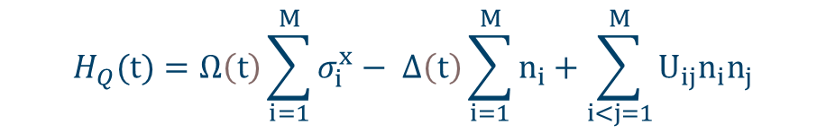
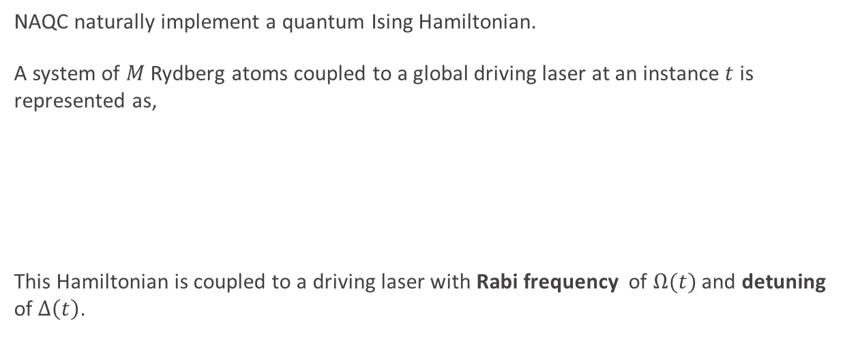
Ising Hamiltonian of NAQC
NAQC naturally implement a quantum Ising Hamiltonian.
A system of $M$ Rydberg atoms coupled to a global driving laser at an instance $t$ is represented as,
This Hamiltonian is coupled to a driving laser with Rabi frequency of $Ω(t)$ and detuning of $Δ\left(t\right)$.
$$H_{Q}(t)=Ω\left(t\right)\sum_{i=1}^{M}{σ_{i}^{x}}− Δ\left(t\right)\sum_{i=1}^{M}{n_{i}}+\sum_{i<j=1}^{M}{U_{ij}n_{i}n_{j}}$$

Slide 9


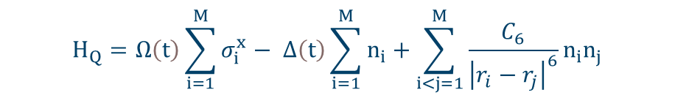
Ising Hamiltonian of NAQC
$U_{ij}$ is the interaction strength and is a function of the distance between atoms $i$ and $j$.
The off-diagonal terms in the QUBO matrix $Q$ can be encoded using the Rydberg interaction between atoms.
Such that,
$$U_{ij}=\frac{C_{6}}{r_{ij}^{6}}$$
$$H_{Q}=Ω\left(t\right)\sum_{i=1}^{M}{σ_{i}^{x}}− Δ\left(t\right)\sum_{i=1}^{M}{n_{i}}+\sum_{i<j=1}^{M}{\frac{C_{6}}{{\left|r_{i}−r_{j}\right|}^{6}}n_{i}n_{j}}$$

Slide 10
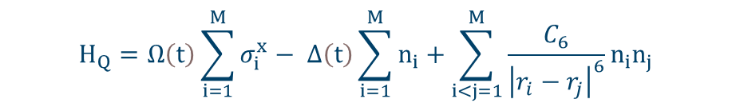

Solving QUBO on NAQC
If our mapping of the QUBO problem on Rydberg atoms is perfect, the last sum replicates the off-diagonal terms of $Q$.
$$H_{Q}=Ω\left(t\right)\sum_{i=1}^{M}{σ_{i}^{x}}− Δ\left(t\right)\sum_{i=1}^{M}{n_{i}}+\sum_{i<j=1}^{M}{\frac{C_{6}}{{\left|r_{i}−r_{j}\right|}^{6}}n_{i}n_{j}}$$

Slide 11
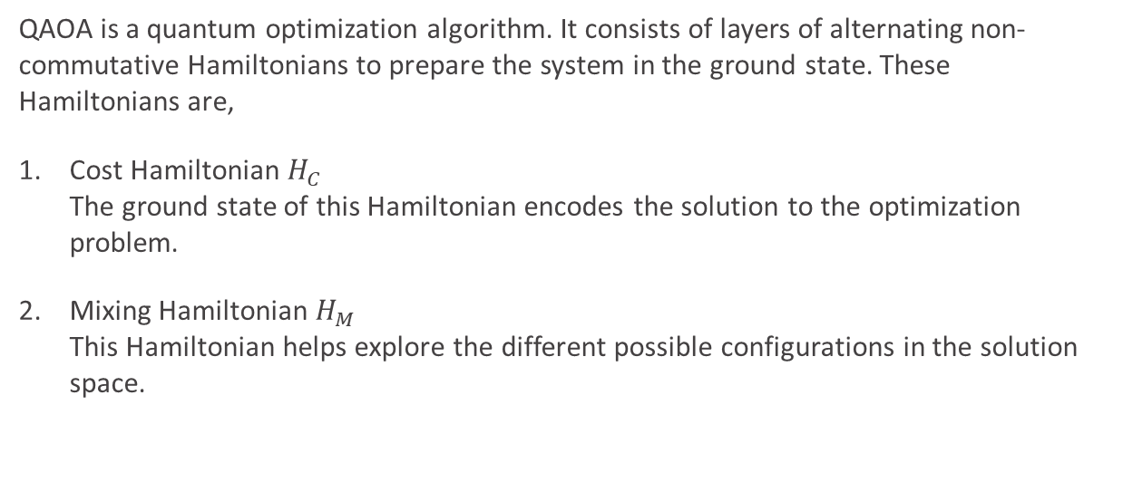
Quantum Approximation Optimization Algorithm (QAOA)
QAOA is a quantum optimization algorithm. It consists of layers of alternating non-commutative Hamiltonians to prepare the system in the ground state. These Hamiltonians are,
Cost Hamiltonian $H_{C}$ The ground state of this Hamiltonian encodes the solution to the optimization problem.
Mixing Hamiltonian $H_{M}$ This Hamiltonian helps explore the different possible configurations in the solution space.

Slide 12



Quantum Approximation Optimization Algorithm (QAOA)
Hamiltonians remain fixed during each step, i.e., their forms do not change, only their duration of application is adjusted. (Time-independent)
$$H_{Q}=Ω\sum_{i=1}^{M}{σ_{i}^{x}}− Δ\sum_{i=1}^{M}{n_{i}}+\sum_{i<j=1}^{M}{\frac{C_{6}}{{\left|r_{i}−r_{j}\right|}^{6}}n_{i}n_{j}}$$
Mixing Hamiltonian $H_{M}$
Cost Hamiltonian $H_{C}$

Slide 13
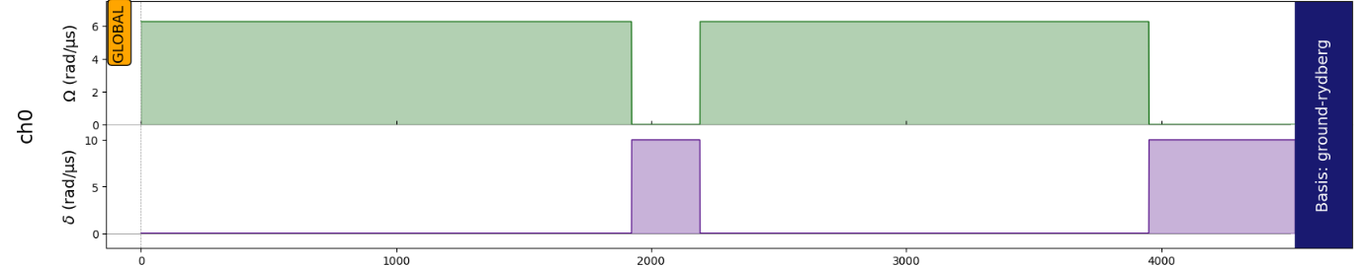
Quantum Approximation Optimization Algorithm (QAOA)

Slide 14
Solving QUBO using QAOA on NAQC
Let’s start with the demonstration!

Slide 15
Thank you!

