Slide 1
Pasqal workshop
QAA: Quantum Adiabatic Algorithm

Slide 2
Summary
What is Quantum Adiabatic Algorithm?
Example: comparison with QAOA for a QUBO problem
The gap problem and solutions

Slide 3
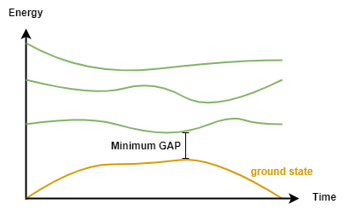
Quantum Adiabatic Algorithm
The idea is to continuously transform a Hamiltonian with a ground state that is easy to prepare to another, possibly harder, that will be the solution for our problem (in this case, a QUBO problem).

Slide 4

Quantum Adiabatic Algorithm
The idea is to continuously transform a Hamiltonian with a ground state that is easy to prepare to another, possibly harder, that will be the solution for our problem (in this case, a QUBO problem).
𝛾 is a time-dependent parameter,
H_{TF} is the Transverse-field Ising Hamiltonian (mixing Hamiltonian),
H_{S} is the Hamiltonian whose solution is what we are looking for (cost Hamiltonian).
$$H\left(t\right)=γ\left(t\right)H_{TF}+(1−γ\left(t\right))H_{S}$$

Slide 5

Quantum Adiabatic Algorithm
Note that it is ideally suited to analog method!
$$H\left(t\right)=γ\left(t\right)H_{TF}+(1−γ\left(t\right))H_{S}$$

Slide 6
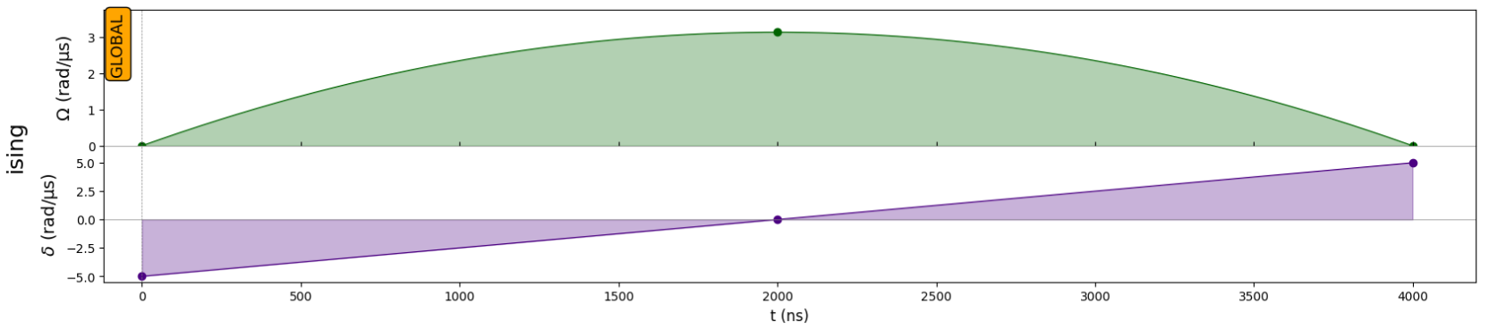
Comparison with QAOA for a QUBO problem
To model the previous QUBO problem in QAA, we will choose Ω_{max} as the median of the values of Q, our QUBO matrix.

Slide 7
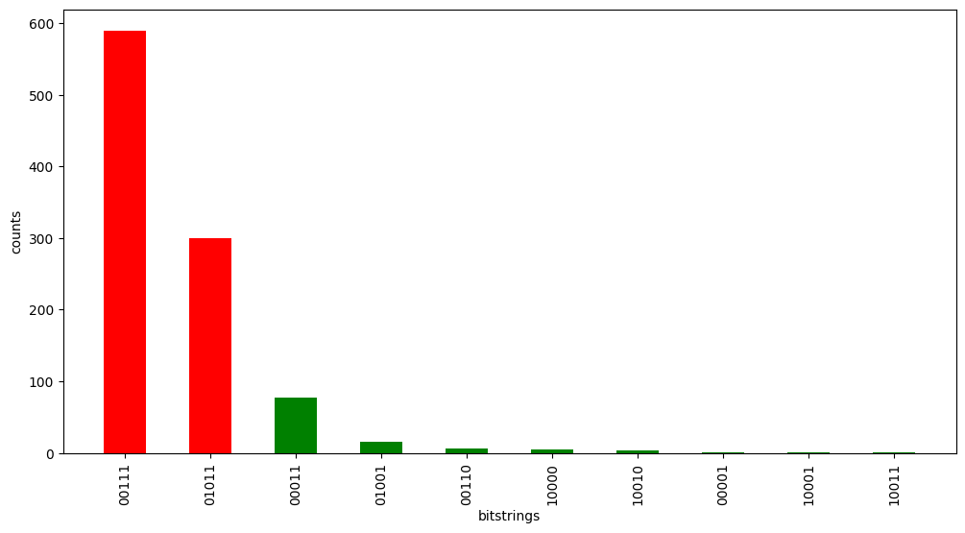
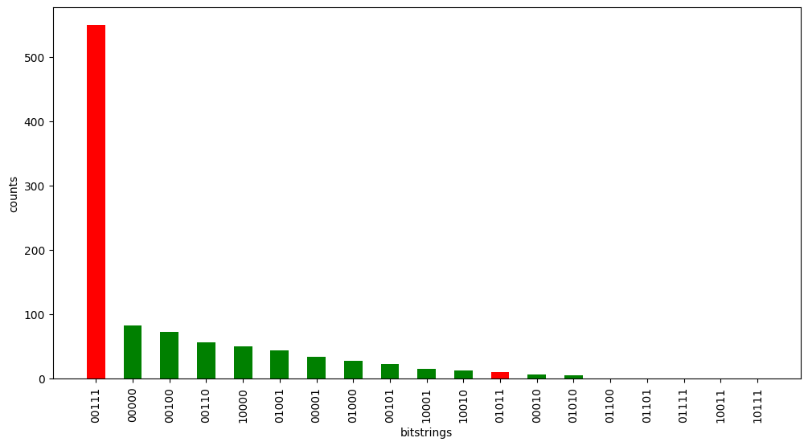
Comparison with QAOA for a QUBO problem
The results are better than the QAOA, faster and not requiring higher depths.
QAA
QAOA with depth 2

Slide 8
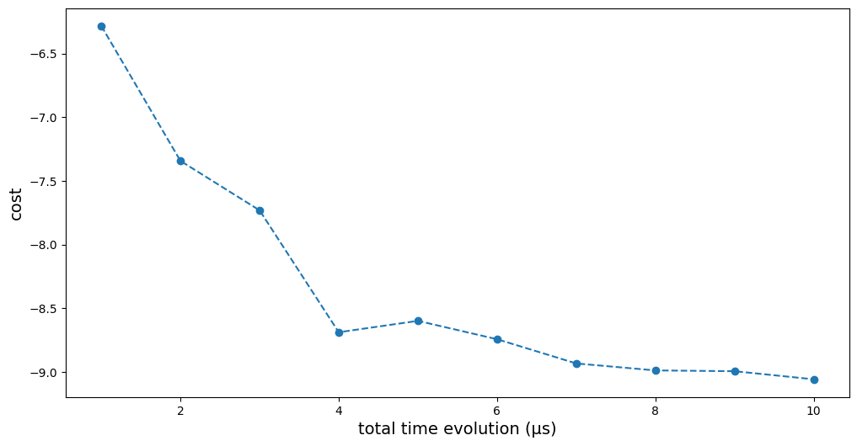
Comparison with QAOA for a QUBO problem
This method obtains good results within few microseconds.

Slide 9

The gap problem and solutions
The algorithm runtime scales with the gap such as:
From Albash, Tameem, and Daniel A. Lidar. "Adiabatic quantum computation." Reviews of Modern Physics 90.1 (2018): 015002.
Therefore, the physical system influences performance.
Problem: the gap for our system is generally very small – thus pushing the time to be large!
$$t_{worst}∝1/∆^{3}$$

Slide 10
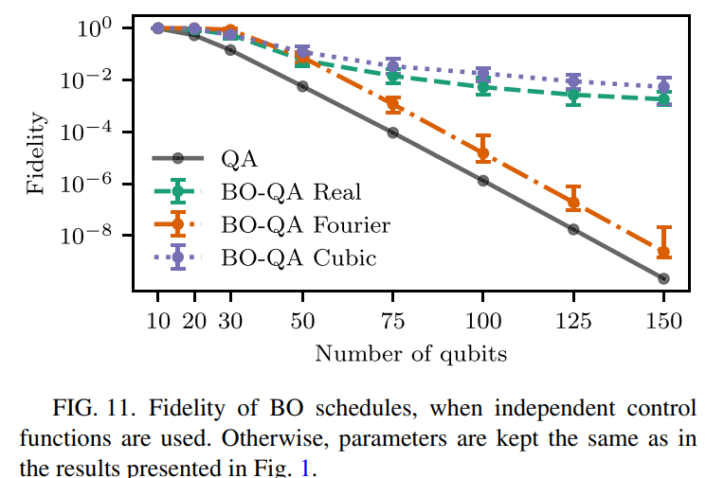
The gap problem and solutions
Finžgar, Jernej Rudi, et al. "Designing quantum annealing schedules using Bayesian optimization." Physical Review Research 6.2 (2024): 023063.
The paper shows how Bayesian Optimization can help optimizing pulse scheduling by taking care of the vanishing gap.

