Slide 1
Maximum Independent Set Problem
Solving combinatorial optimization problems on Neutral Atom Quantum Computers

Slide 2
Table of Contents
Combinatorial Optimization and Graph Problems
Maximum Independent Set (MIS)
Solving MIS on NAQC
Adiabatic Theorem
Pulse Shaping

Slide 3
Table of Contents
Combinatorial Optimization and Graph Problems
Maximum Independent Set (MIS)
Solving MIS on NAQC
Adiabatic Theorem
Pulse Shaping

Slide 4
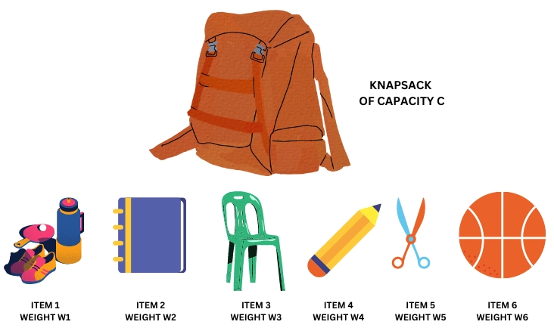
Combinatorial Optimization Problem
Involve finding an optimal group, ordering, or assignment of objects from a discrete and finite set of objects that satisfy some conditions. [1]
The optimization process finds a solution that maximizes or minimizes the objective function.
Examples: Travelling Salesman Problem (TSP), Knapsack problem, etc.
A Knapsack Problem
[1] Introduction: Combinatorial Problems and Search.” Available: https://www.cs.ubc.ca/labs/algorithms/Courses/CPSC532D-05/Slides/ch1-slides.pdf
Image source: https://www.naukri.com/code360/library/objective-of-the-knapsack-problem

Slide 5
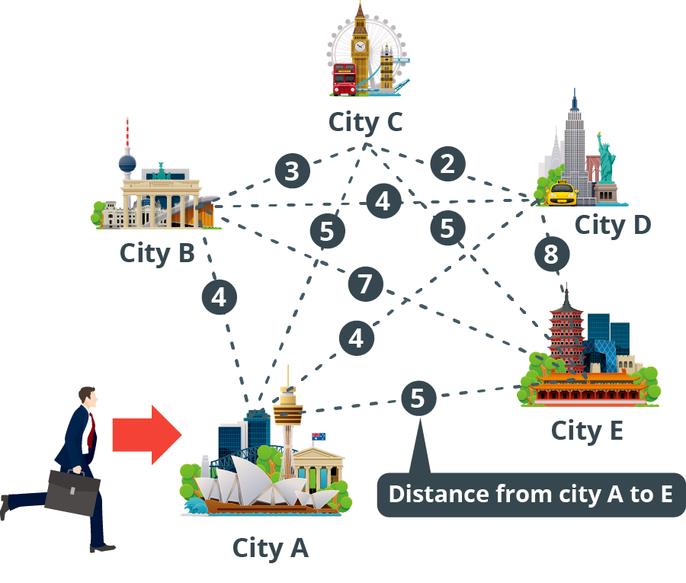
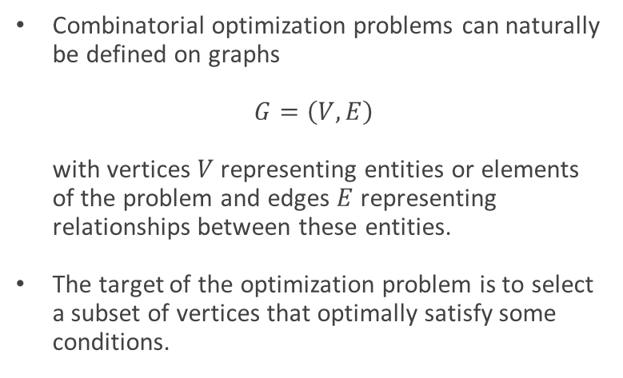
Combinatorial Graph Problem
Combinatorial optimization problems can naturally be defined on graphs $G=\left(V, E\right)$ with vertices $V$ representing entities or elements of the problem and edges $E$ representing relationships between these entities.
The target of the optimization problem is to select a subset of vertices that optimally satisfy some conditions.
Travelling Salesman Problem
Image source: https://annealing-cloud.com/en/knowledge/1.html

Slide 6
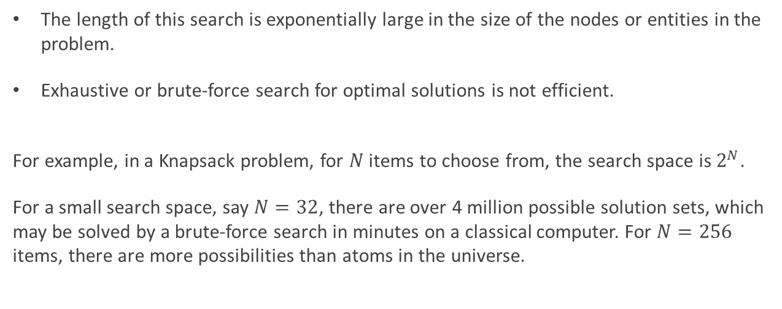
Complexity of Search Space
The length of this search is exponentially large in the size of the nodes or entities in the problem.
Exhaustive or brute-force search for optimal solutions is not efficient.
For example, in a Knapsack problem, for $N$ items to choose from, the search space is $2^{N}$.
For a small search space, say $N=32$, there are over 4 million possible solution sets, which may be solved by a brute-force search in minutes on a classical computer. For $N=256$ items, there are more possibilities than atoms in the universe.

Slide 7
Table of Contents
Combinatorial Optimization and Graph Problems
Maximum Independent Set (MIS)
Solving MIS on NAQC
Adiabatic Theorem
Pulse Shaping

Slide 8
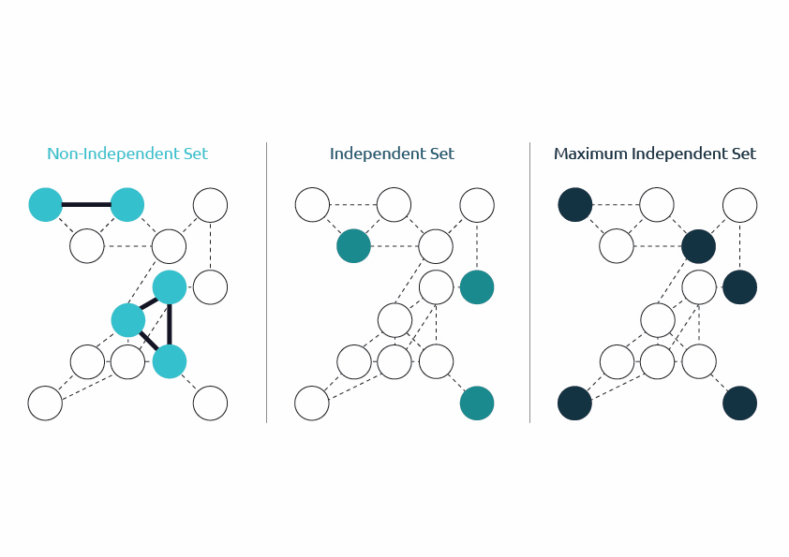

Independent Set (IS)
Given a graph $G=\left(V, E\right)$, an Independent Set (IS) of vertices is a subset of vertices $I⊆V$ such that non two vertices in IS are adjacent to each other on the graph. That is, no two vertices share an edge.
Non-Independent Set
Independent Set
Image source: https://www.capgemini.com/insights/expert-perspectives/finding-good-applications-for-neutral-atoms-quantum-computers/

Slide 9

Maximum Independent Set (MIS)
Given a graph $G=\left(V, E\right)$, a Maximum Independent Set (MIS) of vertices is a subset of vertices $I⊆V$ that consists of the maximum number of independent vertices.
MIS is a combinatorial optimization problem where the objective function is maximized in the domain of the above constraint.
Non-Independent Set
Independent Set
Maximum Independent Set

Slide 10
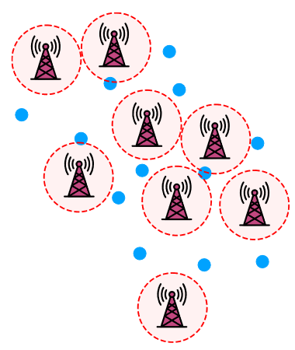
MIS for Antenna Locations
To find optimal choice of antenna locations.
Factors for choosing locations to place antennas include:
Place as many antennas as possible to maximize coverage.
Antennas cannot be placed too close to each other, or their signals might interfere.
This problem corresponds to an MIS combinatorial optimization problem.
Image source: J. Wurtz, P. Lopes, C. Gorgulla, N. Gemelke, A. Keesling, and S.-T. Wang, “Industry applications of neutral-atom quantum computing solving independent set problems.” (2024)

Slide 11
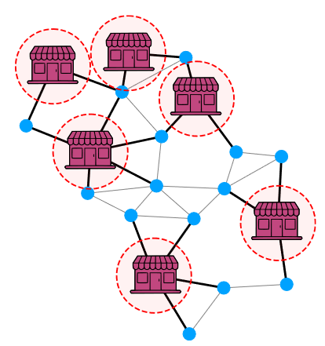
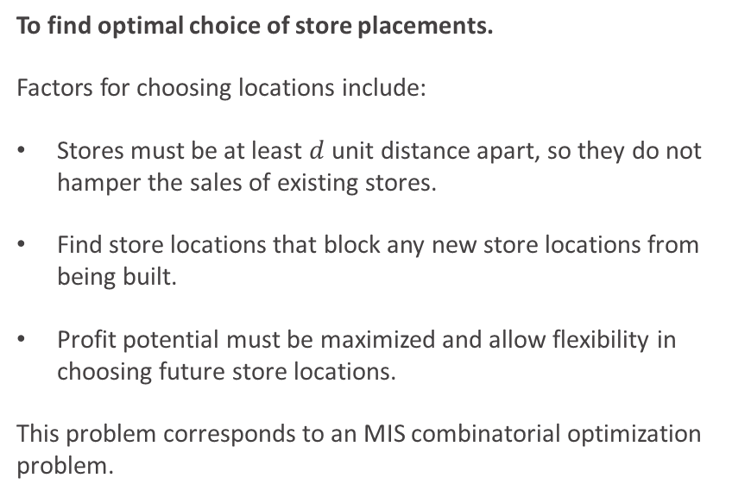
MIS for Store Placement
To find optimal choice of store placements.
Factors for choosing locations include:
Stores must be at least $d$ unit distance apart, so they do not hamper the sales of existing stores.
Find store locations that block any new store locations from being built.
Profit potential must be maximized and allow flexibility in choosing future store locations.
This problem corresponds to an MIS combinatorial optimization problem.
Image source: J. Wurtz, P. Lopes, C. Gorgulla, N. Gemelke, A. Keesling, and S.-T. Wang, “Industry applications of neutral-atom quantum computing solving independent set problems.” (2024)

Slide 12
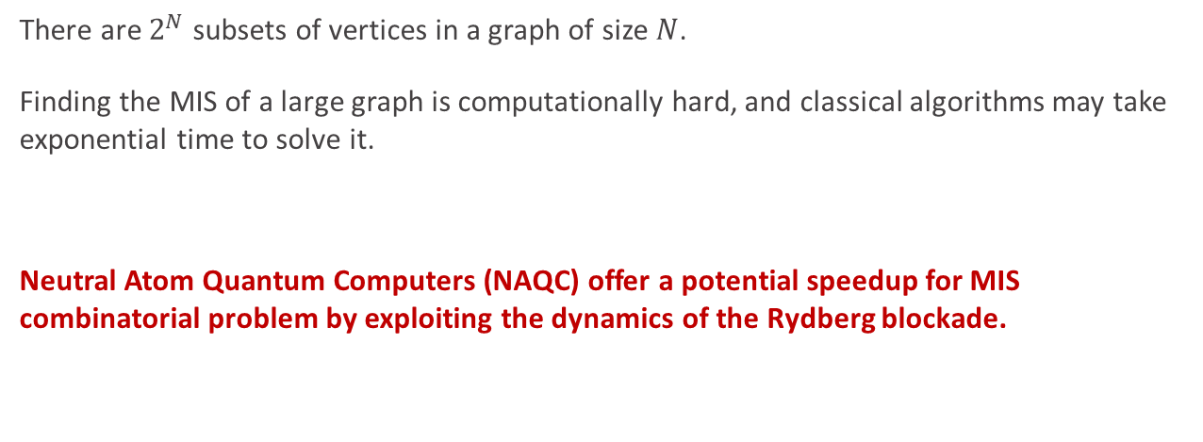
Solution Space of MIS
There are $2^{N}$ subsets of vertices in a graph of size $N$.
Finding the MIS of a large graph is computationally hard, and classical algorithms may take exponential time to solve it.
Neutral Atom Quantum Computers (NAQC) offer a potential speedup for MIS combinatorial problem by exploiting the dynamics of the Rydberg blockade.

Slide 13
MIS on NAQC
Neutral Atom Quantum Computers (NAQC) offer a potential speedup for MIS combinatorial problem by exploiting the dynamics of the Rydberg blockade.
Analog mode of operation involves the evolution of a quantum system under a continuously controllable resource Hamiltonian.
Analog operations provide an advantage over digital operations since,
Gate-based algorithms are limited by lack of error correction whereas an analog algorithm is more resilient to noise.

Slide 14
Steps for solving MIS on NAQC
Representation of MIS as a QUBO formulation
Linking the QUBO formulation to the Ising Hamiltonian of NAQC.
Representation of MIS as a graph problem on unit-disk graphs.

Slide 15
Table of Contents
Combinatorial Optimization and Graph Problems
Maximum Independent Set (MIS)
Solving MIS on NAQC
QUBO Formulation for MIS
Linking QUBO to Ising Hamiltonian of NAQC
Graph Embedding
Adiabatic Theorem
Pulse Shaping

Slide 16
Quadratic Unconstrained Binary Optimization (QUBO)
QUBO is a combinatorial optimization problem that involves finding optimal configuration of binary variables that minimizes a quadratic objective function.
QUBO can model and solve numerous categories of optimization problems, including MIS.

Slide 17

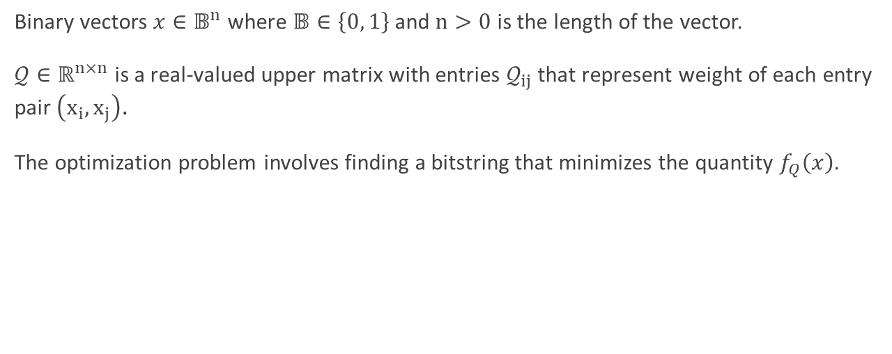
QUBO Formulation
Binary vectors $x∈𝔹^{n}$ where $𝔹∈\left\{0, 1\right\}$ and $n>0$ is the length of the vector.
$𝒬∈ℝ^{n×n}$ is a real-valued upper matrix with entries $𝒬_{ij}$ that represent weight of each entry pair $\left(x_{i}, x_{j}\right)$.
The optimization problem involves finding a bitstring that minimizes the quantity $f_{Q}\left(x\right)$.
$$f_{𝒬}\left(x\right)=x^{T}𝒬x=\sum_{i=0}^{n}{\sum_{j=0}^{n}{𝒬_{ij}x_{i}x_{j}}}$$

Slide 18


QUBO Formulation
To find a binary vector $x^{∗}$ that is minimal with respect to $f_{𝒬}$, we solve.
Maximization of $f_{𝒬}$ is given as $f_{−𝒬}=−f_{𝒬}$
$f_{𝒬}\left(x^{∗}\right)≤f_{𝒬}(x)$ $∀ x∈𝔹^{n}$

Slide 19
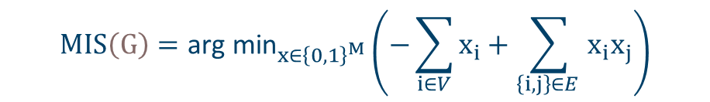

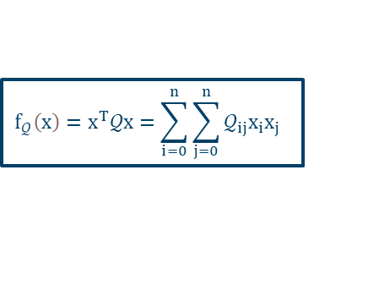
MIS as QUBO Formulation
For reference: QUBO
$$f_{𝒬}\left(x\right)=x^{T}𝒬x=\sum_{i=0}^{n}{\sum_{j=0}^{n}{𝒬_{ij}x_{i}x_{j}}}$$
Let us consider the binary vectors $x∈𝔹^{n}$ where $𝔹∈\left\{0, 1\right\}$ and $n>0$. For each vertex $i$ of the graph, $x_{i}$ is a binary variable that holds $1$ if it is activated in the final solution, and $0$ otherwise.
$$MIS\left(G\right)=\text{arg} {\text{min}}_{x∈{\left\{0, 1\right\}}^{M}}\left(−\sum_{i∈V}{x_{i}}+\sum_{\left\{i, j\right\}∈E }{x_{i}x_{j}}\right)$$
Independent term
(to maximize)
Two-body interaction term
(to minimize)

Slide 20
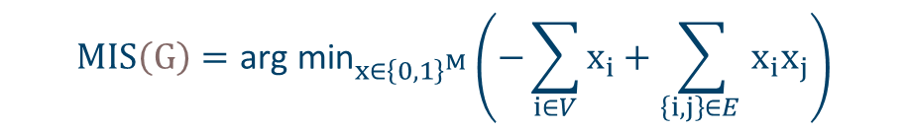
MIS as QUBO Formulation
The two-body interaction term acts like a penalty anytime when two vertices are connected by an edge in the graph. This penalty is represented as a positive term in the Hamiltonian.
The independent term has a negative factor we need to maximize the independent sets of vertices.
$$MIS\left(G\right)=\text{arg} {\text{min}}_{x∈{\left\{0, 1\right\}}^{M}}\left(−\sum_{i∈V}{x_{i}}+\sum_{\left\{i, j\right\}∈E }{x_{i}x_{j}}\right)$$
maximize
penalty term

Slide 21
Table of Contents
Combinatorial Optimization and Graph Problems
Maximum Independent Set (MIS)
Solving MIS on NAQC
QUBO Formulation for MIS
Linking QUBO to Ising Hamiltonian of NAQC
Graph Embedding
Adiabatic Theorem
Pulse Shaping

Slide 22
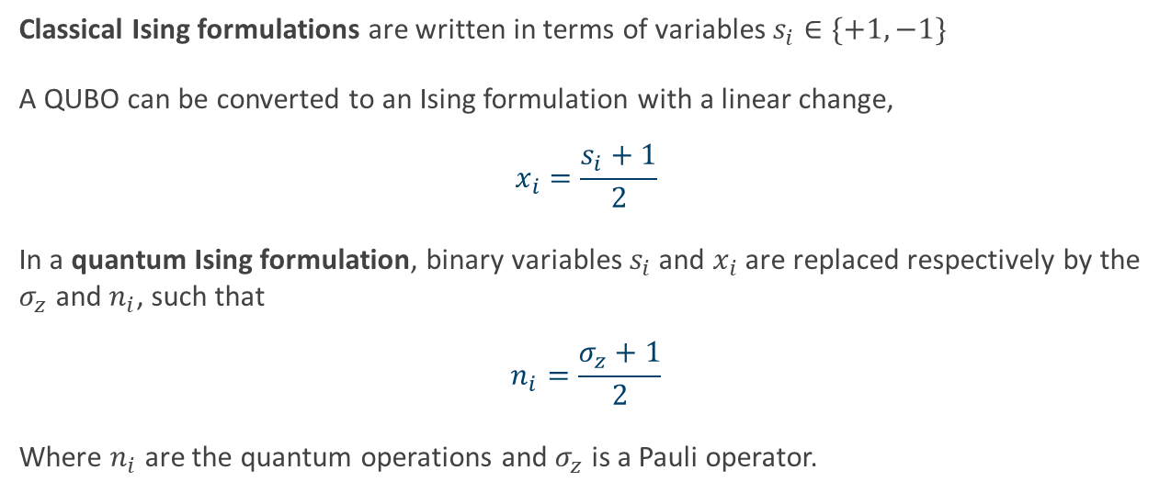
QUBO to Ising Formulation
Classical Ising formulations are written in terms of variables $s_{i}∈\{+1, −1\}$
A QUBO can be converted to an Ising formulation with a linear change,
$$x_{i}=\frac{s_{i}+1}{2}$$
In a quantum Ising formulation, binary variables $s_{i}$ and $x_{i}$ are replaced respectively by the $σ_{z}$ and $n_{i}$, such that
$$n_{i}=\frac{σ_{z}+1}{2}$$
Where $n_{i}$ are the quantum operations and $σ_{z}$ is a Pauli operator.

Slide 23


MIS as Ising Formulation
The MIS cost function can now be represented as,
Here $α>1$ is a positive coefficient.
$$MIS\left(G\right)=−\sum_{i∈V}{n_{i}}+\sum_{\left\{i, j\right\}∈E }{α n_{i}n_{j}}$$
This is similar to the Ising Hamiltonian of NAQC

Slide 24
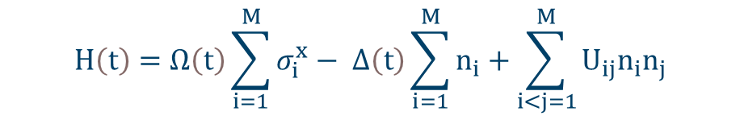
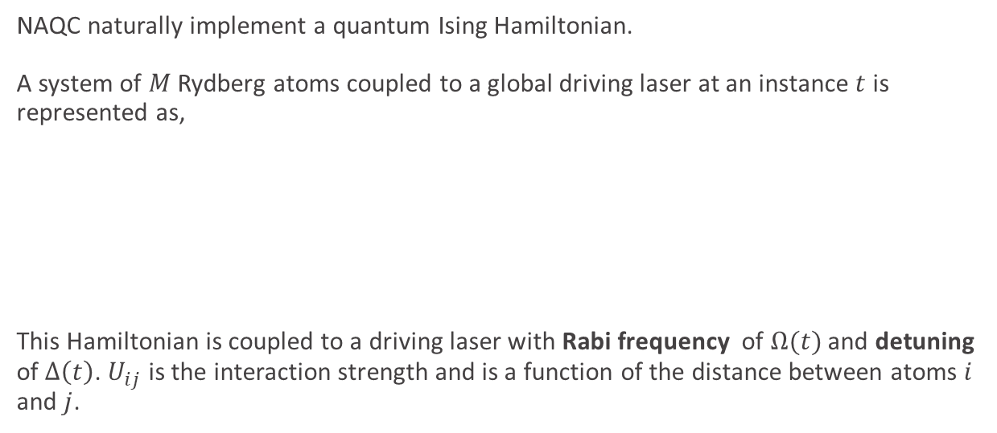
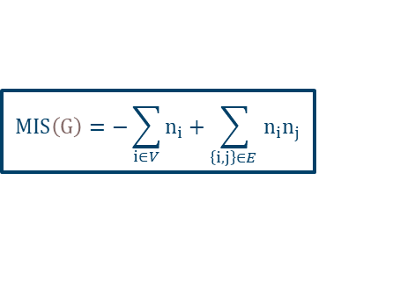
Ising Hamiltonian of NAQC
For reference: MIS as QUBO
$$MIS\left(G\right)=−\sum_{i∈V}{n_{i}}+\sum_{\left\{i, j\right\}∈E }{n_{i}n_{j}}$$
NAQC naturally implement a quantum Ising Hamiltonian.
A system of $M$ Rydberg atoms coupled to a global driving laser at an instance $t$ is represented as,
This Hamiltonian is coupled to a driving laser with Rabi frequency of $Ω(t)$ and detuning of $Δ\left(t\right)$. $U_{ij}$ is the interaction strength and is a function of the distance between atoms $i$ and $j$.
$$H\left(t\right)=Ω\left(t\right)\sum_{i=1}^{M}{σ_{i}^{x}}− Δ\left(t\right)\sum_{i=1}^{M}{n_{i}}+\sum_{i<j=1}^{M}{U_{ij}n_{i}n_{j}}$$

Slide 25
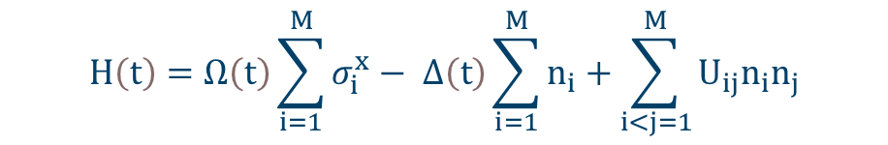
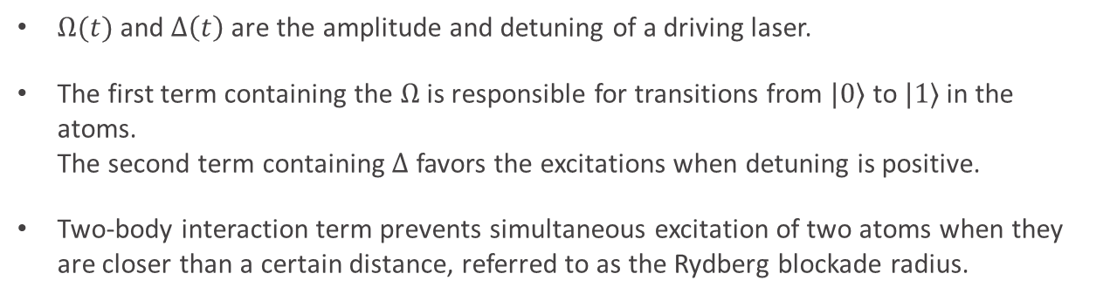
Ising Hamiltonian of NAQC
For reference: MIS as QUBO
$$MIS\left(G\right)=−\sum_{i∈V}{n_{i}}+\sum_{\left\{i, j\right\}∈E }{n_{i}n_{j}}$$
$$H\left(t\right)=Ω\left(t\right)\sum_{i=1}^{M}{σ_{i}^{x}}− Δ\left(t\right)\sum_{i=1}^{M}{n_{i}}+\sum_{i<j=1}^{M}{U_{ij}n_{i}n_{j}}$$
Two-body interaction term
$Ω(t)$ and $Δ\left(t\right)$ are the amplitude and detuning of a driving laser.
The first term containing the $Ω$ is responsible for transitions from $|0⟩$ to $|1⟩$ in the atoms. The second term containing $Δ$ favors the excitations when detuning is positive.
Two-body interaction term prevents simultaneous excitation of two atoms when they are closer than a certain distance, referred to as the Rydberg blockade radius.

Slide 26

MIS on NAQC
Goal: To find the time-series of control parameters, $Ω(t)$ and $Δ(t)$, such that the outcome of quantum evolution and measurement is a good solution to the related QUBO representing the MIS problem.

Slide 27
Table of Contents
Combinatorial Optimization and Graph Problems
Maximum Independent Set (MIS)
Solving MIS on NAQC
QUBO Formulation for MIS
Linking QUBO to Ising Hamiltonian of NAQC
Graph Embedding
Adiabatic Theorem
Pulse Shaping

Slide 28
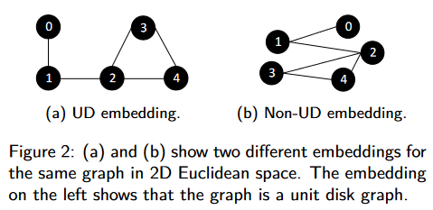
Unit-Disk (UD) Graphs
A unit disk (UD) graph is a geometric graph where two nodes, each representing points in a plane, are connected by an edge if and only if the Euclidian distance between them is below a fixed threshold.
Two different embeddings for a same graph of 5 nodes
Image source: W. Da, S. Coelho, M. Arcangelo, and L.-P. Henry, “Efficient protocol for solving combinatorial graph problems on neutral-atom quantum processors.” (2022)

Slide 29
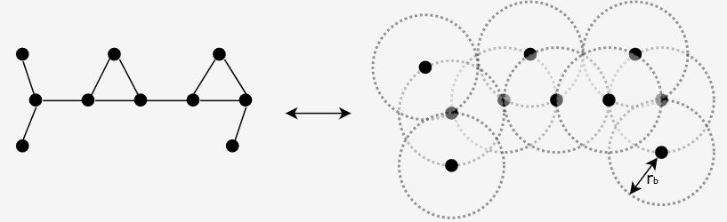
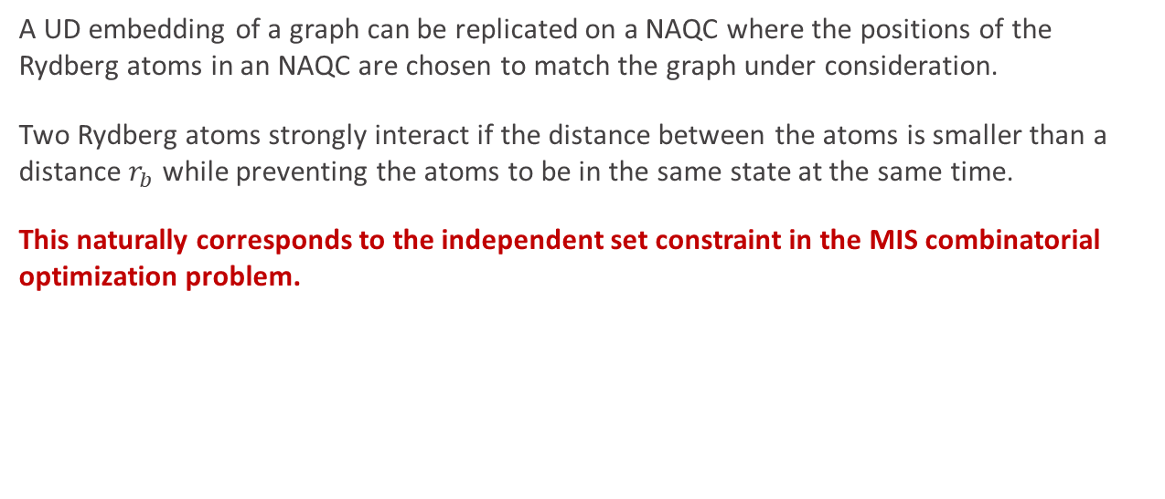
UD Graphs and Rydberg Blockade
A UD embedding of a graph can be replicated on a NAQC where the positions of the Rydberg atoms in an NAQC are chosen to match the graph under consideration.
Two Rydberg atoms strongly interact if the distance between the atoms is smaller than a distance $r_{b}$ while preventing the atoms to be in the same state at the same time.
This naturally corresponds to the independent set constraint in the MIS combinatorial optimization problem.
Image source: L. Henriet et al., “Quantum computing with neutral atoms,” Quantum, Sep. 2020

Slide 30
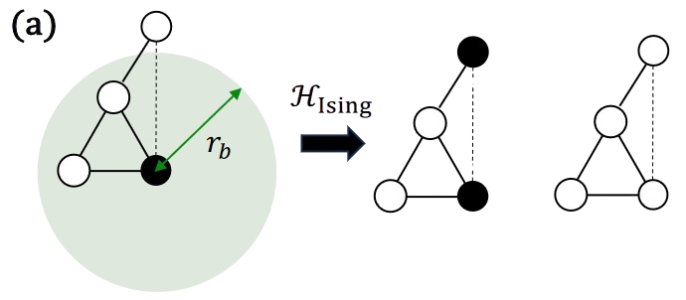
MIS on UD Graphs
The positions of the Rydberg atoms on an NAQC form the vertices of the MIS graph under consideration. The edges only link atoms that are at a distance closer than the Rydberg blockade radius.
As a result, the evolution of the quantum system is restricted to a subspace of the Hilbert space where only vertices in the independent set are excited.
3
2
1
Image source: Constantin Dalyac et al., “Graph algorithms with neutral atom quantum processors,” The European Physical Journal A, Sep. 2024

Slide 31
Embedding Strategies
For reference:
Finding a UD embedding for a graph is an NP-hard problem.
Fruchterman-Reingold Algorithm Any two connected nodes must be placed close to each other, with a uniform minimum distance between them.
Each edge is treated as a spring that holds vertices close to each other while a competing repulsive force is applied to push all vertices away from one another, even though they are not connected by an edge in the original graph.
The iterations will stop when the system reaches the equilibrium, which minimizes the difference between all repulsive and attractive forces.

Slide 32
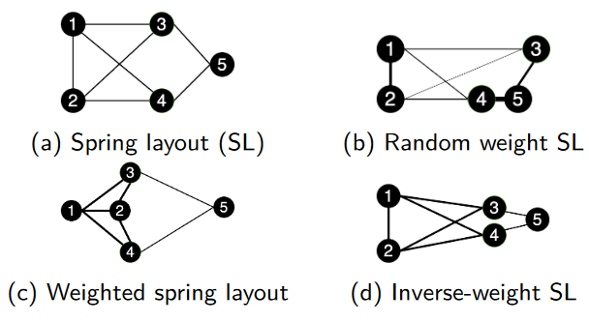

Topologies based on Fruchterman-Reingold Algorithm
There are multiple topologies based on the Fruchterman-Reingold algorithm on the same graph $G=\left(V, E\right)$.
The embedding strategies in the figure are feasible on NAQC given they respect technical constraints, such as minimum distance between atoms and maximum distance from the register’s center.

Slide 33
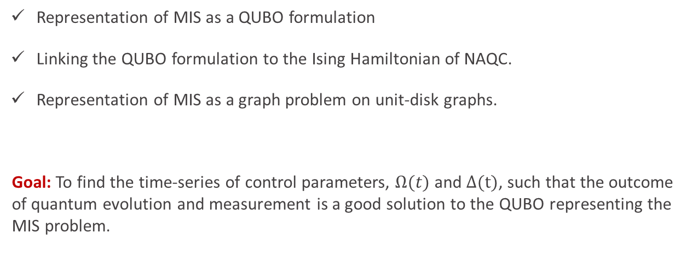
MIS on NAQC
Representation of MIS as a QUBO formulation
Linking the QUBO formulation to the Ising Hamiltonian of NAQC.
Representation of MIS as a graph problem on unit-disk graphs.
Goal: To find the time-series of control parameters, $Ω(t)$ and $Δ(t)$, such that the outcome of quantum evolution and measurement is a good solution to the QUBO representing the MIS problem.

Slide 34
Table of Contents
Combinatorial Optimization and Graph Problems
Maximum Independent Set (MIS)
Solving MIS on NAQC
Adiabatic Theorem
Pulse Shaping

Slide 35
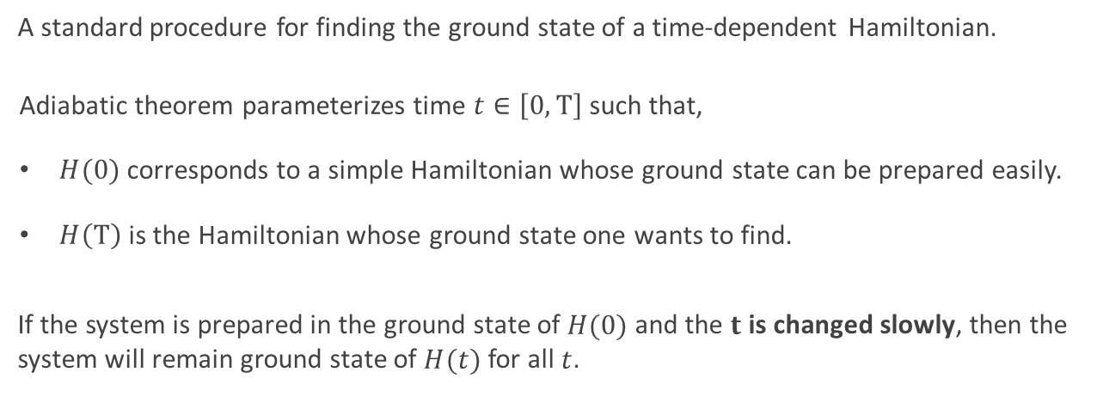
Adiabatic Theorem
A standard procedure for finding the ground state of a time-dependent Hamiltonian.
Adiabatic theorem parameterizes time $t∈\left[0, T\right]$ such that,
$H(0)$ corresponds to a simple Hamiltonian whose ground state can be prepared easily.
$H\left(T\right)$ is the Hamiltonian whose ground state one wants to find.
If the system is prepared in the ground state of $H(0)$ and the $t$ is changed slowly, then the system will remain ground state of $H(t)$ for all $t$.

Slide 36

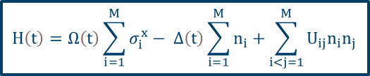
Adiabatic Theorem
For reference: Ising Hamiltonian of NAQC
$$H\left(t\right)=Ω\left(t\right)\sum_{i=1}^{M}{σ_{i}^{x}}− Δ\left(t\right)\sum_{i=1}^{M}{n_{i}}+\sum_{i<j=1}^{M}{U_{ij}n_{i}n_{j}}$$
A ground state ${\left|0\right\rangle }^{N}$ is prepared with $Ω\left(t=0\right)=0$ and $Δ\left(t=0\right)<0$
Slow evolutions change $Δ\left(t\right)$ from a negative to positive value and $Ω>0,$ such that the ground state of the final Hamiltonian encodes the solution to the MIS problem.

Slide 37
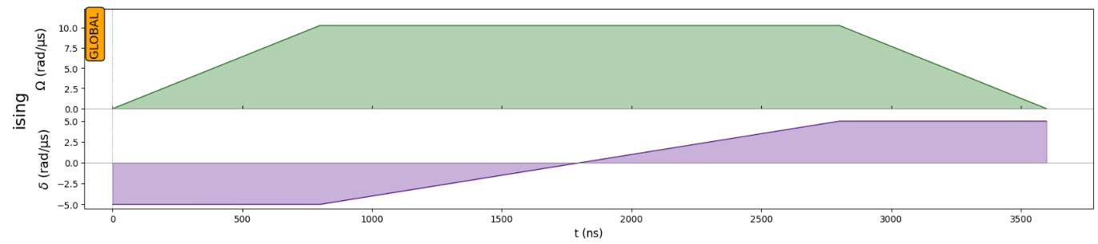

Adiabatic Theorem
For reference: Ising Hamiltonian of NAQC
$$H\left(t\right)=Ω\left(t\right)\sum_{i=1}^{M}{σ_{i}^{x}}− Δ\left(t\right)\sum_{i=1}^{M}{n_{i}}+\sum_{i<j=1}^{M}{U_{ij}n_{i}n_{j}}$$
For positive detuning, $Δ\left(t\right)>0$, excitations to the Rydberg state are energetically favored. This leads to the ground state of the system at time $t=T$ to be a possible solution to the MIS of the embedded graph.

Slide 38
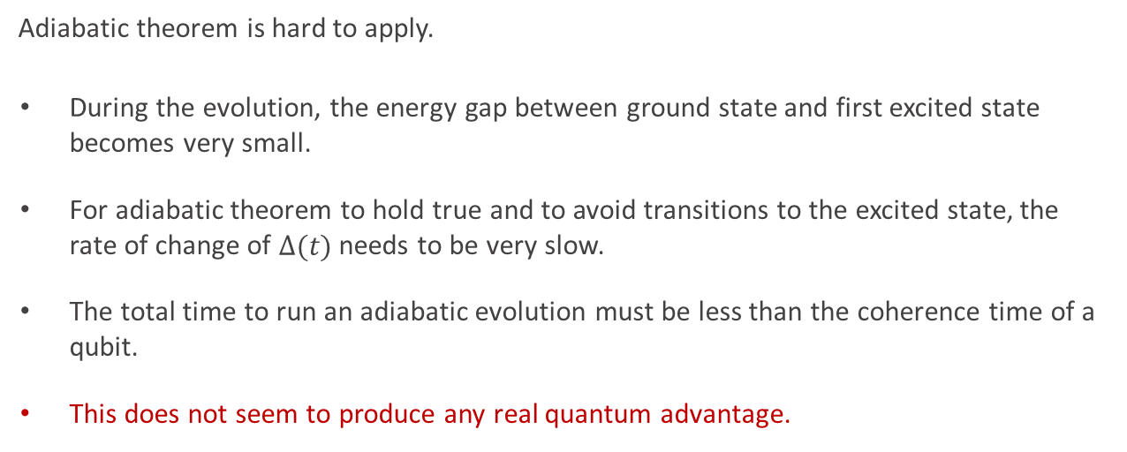
Limitations of the Adiabatic Theorem
Adiabatic theorem is hard to apply.
During the evolution, the energy gap between ground state and first excited state becomes very small.
For adiabatic theorem to hold true and to avoid transitions to the excited state, the rate of change of $Δ(t)$ needs to be very slow.
The total time to run an adiabatic evolution must be less than the coherence time of a qubit.
This does not seem to produce any real quantum advantage.

Slide 39
Table of Contents
Combinatorial Optimization and Graph Problems
Maximum Independent Set (MIS)
Solving MIS on NAQC
Adiabatic Theorem
Pulse Shaping

Slide 40
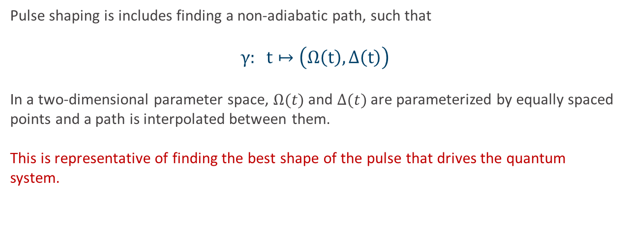
Pulse Shaping
Pulse shaping is includes finding a non-adiabatic path, such that
$$γ: t↦\left(Ω\left(t\right), Δ\left(t\right)\right)$$
In a two-dimensional parameter space, $Ω(t)$ and $Δ(t)$ are parameterized by equally spaced points and a path is interpolated between them.
This is representative of finding the best shape of the pulse that drives the quantum system.

Slide 41
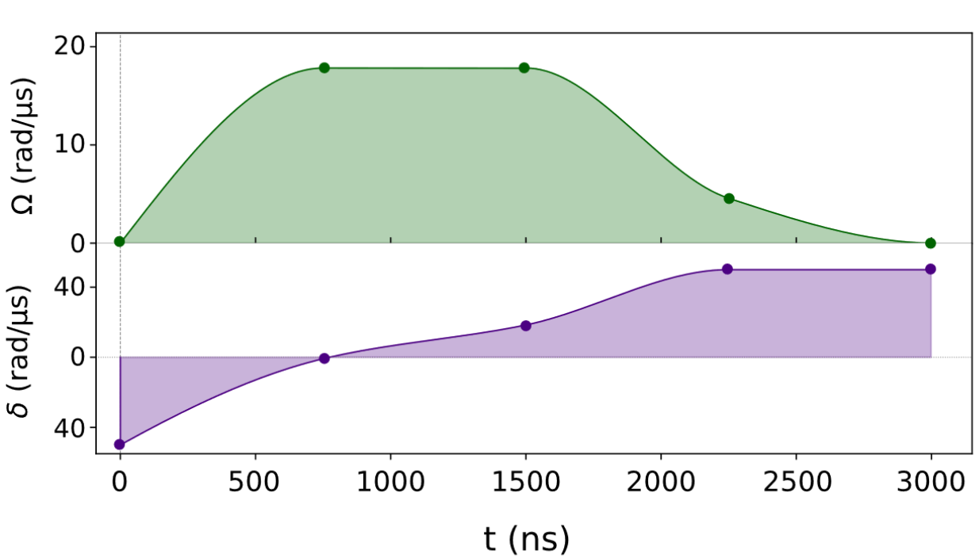
Pulse Shaping
Best pulse found by a pulse shaping routine. The pulse resembles a simple adiabatic protocol.
Image source: W. Da, S. Coelho, M. Arcangelo, and L.-P. Henry, “Efficient protocol for solving combinatorial graph problems on neutral-atom quantum processors.” (2022)

Slide 42
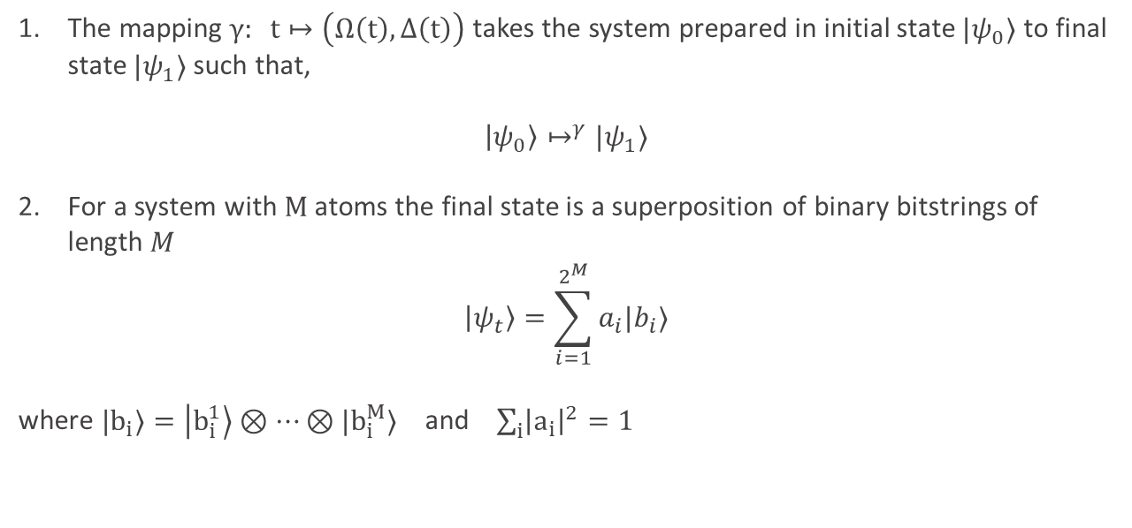
Pulse Shaping
The mapping $γ: t↦\left(Ω\left(t\right), Δ\left(t\right)\right)$takes the system prepared in initial state $|ψ_{0}⟩$ to final state $|ψ_{1}⟩$such that,
$$\left|ψ_{0}\right\rangle ↦^{γ}|ψ_{1}⟩$$
For a system with $M$ atoms the final state is a superposition of binary bitstrings of length $M$
$$\left|ψ_{t}\right\rangle =\sum_{i=1}^{2^{M}}{a_{i}|b_{i}⟩}$$ where ${|b}_{i}⟩=\left|b_{i}^{1}\right\rangle ⊗…⊗|b_{i}^{M}⟩$ and $\sum_{i}{{\left|a_{i}\right|}^{2}=1}$

Slide 43
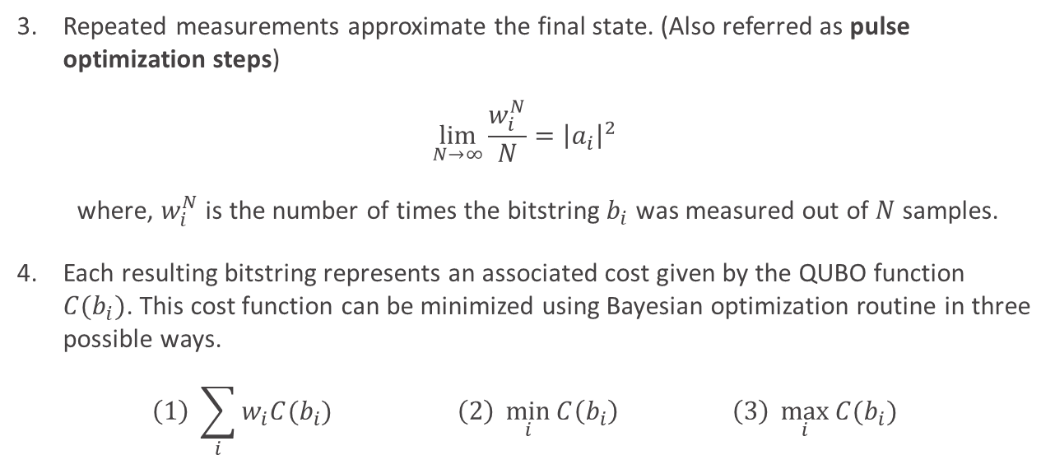
Pulse Shaping
Repeated measurements approximate the final state. (Also referred as pulse optimization steps)
$$\lim_{N→∞}{\frac{w_{i}^{N}}{N}}={\left|a_{i}\right|}^{2}$$
where, $w_{i}^{N}$ is the number of times the bitstring $b_{i}$ was measured out of $N$ samples.
Each resulting bitstring represents an associated cost given by the QUBO function $C(b_{i})$. This cost function can be minimized using Bayesian optimization routine in three possible ways.
$$\left(1\right) \sum_{i}{w_{i}C(b_{i})} \left(2\right) \min_{i}{C\left(b_{i}\right)} \left(3\right) \max_{i}{C(b_{i})}$$

Slide 44
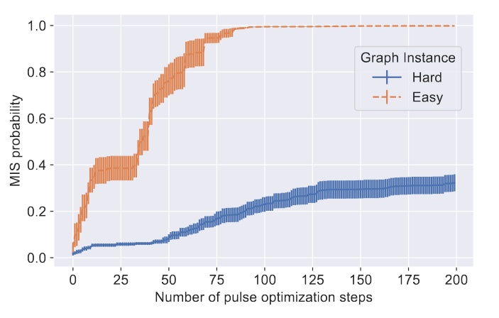
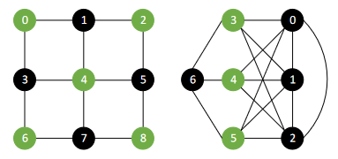
Results – Easy vs Hard Graphs
Graph embeddings influence the effectiveness in finding the MIS solution.
Easy Graph (UD embedding)
Hard Graph (Non-UD embedding)

Slide 45
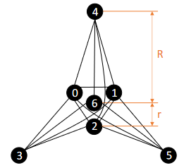
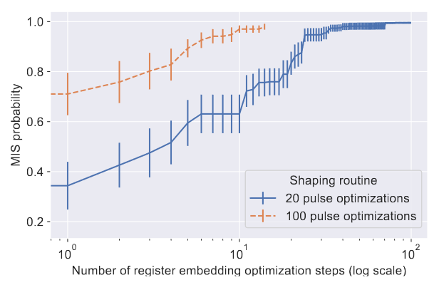

Results
Implementing pulse shaping by optimizing graph embedding yields better results.
Graph embedding with parameters $R$ and $r$ that preserve the symmetries of the graph

Slide 46
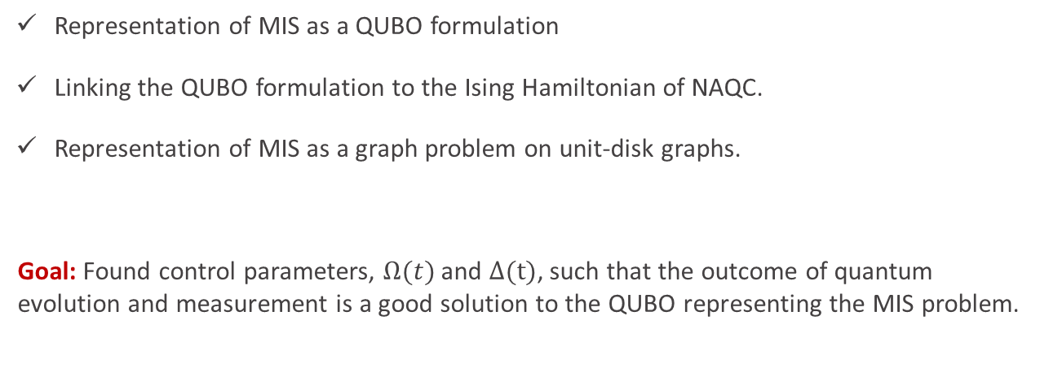
To summarize: MIS on NAQC
Representation of MIS as a QUBO formulation
Linking the QUBO formulation to the Ising Hamiltonian of NAQC.
Representation of MIS as a graph problem on unit-disk graphs.
Goal: Found control parameters, $Ω(t)$ and $Δ(t)$, such that the outcome of quantum evolution and measurement is a good solution to the QUBO representing the MIS problem.

Slide 47
Thank you!

