Slide 1
Combinatorial Optimization Problems
Use cases

Slide 2
Table of Contents
Maximum Independent Set
Maximum Clique
Maximum Vertex Cover
Maximum Dominating Set
Minimum Connected Dominating Set
Independent Set Sampling
Graph Coloring

Slide 3
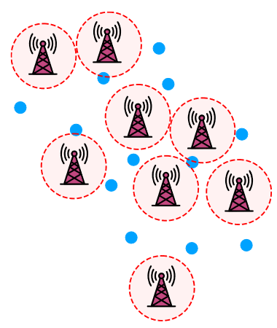
MIS for Antenna Locations
To find optimal choice of antenna locations.
Factors for choosing locations to place antennas include:
Place as many antennas as possible to maximize coverage.
Antennas cannot be placed too close to each other, or their signals might interfere.
This problem corresponds to an MIS combinatorial optimization problem.
Image source: J. Wurtz, P. Lopes, C. Gorgulla, N. Gemelke, A. Keesling, and S.-T. Wang, “Industry applications of neutral-atom quantum computing solving independent set problems.” (2024)

Slide 4
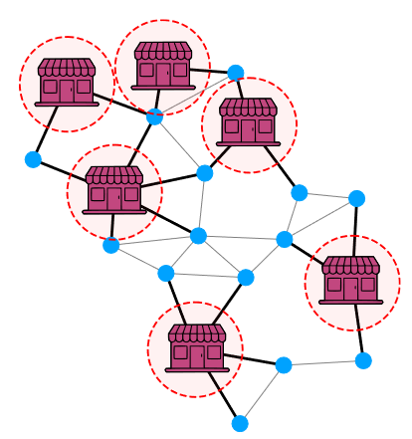
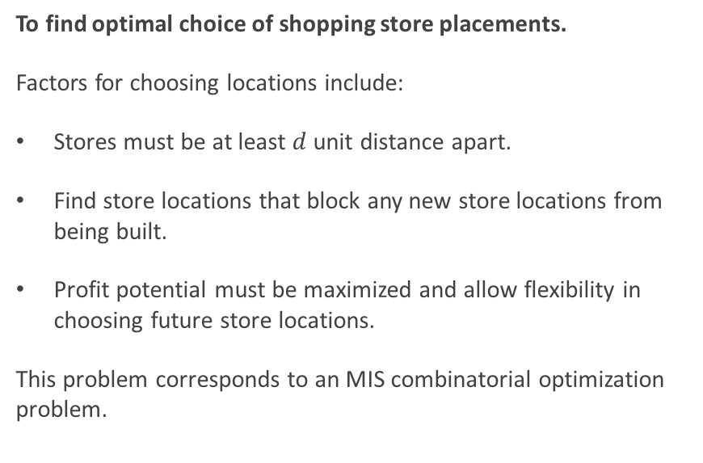
MIS for Store Placement
To find optimal choice of shopping store placements.
Factors for choosing locations include:
Stores must be at least $d$ unit distance apart.
Find store locations that block any new store locations from being built.
Profit potential must be maximized and allow flexibility in choosing future store locations.
This problem corresponds to an MIS combinatorial optimization problem.
Image source: J. Wurtz, P. Lopes, C. Gorgulla, N. Gemelke, A. Keesling, and S.-T. Wang, “Industry applications of neutral-atom quantum computing solving independent set problems.” (2024)

Slide 5
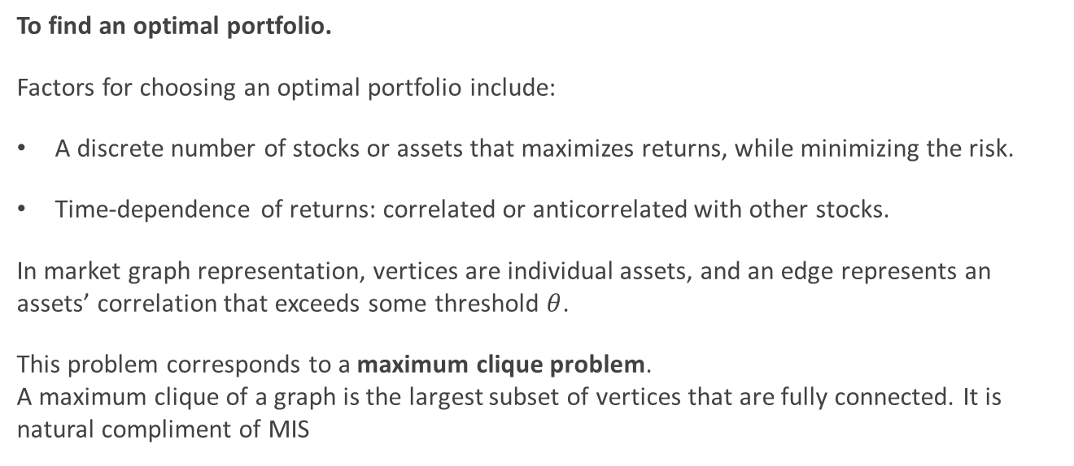
Maximum Clique for Portfolio Optimization
To find an optimal portfolio.
Factors for choosing an optimal portfolio include:
A discrete number of stocks or assets that maximizes returns, while minimizing the risk.
Time-dependence of returns: correlated or anticorrelated with other stocks.
In market graph representation, vertices are individual assets, and an edge represents an assets’ correlation that exceeds some threshold $θ$.
This problem corresponds to a maximum clique problem. A maximum clique of a graph is the largest subset of vertices that are fully connected. It is natural compliment of MIS

Slide 6
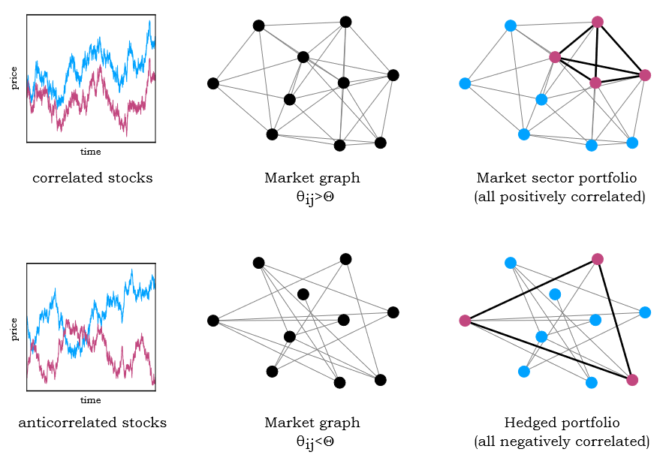

Maximum Clique for Portfolio Optimization
Correlated Stocks: Maximizes Returns $θ_{ij}≤θ≤0$ indicates stocks are correlated if they are connected.
The portfolio obtained through a clique corresponds to a collection of assets that are all mutually correlated to each other. This is a natural compliment to the MIS of the graph.
Image source: J. Wurtz, P. Lopes, C. Gorgulla, N. Gemelke, A. Keesling, and S.-T. Wang, “Industry applications of neutral-atom quantum computing solving independent set problems.” (2024)

Slide 7

Maximum Clique for Portfolio Optimization
Anticorrelated Stocks: Minimizes Risk $θ_{ij}≥θ≥0$ indicates stocks are anti-correlated if they are connected.
The portfolio obtained through a clique corresponds to a collection of assets that are all mutually anticorrelated to each other. This is a natural compliment to the MIS of the graph.
Image source: J. Wurtz, P. Lopes, C. Gorgulla, N. Gemelke, A. Keesling, and S.-T. Wang, “Industry applications of neutral-atom quantum computing solving independent set problems.” (2024)

Slide 8
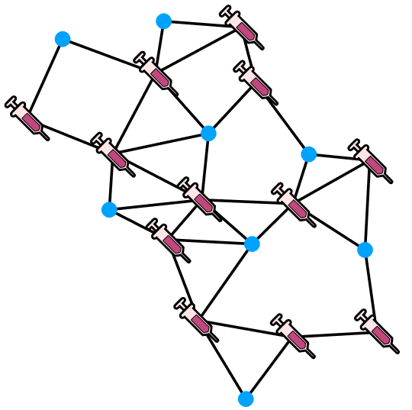
Minimum Vertex Cover for Network Immunization
To find optimal immunization vertices.
Factors for choosing immunization locations include:
Subset of vertices to immunize to reduce the spread of infection.
Remove all edges from the network such that the spread of infection stop.
Utilize minimum resources. (Minimum vertex cover)
This problem corresponds to a vertex cover problem.
Image source: J. Wurtz, P. Lopes, C. Gorgulla, N. Gemelke, A. Keesling, and S.-T. Wang, “Industry applications of neutral-atom quantum computing solving independent set problems.” (2024)

Slide 9
Minimum Vertex Cover
In other examples, any malevolent entity may include,
Computer virus on a LAN
Power fluctuations in a power grid
Disinformation spreading on social media
Pathogen spreading between hospitals.

Slide 10
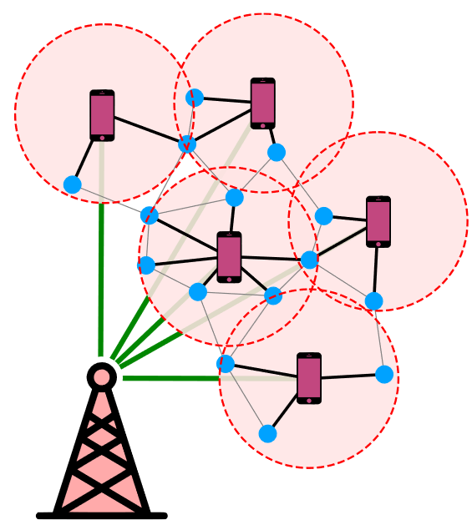
Minimum Dominating Set
To find optimize the number of connections to the cell tower.
Factors for choosing gateway locations include:
Gateway nodes must be connected to the wider internet and serve as a relay for all nodes within their range.
Main requirement: Every node in the network must be within range of at least one gateway node.
Connections with cell tower (gateway nodes) must be minimal.
This problem corresponds to a minimum dominating set constraint.

Slide 11
Minimum Dominating Set
Other examples include,
Optimizing supply chain logistics by concentrating stock to a subset of warehouses
Following a hierarchical assignment order (leader-follower) for a distributed computing cluster.
Router or LAN networks.

Slide 12
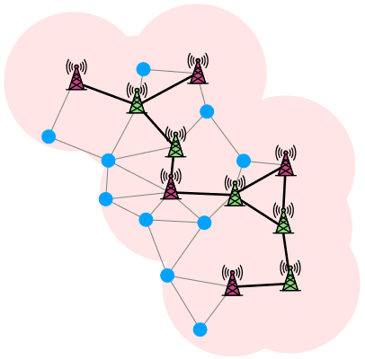
Minimum Connected Dominating Sets
The gateway nodes must form a connected subgraph. That is, the gateway nodes must be interconnected.
The connected condition adds resilience to the system. In case a connection between nodes breaks, the message can be rerouted along the components of the connected gateway nodes, forming a communication backbone.
This problem corresponds to a minimum counting dominating set constraint.
Image source: J. Wurtz, P. Lopes, C. Gorgulla, N. Gemelke, A. Keesling, and S.-T. Wang, “Industry applications of neutral-atom quantum computing solving independent set problems.” (2024)

Slide 13
Quantum Implementation
Dominating sets correspond to a minimum-maximal independent set problem. Such problems are solved by a variational hybrid approach such as quantum machine learning models.
These models sample independent sets (IS) from a weighted probability distribution.
Each sampled set undergoes classical post-processing adding required vertices for formulating a dominating set.
This quantum-inspired classical post-processing step may offer advantages over purely classical solutions.

Slide 14
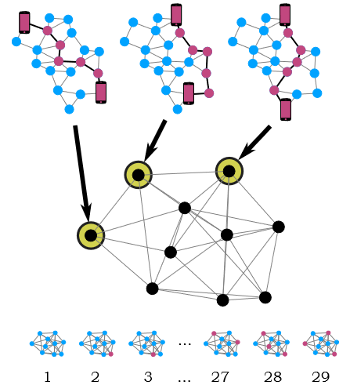
Counting Independent Sets
To find optimal routing network.
Factors for choosing an independent call route include:
Calls between customers are routed between nodes. No two calls can have a common link.
Each call route is a vertex in the interaction graph, and there is an edge if two routes share at least one link.
If call routes share a link, routing must be delayed or fail. Allowed calls are independent sets in the interaction graph.
This problem corresponds to an MIS problem.
Image source: J. Wurtz, P. Lopes, C. Gorgulla, N. Gemelke, A. Keesling, and S.-T. Wang, “Industry applications of neutral-atom quantum computing solving independent set problems.” (2024)

Slide 15
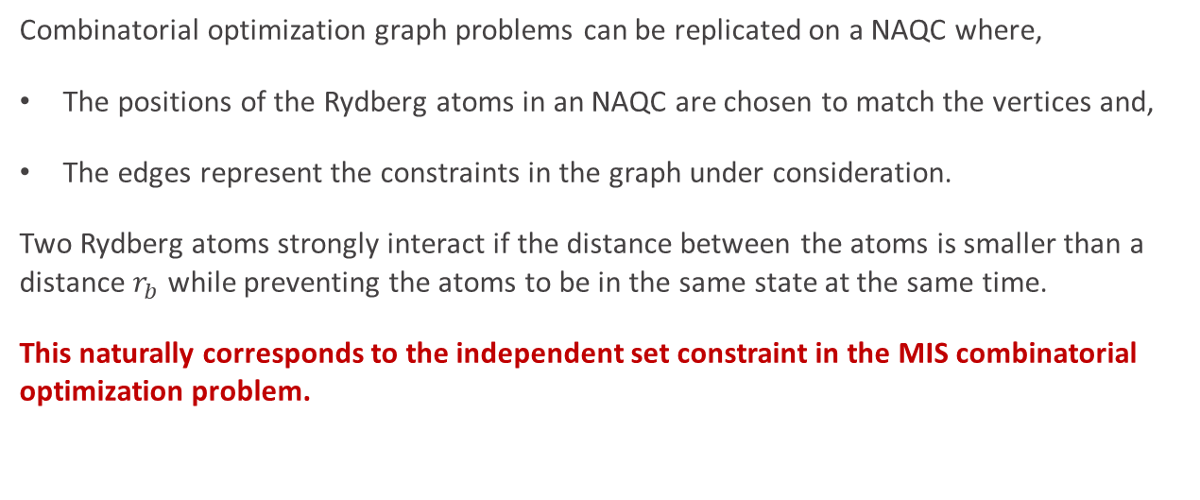
Implementation on NAQC
Combinatorial optimization graph problems can be replicated on a NAQC where,
The positions of the Rydberg atoms in an NAQC are chosen to match the vertices and,
The edges represent the constraints in the graph under consideration.
Two Rydberg atoms strongly interact if the distance between the atoms is smaller than a distance $r_{b}$ while preventing the atoms to be in the same state at the same time.
This naturally corresponds to the independent set constraint in the MIS combinatorial optimization problem.

Slide 16
MIS on NAQC
Neutral Atom Quantum Computers (NAQC) offer a potential speedup for MIS combinatorial problem by exploiting the dynamics of the Rydberg blockade.
Analog mode of operation involves the evolution of a quantum system under a continuously controllable resource Hamiltonian, providing an advantage over digital operations that lack proper error correction techniques.

Slide 17
What’s next?
Graph coloring

Slide 18
Thank you!

