Slide 1

Selection Sort
Nav Sanya Anand

Slide 2
Selection Sort – Algorithm/Pseudo Code
SELECTION-SORT(A)
n ← length[A]
for i ← 1 to n – 1
do smallestpos ← i
for j ← i + 1 to n
do if A[j] < A[smallestpos]
then smallestpos ← j
exchange A[i] ↔ A[smallestpos]

Slide 3
Selection Sort – Dry Run
SELECTION-SORT(A)
n ← length[A]
for i ← 1 to n – 1
do smallestpos ← i
for j ← i + 1 to n
do if A[j] < A[smallestpos]
then smallestpos ← j
exchange A[i] ↔ A[smallestpos]
1 | 2 | 3 | 4 | 5 | 6
A
3 | 5 | 2 | 4 | 1 | 6
i =
j =

Slide 4
Selection Sort – Dry Run
SELECTION-SORT(A)
n ← length[A]
for i ← 1 to n – 1
do smallestpos ← i
for j ← i + 1 to n
do if A[j] < A[smallestpos]
then smallestpos ← j
exchange A[i] ↔ A[smallestpos]
i | j
1 | 2 | 3 | 4 | 5 | 6
A
3 | 5 | 2 | 4 | 1 | 6
i = 1
j = 2
smallestpos = 3

Slide 5
Selection Sort – Dry Run
SELECTION-SORT(A)
n ← length[A]
for i ← 1 to n – 1
do smallestpos ← i
for j ← i + 1 to n
do if A[j] < A[smallestpos]
then smallestpos ← j
exchange A[i] ↔ A[smallestpos]
i |  | j
1 | 2 | 3 | 4 | 5 | 6
A
3 | 5 | 2 | 4 | 1 | 6
i = 1
j = 2, 3
smallestpos = 3, 2

Slide 6
Selection Sort – Dry Run
SELECTION-SORT(A)
n ← length[A]
for i ← 1 to n – 1
do smallestpos ← i
for j ← i + 1 to n
do if A[j] < A[smallestpos]
then smallestpos ← j
exchange A[i] ↔ A[smallestpos]
i |  |  | j
1 | 2 | 3 | 4 | 5 | 6
A
3 | 5 | 2 | 4 | 1 | 6
i = 1
j = 2, 3, 4
smallestpos = 3, 2

Slide 7
Selection Sort – Dry Run
SELECTION-SORT(A)
n ← length[A]
for i ← 1 to n – 1
do smallestpos ← i
for j ← i + 1 to n
do if A[j] < A[smallestpos]
then smallestpos ← j
exchange A[i] ↔ A[smallestpos]
i |  |  |  | j
1 | 2 | 3 | 4 | 5 | 6
A
3 | 5 | 2 | 4 | 1 | 6
i = 1
j = 2, 3, 4, 5
smallestpos = 3, 2, 5

Slide 8
Selection Sort – Dry Run
SELECTION-SORT(A)
n ← length[A]
for i ← 1 to n – 1
do smallestpos ← i
for j ← i + 1 to n
do if A[j] < A[smallestpos]
then smallestpos ← j
exchange A[i] ↔ A[smallestpos]
i |  |  |  |  | j
1 | 2 | 3 | 4 | 5 | 6
A
3 | 5 | 2 | 4 | 1 | 6
i = 1
j = 2, 3, 4, 5, 6
smallestpos = 3, 2, 5

Slide 9

Selection Sort – Dry Run
SELECTION-SORT(A)
n ← length[A]
for i ← 1 to n – 1
do smallestpos ← i
for j ← i + 1 to n
do if A[j] < A[smallestpos]
then smallestpos ← j
exchange A[i] ↔ A[smallestpos]
i |  |  |  |  | j
1 | 2 | 3 | 4 | 5 | 6
A
1 | 5 | 2 | 4 | 3 | 6
i = 1
j = 2, 3, 4, 5, 6
smallestpos = 1, 3, 5

Slide 10
Selection Sort – Dry Run
SELECTION-SORT(A)
n ← length[A]
for i ← 1 to n – 1
do smallestpos ← i
for j ← i + 1 to n
do if A[j] < A[smallestpos]
then smallestpos ← j
exchange A[i] ↔ A[smallestpos]
 | i | j
1 | 2 | 3 | 4 | 5 | 6
A
1 | 5 | 2 | 4 | 3 | 6
i = 1, 2
j = 3
smallestpos = 2

Slide 11
Selection Sort – Dry Run
SELECTION-SORT(A)
n ← length[A]
for i ← 1 to n – 1
do smallestpos ← i
for j ← i + 1 to n
do if A[j] < A[smallestpos]
then smallestpos ← j
exchange A[i] ↔ A[smallestpos]
 | i | j
1 | 2 | 3 | 4 | 5 | 6
A
1 | 5 | 2 | 4 | 3 | 6
i = 1, 2
j = 3
smallestpos = 2

Slide 12
Selection Sort – Dry Run
SELECTION-SORT(A)
n ← length[A]
for i ← 1 to n – 1
do smallestpos ← i
for j ← i + 1 to n
do if A[j] < A[smallestpos]
then smallestpos ← j
exchange A[i] ↔ A[smallestpos]
 | i | j
1 | 2 | 3 | 4 | 5 | 6
A
1 | 5 | 2 | 4 | 3 | 6
i = 1, 2
j = 3
smallestpos = 2, 3

Slide 13
Selection Sort – Dry Run
SELECTION-SORT(A)
n ← length[A]
for i ← 1 to n – 1
do smallestpos ← i
for j ← i + 1 to n
do if A[j] < A[smallestpos]
then smallestpos ← j
exchange A[i] ↔ A[smallestpos]
 | i |  | j
1 | 2 | 3 | 4 | 5 | 6
A
1 | 5 | 2 | 4 | 3 | 6
i = 1, 2
j = 3, 4
smallestpos = 2, 3

Slide 14
Selection Sort – Dry Run
SELECTION-SORT(A)
n ← length[A]
for i ← 1 to n – 1
do smallestpos ← i
for j ← i + 1 to n
do if A[j] < A[smallestpos]
then smallestpos ← j
exchange A[i] ↔ A[smallestpos]
 | i |  |  | j
1 | 2 | 3 | 4 | 5 | 6
A
1 | 5 | 2 | 4 | 3 | 6
i = 1, 2
j = 3, 4, 5
smallestpos = 2, 3

Slide 15
Selection Sort – Dry Run
SELECTION-SORT(A)
n ← length[A]
for i ← 1 to n – 1
do smallestpos ← i
for j ← i + 1 to n
do if A[j] < A[smallestpos]
then smallestpos ← j
exchange A[i] ↔ A[smallestpos]
 | i |  |  |  | j
1 | 2 | 3 | 4 | 5 | 6
A
1 | 5 | 2 | 4 | 3 | 6
i = 1, 2
j = 3, 4, 5, 6
smallestpos = 2, 3

Slide 16
Selection Sort – Dry Run
SELECTION-SORT(A)
n ← length[A]
for i ← 1 to n – 1
do smallestpos ← i
for j ← i + 1 to n
do if A[j] < A[smallestpos]
then smallestpos ← j
exchange A[i] ↔ A[smallestpos]
 | i |  |  |  | j
1 | 2 | 3 | 4 | 5 | 6
A
1 | 2 | 5 | 4 | 3 | 6
i = 1, 2
j = 3, 4, 5, 6
smallestpos = 2, 3

Slide 17
Selection Sort – Dry Run
SELECTION-SORT(A)
n ← length[A]
for i ← 1 to n – 1
do smallestpos ← i
for j ← i + 1 to n
do if A[j] < A[smallestpos]
then smallestpos ← j
exchange A[i] ↔ A[smallestpos]
 |  | i | j
1 | 2 | 3 | 4 | 5 | 6
A
1 | 2 | 5 | 4 | 3 | 6
i = 1, 2, 3
j = 4
smallestpos = 3, 4

Slide 18
Selection Sort – Dry Run
SELECTION-SORT(A)
n ← length[A]
for i ← 1 to n – 1
do smallestpos ← i
for j ← i + 1 to n
do if A[j] < A[smallestpos]
then smallestpos ← j
exchange A[i] ↔ A[smallestpos]
 |  | i |  | j
1 | 2 | 3 | 4 | 5 | 6
A
1 | 2 | 5 | 4 | 3 | 6
i = 1, 2, 3
j = 4, 5
smallestpos = 3, 4, 5

Slide 19
Selection Sort – Dry Run
SELECTION-SORT(A)
n ← length[A]
for i ← 1 to n – 1
do smallestpos ← i
for j ← i + 1 to n
do if A[j] < A[smallestpos]
then smallestpos ← j
exchange A[i] ↔ A[smallestpos]
 |  | i |  |  | j
1 | 2 | 3 | 4 | 5 | 6
A
1 | 2 | 5 | 4 | 3 | 6
i = 1, 2, 3
j = 4, 5, 6
smallestpos = 3, 4, 5

Slide 20
Selection Sort – Dry Run
SELECTION-SORT(A)
n ← length[A]
for i ← 1 to n – 1
do smallestpos ← i
for j ← i + 1 to n
do if A[j] < A[smallestpos]
then smallestpos ← j
exchange A[i] ↔ A[smallestpos]
 |  | i |  |  | j
1 | 2 | 3 | 4 | 5 | 6
A
1 | 2 | 3 | 4 | 5 | 6
i = 1, 2, 3
j = 4, 5, 6
smallestpos = 3, 4, 5

Slide 21
Selection Sort – Dry Run
SELECTION-SORT(A)
n ← length[A]
for i ← 1 to n – 1
do smallestpos ← i
for j ← i + 1 to n
do if A[j] < A[smallestpos]
then smallestpos ← j
exchange A[i] ↔ A[smallestpos]
 |  |  | i | j
1 | 2 | 3 | 4 | 5 | 6
A
1 | 2 | 3 | 4 | 5 | 6
i = 1, 2, 3, 4
j = 5
smallestpos = 4

Slide 22
Selection Sort – Dry Run
SELECTION-SORT(A)
n ← length[A]
for i ← 1 to n – 1
do smallestpos ← i
for j ← i + 1 to n
do if A[j] < A[smallestpos]
then smallestpos ← j
exchange A[i] ↔ A[smallestpos]
 |  |  | i |  | j
1 | 2 | 3 | 4 | 5 | 6
A
1 | 2 | 3 | 4 | 5 | 6
i = 1, 2, 3, 4
j = 5, 6
smallestpos = 4

Slide 23
Selection Sort – Dry Run
SELECTION-SORT(A)
n ← length[A]
for i ← 1 to n – 1
do smallestpos ← i
for j ← i + 1 to n
do if A[j] < A[smallestpos]
then smallestpos ← j
exchange A[i] ↔ A[smallestpos]
 |  |  | i |  | j
1 | 2 | 3 | 4 | 5 | 6
A
1 | 2 | 3 | 4 | 5 | 6
i = 1, 2, 3, 4
j = 5, 6
smallestpos = 4

Slide 24
Selection Sort – Dry Run
SELECTION-SORT(A)
n ← length[A]
for i ← 1 to n – 1
do smallestpos ← i
for j ← i + 1 to n
do if A[j] < A[smallestpos]
then smallestpos ← j
exchange A[i] ↔ A[smallestpos]
 |  |  |  | i | j
1 | 2 | 3 | 4 | 5 | 6
A
1 | 2 | 3 | 4 | 5 | 6
i = 1, 2, 3, 4, 5
j = 6
smallestpos = 5

Slide 25
Selection Sort – Dry Run
SELECTION-SORT(A)
n ← length[A]
for i ← 1 to n – 1
do smallestpos ← i
for j ← i + 1 to n
do if A[j] < A[smallestpos]
then smallestpos ← j
exchange A[i] ↔ A[smallestpos]
1 | 2 | 3 | 4 | 5 | 6
A
1 | 2 | 3 | 4 | 5 | 6

Slide 26
Selection Sort – Dry Run
SELECTION-SORT(A)
n ← length[A]
for i ← 1 to n – 1
do smallestpos ← i
for j ← i + 1 to n
do if A[j] < A[smallestpos]
then smallestpos ← j
exchange A[i] ↔ A[smallestpos]
1 | 2 | 3 | 4 | 5 | 6
A
1 | 2 | 3 | 4 | 5 | 6

Slide 27

Selection Sort – Time Complexity
SELECTION-SORT(A)
n ← length[A]
for i ← 1 to n – 1
do smallestpos ← i
for j ← i + 1 to n
do if A[j] < A[smallestpos]
then smallestpos ← j
exchange A[i] ↔ A[smallestpos]
1
n - 1
n – 1
$\sum_{t=n}^{i+1}{t}≈n^{2}$
$\sum_{t=n}^{i+1}{t}≈n^{2}$
$\sum_{t=n}^{i+1}{t}≈n^{2}$
n - 1
O(n) = $n^{2}$

Slide 28
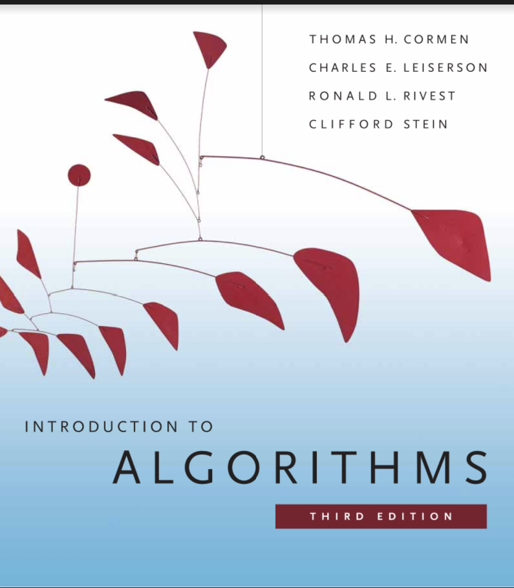
References

