Slide 1

Team Members Details :-
FIND ME-AI ASSISTED MISSING CHILD IDENTIFICATION PORTAL(CNN BASED DEEP LEARNING MODEL)
NAWAB PRANAY - 21N31A7249
MOGILI GOPI PRASAD - 21N31A7241
LAVUDYA SIDDHARTH - 21N31A7233
IV Year B.Tech-II Semester – AI&DS (Artificial Intelligence and Data Science)
Under the Guidance of
Dr. Kannaiah chattu
Associate Professor & Dept. of CI
MRCET CAMPUS (UGC AUTONOMOUS INSTITUTION)
B.Tech IV Year – II Sem | Major Project Review

Slide 2


Introduction
The Missing Child Identification Portal is a web-based platform leveraging facial recognition technology to address the issue of missing children. It allows users to report and register cases of missing children, upload images for identification using a CNN-based model integrated with Python’s DeepFace library, and matches these images against a database to identify potential leads.
Key features include Automated Email Notifications for new cases, secure data storage, and a robust backend powered by Node.js, Express.js, and MySQL. The portal enhances the chances of reuniting missing children with their families and aims to integrate future improvements like mobile support and advanced algorithms.

Slide 3
Abstract
This project introduces a web-based Missing Child Identification Portal designed to assist in reuniting missing children with their families through the application of advanced facial recognition technology. The system leverages Convolutional Neural Networks (CNN) powered by Python's Deep Face library for accurate and efficient face matching. Built with Node.js for the backend and MySQL for database management, the portal enables users to register missing cases, upload images, and compare them with an existing database of missing children. A real-time email notification system ensures that all registered users are informed of newly reported cases, enhancing community engagement. By utilizing deep learning models to analyze and match facial features, the system emphasizes real-time identification with high accuracy and efficiency. This solution aims to streamline the process of child identification, significantly reducing response times and increasing the likelihood of reuniting children with their families.

Slide 4
Requirements
□Software Requirements:-
Operating System: Windows 7 and above
Libraries:TensorFlow,keras,OpenCV,NumPy, Matplotlib,Flask
Programming Language:Python,MySql
□Hardware Requirements:-
Processor: Intel Core i3, AMD Ryzen 3 and above
Storage: Minimum 50GB disk space
Memory: Minimum 4GB RAM

Slide 5
Existing Systems
TEAM ADAM:-
Team ADAM Is A Program Established By The National Center For Missing & Exploited Children (NCMEC). It Provides Rapid-response Technical Assistance And Expertise To Law Enforcement Agencies And Families In Cases Of Child Abduction And Endangered Missing Children
Rapid Deployment:-
Team ADAM deploys experienced consultants (retired law enforcement professionals) to assist local authorities in managing abduction cases

Slide 6
Disadvantages of Existing Systems
Manual Process
Inefficient Matching
Delayed Information Distribution
Lack of Public Involvement
Security concerns

Slide 7
Proposed System
The Missing Child Identification Portal is designed to provide a streamlined, technology-driven solution for the identification and tracking of missing children. Unlike traditional methods that rely heavily on manual intervention and human effort, our system leverages the power of Convolutional Neural Networks (CNN) and facial recognition technology to automate the matching process, significantly increasing the efficiency and accuracy of child identification.
Facial Recognition
Automated Notification System
Web-Based Portal
Photo Management

Slide 8
Advantages of Proposed System
High Accuracy With CNN
Automation And Speed
Community Involvement
Scalability And Flexibility
CommunicationThrough Email
Proactive Identification

Slide 9
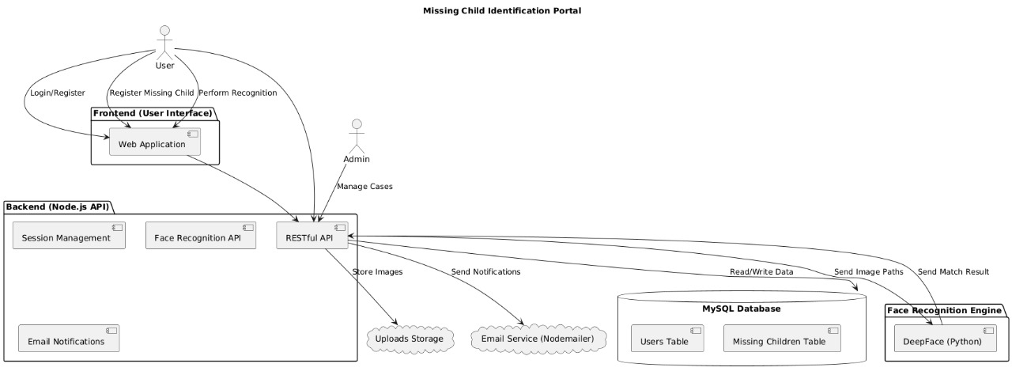
Architecture

Slide 10
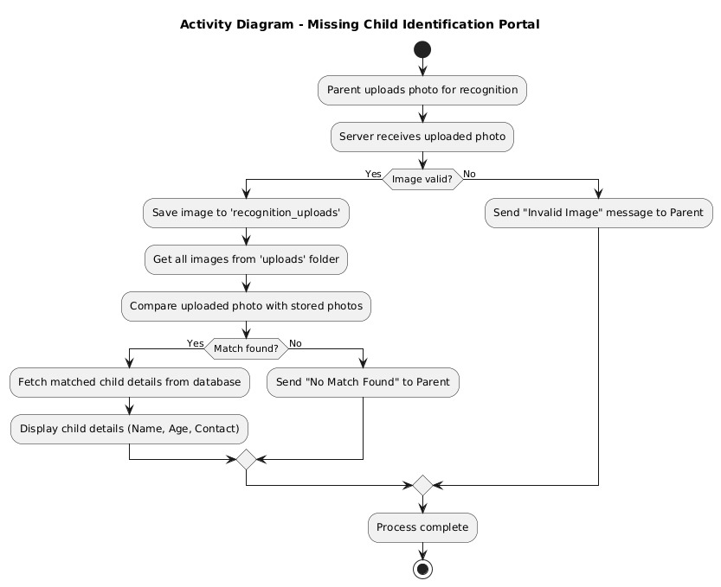
Activity Diagram

Slide 11
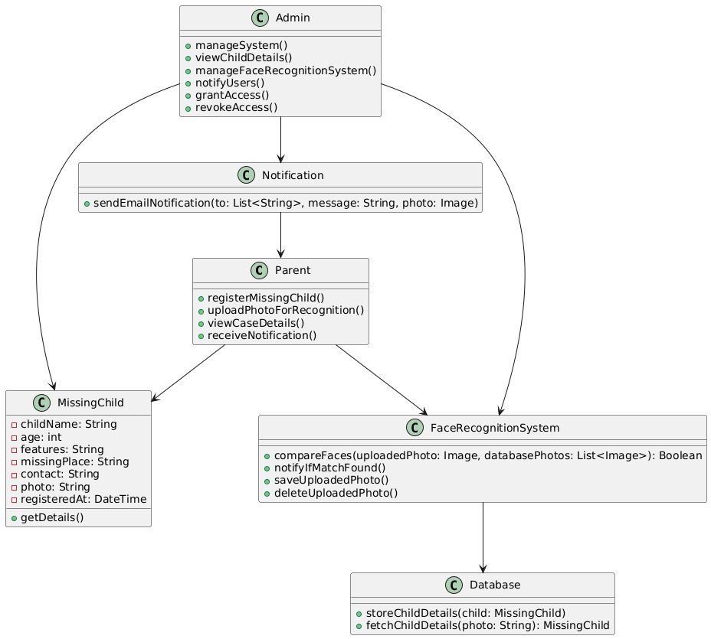
Class Diagram

Slide 12
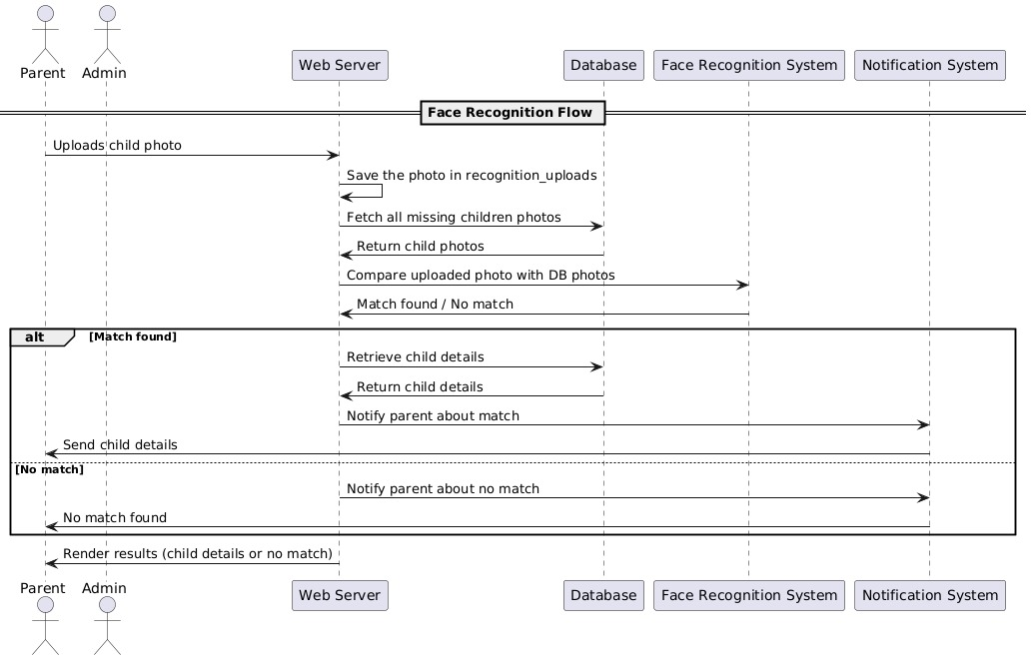
Sequence Diagram

Slide 13
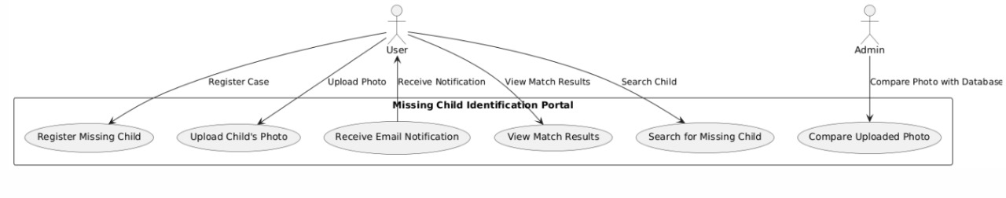
Usecase Diagram

Slide 14
Sample Code:
const express = require('express');
const path = require('path');
const mysql = require('mysql2');
const bcrypt = require('bcryptjs');
const bodyParser = require('body-parser');
const session = require('express-session');
const multer = require('multer');
const fs = require('fs');
const { spawn } = require('child_process');
const nodemailer = require('nodemailer'); // For sending emails
require('dotenv').config();
const app = express();
const port = 3000;
app.set('view engine', 'ejs');
app.set('views', path.join(__dirname, 'views'));
// Set up multer for file uploads
// Set up multer for file uploads with correct extensions
// Set up multer for file uploads with the original filename

Slide 15
Code
const storage = multer.diskStorage({
destination: (req, file, cb) => {
cb(null, 'public/uploads/');
},
filename: (req, file, cb) => {
cb(null, file.originalname);
}
});
const upload = multer({
storage: storage,
fileFilter: (req, file, cb) => {
if (file.mimetype.startsWith('image/')) {
cb(null, true);
} else {
cb(new Error('Only images are allowed'), false);
}
},
limits: { fileSize: 2 * 1024 * 1024 } // 2MB limit
});

Slide 16
Connecting to data base
// Database connection
const db = mysql.createPool({
host: 'localhost',
user: 'root',
password: process.env.DB_PASSWORD,
database: 'users',
connectionLimit: 10
});
db.getConnection((err) => {
if (err) {
console.error('Error connecting to the database:', err.message);
process.exit(1);
}
console.log('Connected to the database.');
});
// Nodemailer transporter
const transporter = nodemailer.createTransport({
service: 'gmail',
auth: {
user: process.env.EMAIL_USER,
pass: process.env.EMAIL_PASS
}
});

Slide 17
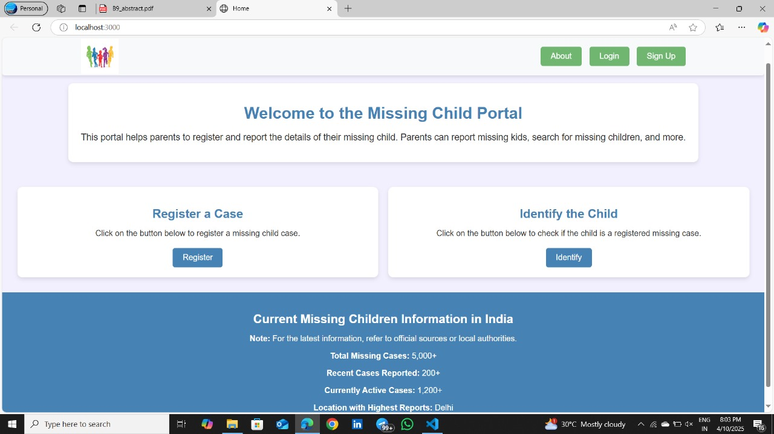
Missing Child Portal:

Slide 18
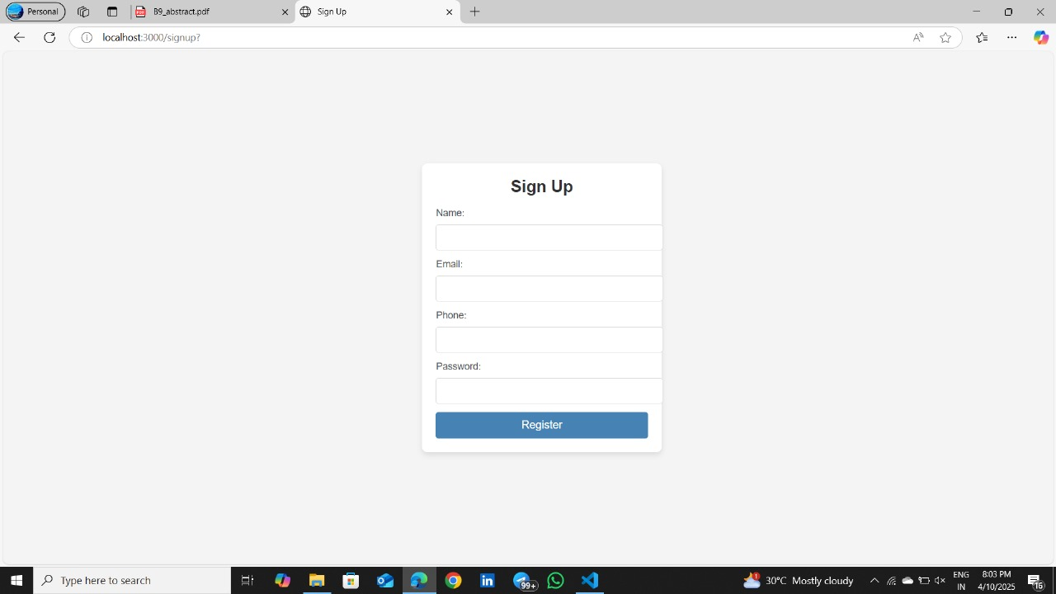
Missing Child Sign Up Page:

Slide 19
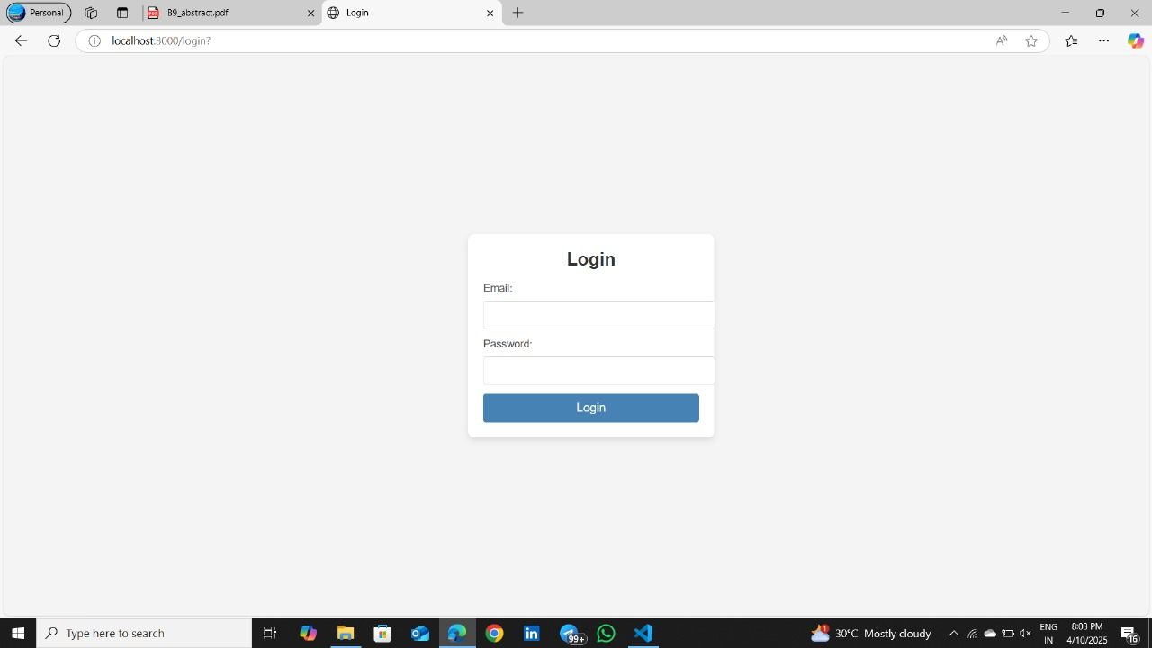
Missing Child Login Page:

Slide 20
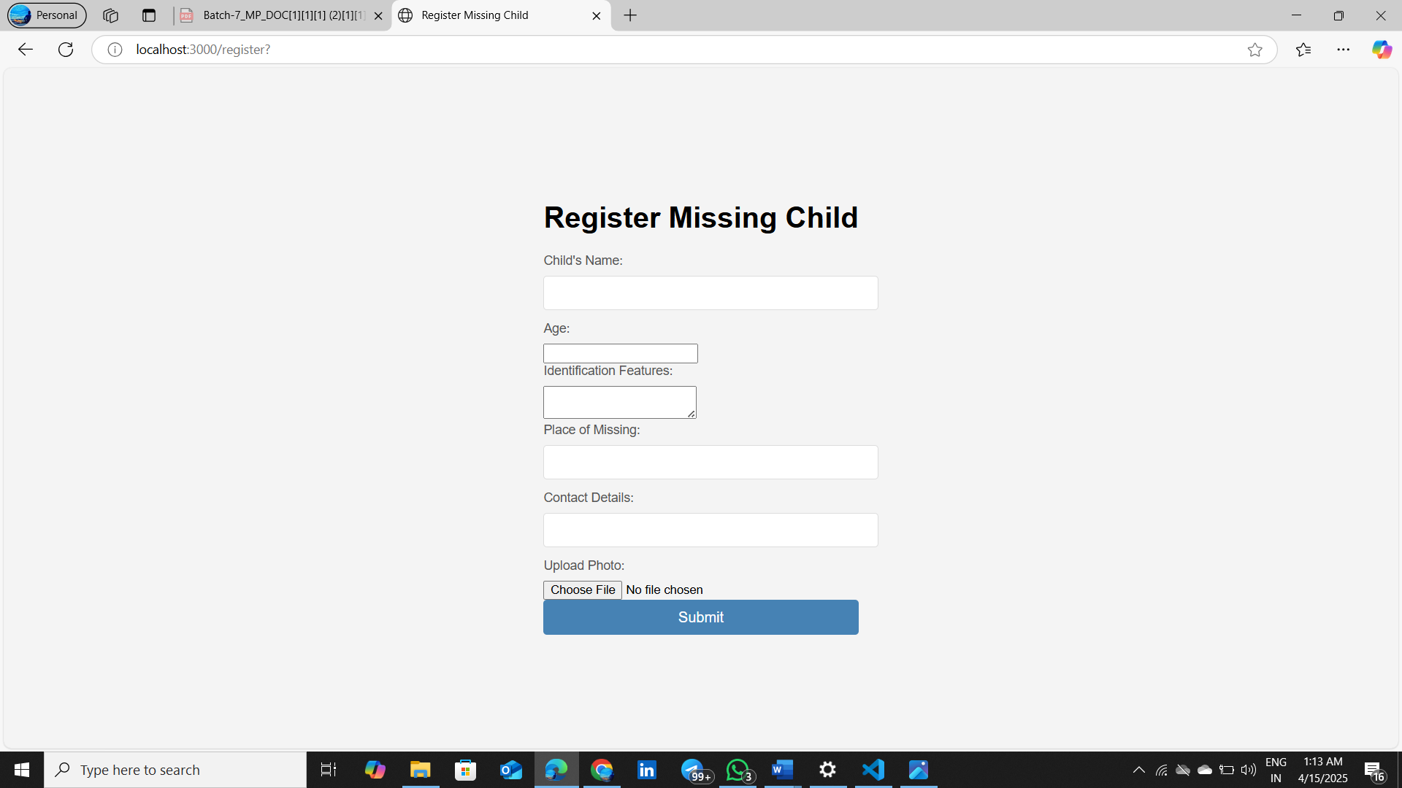
Missing Child Registration Page:

Slide 21
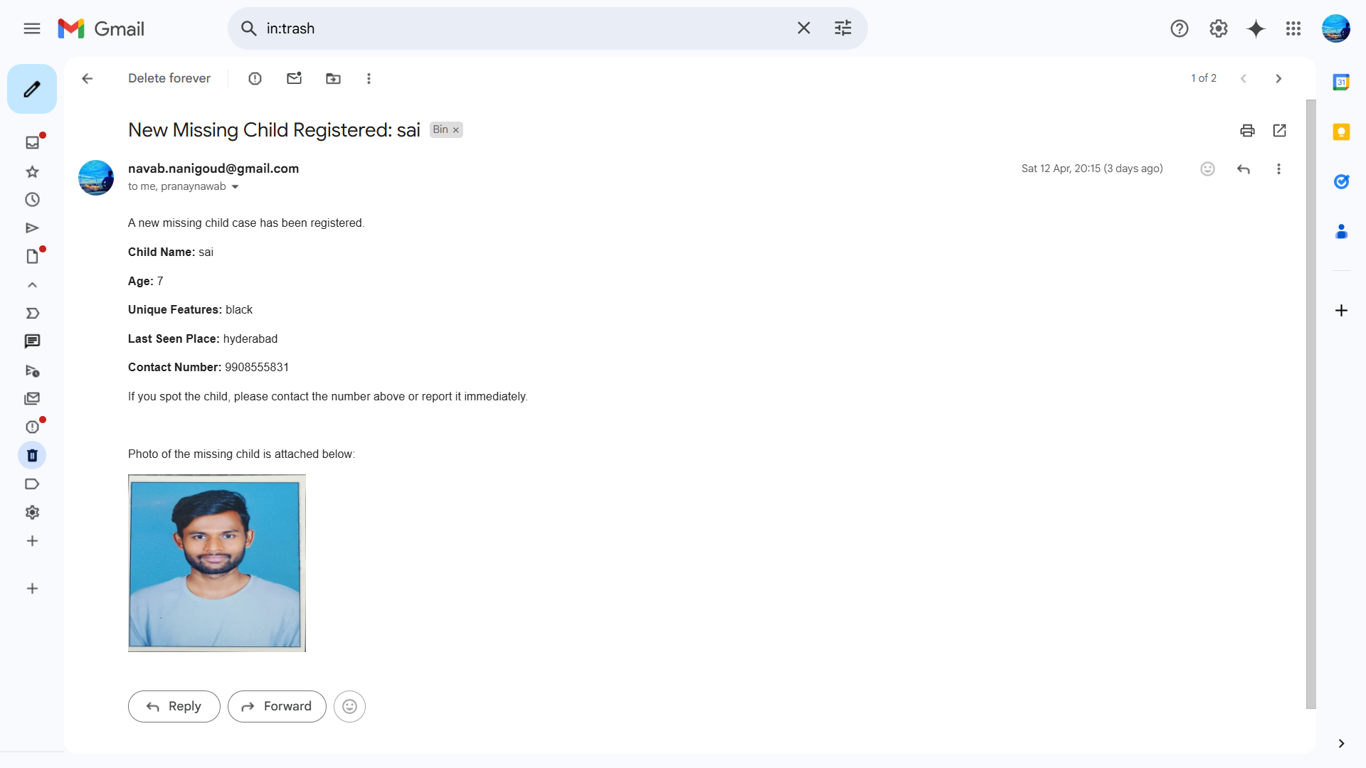
Email Notification:

Slide 22
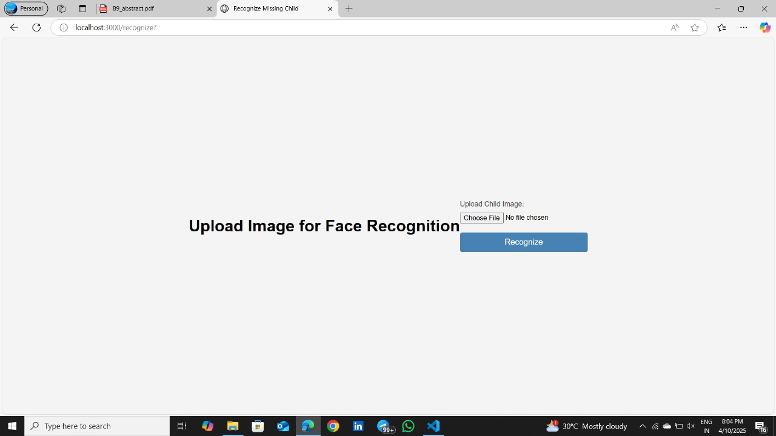
Missing Child Image Upload Page:

Slide 23
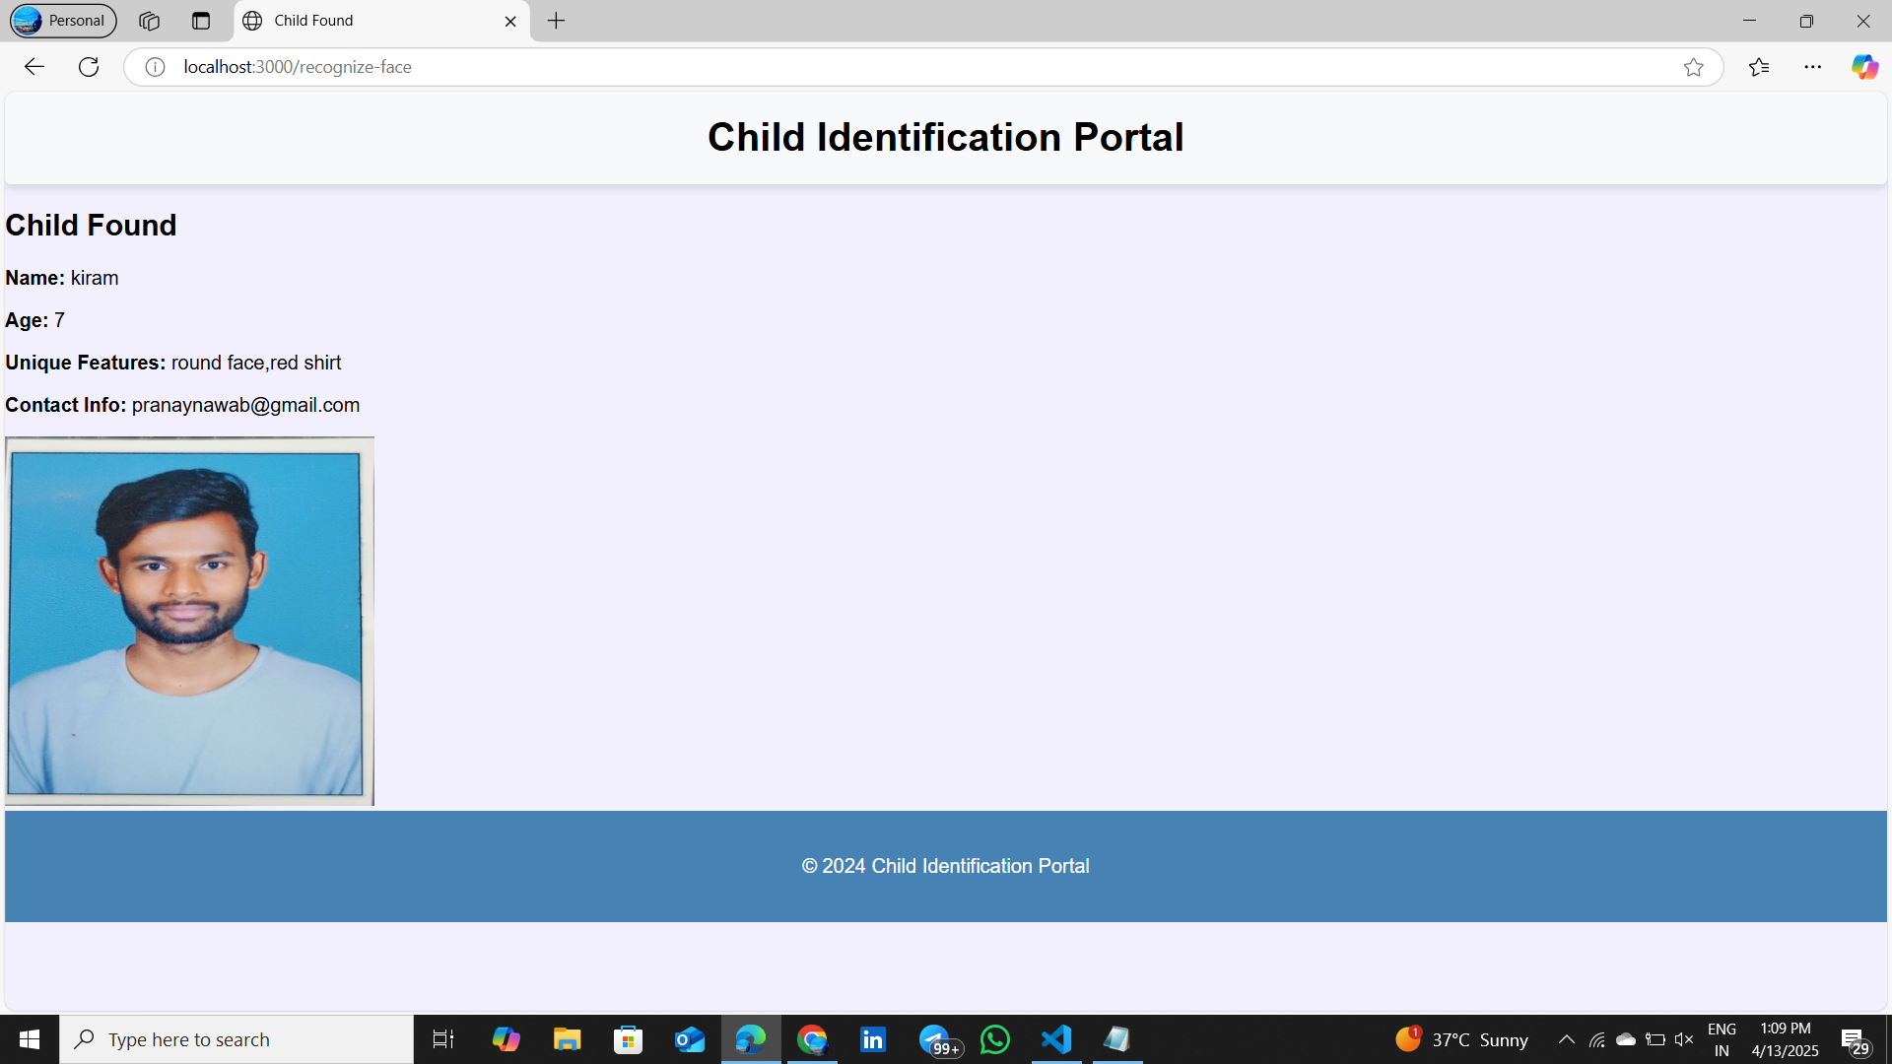
Missing Child Found:

Slide 24

CONCLUSION
The Missing Child Identification System offers a powerful technological solution to the pressing issues of child abduction and disappearance. By leveraging CNN-based facial recognition models within a user-friendly web portal, the system empowers parents and authorities to register and identify missing children with greater efficiency and accuracy.
Features such as automated email notifications enhance public awareness and involvement, while a scalable and reliable backend infrastructure ensures system robustness. This project exemplifies the meaningful intersection of technology, civic engagement, and law enforcement, contributing significantly to child recovery efforts and societal safety.

Slide 25
Thank You

