Slide 1



CODE CARNIVAL 3.0
ATMIYA DEVELOPER STUDENTS CLUB PRESENTS
Idea Submission · AegisRAG: answers only from the files you are allowed to read
TEAM NAME
TEAM ID
TEAM LEADER
The Boor Bots
SJX3
Navadeep Gandloju
PROBLEM STATEMENT TITLE
THEME / TRACK
PS-01 · Secure Multi-Modal RAG System with Access Control
AI Security · Enterprise RAG
Notes:
Team: Navadeep Gandloju (leader), Adithya Mamidala.

Slide 2
PROBLEM STATEMENT & UNDERSTANDING
01 · THE TARGET
PROBLEM STATEMENT
OUR UNDERSTANDING
Companies want one AI assistant over all files, but each file has its own readers
Typical RAG searches everything, then filters, so restricted text can reach the model
Access rules must hold across PDFs, scans, photos and spreadsheets
Root cause: permissions are checked after retrieval or written into the prompt
Prompt rules can be bypassed by injected text such as “ignore previous instructions”
LLMs guess totals over tables and cite sources that do not say it
Revoking access must also hide answers given earlier
Code Carnival 3.0 · ADSC, Atmiya University
THE BOOR BOTS

Slide 3
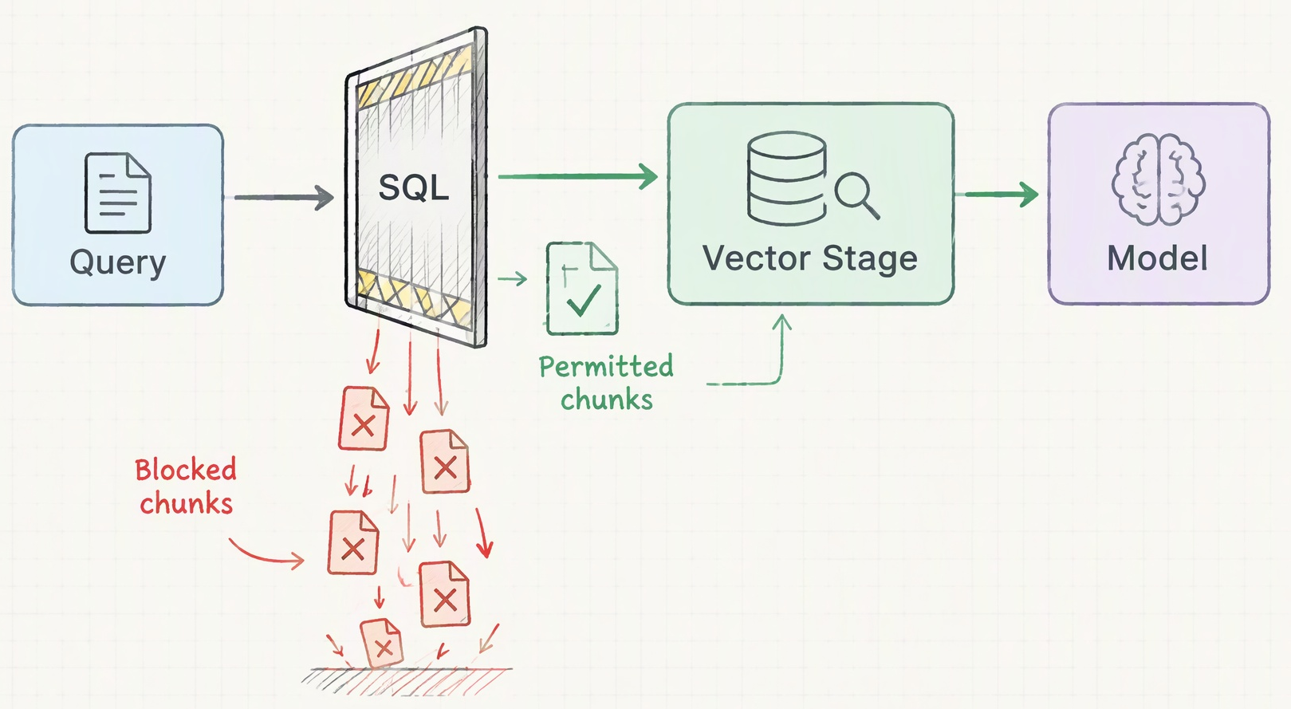
PROPOSED SOLUTION
02 · THE PLAN
OUR IDEA
AegisRAG compiles each user’s permissions into the retrieval SQL query
Restricted chunks are never loaded, ranked or sent to the model
Totals over spreadsheets are computed in code, only on rows the user may read
Every answer cites its source; unsupported claims are removed
Deny by default: blocked chunks are filtered inside the database
Code Carnival 3.0 · ADSC, Atmiya University
THE BOOR BOTS

Slide 4
KEY FEATURES / FUNCTIONALITY
03 · THE ARSENAL
01
Access rule inside SQL
02
Multimodal ingestion
Tenant, grant, clearance and row rules filter every search, count and citation
PDF, scans, photos, DOCX, XLSX, CSV and JSON; OCR via Gemini Vision or RapidOCR
03
Exact answers over records
04
Verified citations and audit
Sums, averages and group-bys run in code on only the rows each user may see
Each claim is checked against its cited chunk; revoked access withdraws old answers
Code Carnival 3.0 · ADSC, Atmiya University
THE BOOR BOTS

Slide 5

HOW THE SOLUTION WILL WORK
04 · THE EXECUTION
STEP 1
STEP 2
STEP 3
STEP 4
Sign in: signed JWT
SQL permission filter
Search or compute
Cited, verified answer
User question
Identity read only from the signed token: roles, clearance, department
SQL access gate
Document rule AND row rule, inside every query
Track A · Records
Exact SUM, COUNT, GROUP BY in code
Grounded answer
Gemini returns JSON; every point cites an evidence id
Claim check
Numbers and words must match the cited chunk
Answer + audit
Highlighted source on the page; decision logged
Track B · Docs
Vectors + BM25, fused with RRF
Blocked chunks are never loaded, ranked or sent to the model
Unsupported claims are removed before the user sees the answer
Code Carnival 3.0 · ADSC, Atmiya University
THE BOOR BOTS

Slide 6
TECHNOLOGY / TECH STACK
05 · THE GEAR
Layer | Technology | Why we chose it
Frontend | React 18, TypeScript, Vite, Tailwind | Typed UI, fast builds
Backend | Python, FastAPI, SQLAlchemy | Async API, signed identity
Database | PostgreSQL + pgvector, SQLite | Vectors and access rule in one query
AI / APIs | Gemini API, RapidOCR | Grounded JSON; offline OCR fallback
Hosting | Render, Docker Compose | One-file deploy via render.yaml
Tools | GitHub, pytest, PyMuPDF, openpyxl | 97 automated tests guard the rules
Code Carnival 3.0 · ADSC, Atmiya University
THE BOOR BOTS

Slide 7
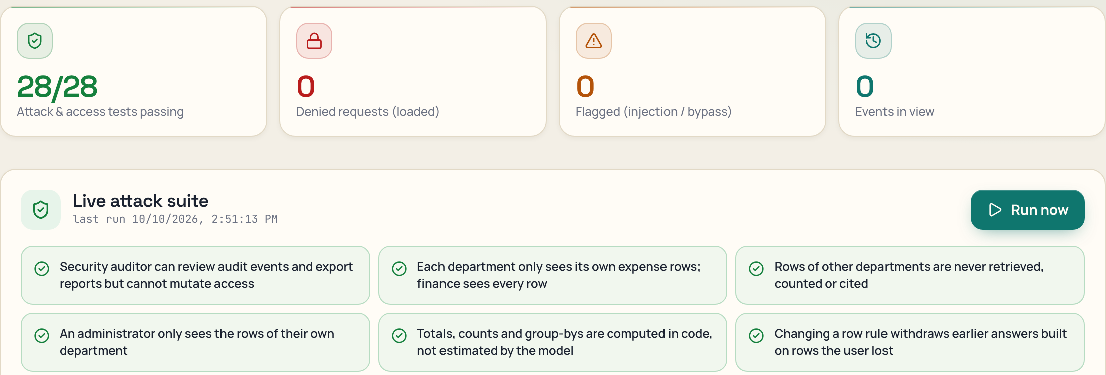
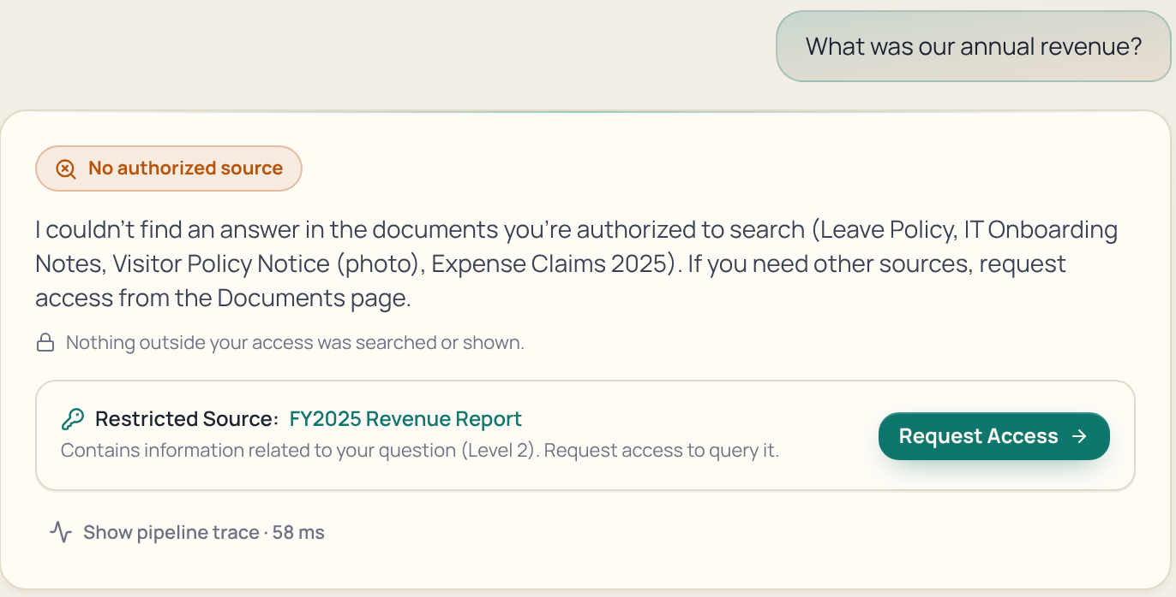
CURRENT PROGRESS / WORK DONE
06 · INSIDE THE MINT
COMPLETED
IN PROGRESS
Access rule in SQL, row rules, multi-tenant
Ingestion: PDF, scans, photos, DOCX, sheets
Hybrid search and exact analytics
97 / 97 backend tests passing
Gemini tuning within free-tier rate limits
Cleaner tables in answers
Catching rephrased injection (pattern-based today)
Live attack suite: 28 / 28 passing
Employee asks for revenue: refused, no leak
Code Carnival 3.0 · ADSC, Atmiya University
THE BOOR BOTS

Slide 8
FUTURE PLAN / NEXT STEPS
07 · THE GETAWAY
PHASE 1
PHASE 2
PHASE 3
DURING THE HACKATHON
RIGHT AFTER
LONG-TERM VISION
Deploy live with Gemini on Render
Fix answer table layout
Run the attack suite live in the demo
Okta / Entra ID sign-in with SCIM role sync
Reranker after RRF for sharper results
Malware scanning of uploads
Audio and meeting transcripts with speaker-level access
Pilot with one college or company department
Per-seat SaaS plus a self-hosted option
Code Carnival 3.0 · ADSC, Atmiya University
THE BOOR BOTS

Slide 9

GITHUB REPOSITORY LINK
08 · THE VAULT
https://github.com/Navadeep44/aegisrag-2
PUBLIC
README
COMMITS
DEMO (OPTIONAL)
Repository visibility is set to public.
Covers setup, features, demo accounts and tests.
Regular commits from both team members.
Run locally in two commands (see README); Render config included.
Code Carnival 3.0 · ADSC, Atmiya University
THE BOOR BOTS

