Slide 1
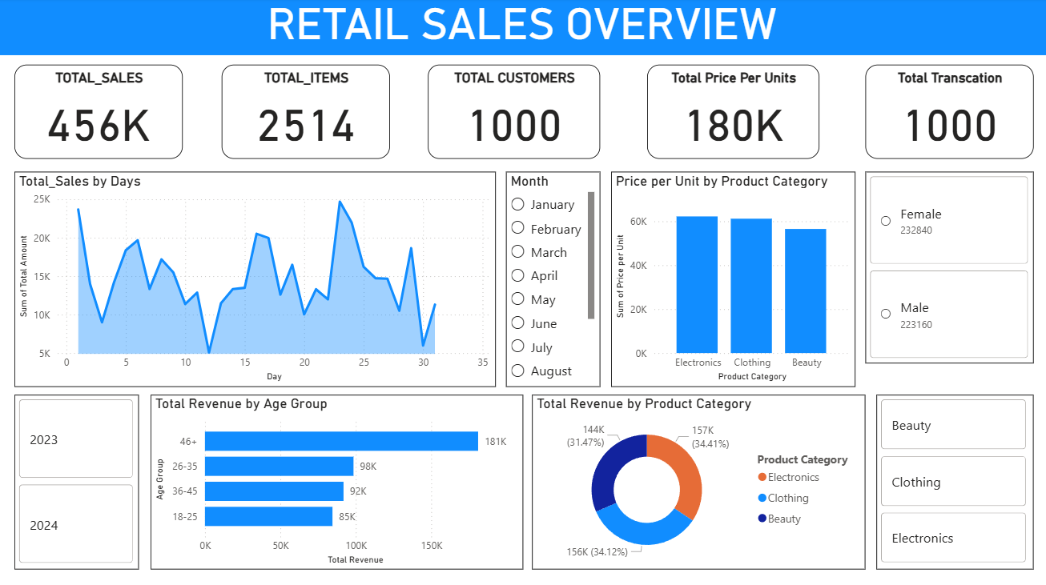
Retail Sales Performance Overview

Slide 2
Executive Summary & Project Objective
The Mission: To design and build an interactive dashboard using a retail sales dataset to monitor core business performance, identify key revenue drivers, and provide actionable insights to support strategic decision-making.
Key Deliverables:
Interactive Dashboard built in Power BI .
PPT Summary of analysis and insights.
Dashboard Principles Applied:
Clear visualization of core KPIs (Sales, Customers, Items).
Inclusion of Time-Series Analysis to track trends.
Built-in Interactivity using slicers (Year, Month, Category).
Focus on data that informs business decisions (Category and Demographics).

Slide 3
Key Performance Indicators (KPIs)
KPI | Value (from Dashboard) | Context & Business Purpose
TOTAL SALES (Revenue) | $456K | The total top-line revenue generated across the analyzed period.
TOTAL CUSTOMERS (Unique) | 1000 | The active customer base being tracked.
TOTAL TRANSACTIONS (Orders) | 1000 | The total volume of orders. (Note: 1 customer per transaction suggests no repeat customers in this current view.)
TOTAL ITEMS (Quantity Sold) | 2514 | Total units moved, indicating demand volume.
Key Metric to Calculate: | Average Order Value | [Total Sales / Total Transactions]. This would be a crucial benchmark for sales strategy.

Slide 4
Key Insight 1: Sales Trends & Product Drivers
Focus: Time-Series Analysis and Product Category Performance.
Time-Series Analysis: Sales Trends
The Total Sales by Days (Area Chart) displays clear fluctuations throughout the period (days 1-30/31). This confirms a non-uniform sales pattern, likely driven by weekly cycles, pay periods, or promotions.
Actionable Insight: Marketing and Operations teams should analyze the peaks and troughs to optimize scheduling and target advertising spend when demand is naturally highest.
Product Category Performance
The Total Revenue by Product Category (Donut Chart) shows a near-equal distribution of revenue among the top three categories:
Beauty (Approx. 34.1%)
Electronics (Approx. 34.4%)
Clothing (Approx. 31.5%)
Actionable Insight: The business relies heavily on balancing these three lines. Further analysis should confirm which one yields the highest Profit (a KPI for future development).

Slide 5
Slide 5: Key Insight 2: Customer Demographics
Focus: Segmenting sales by Age and Gender for targeted marketing.
Revenue by Age Group
Top Spending Segments: The 36-45 age group is the largest revenue contributor ($107K), followed closely by the 26-35 group ($98K).
Actionable Insight: The core customer for high-value sales falls within the 26-45 demographic. Marketing budget and product curation should prioritize the needs and preferences of these high-performing segments.
Revenue by Gender
Sales are slightly skewed towards Female customers.
Actionable Insight: While a slight preference exists, the split is relatively balanced. The slight skew suggests an opportunity for targeted campaigns to grow the male customer segment without neglecting the primary female audience.

Slide 6
Conclusion & Business Recommendations
1.Strategic Focus for Stakeholders:
Profitability Over Revenue: The current focus is revenue. The next step is critical: introduce a Profit KPI (Selling Price - Cost) to identify which of the top revenue categories (Electronics, Beauty, Clothing) is the most profitable.
Targeted Retention: Develop specific loyalty programs and product recommendation strategies for the 26-45 Age Group, as they represent the most valuable customer segment.
2. Dashboard Impact:
The dashboard is fully interactive via slicers for Year, Month, Gender, and Product Category. This capability empowers business stakeholders to explore trends and segment data instantly, facilitating faster, data-driven decision-making.
3. Future Enhancements:
Incorporate Year-over-Year (YoY) Growth metrics directly on the dashboard to track performance against previous periods.
Add a Drill-Through page to view performance at the specific Sub-Category level for deeper inventory and pricing decisions.

