Slide 1

School of Computing
Vel Tech Rangarajan Dr. Sagunthala R&D Institute of Science and Technology
Department of Computer Science and Engineering
10211CS224 / FULL STACK APPLICATION DEVELOPMENT (JAVA)
PROJECT REVIEW : MILESTONE PROJECT – 1 Date: 23-03-2026
Full Stack Skill Learning Academy Marketplace with Secure Authentication
SDG:– SDG 4- Quality Education
Presented By: Velaga Sai Navadeep Krishna VTU24596 – Reg.No:23UECS0600
Courses Handling Faculty:
Dr. Hafizur Rahman- B.E., M.Tech., Ph.D.

Slide 2
INTRODUCTION
Internal department events like technical fests require an efficient system to manage registrations and track attendees.
Manual ticketing processes lead to data loss, long queues, and confusion over seat availability.
This creates a strong need for a dynamic, user-friendly online booking platform for students and faculty.
The proposed system is a Single Page Application (SPA) built purely using React JS for seamless interaction.
It allows users to instantly view event details, book tickets, and receive real-time confirmation without page reloads.
1
2
3
4
5
6
7
8
9

Slide 3
PROBLEM STATEMENT
1
Students and faculty struggle with traditional, paper-based forms that lack real-time updates.
Static forms fail to track available tickets dynamically, frequently resulting in severe overbooking.
Users often submit invalid data, such as incorrect email formats or negative ticket quantities, causing administrative overhead.
The absence of immediate booking confirmation leaves attendees uncertain about their registration status.
There is a clear need for a React-based application that enforces strict client-side validation and instant state updates.
2
3
4
5
6
7
8
9

Slide 4
OBJECTIVE(S)
1
To design and develop a React JS based web application that allows students and faculty to seamlessly view event details and book tickets online.
To implement dynamic state management using the React useState hook for tracking available tickets and preventing overbooking.
To ensure data integrity by enforcing strict client-side validation for mandatory fields, valid email formats, and positive ticket quantities.
To provide an intuitive, component-based user interface that dynamically renders a booking confirmation summary upon success.
2
3
4
5
6
7
8
9

Slide 5
PROPOSED SYSTEM
A fast, responsive web application built using functional React components and JSX.
Features a dedicated Event Details Module that displays the venue, date, time, and dynamic ticket availability.
Includes a secure Ticket Booking Module that captures user data (Name, Email, Department, Quantity).
Implements instant client-side validation to catch invalid inputs gracefully before submission.
Utilizes conditional rendering to replace the booking form with a personalized success summary automatically.
1
2
3
4
5
6
7
8
9

Slide 6
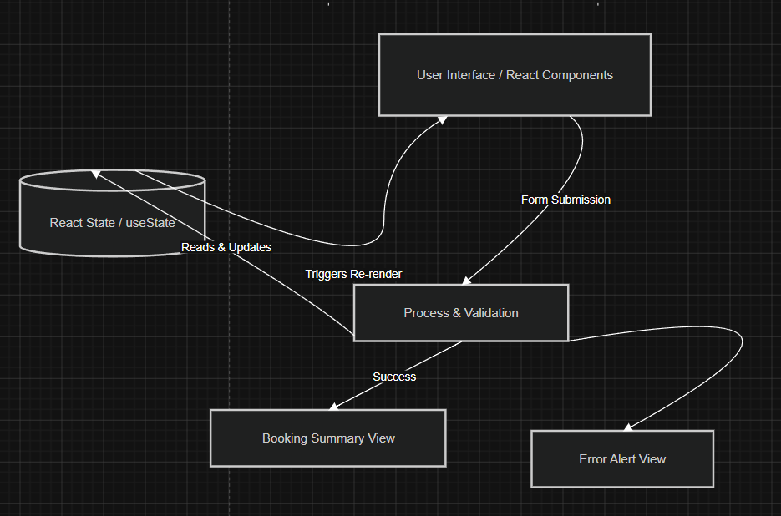
PROPOSED SYSTEM ARCHITECTURE
1
2
3
4
5
6
7
8
9

Slide 7
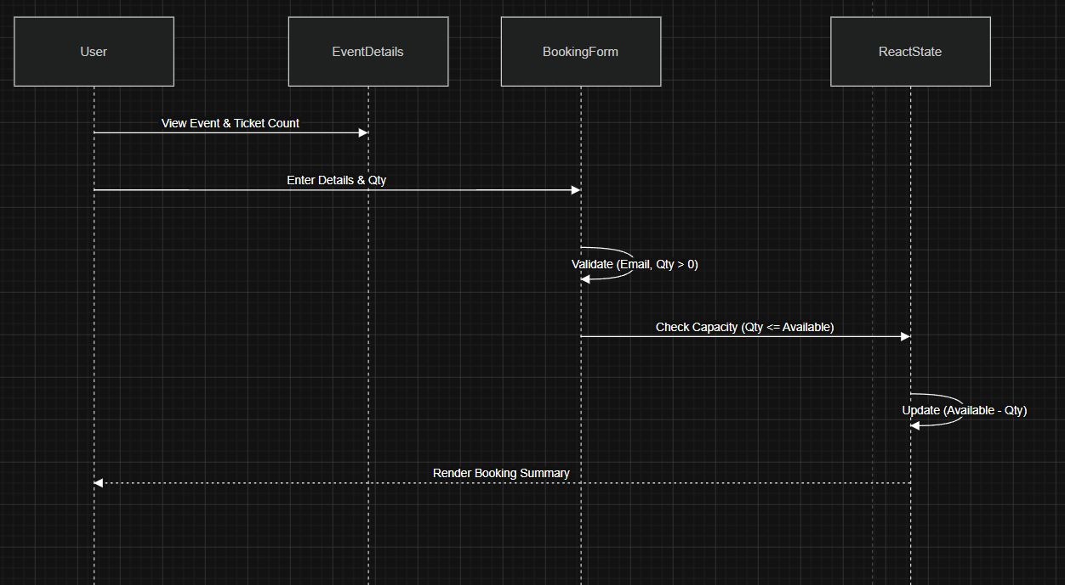
WORKFLOW
1
2
3
4
5
6
7
8
9

Slide 8
TECHNOLOGIES USED
Frontend: HTML5, CSS3, JavaScript (ES6)
Core Library: React JS (Functional Components, JSX)
State Management: React Hooks (useState)
Tools: Node.js, NPM (Node Package Manager), VS Code (Source Code Editor)
Hardware / Software Requirements:
RAM: Minimum 4GB Processor
Storage: Minimum 500MB free disk space
Software: Node.js runtime environment, Web Browser (Google Chrome)
1
2
3
4
5
6
7
8
9

Slide 9
MODULE DESCRIPTION
1
Module 1: Event Details Module
Displays event name, department, venue, and price.
Dynamically renders the updating available ticket count based on user actions.
Module 2: Ticket Booking Module
Provides controlled form inputs for Name, Email, Dept, and Ticket Quantity.
Module 3: Validation Module
Ensures mandatory fields, valid email formats, and positive ticket numbers.
Displays user-friendly error messages if criteria are not met.
Module 4: Output & Summary Module
Conditionally renders a booking receipt showing the total amount calculated.
Hides the booking form and updates the global ticket capacity.
2
3
4
5
6
7
8
9

Slide 10
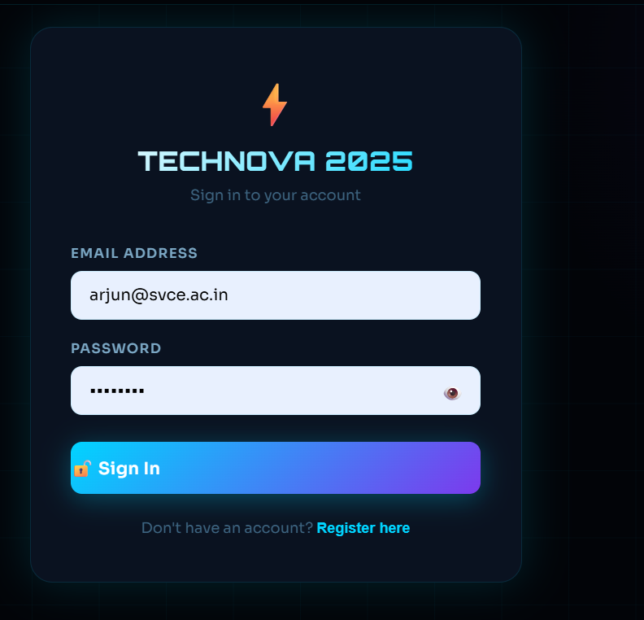
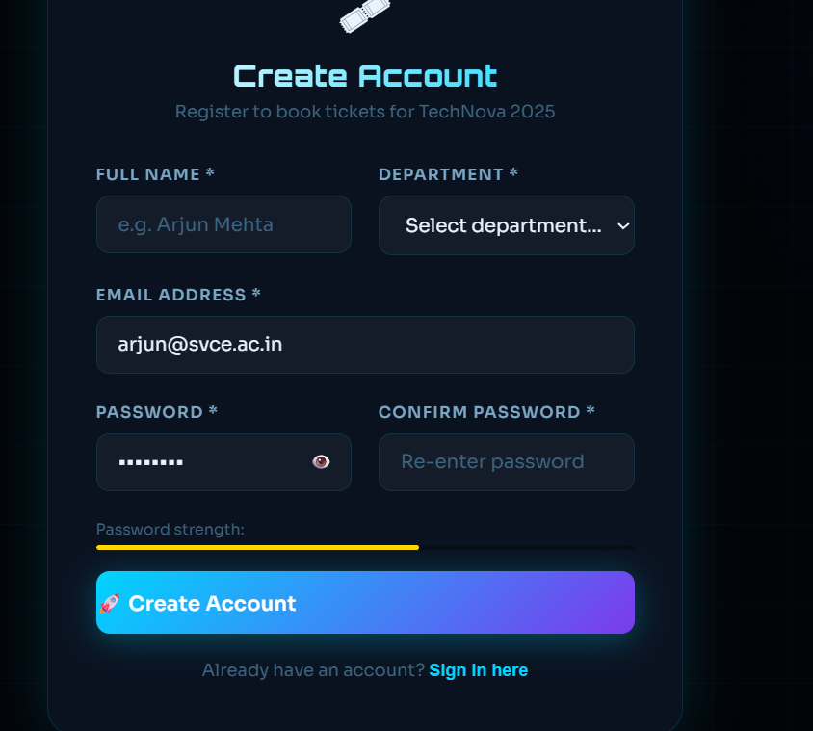
IMPLEMENTATION SCREENSHOTS
1
Login Page :
Allows registered students to enter their email and password to access the system.
The system verifies the credentials from the database for authentication.
After successful login, the user is redirected to the dashboard to select courses.
2
3
4
5
6
7
8
Register Page :
Enables new users to create an account by entering name, email, and password.
The system stores the user details securely in the database
After successful registration, the user can login and access Student.
9

Slide 11
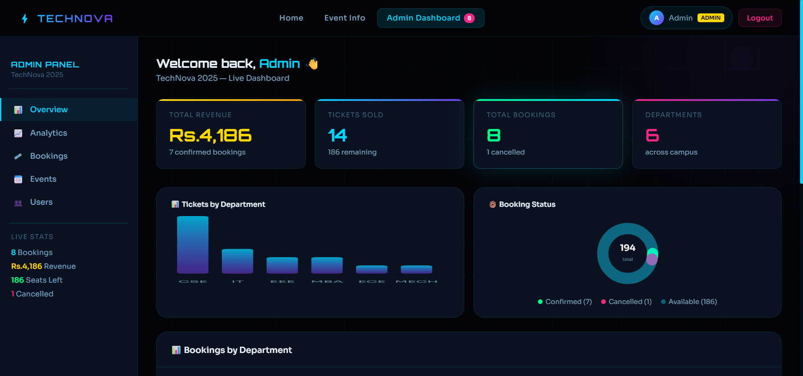
IMPLEMENTATION SCREENSHOTS
Admin Dashboard Page:
Dynamic Data Visualization: Utilizes clear visual charts—such as a bar chart for departmental ticket distribution and a donut chart for booking statuses—to make complex data easy to read at a glance.
Centralized Control Panel: Provides a dedicated administrative sidebar menu, giving organizers quick access to manage overall bookings, track analytics, and monitor live event stats from a single view.
1
2
3
4
5
6
7
8(A)
9

Slide 12
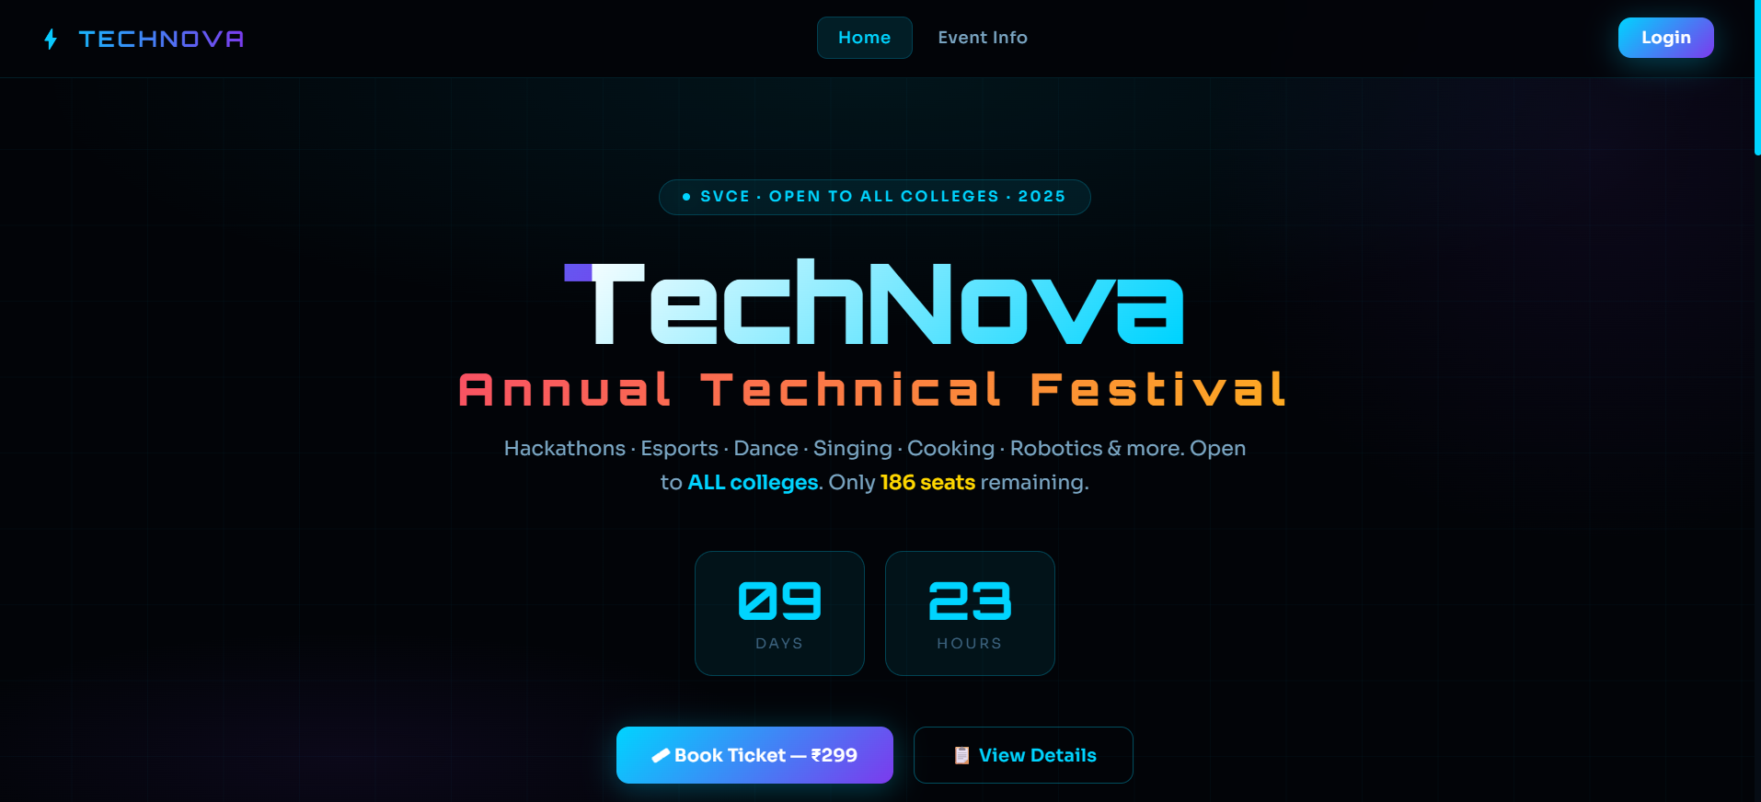
IMPLEMENTATION SCREENSHOTS
Dashboard Page:
1
Event Details: Clearly displays core information like the event name, activities, and ticket price.
Live State Tracking: Shows real-time available seats, driven by React's useState hook.
Interactive CTA: The "Book Ticket" button acts as the event handler to trigger the booking form via conditional rendering.
2
3
4
5
6
7
8(B)
9

Slide 13
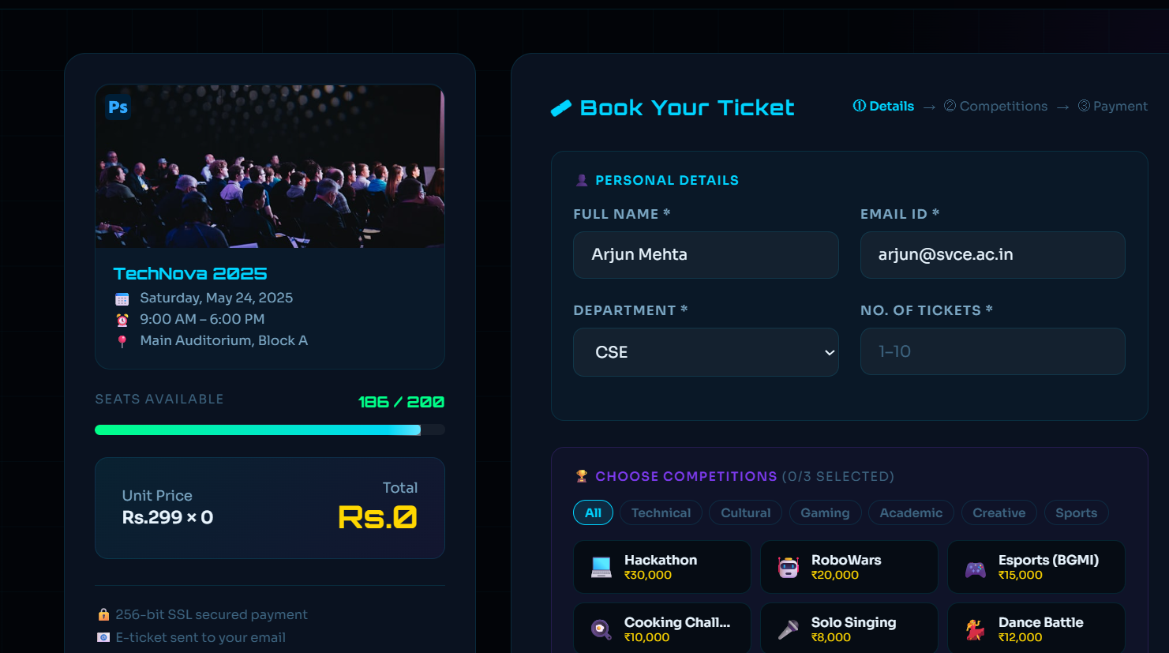
IMPLEMENTATION SCREENSHOTS
Book Ticket Dashboard Page:
1
Dynamic State Visuals: Features a real-time progress bar tracking seat capacity (186/200) and an instant price calculator that updates the total cost via React state.
Controlled Form Inputs: Captures all mandatory user data (Name, Email, Department, Ticket Quantity) required for strict client-side validation before submission.
2
3
4
5
6
7
8(C)
9

Slide 14
ADVANTAGES & LIMITATIONS
1
ADVANTAGES
Provides a digital ticketing platform that eliminates the need for manual, paper-based registration processes.
Instant client-side validation ensures users submit correct data without requiring administrative help or server round-trips.
Users can seamlessly view event details and book tickets instantly without slow page reloads, thanks to React's component-based architecture.
Dynamic state management automatically tracks and updates available tickets in real time, preventing overbooking.
2
3
4
5
6
LIMITATIONS
Currently does not support a persistent backend database, meaning available ticket counts reset upon refreshing the browser.
No payment gateway integration is available in the current implementation for processing actual financial transactions.
Requires a local Node.js development environment to run, making it not yet ready for live cloud deployment.
7
8
9

Slide 15
Thank you

