Slide 1
Passages analysis system

Slide 2
Navin Adhikary(Leader)
01
Team
02
Rajesh Pahari
Cui Su
03

Slide 3

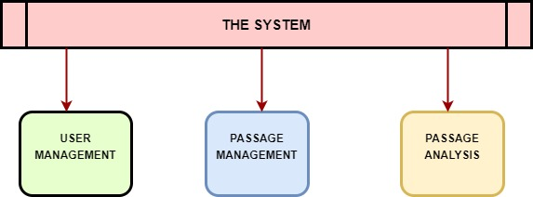
System Functions
Notes:
3

Slide 4
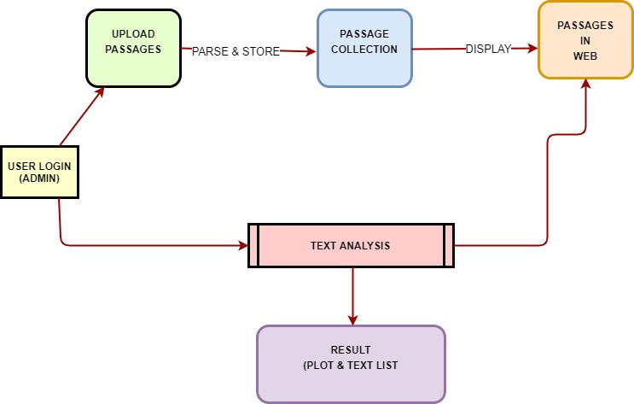
System Flow

Slide 5
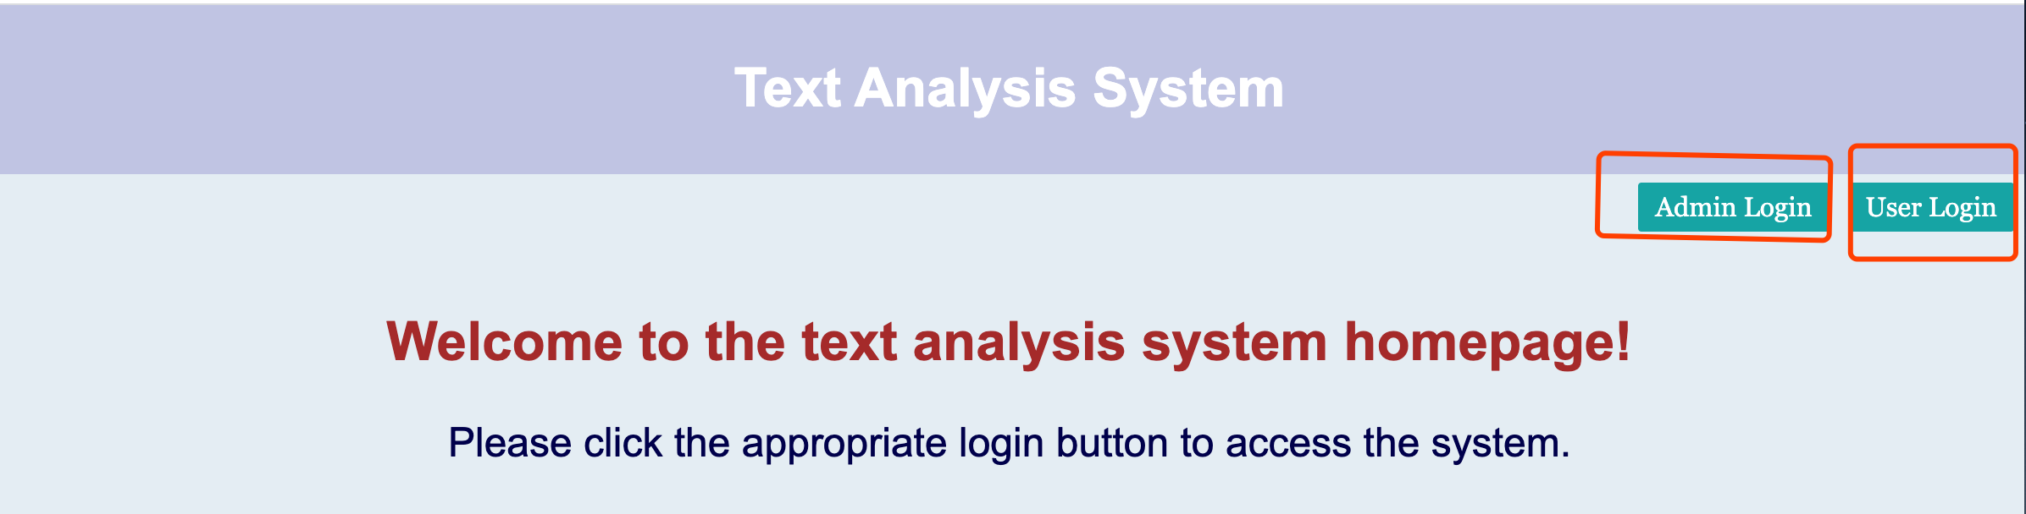


Part1: Users Management

Slide 6
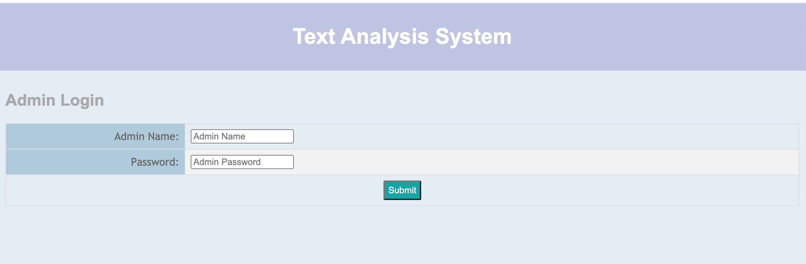
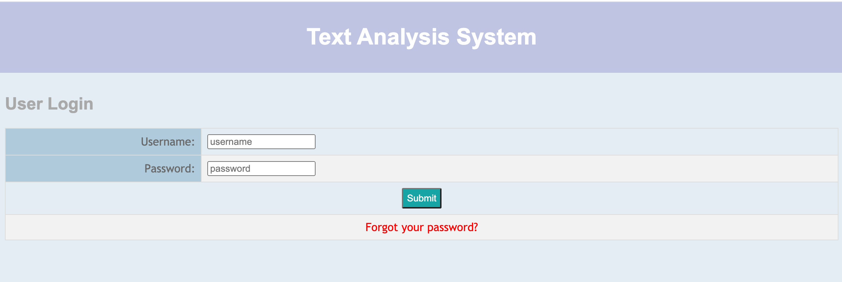
Admin Login and User Login

Slide 7
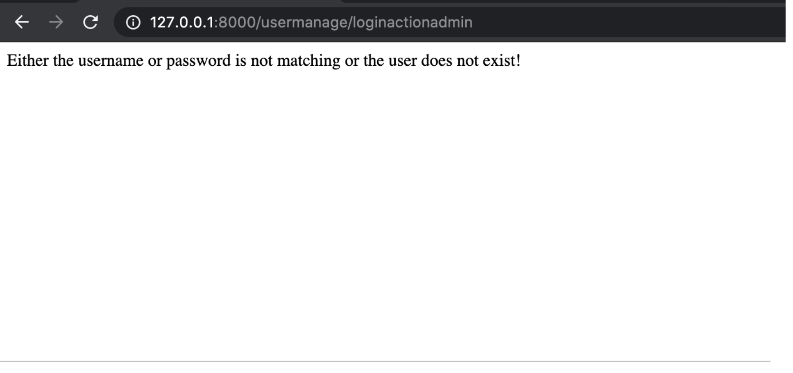
When you enter the wrong password

Slide 8
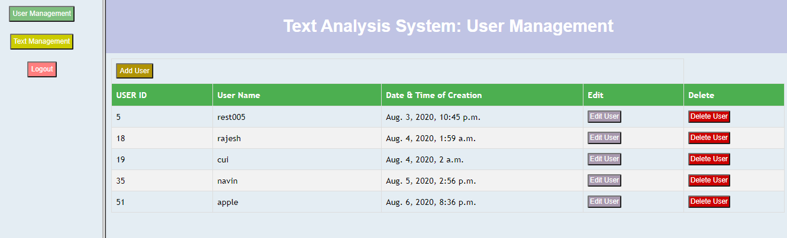
User Management Page

Slide 9
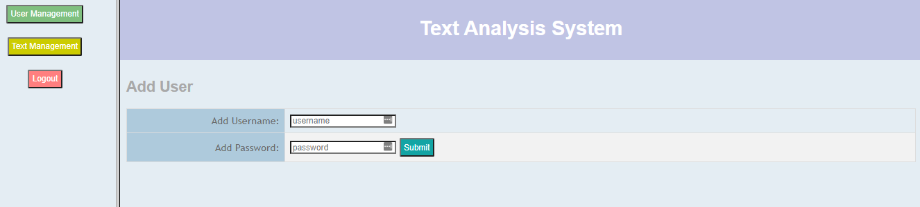
Add User

Slide 10
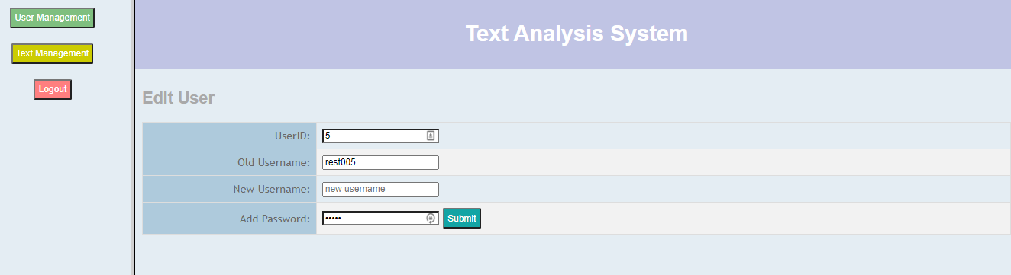
Edit User

Slide 11
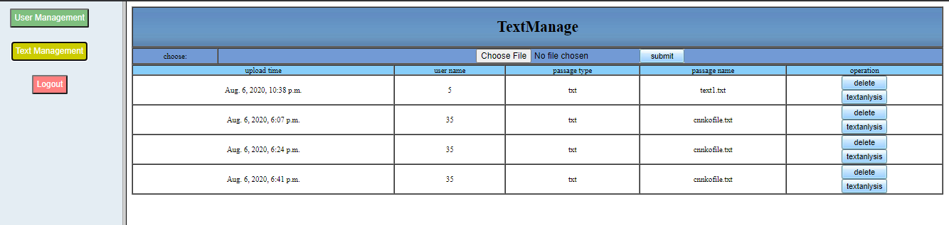
Part2: Passage Management

Slide 12
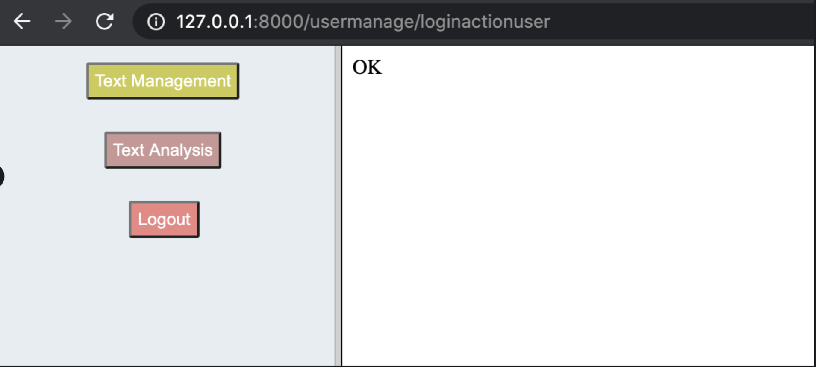
File upload successfully

Slide 13
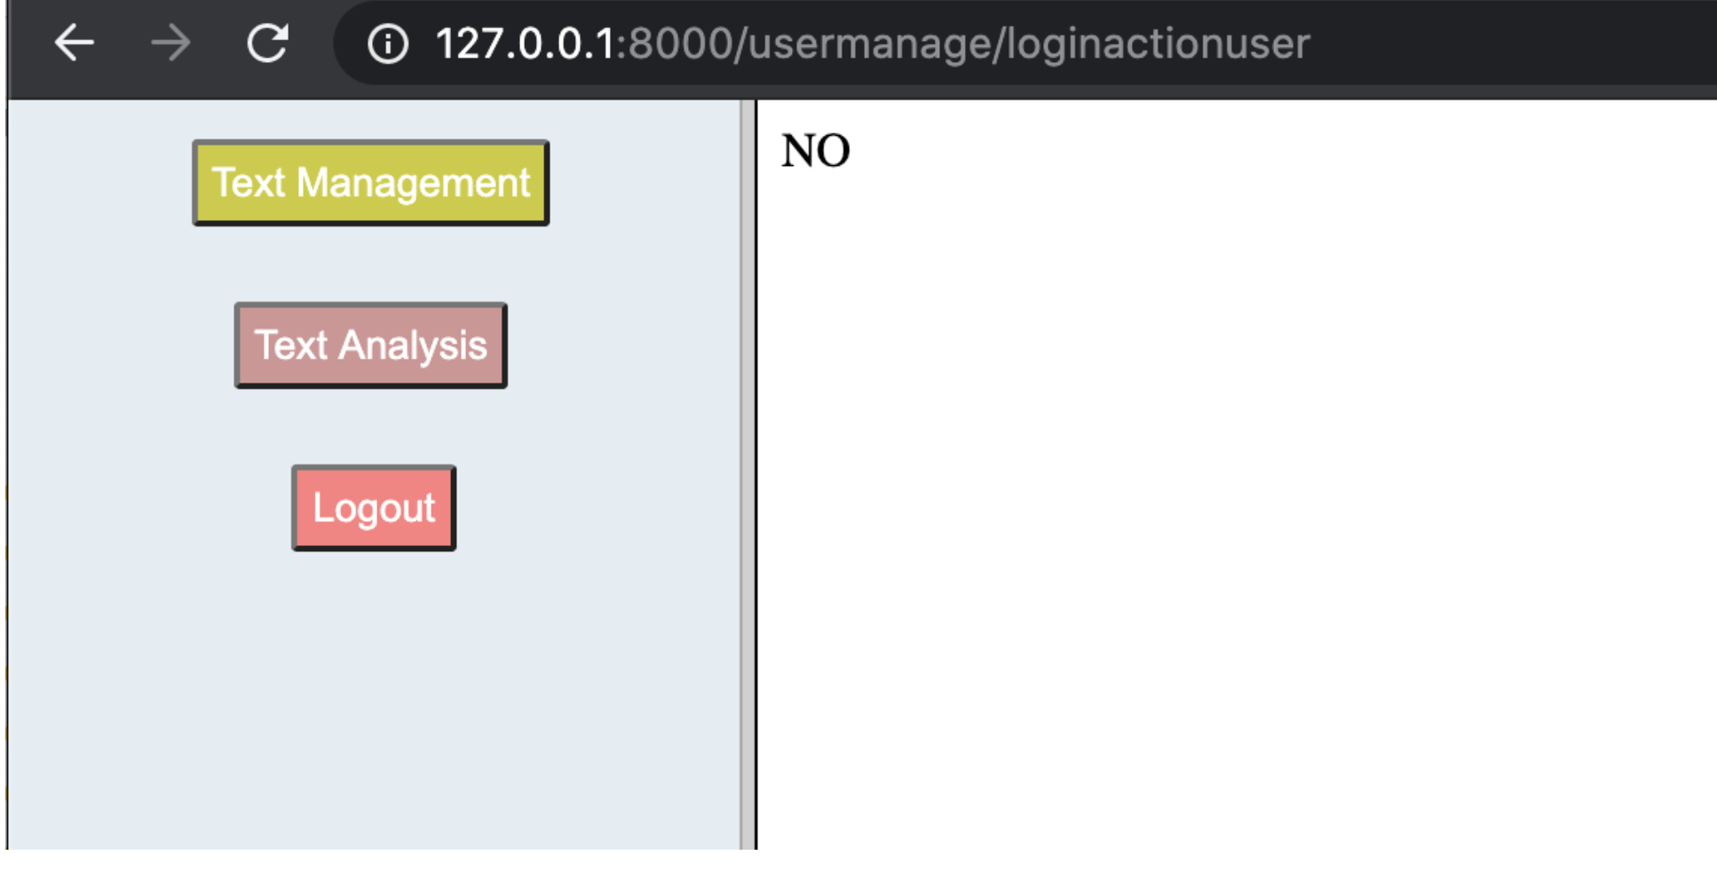
File upload failed

Slide 14
Part 3: Passage Analysis
• Utilizes Python nltk, numpy, datascience and pandas library.
• Displays the top 10 more frequent words and word counts in the bar diagram.
• Generates separate html file that shows the part of speech for the words.
• Csv file that consists of the words, frequency and part of speech can be downloaded via the download link.

Slide 15
Passage Analysis – Barh Diagram for top 10 frequent words
• Read File
• Tokenize the text in the file
• Remove numbers, punctuations, special characters from the tokens
• Lowercase all the tokens

Slide 16
• Remove Stopwords from the tokens
• Use nltk.FreqDist() on the array of tokens to find the words and frequency count, and save it to a datascience table
• Bar diagram of word frequency can be built based on the graph above

Slide 17
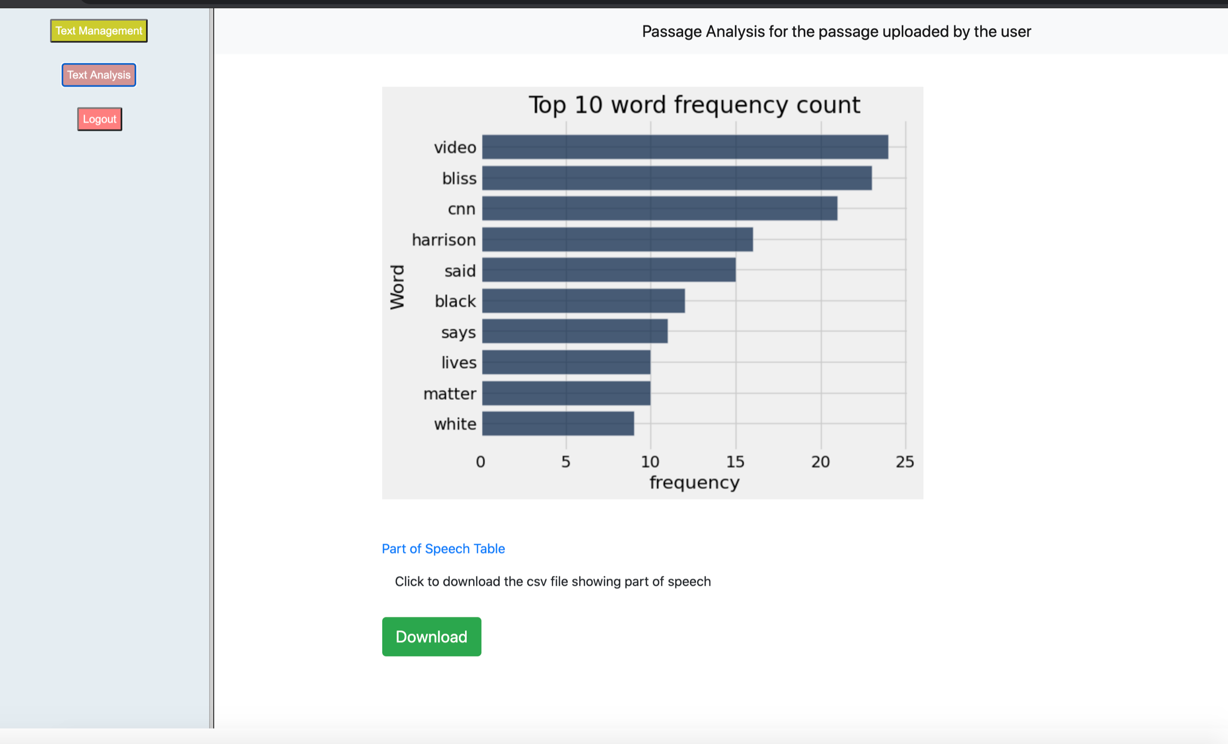
Passage Analysis-Word Frequency

Slide 18
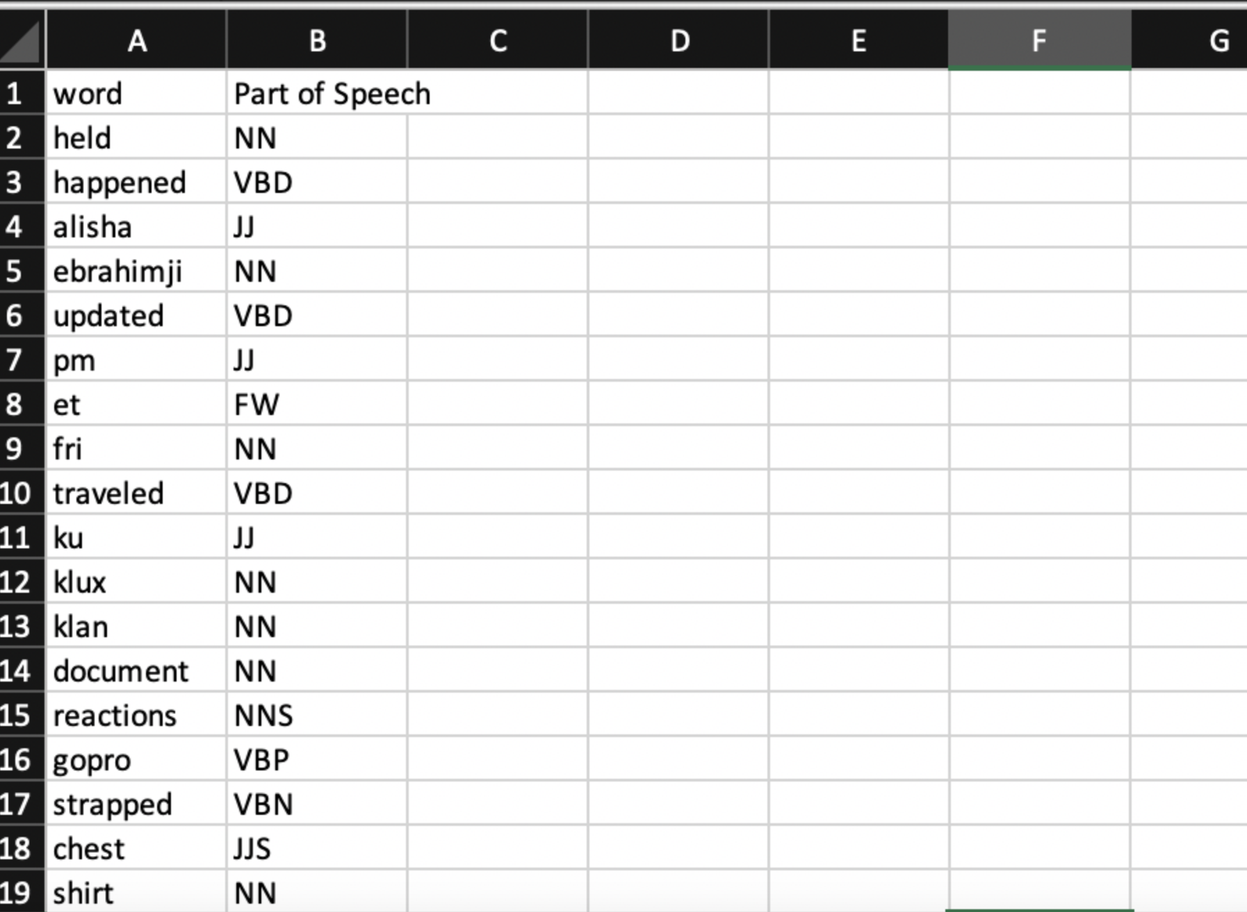
Passage Analysis: Part of Speech

Slide 19
Passage Analysis – Part of Speech Analysis
• Reuse the result generated after running nltk.FreqDist() in the previous process
• Take all the tokens and add them to a long sentence with words separated by the space and save it to the variable sentence
• Calculate the part of speech by applying nltk.pos_tag (nltk.word_tokenize(sentence))
• This result is to save into a separate html as well as csv file

