Slide 1
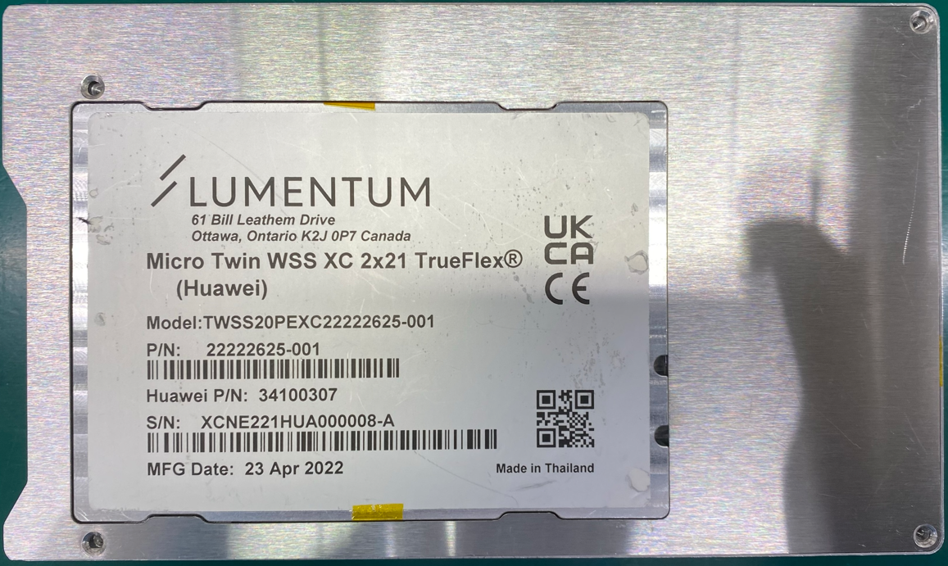
1

Slide 2
2
1

Slide 3
3
2
1

Slide 4
4
3
2
1

Slide 5
4
3
2
1

Slide 6
TorqueCheck
Power on Hios(torque measure equipment)
Open smartScrew tip

