Slide 1

Power BI Driven Exhaustive Analysis of the Indian Agriculture Sector

Slide 2

Student Name :Naval
Student ID :STU65a90ea4e4e011705578148
College Name :M.L.V Textile & Engineering College, Bhilwara

Slide 3
CAPSTONE PROJECT SHOWCASE
Project Title : Analysis of the Indian Agriculture Sector
Abstract | Problem Statement | Project Overview | Proposed Solution | Technology Used | Modelling & Results | Conclusion | Q&A

Slide 4
Abstract
The Indian agriculture sector plays a vital role in the nation’s economy, providing livelihoods to millions and contributing significantly to GDP. This project leverages Power BI to conduct an exhaustive analysis of the Indian agriculture sector, presenting actionable insights through dynamic visualizations and comprehensive data models.
The analysis integrates multi-dimensional datasets encompassing crop production, climatic conditions, soil health, irrigation patterns, and market trends. Power BI's advanced capabilities enable in-depth exploration of key metrics such as crop yields, region-wise performance, and agricultural exports. By identifying trends, anomalies, and correlations, this project highlights critical areas for improvement, optimizes resource allocation, and supports data-driven decision-making.

Slide 5
Problem Statement
Develop an interactive Power BI dashboard to provide a comprehensive analysis of the Indian agriculture sector, leveraging 19 years of historical data from 33 states, 646 districts, and across five seasons for 122 unique crops

Slide 6
Project Overview
This project presents a comprehensive analysis of the Indian agriculture sector using Power BI. By leveraging 19 years of historical data from 33 states, 646 districts, and across five seasons for 122 unique crops, the project aims to uncover valuable insights and trends. Key findings include the dominance of coconut as the most produced crop, Kerala's leadership in total production, and the seasonal variations in crop yields. The analysis also highlights regional disparities and the potential for growth through diversification and improved agricultural practices

Slide 7
Proposed Solution
Leverage Power BI to integrate and analyze agriculture data, creating interactive dashboards for crop performance, soil health, irrigation, and market trends. Provide real-time insights and predictions to support data-driven decisions for sustainable growth and productivity.

Slide 8
Technology Used
Power BI refers to a business intelligence (BI) platform developed by Microsoft. It allows users to connect to various data sources, analyze it, create interactive visualizations, and share their findings with others. Power BI offers both a desktop application for detailed analysis and a cloud-based service for sharing and collaboration.
In this Project Space Mission data source is of CSV type. After Importing the data into Power BI, we will write DAX which is useful for the analysis of the data, and sorting of various columns will be done. Visualization will be implemented and formatted. Finally, the functionality of the project will be tested and submitted.

Slide 9
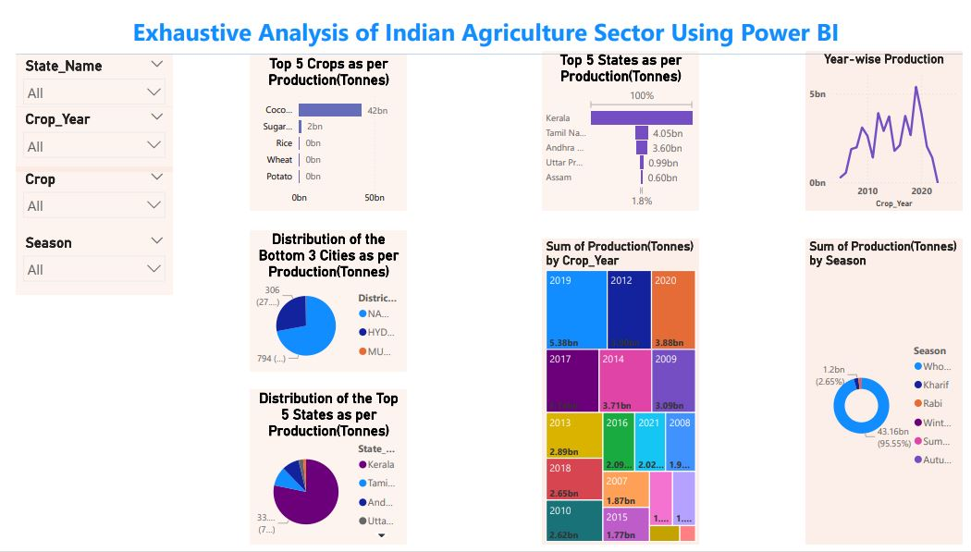
Modelling & Results

Slide 10
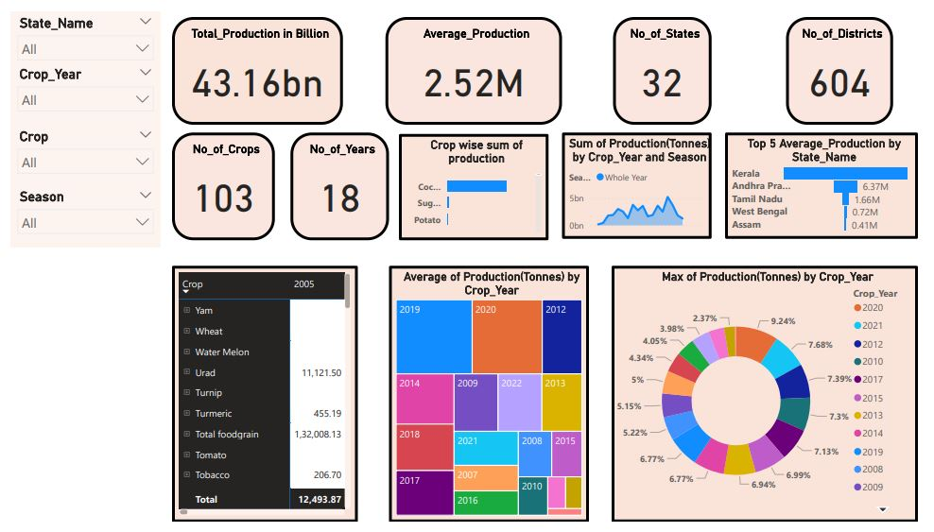

Slide 11
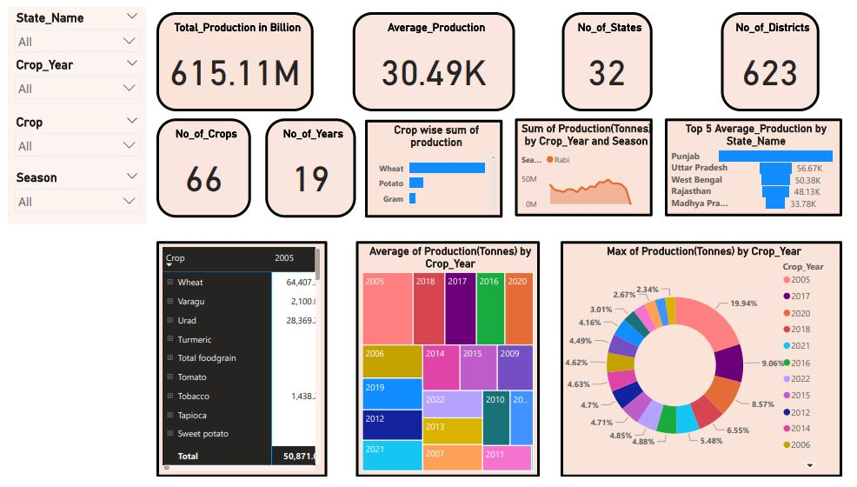

Slide 12
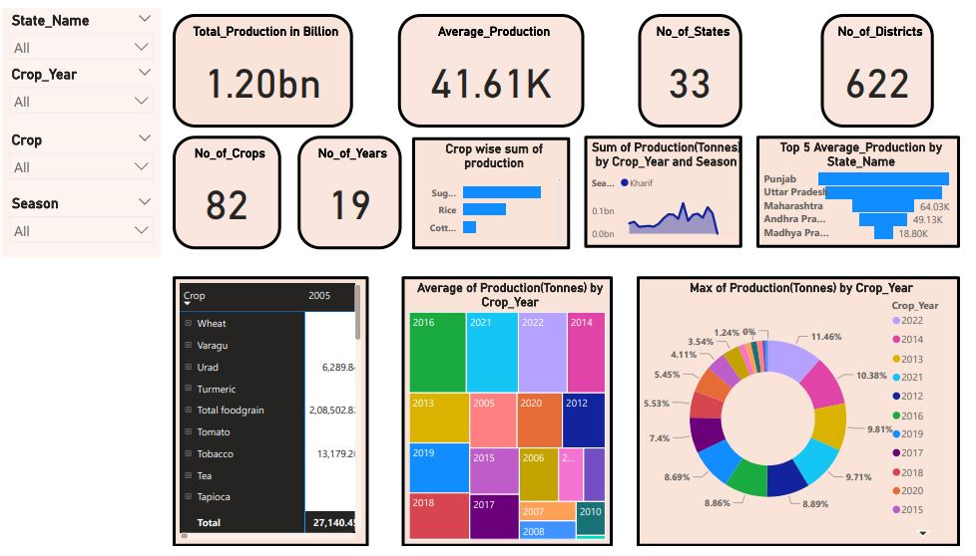

Slide 13
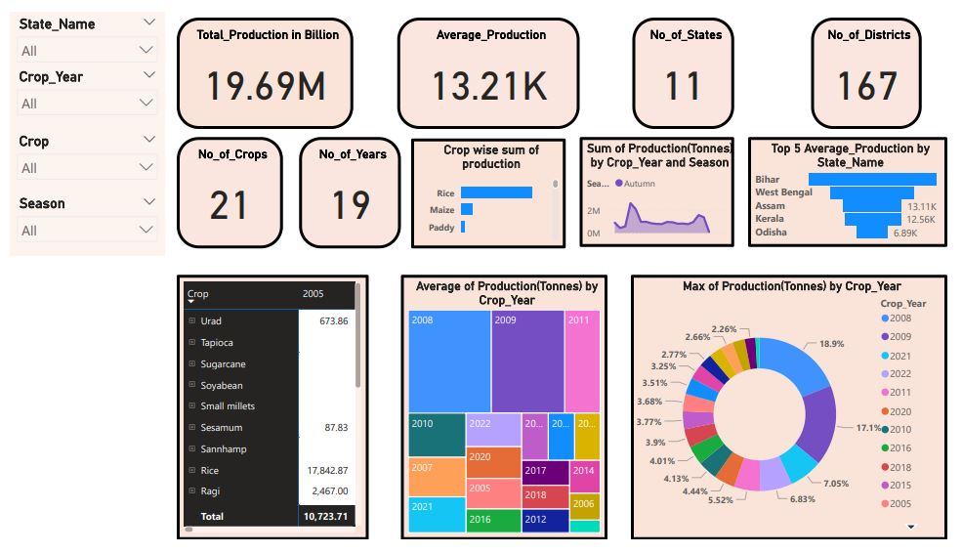

Slide 14
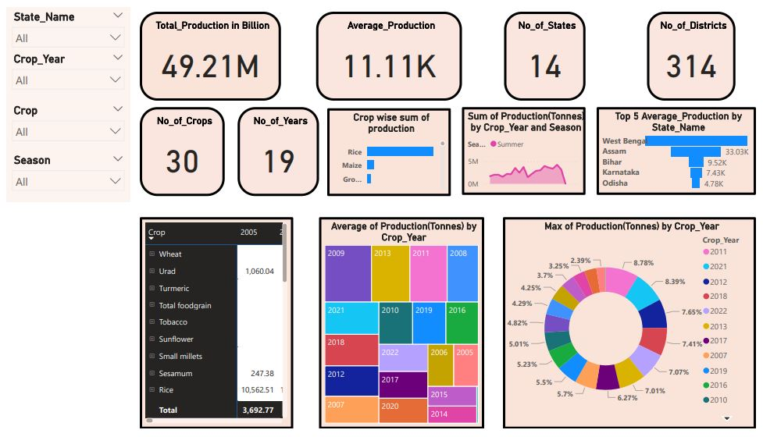

Slide 15
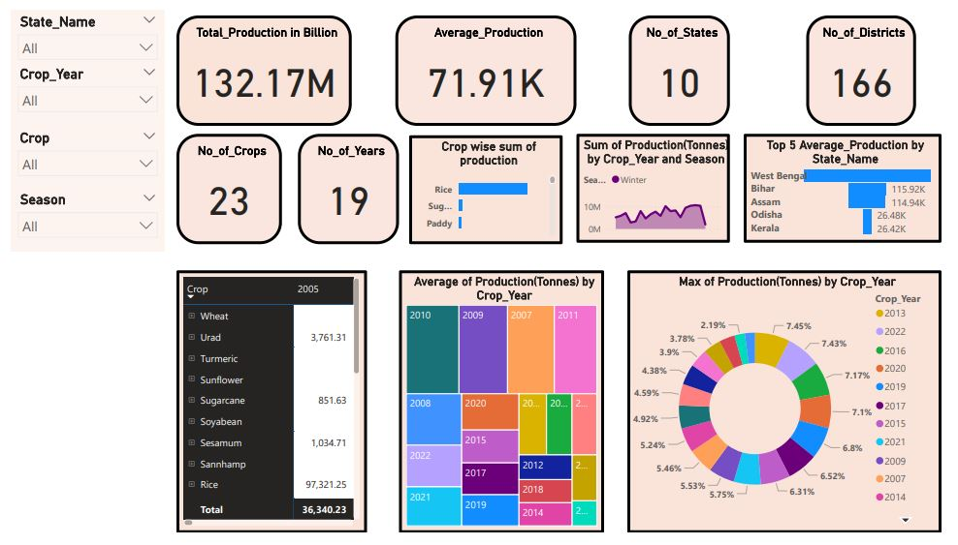

Slide 16


Slide 17
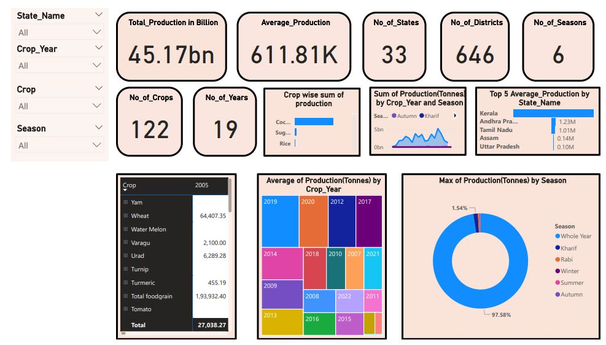

Slide 18
Conclusion
The Power BI-driven analysis of the Indian agriculture sector provides valuable insights into the trends, patterns, and challenges faced by the industry. By leveraging 19 years of historical data, the project has successfully identified key crops, regions, and seasons that contribute significantly to the overall production. The analysis has also revealed regional disparities, the impact of climate factors, and the potential for growth through diversification and improved agricultural practices.
The interactive dashboard developed in Power BI empowers users to explore and visualize the data in a user-friendly manner, enabling informed decision-making and policy development. The findings from this analysis can be utilized by policymakers, researchers, and agricultural stakeholders to address the challenges faced by the sector and promote sustainable and equitable agricultural development in India.

Slide 19
Thank You!
Notes:
Thank You !!

