Slide 1

Weekly Circular

Slide 2
PROJECT TEAM
Product Owner: Naval Kaur
Scrum Master: Erald Velmisi
Developers:
      Mounika Basetty
      Gautami Chaluvadi

Slide 3
PROJECT DESCRIPTION
Application: Weekly Circular
Description: This is an application which allows you to search for deals in the various grocery stores near you and get recipes of different cuisines,courses.
Targeted Users : Anyone who loves to cook or save money or maybe both!

Slide 4
ISSUES COVERED
User Registration
PostgreSQL integration
Create Database schema for the application.
Scraping deals from stores
Yummly API Integration to get recipe details
Displaying deals of various products for a store in different locations.

Slide 5
DATABASE SCHEMA
User
User Profile
Store
Store Location
Products
Recipe

Slide 6
CONTRIBUTION

Slide 7
NAVAL KAUR
Role: Product Owner
Tasks:
  Worked on creating data models for the project
  Worked on scrapping data using Selenium and Scrappy
  Managed content on the frontend pages of the website
  Worked on the CSS of the website
  Acceptance and Integration testing for the project

Slide 8
ERALD VELMISI
Role: Scrum Master
  As the Scrum master, my responsibility to make sure that code submitted by the team member was correct and did not break the app.
  Also i did put the project only on heroku and made sure that the all the different apps integrated correctly
Tasks:
  Set up the initial Django project and created the templates for the different pages.
  Research/Integration of Django Registration and implementing the standard templates for registration log-in
  Models for the main circular app.
  Creating the user profile by extending the standard Django User module. (django app models views html templates)
  Research for the scraper tool / implementation of the spiders and integration with Django.
  Template page for Stores/Store location/products and the
  Unit testing utility function from the scraper

Slide 9
GAUTAMI CHALUVADI
Role: Developer
Tasks:
  Initially worked on User sign in feature.
  Password Reset and Password Forget Feature
  Displaying deals and its products using JQuery
  Implementing Yummly API and the html page form for the API using ajax function.
  Unit testing for User Registration
  CSS for the home page and recipes page.

Slide 10
MOUNIKA BASETTY
Role: Developer
Tasks:
  Worked on developing basic python code to get recipes from yummly API.
  Worked on creating model for recipe.
  Worked on home page.
  Worked on creating models for storing User Preferences.
  Worked on User Preference Page.
  Worked on improving pylint score.

Slide 11
PROJECT STATISTICS

Slide 12
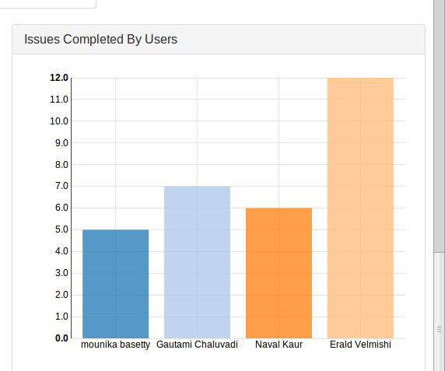
ISSUE COVERAGE

Slide 13
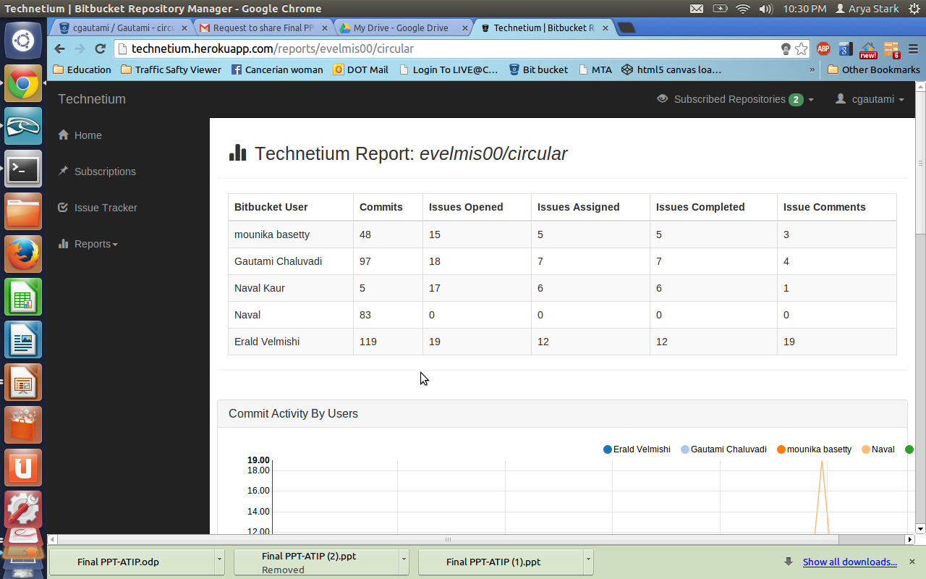
COMMITS

Slide 14
TEST
Acceptance, Integration and Unit testing
Tests to ensure valid information is provided by the users at registration and login time
Tests to obtain the screenshots and html source file of all webpages, for further evaluation
Tests to ensure that all he pages are up and running and their titles are valid
Tests to input valid entries in the recipe page to obtain recipes

Slide 15
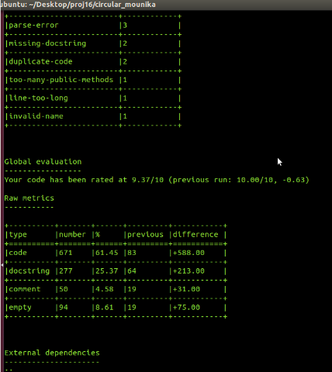
PYLINT SCORE
Pylint score: 9.37/10.00

Slide 16
DEMO
SHOW TIME!

