Slide 1
FRACTALS
By : Naval Kaur

Slide 2
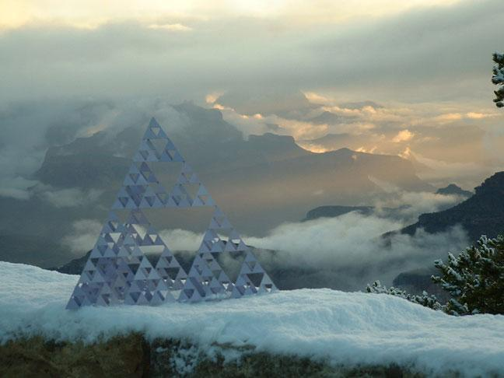
Fractals in Nature
“Clouds are not spheres, mountains are not cones, coastlines are not circles, and bark is not smooth, nor does lightning travel in a straight line."
-- Benoit Mandelbrot

Slide 3
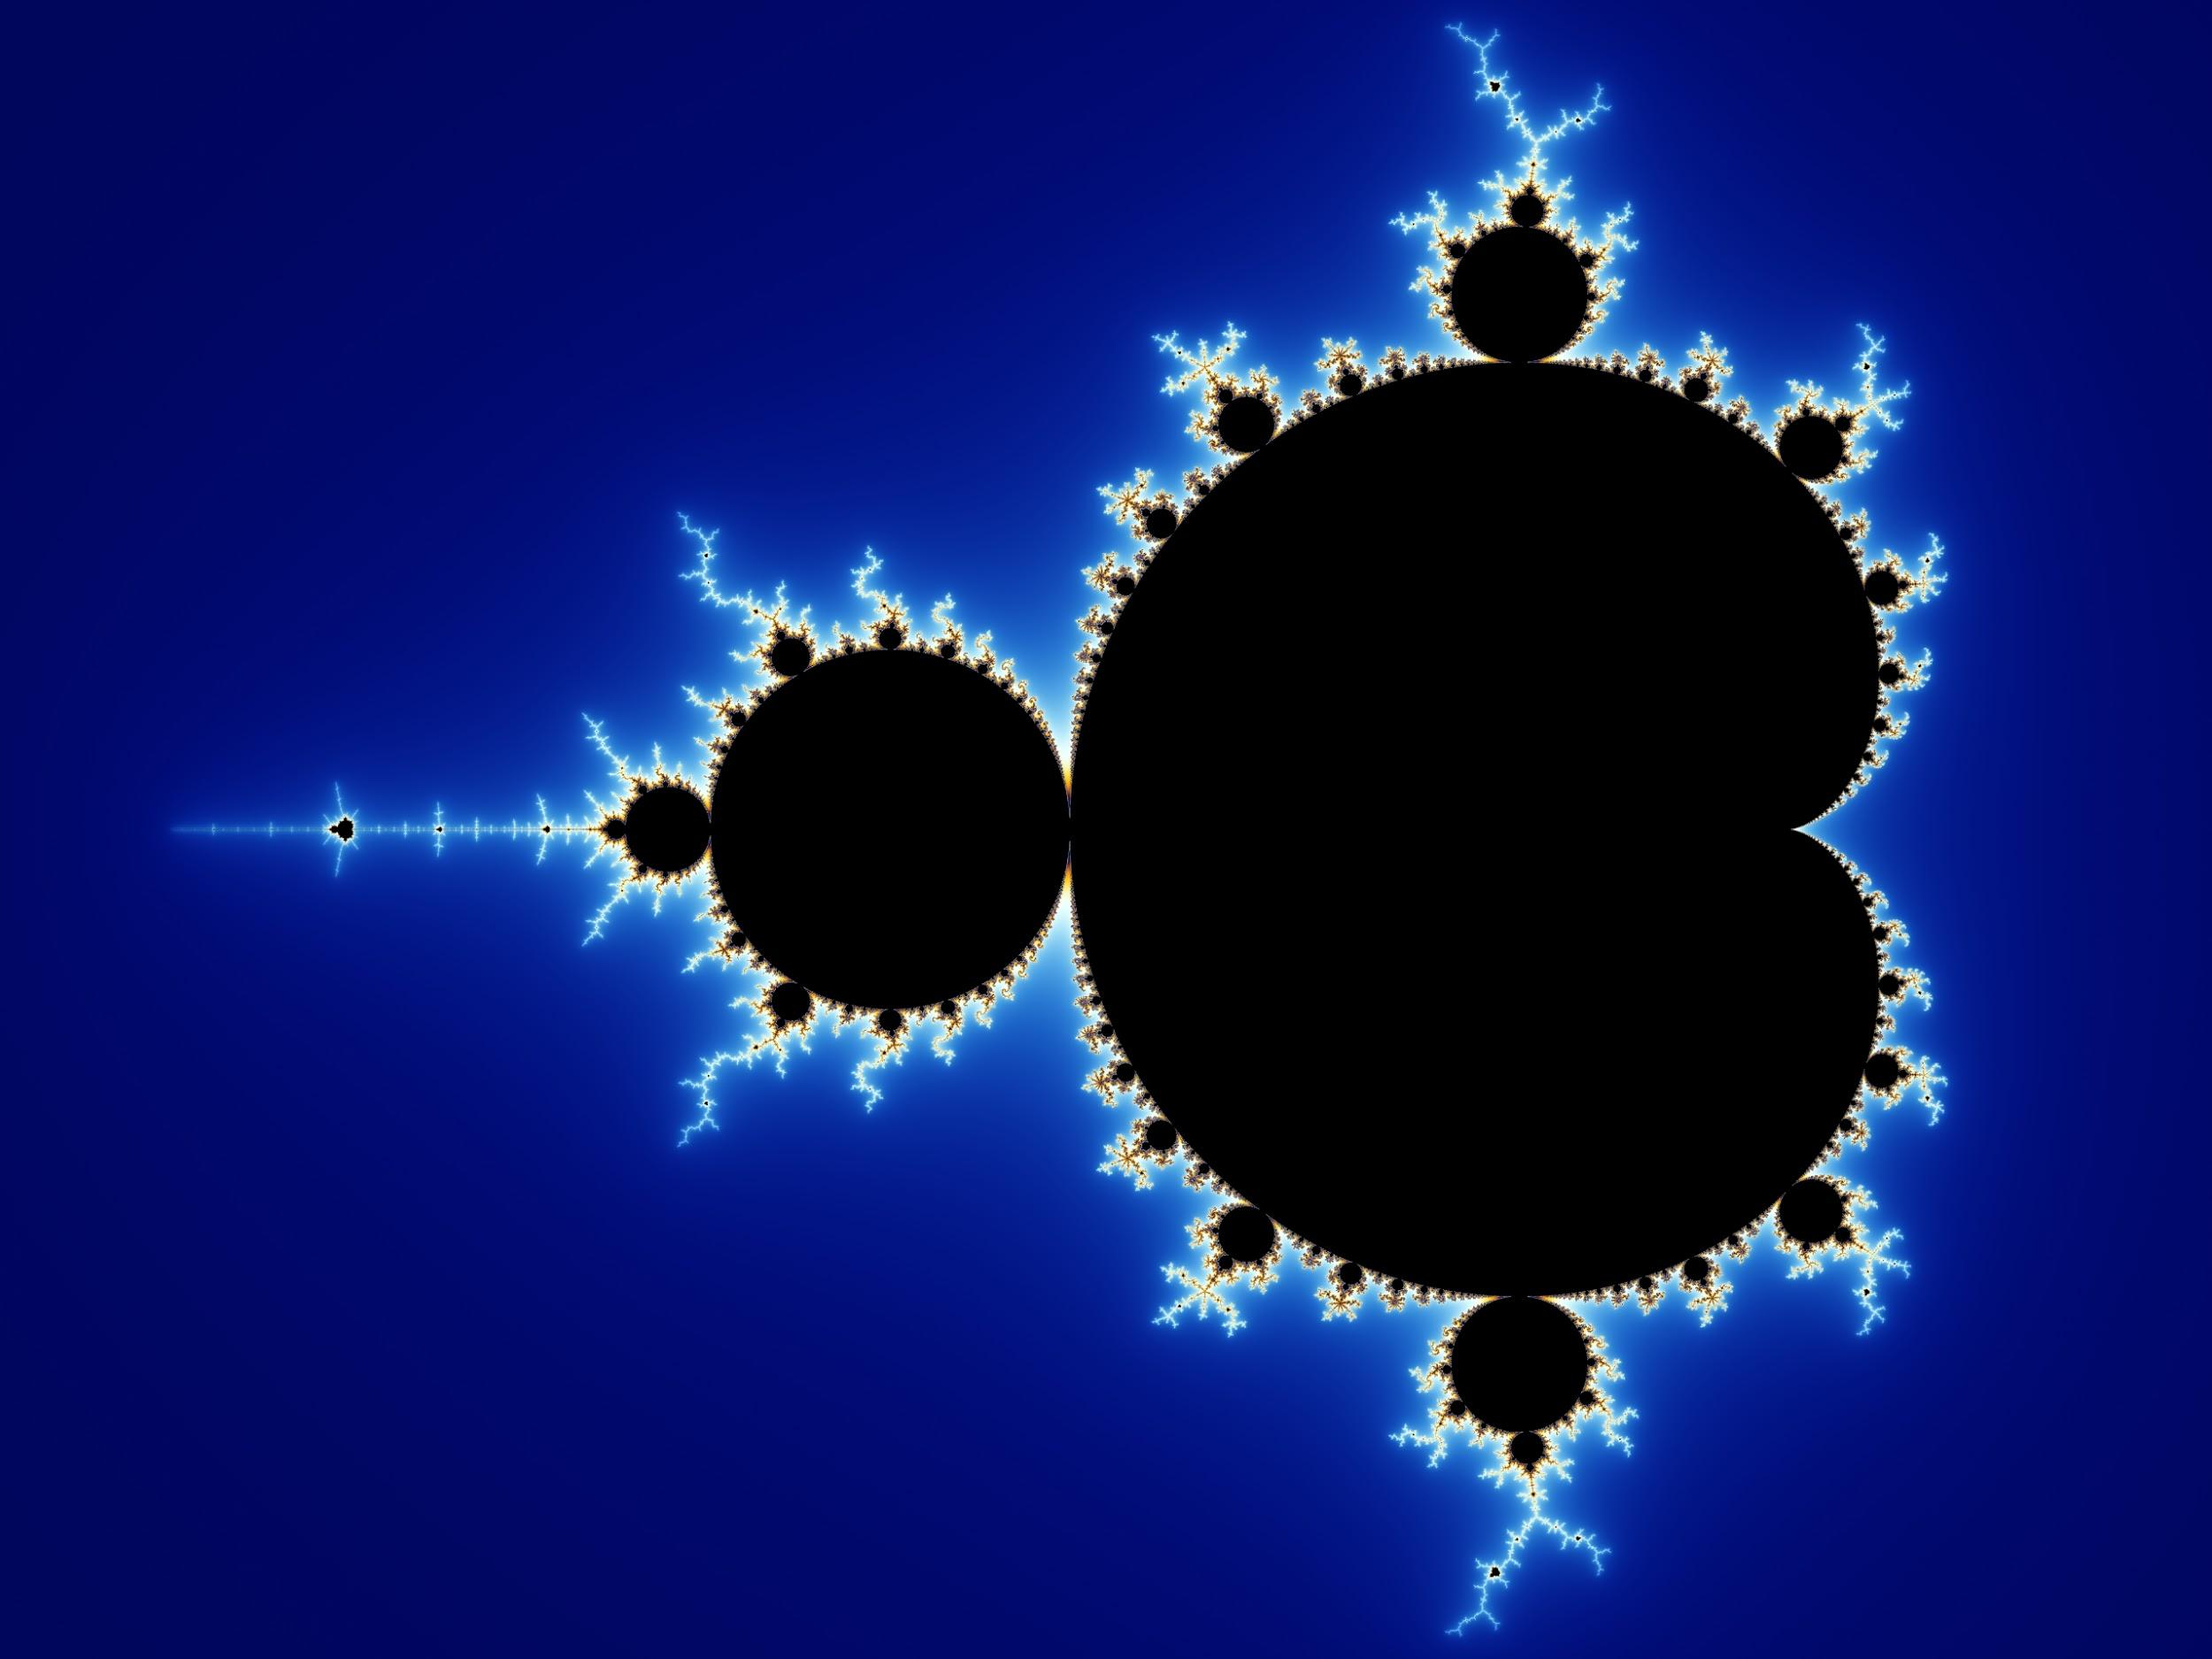
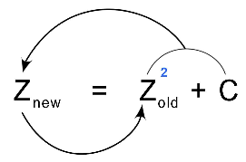
HISTORY
The term Fractal was coined by Benoit Mandelbrot in 1975.
It’s derived from a Latin word “Fractua” which means irregular

Slide 4
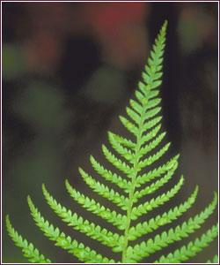
What are Fractals?
It is defined to be a geometric figure that repeats itself under several levels of magnification, a shape that appears irregular at all scales of length, e.g. a fern

Slide 5
CHARACTERISTICS OF FRACTALS
It has a fine structure at arbitrarily small scales.
It is too irregular to be easily described in traditional Euclidean geometric language.
They are recursive; that is, the process of their creation gets repeated indefinitely
They are self-similar; that is, copies of the entire fractal may be found, in reduced form, within the fractal.

Slide 6
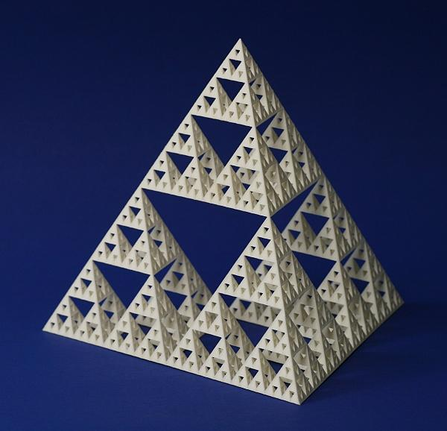
Self - Similarity
Fractals are a never ending pattern that repeats itself at different scales. This property is called self similarity.

Slide 7
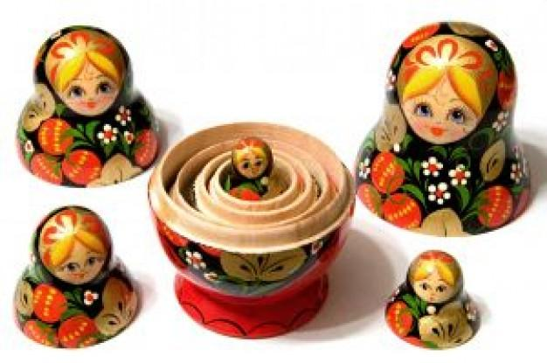
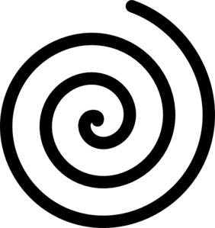
Self - Similarity
Not all self-similarity, however is of a fractal nature. Objects like spirals and nested dolls that are self-similar around a single point are NOT fractal

Slide 8
Types of Fractals
In the broadest sense, fractals can be divided into two categories:
Natural Fractals
Mathematical Fractals

Slide 9
Natural Fractals
Natural fractals include branching patterns like trees, river networks, lightning bolts, blood vessels etc and spiral patterns like seashell, hurricanes and galaxies.
Natural objects exhibit scaling symmetry, but only over a limited range of scale.
They also tend to be “roughly” self-similar, appearing more or less the same at different scales of measurement.

Slide 10
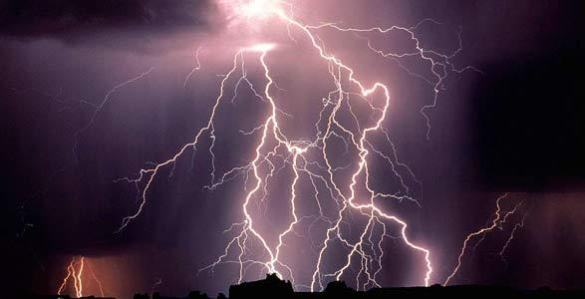
LIGHTNING

Slide 11
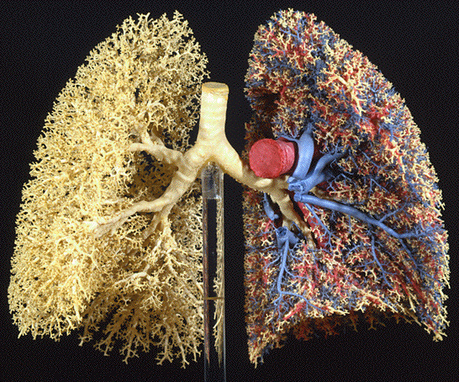
LUNGS

Slide 12
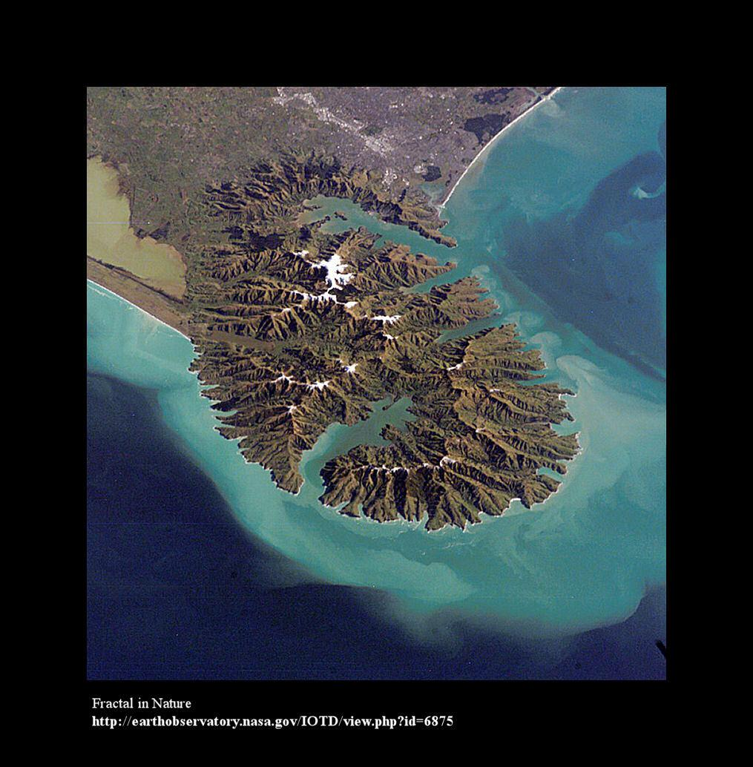
COAST LINE

Slide 13
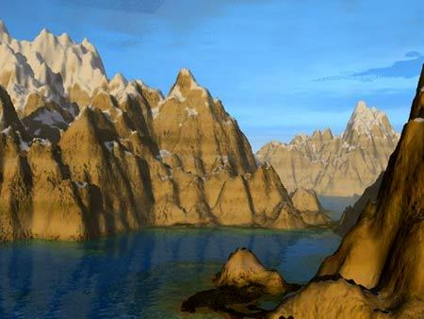
MOUNTAINS

Slide 14
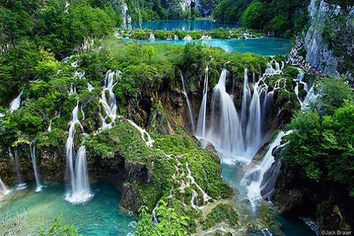
WATERFALL

Slide 15
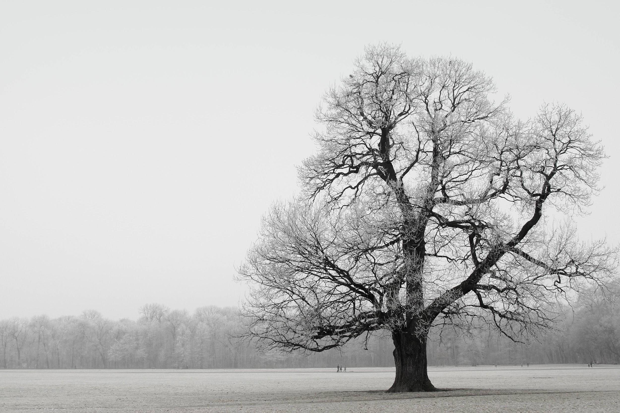
TREES

Slide 16
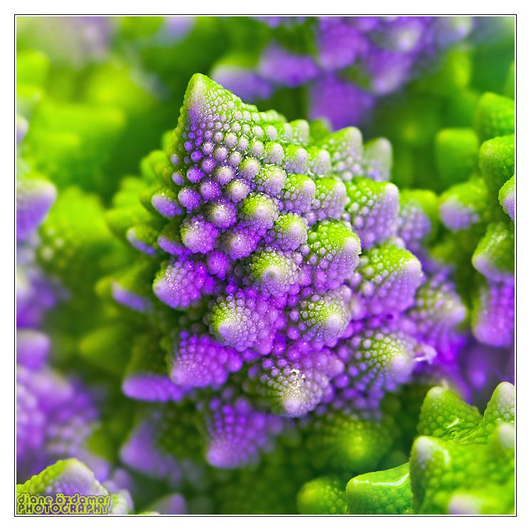
BROCCOLI

Slide 17
Mathematical Fractals
Mathematical fractals like the Mandelbrot Set, are formed by calculating a simple equation thousands of times, feeding the answer back in to the start.
In contrast to naturally occurring fractals, mathematical fractals can possess an infinite range of scaling symmetry.
They also tend to be exactly self similar.
The fractals are infinitely complex, meaning we can zoom in forever.

Slide 18
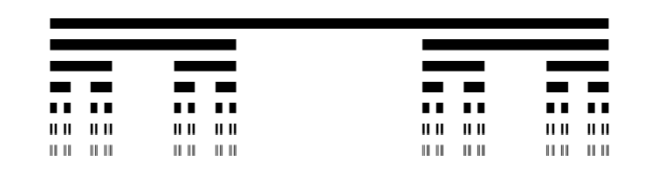
CANTOR SET

Slide 19
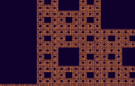
MENGER SPONGE

Slide 20
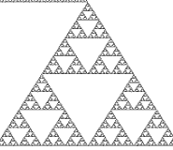
SIERPINKI TRIANGLE

Slide 21
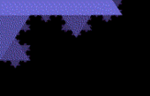
A zoom out of the Koch Snowflake

Slide 22
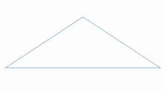
A fractal that models the surface of a mountain

Slide 23
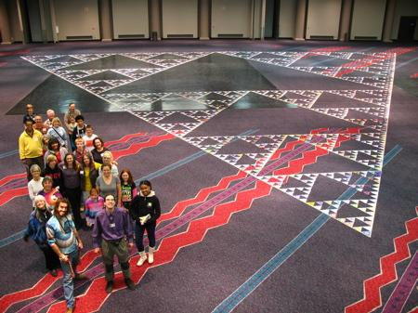
World’s Largest Fractal Triangle

Slide 24
APPLICATIONS

Slide 25
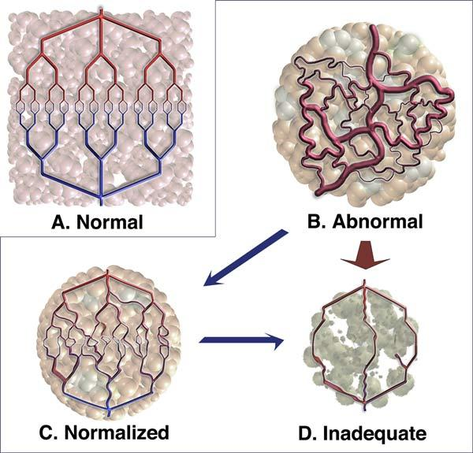
MEDICINE
Researchers are using Fractal analysis to assess the health of blood vessels in cancerous tumors. Fractal analysis of CT scans can also quantify the health of lungs suffering from emphysema or other pulmonary illnesses

Slide 26
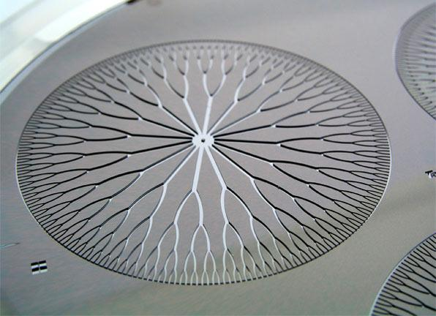
ENGINEERING
Engineers have developed a fractal pattern that can be etched into a silicon chip to allow a cooling fluid (such as liquid nitrogen) to uniformly flow across the surface of the chip and keep it cool.

Slide 27
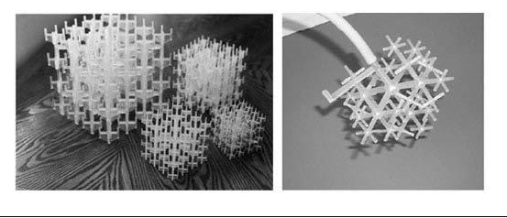
INDUSTRIES
Space-filling fractal devices have been created for high precision fluid mixing. Used in many industries, these devices allow fluids to be carefully and precisely blended without the need of turbulent stirring.

Slide 28
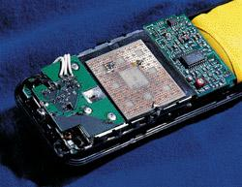
TELECOMMUNICATIONS
Fractal antennas are making their way into cellphones and other devices. Because of their fractal shapes, these antennas can be very compact while receiving radio signals across a range of frequencies.

Slide 29
OTHER APPLICATIONS
fractal techniques are used for data analysis
image compression and decompression
used in Film Industry - to create visual effects.
to design video games
used in finance to make predictions as to the risk involved for particular stocks

