Slide 1
WebHooks

Slide 2
Meaning
Pattern for enabling user-defined callbacks in web applications.

Slide 3
WebHooks History
The name is new, the technology isn't.
Coined by Jeff Lindsay in 2007, the pattern became popular from then on

Slide 4
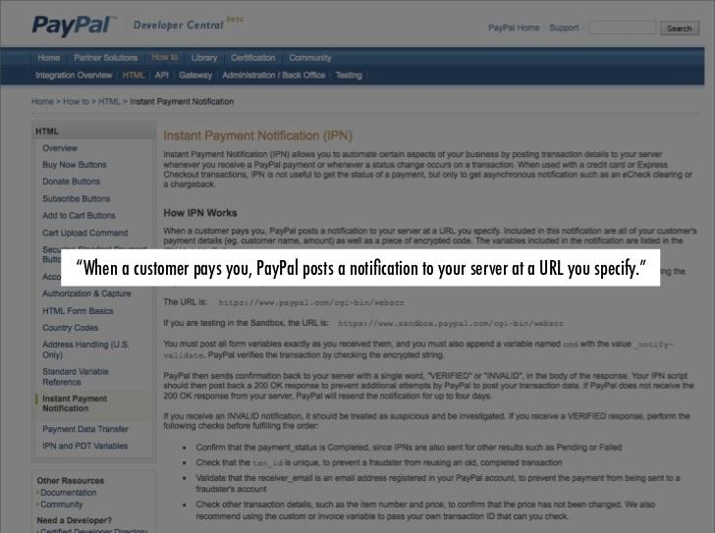

Slide 5
To WebHooks
When something happens, perform
HTTP POST with relevant data to a url
the user gives you

Slide 6
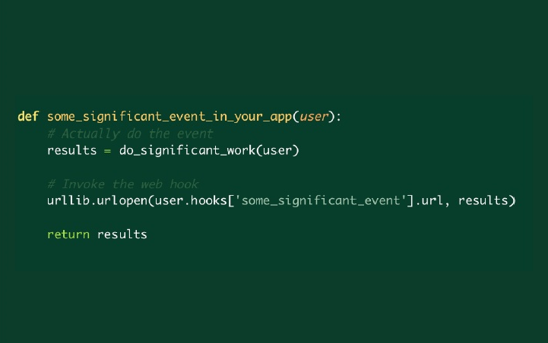
When something happens, perform
HTTP POST will relevant data from URL
that the user gives you

Slide 7
How does it make things better?
It is replacing polling and it should.
Let's understand polling...

Slide 8
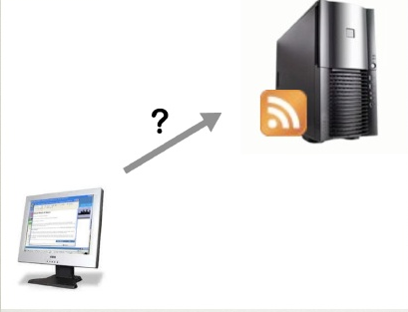
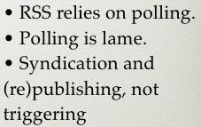

Slide 9
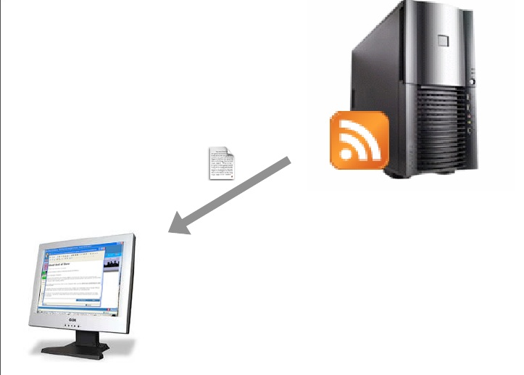

Slide 10
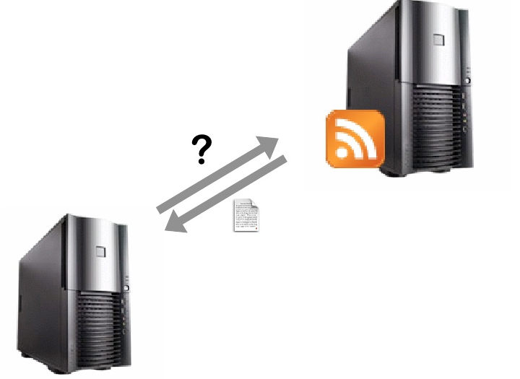

Slide 11
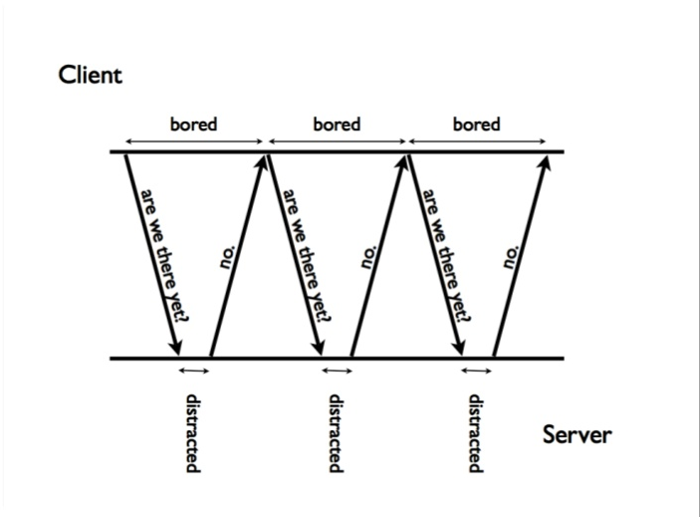

Slide 12
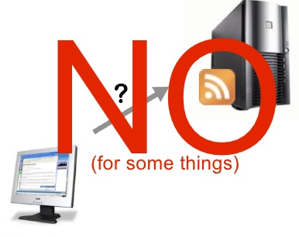
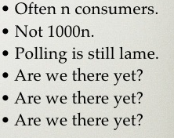

Slide 13
Push: data in real time
Instead,
Register a Webhook
and get data at your doorsteps as soon as it exists

Slide 14
Pipes: receiving data and passing it on
Output of Webhook can be combined with the input of an API.
This gives the user tremendous power.

Slide 15
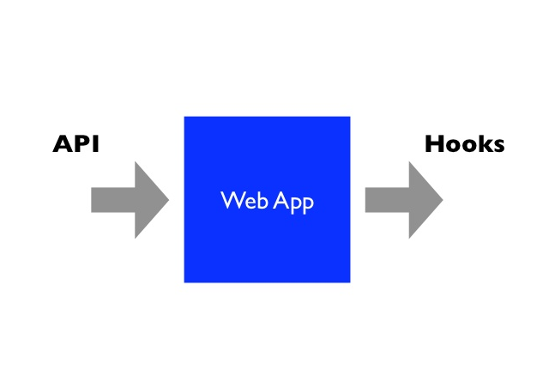

Slide 16
Why HTTP?

Slide 17
HTTP is the easiest
way to trigger code

Slide 18
Characteristics
Event-driven
User Callbacks
Triggers
Lightweight
Post to a URL

Slide 19
Event-driven programming
Writing event handlers
Event driven Web

Slide 20
