Slide 1
PhoneGap

Slide 2
What is it?
Mobile web development framework
Based on HTML5, CSS3 and JavaScript
Open Source: Apache 2.0 License
Supported platforms: Android, IOS, Windows phone, Blackberry, Symbian, webOS and Bada

Slide 3
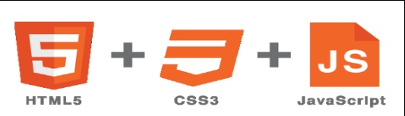
PhoneGap

Slide 4
PhoneGap History
Developed by Nitobi
Bought by Adobe in 2011

Slide 5
PhoneGap API Overview
Common Plugins: Good support across platforms
Accerometer
Capture
Camera
Compass
Contacts
Connection
Device and much more!!

Slide 6
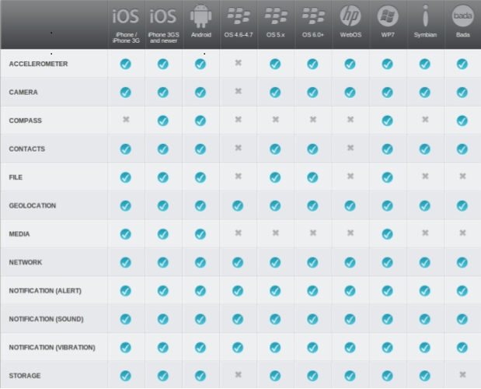

Slide 7
Development Environment
IDE tools:
Eclipse, Xcode, Visual Studio, Dreamweaver etc.
Software Tools
iOS Development: iOS SDK
Android: Android SDK, ADT plugin
Blackberry: Sun SDK, Apache ANT
Symbian: SDK..

Slide 8
How does it work?
Build your app once with web-standards
Based on HTML5
Wrap it up with PhoneGap
Using the free open source framework or PhoneGap build
You can access the native APIs
Deploy to multiple platforms
Standards-based web technologies to bridge web applications and mobile devices

Slide 9
Advantages
Not having to build an app for each platform
Front end is all HTML5, JavaScript,CSS3
Vast amount of JavaScript libraries available
Super easy to use

Slide 10
Disadvantages
Poor performance
If your app is graphically intense, i.e. a game.

Slide 11
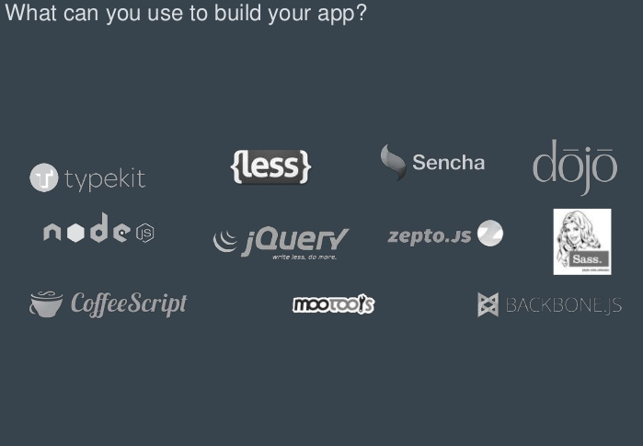

Slide 12
Conclusion
PhoneGap is a cross-platform mobile development framework
Based on HTML5 and JavaScript
Using web standards
PhoneGap is useful
For creation of small apps
When there is a lack of human resources
Need a single app deployed on many OS

Slide 13
DEMO!!

