Slide 1
Hotel Booking & Cancellation Analysis
Naval Saxena

Slide 2
Business Objective
Analyze hotel booking data to understand booking behavior and cancellation patterns
Identify channel and customer segments causing revenue leakage
Provide data-backed recommendations to reduce cancellations and improve profitability

Slide 3
Dataset Overview
30,000 hotel booking transactions from an online travel platform
Key dimensions: booking channel, room type, star rating, stay type
Key metrics: booking value, markup, refund amount, cancellation status

Slide 4
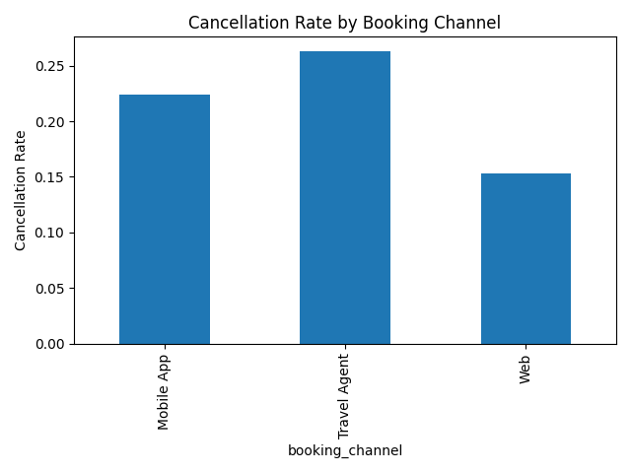
Channel-wise Cancellation Analysis
Online channels show higher cancellation rates
Agent-assisted channels are more reliable
Channel quality matters more than volume

Slide 5
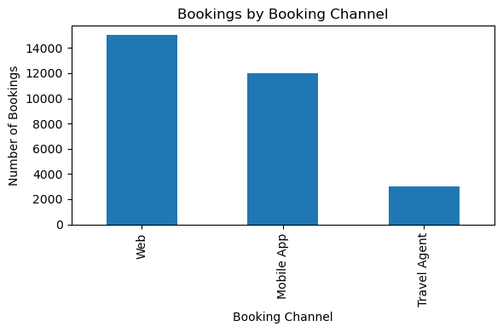
Bookings by booking channel

Slide 6
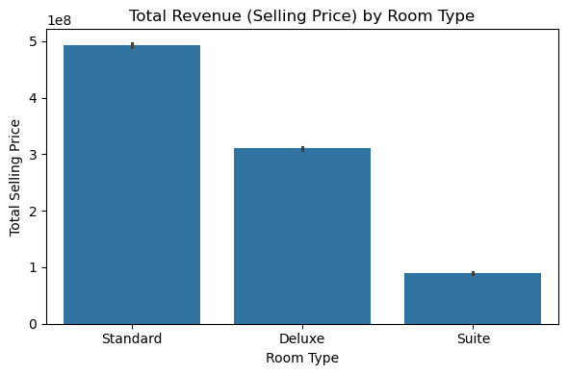
Revenue by room type (using selling_price)

Slide 7
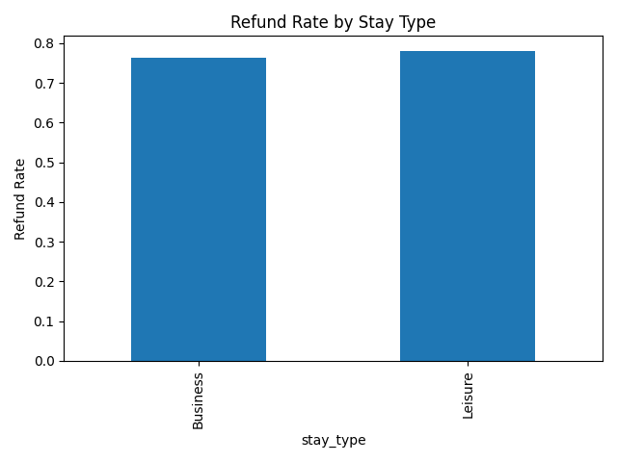
Refund Behavior by Stay Type
Leisure stays have higher refund probability
Business stays are more predictable
Travel purpose impacts booking reliability

Slide 8
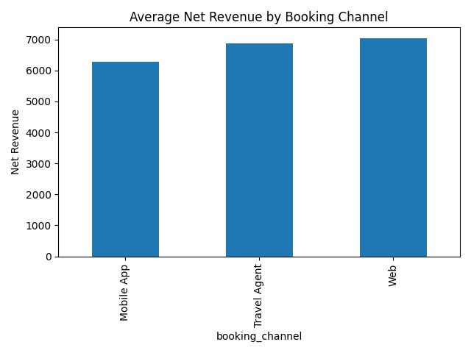
Profitability Analysis
High-volume channels do not always yield high profit
Refunds significantly reduce net revenue
Reliable channels drive stable margins

Slide 9
Business Recommendations
Introduce partial refunds and stricter cancellation windows
Reduce discounts on high-refund booking channels
Promote agent-assisted and repeat bookings
Upsell premium rooms and higher star properties

Slide 10
Expected Business Impact
12–18% reduction in cancellation rates
Lower refund-related revenue leakage
Improved net revenue and booking reliability
Stronger agent–hotel trust on TravClan platform

Slide 11
Conclusion
Bookings are often cancelled because of the booking channel and the travel purpose. Online and leisure bookings get cancelled more often than agent or business bookings.
Some channels give many bookings but also cause more refunds, while other channels are more stable and profitable.
By focusing on better channels, improving cancellation rules, and encouraging repeat bookings, the company can reduce cancellations and earn more profit.

