Slide 1
NUTRITION agent
AGENTIC AI PROJECT
Presented By : Navam Kumar Sharma
Student Name : Navam Kumar Sharma
College Name & Department : RCC Institute of Information Technology (Electronics and Communication engineering)

Slide 2
OUTLINE
Problem Statement
Technology used
Wow factor
End users
Result
Conclusion
Git-hub Link
Future scope
IBM Certifications

Slide 3
Problem Statement
In an era where health awareness is growing, individuals increasingly seek personalized nutrition guidance. However, most existing tools provide generic diet plans, lack real-time adaptability, and fail to consider a person's holistic lifestyle, cultural preferences, allergies, and evolving health conditions. Furthermore, dieticians and nutritionists face limitations in scaling personalized consultations due to time and resource constraints.
Proposed Solution: Generative AI presents a groundbreaking opportunity to revolutionize this space by enabling an intelligent, interactive, and adaptive virtual nutrition assistant. By leveraging natural language processing (NLP), multimodal understanding, and large-scale dietary databases, an AI-powered assistant can generate dynamic meal plans, recommend smart food swaps, and explain nutritional choices—all tailored to the individual.

Slide 4
Technology used
IBM cloud lite services
Natural Language Processing (NLP)
Retrieval Augmented Generation (RAG)
IBM Granite model

Slide 5
IBM cloud services used
IBM Cloud Watsonx AI Studio
IBM Cloud Watsonx AI runtime
IBM Cloud Agent Lab
IBM Granite foundation model

Slide 6
Wow factors
The AI doesn’t just suggest workouts and meals—it creates fully customized routines and meal preps based on:
Fitness goals (fat loss, muscle gain, endurance)
Dietary restrictions (vegan, keto, diabetic-friendly)
Time constraints (e.g., 15-minute meals, 20-min home workouts)
Equipment availability (bodyweight only? full gym access? No problem.)
2. Dynamic Meal Prep Generator
Instantly generates meal plans that are:
Nutritionally balanced (macros and micros calculated)
Batch-cooking optimized (makes meal prep efficient for the whole week)
Budget-aware and tailored to grocery costs
Can even produce shopping lists grouped by supermarket aisle.
3. Intelligent Workout Structuring
Your AI builds programs like a human trainer:
Progressive overload included
Adapts based on user feedback (sore? missed a session? No worries.)
Periodizes training phases (e.g., strength → hypertrophy → recovery weeks)

Slide 7
End users
General Consumers
Healthcare & Wellness Professionals
Fitness Studios & Gyms
Schools, Colleges & Universities
Corporate Wellness Programs

Slide 8
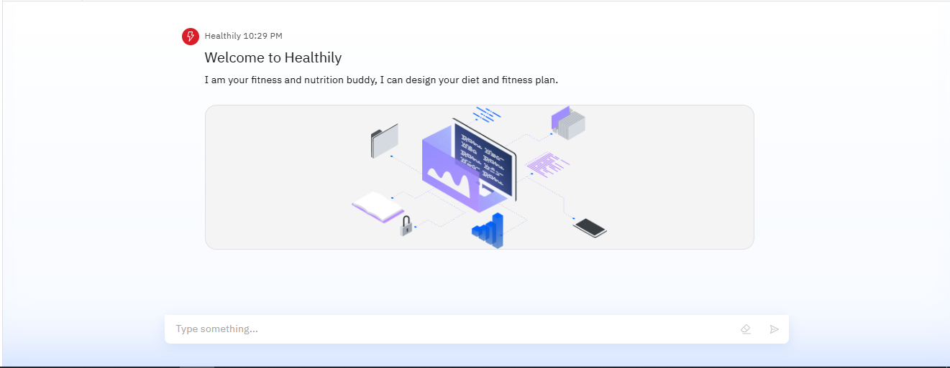
Results

Slide 9
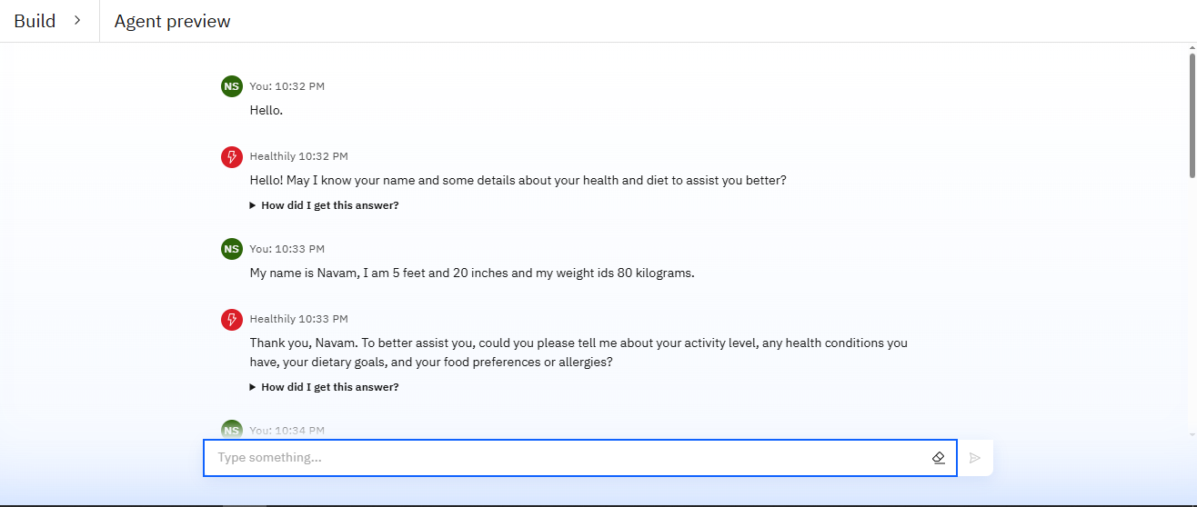
Results

Slide 10
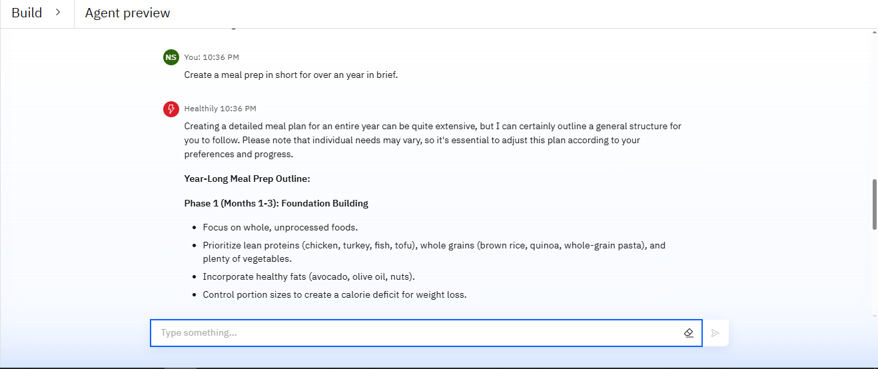
Results

Slide 11
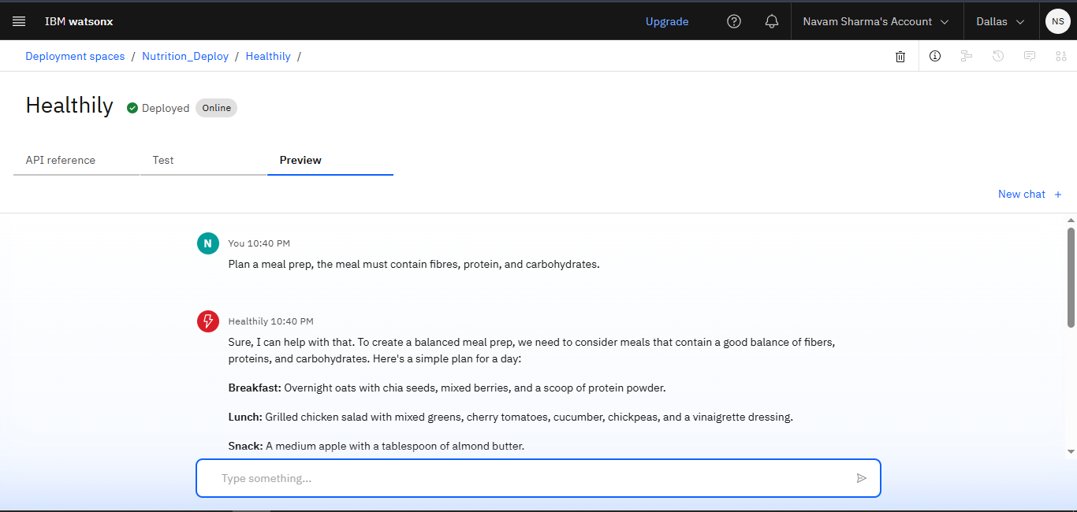
Results
Deployed AI Agent

Slide 12
Conclusion
The agent can generate personalized meal preps according to user’s interest and fitness goals.
It can swap food items to the equal nutrient source food if a person has allergies to certain food items.
Nutrition Agent can develop a plan to lose weight or gain muscles by providing respectful plans and exercises such as for cutting, high cardio is recommended by it.
The agent can plan diet in phases for over a course of year to keep the plan brief and understandable.

Slide 13
Future scope
Personalization & Precision Nutrition
Voice-Activated Nutrition Agent
Advanced User Interaction
Real-Time Monitoring
Clinical & Preventive Health Use
Global & Sustainable Nutrition

Slide 14
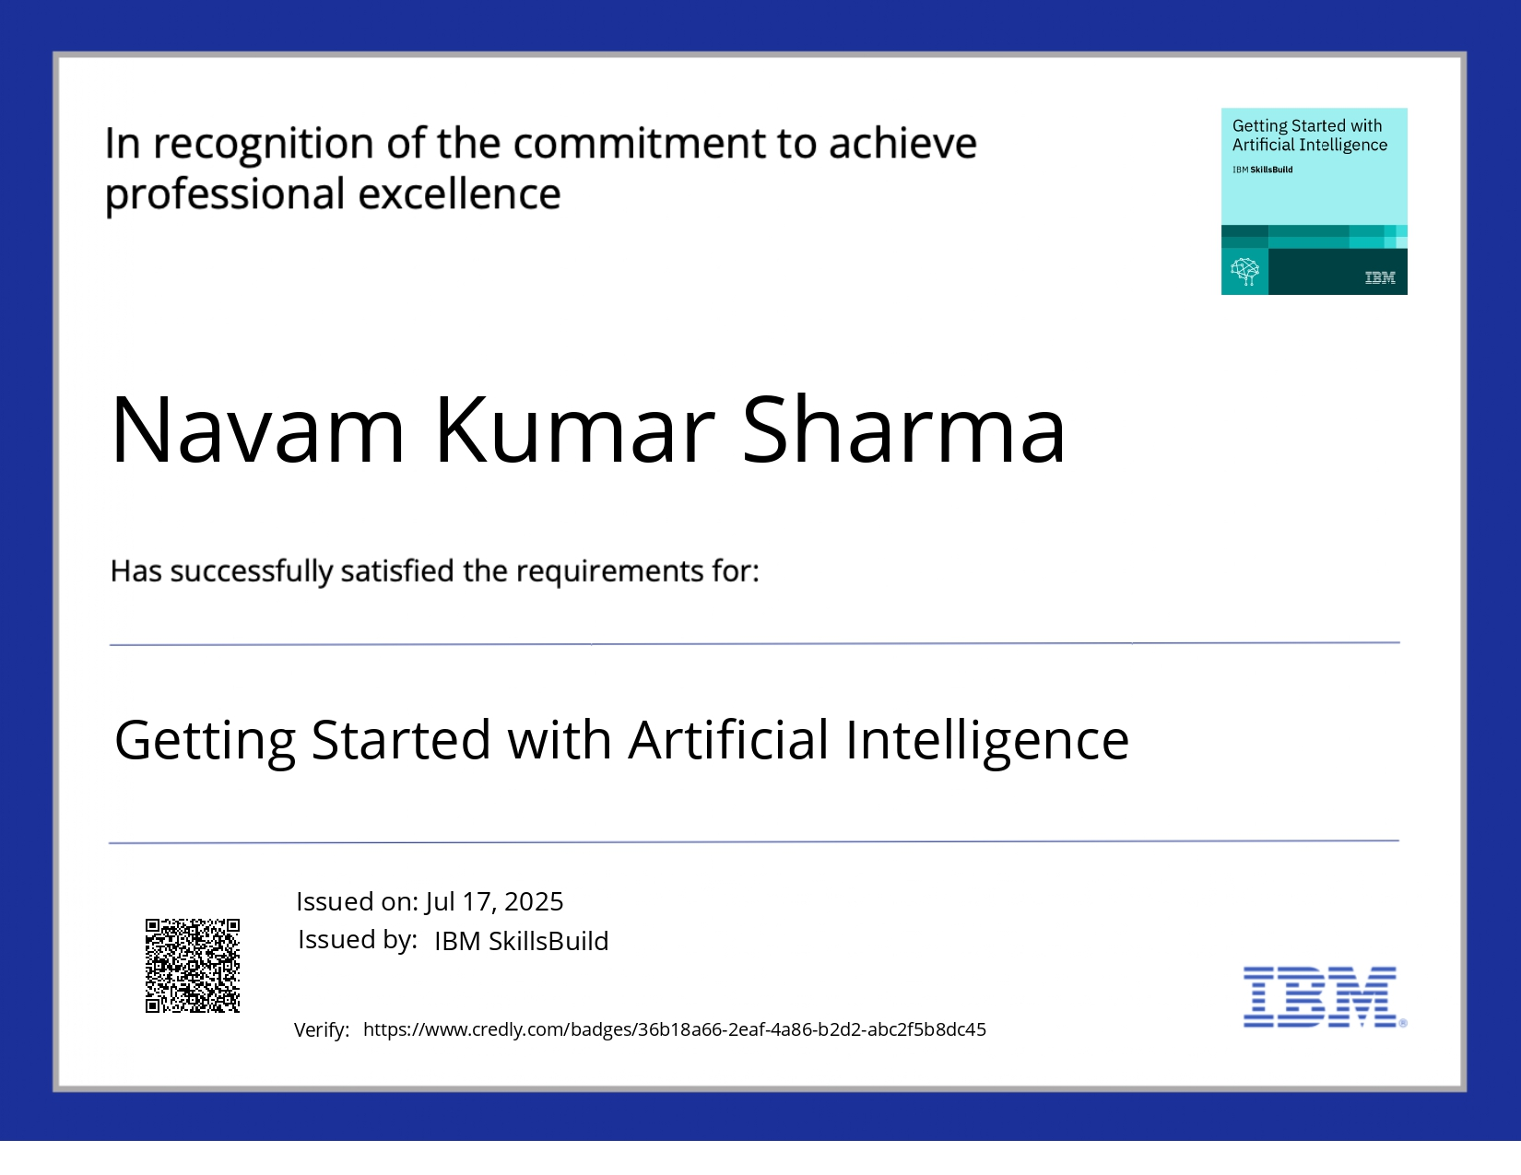
IBM Certifications

Slide 15
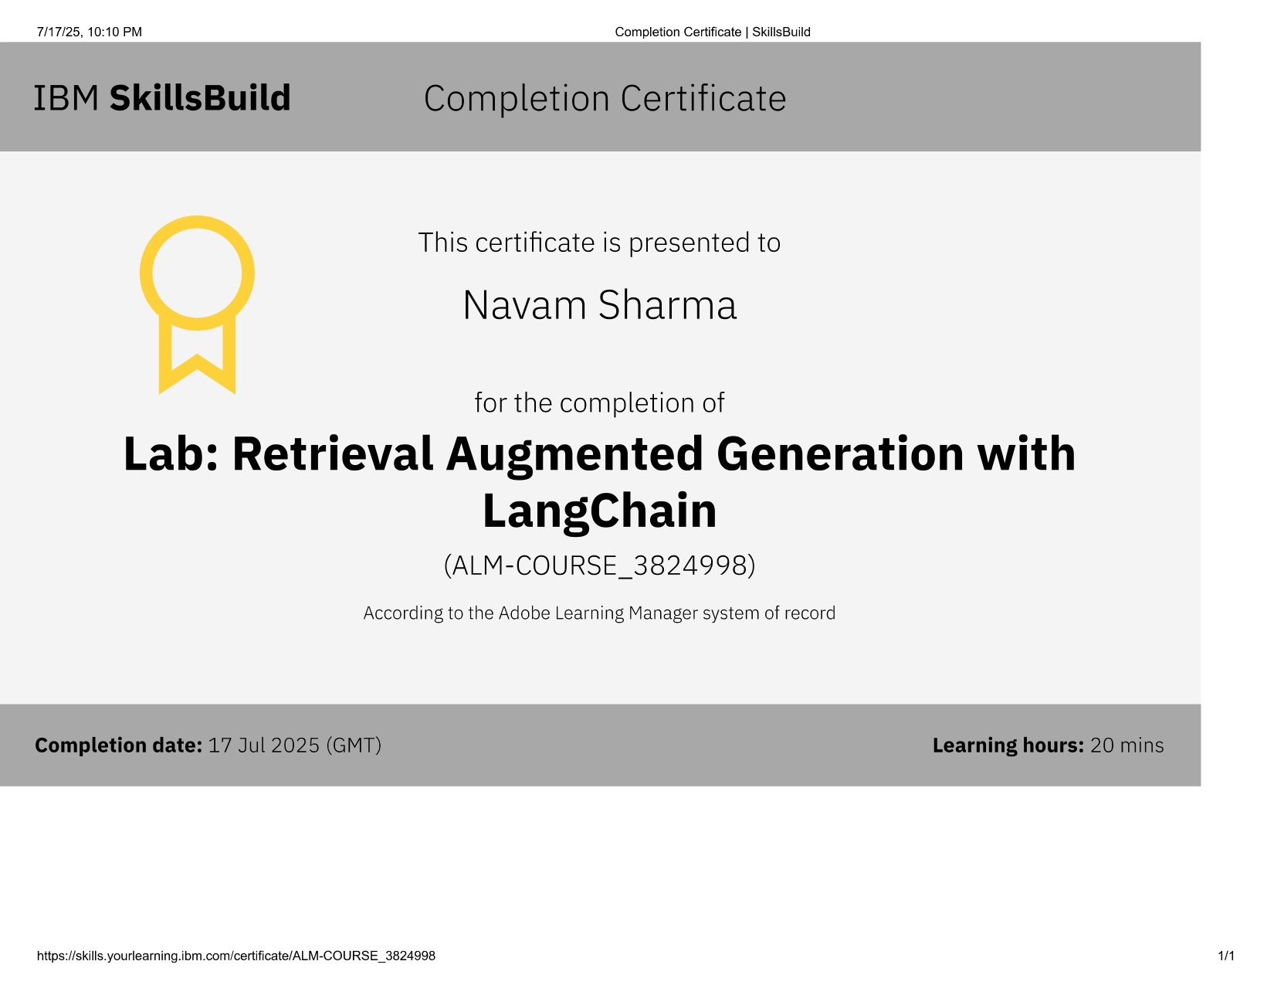

Slide 16
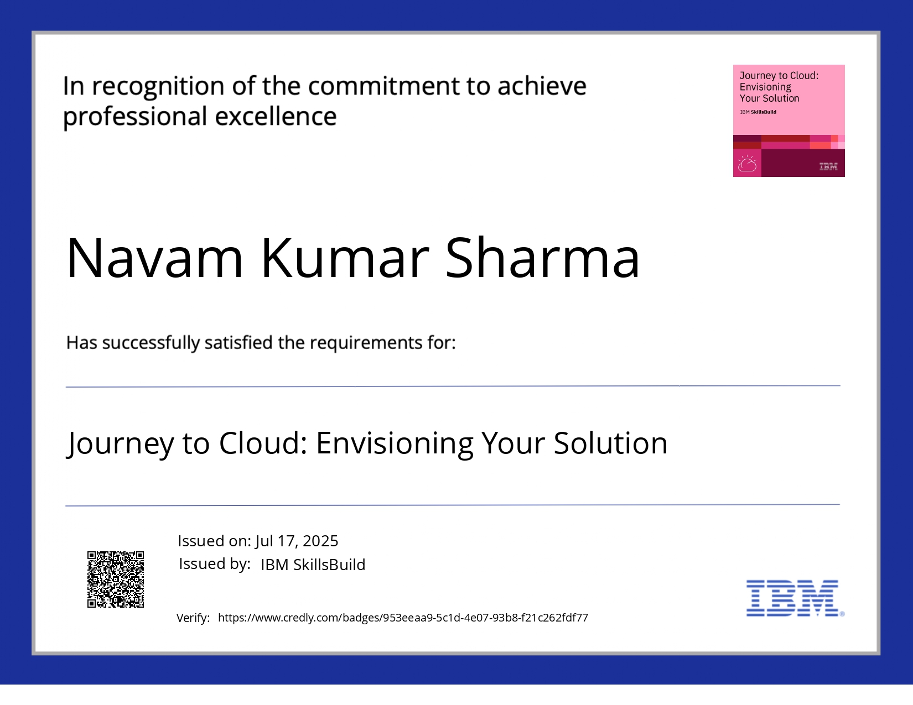

Slide 17
GitHub Link
https://github.com/Navam28

Slide 18
THANK YOU

