Slide 1
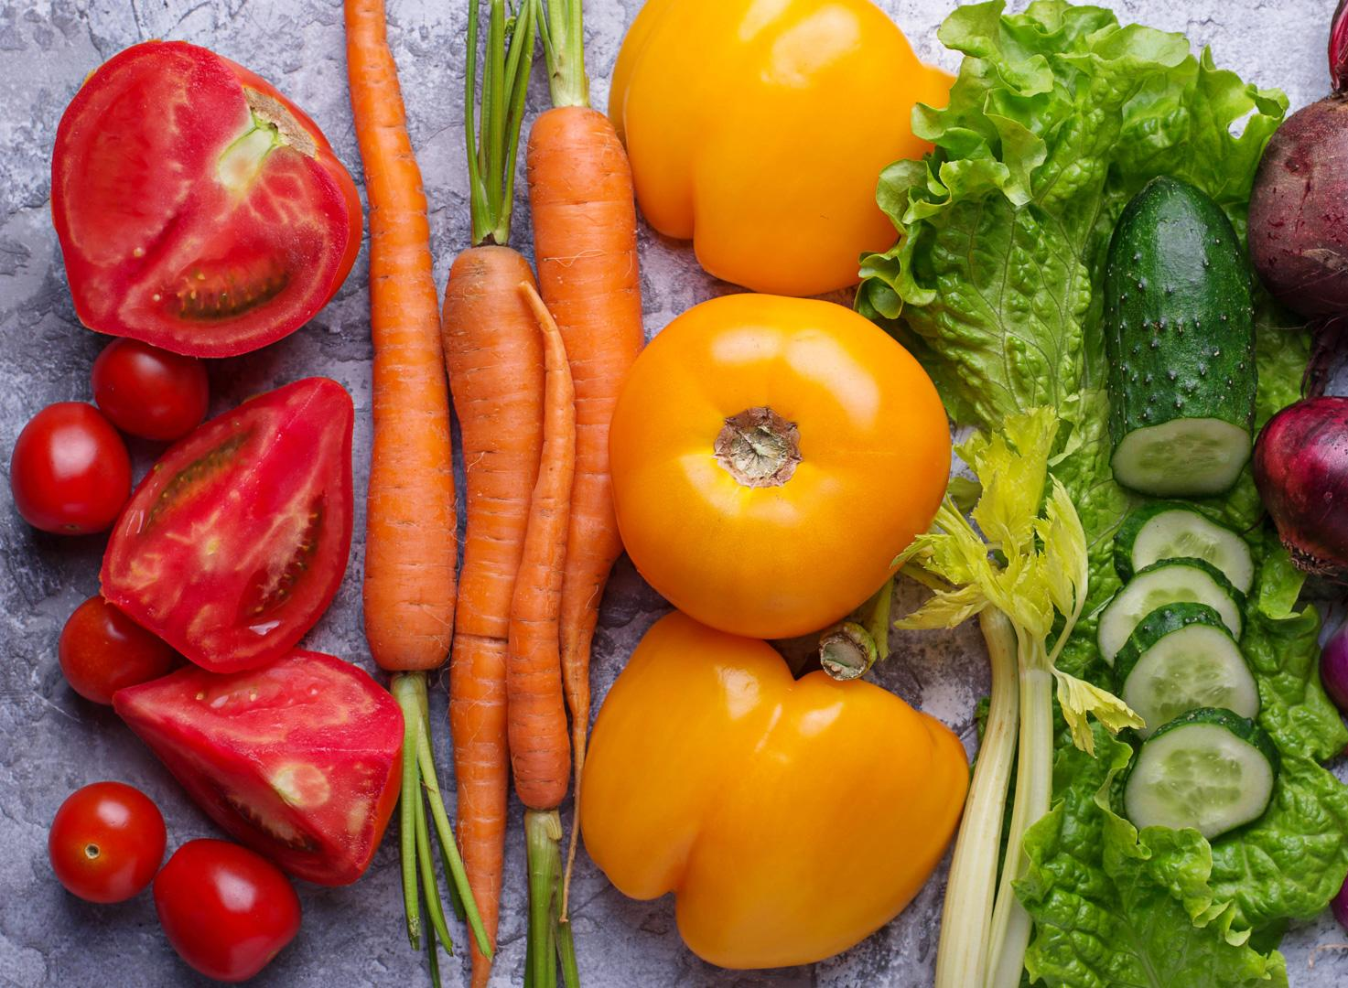

Buy Fresh
Feed your Family with the best.

Slide 2

Team Members:
Navandeep Singh
Sukhman Kaur
Manjot Singh
Rohit Jaswal

Slide 3

What is this app about?
Through this application users will have a chance to choose from a wide range of options in every category, exclusively handpicked with best quality available at the lowest prices. Buy Fresh will allow its users to walk away from the drudgery of grocery shopping and will introduce an easy relaxed way of browsing and shopping for groceries. No more getting stuck in traffic jams, paying for parking, standing in long queues and carrying heavy bags – get everything you need, when you need, right at your doorstep.

Slide 4


Target Audience?
Old aged people
Working people

Slide 5
Features of this app
User Friendly UI
Nine category of groceries available
Products categorised
Online Payment
Product’s details.
Cancel order anytime
No minimum Order

Slide 6
Challenges faced during Application development
Time limitations
Development Expectations and Outcome
Different knowledge base

Slide 7

What makes our app different from other apps?
User Friendly UI
Products categorised
Cancel order anytime
No minimum Order

Slide 8

Dropped plans during final implementation
Shopping Cart
Database

