Slide 1

PRIMEARCTECH / APPLIED AI SYSTEMS
CAPABILITIES / 01
We build AI systems
that complete real work.
PrimeArcTech turns costly workflows, credible product ideas, and partner briefs into controlled software.
OPERATING TEAMS / PRODUCT FOUNDERS / AGENCY PARTNERS
primearc.tech
Notes:
[Sources]
- Internal PrimeArcTech positioning and visual asset: public/primearc-studio/01-hero.webp
- Design pacing reference: https://www.deck.gallery/studio-freight-capabilities-deck-2023/
[/Sources]

Slide 2
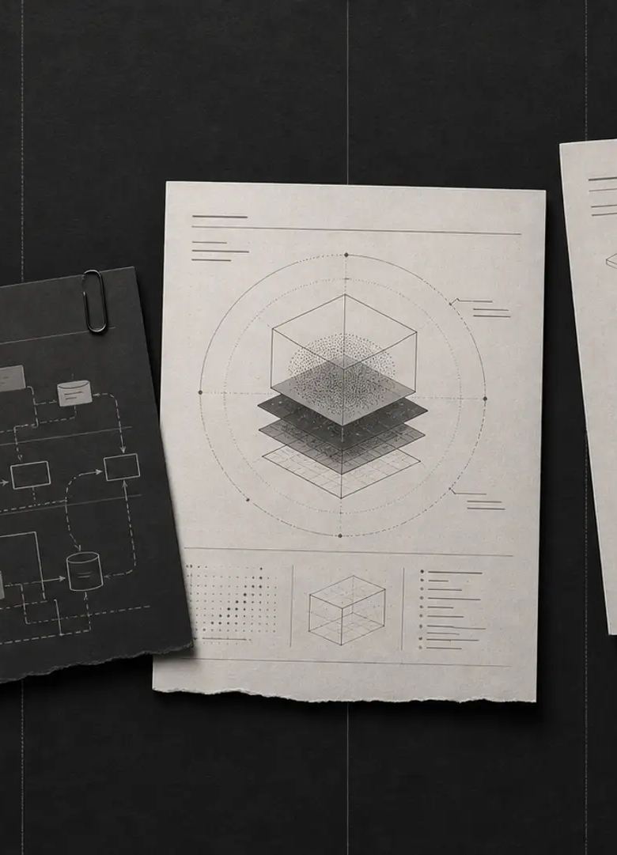
PRIMEARCTECH / APPLIED AI SYSTEMS
CAPABILITIES / 02
Start with the work,
not the model.
One costly pattern. One visible consequence. One owner who knows what good looks like.
01
OPERATING BOTTLENECK
Repeated calls, inboxes, documents, routing, approvals, or follow-up consume skilled time and still drop work.
02
AI PRODUCT IDEA
A promising demo needs policy, tools, failure paths, and a credible route to production.
03
PARTNER DELIVERY
Your client needs specialist execution behind your relationship, with clean handoff and discretion.
If simpler software already solves it, we will say so.
Notes:
[Sources]
- Internal PrimeArcTech Agency Profile, starting-point and fit-filter copy.
- Internal visual asset: public/primearc-studio/04-triggers.webp
[/Sources]

Slide 3
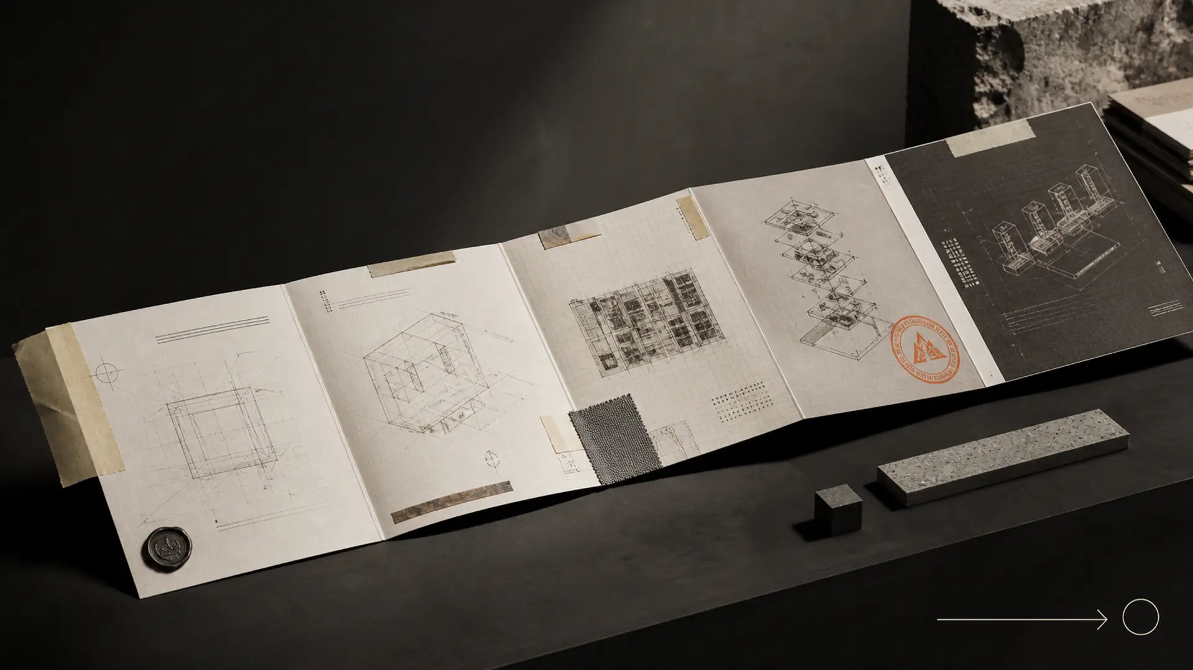
PRIMEARCTECH / APPLIED AI SYSTEMS
CAPABILITIES / 03
We ship the operating layer
around the model.
Context, tools, permissions, human exceptions, tests, and evidence of what happened.
FRAME
PROTOTYPE
ATTACK
SHIP
MONITOR
Workflow map
Success condition
Smallest useful loop
Working behavior
Edge cases
Failure injection
Deployment
Ownership + runbook
Receipts
Review + change log
WHAT LEAVES THE STUDIO
Working software / Boundary policy / Adversarial test record / Failure paths / Operator receipt / Launch runbook
Direct ownership from framing through deployment. No mystery delivery layer.
Notes:
[Sources]
- Internal PrimeArcTech Agency Profile, delivery method and artifact list.
- Internal visual asset: public/primearc-studio/06-process.webp
[/Sources]

Slide 4

PRIMEARCTECH / APPLIED AI SYSTEMS
CAPABILITIES / 04
OWNED PRODUCT / INSPECTABLE PROOF
FieldRelay makes
the method visible.
A managed voice system for missed and after-hours home-service calls. One proving ground for our standard—not the limit of our studio.
DOES
Answers, screens danger, qualifies, validates service area, and creates a provisional outcome.
REFUSES
No diagnosis, repair instruction, firm estimate, invented booking, transfer, or provider success.
RETURNS
Live transcript, policy events, provenance, failure state, and structured dispatcher receipt.
LIVE SANDBOX / primearc.tech/fieldrelay/demo
Notes:
[Sources]
- PrimeArcTech FieldRelay product route: https://primearc.tech/fieldrelay
- Live demo route: https://primearc.tech/fieldrelay/demo
- Internal visual asset: public/fieldrelay/01-hero.webp
[/Sources]

Slide 5
PRIMEARCTECH / APPLIED AI SYSTEMS
CAPABILITIES / 05
Start with one workflow.
Leave with a decision.
Free AI Workflow Audit. Fit review, not disguised project.
YOU BRING
YOU LEAVE WITH
One repeated workflow or product brief.
What happens today.
What failure costs.
Who owns the outcome.
Best opportunity worth pursuing.
Smallest useful system scope.
Key risks and human controls.
Build, buy, narrow, or stop recommendation.
GET FREE AI WORKFLOW AUDIT
primearc.tech/build-brief
Notes:
[Sources]
- Internal PrimeArcTech Agency Profile, free AI Workflow Audit offer and fit-review language.
[/Sources]

