Slide 1
SIGN LANGUAGE RECOGNITION USING DEEP LEARNING

Slide 2
1.
Why?

Slide 3
Communication
Communication comes from the Latin word communicare, meaning "to share“
It helps us humans share our feeling and create bonds
But what about mute people?
They must not be deprived the ability to bond just because they can’t talk.

Slide 4
Sign Language
Mute people predominantly use sign language for their daily communication
But not everyone can understand sign language
Viewing a gesture from another perspective makes it difficult to be understood
Since every finger position and movement will not be observable.

Slide 5
2.
How?

Slide 6
Idea
Cameras can be attached to the head or chest of a mute person
The camera observe the hand gesture and recognises it using Deep learning
Using text-to-speech software the recognised gesture can be converted to audio
The cameras attached will in no way hinder their daily activities
.

Slide 7
Our Model
We have written our model using Pytorch library and trained it using GPU
The model was able to recognise the signs with 96-97% accuracy.
We have currently deployed our model to a desktop app
The app takes an image as an input and gives out the predicted character
The model can identify alphabets, numbers and an underscore character used as space
.

Slide 8
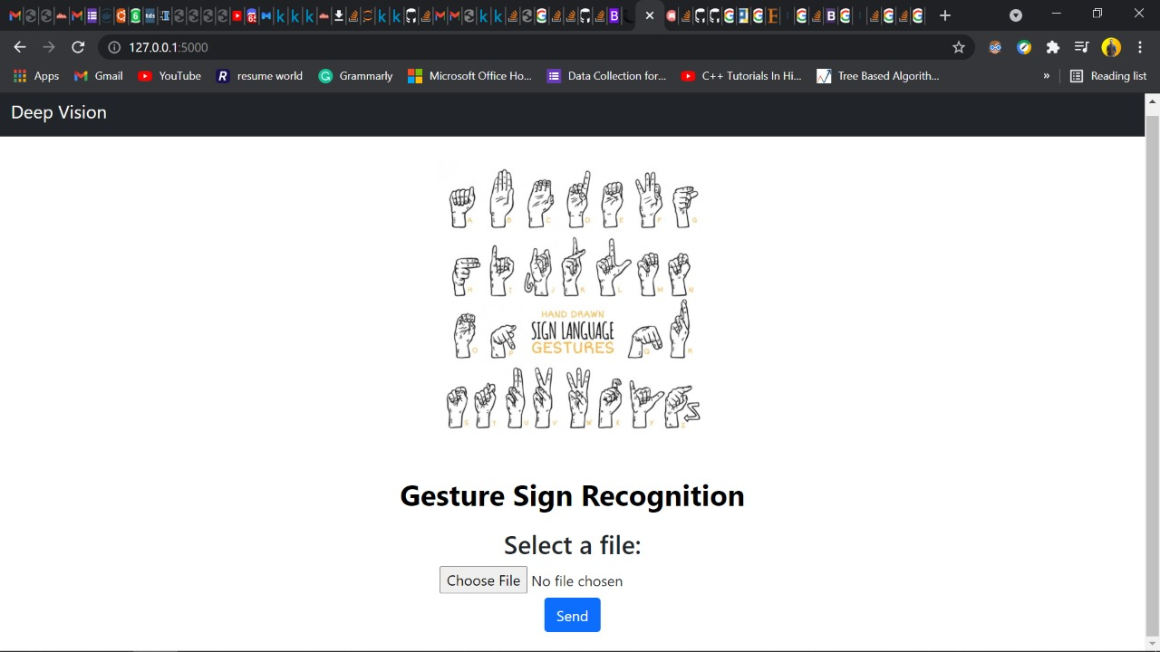
DESKTOP APP
.

Slide 9
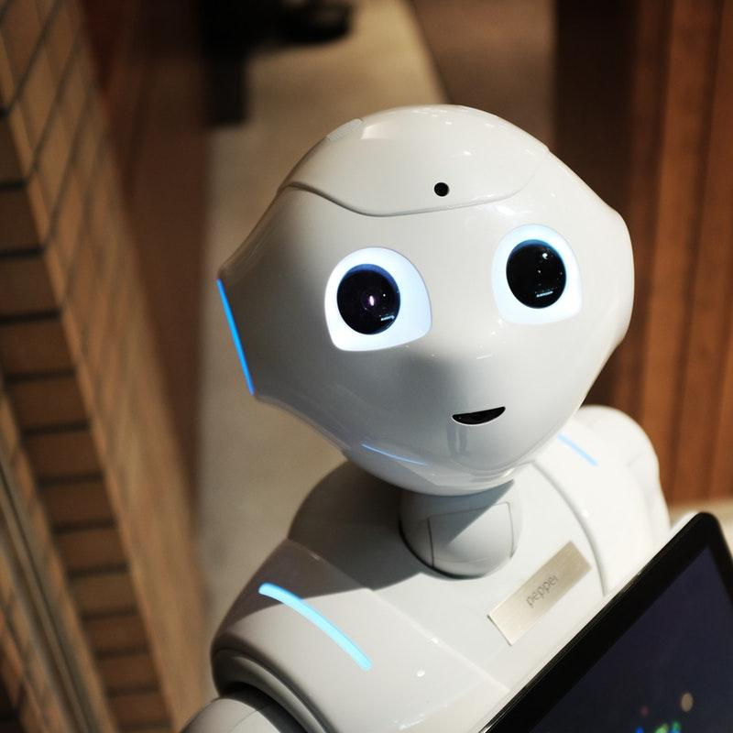
Future Scope
The model can be trained to recognise gestures from a live video feed in realtime.
Translate feature can be added to further enhance the capabilities.

Slide 10
Thank You
Team Name: Deep Vision
Members: Navaneeth Sharma, R Bharath

