Slide 1


Impact of temperature variations over the Bay of Bengal on the climate of Eastern coast of India
VISVESVARAYA TECHNOLOGICAL UNIVERSITY
Jnana Sangama, Machhe, Belagavi, Karnataka 590018
B.N.M. Institute of Technology
Vidyaya Amrutham Ashnuthe
12th Main, 27th Cross, Banashankari II Stage, Bangalore 560 070.
Department of Information Science and Engineering2017-2018
Phase two seminar presentation
on
Under the Guidance of Dr. Saritha Chakrasali Professor, Dept. of ISE B.N.M.I.T
Submitted by:
Sai Navaneeth V – 1BG14IS041
Satish Kumar M S – 1BG14IS045
Bhavana – 1BG14IS008
H Sudhanva – 1BG14IS017

Slide 2
Introduction
Artificial intelligence (AI)
Creation of human-like intelligence.
Learn, reason, plan, perceive, or process natural language.
Instructions that allow model to learn from data without step-by-step instructions by the programmer.
Data analytics
Qualitative and quantitative techniques and processes
To enhance productivity and business gain.
Data is extracted and categorized to identify and analyze behavioral data and patterns.
Weather forecasting.

Slide 3
Problem statement
To study the correlation between sea surface temperature to corresponding coastal temperature by implementing supervised machine learning algorithm on the available dataset and to forecast the weather conditions.

Slide 4
Motivation
To be able to recognize pattern between sea surface temperature and land temperature.
Improving weather forecasting process.
Being able to provide warnings in time to reduce the consequences.

Slide 5
System Design
Data Collection
Data Filtering and Cleaning
Feature selection
Regression Model Implementation
Testing
Final trained model
Final application

Slide 6
Dataflow diagram
LEVEL-0
Raw Data
Pre-Processing
Learning
Evaluation
Prediction

Slide 7
LEVEL-1
Raw Data
Pre-Processing
Learning
Evaluation
Prediction
Feature Extraction and Scaling
Model Selection
Feature Selection / Dimensionality Reduction
Learnt Model
Cross Validation
Sampling and
Training Dataset

Slide 8
LEVEL-2
Raw Data
Pre-Processing
Learning
Evaluation
Prediction
Performance Metric
Final Model
New Data

Slide 9
Implementation Details
Module-1
Data Collection
Module-2
Data Cleaning and Filtering
Module-3
Feature Extraction
Module-4
Implementing Regression model
Module-5
Final study

Slide 10
Module 1:
Data Collection

Slide 11
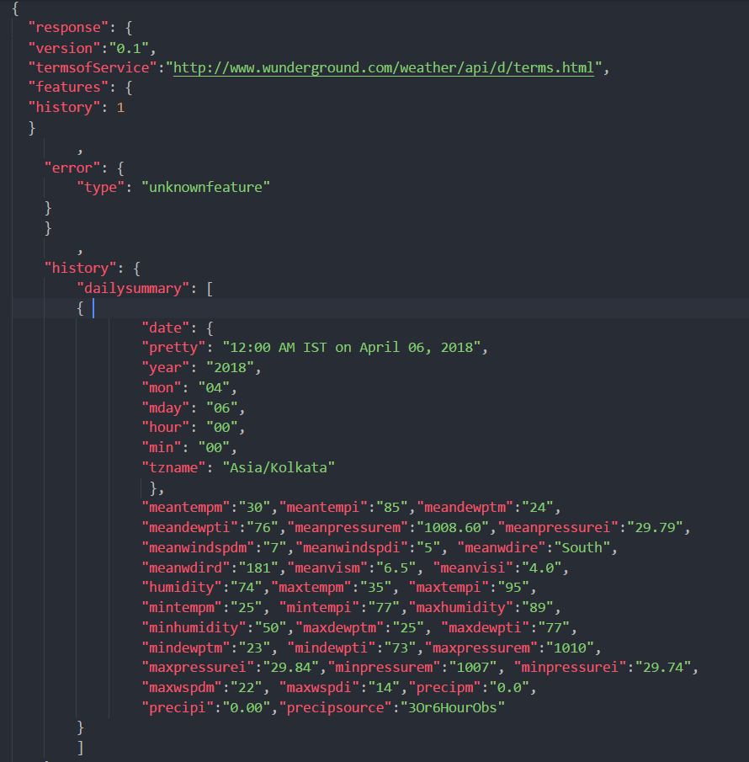

Slide 12
Algorithm 1:
step 1: Initialize base url, api key, target date, feature name list.
step 2: open a csv file in write mode
set the fieldnames to feature list values
step 3: for each in range(days)
send a request to the base url defined
convert the api response to json format
write the json data to the opened csv file
increment the target date to next day
end for
step 4: end

Slide 13
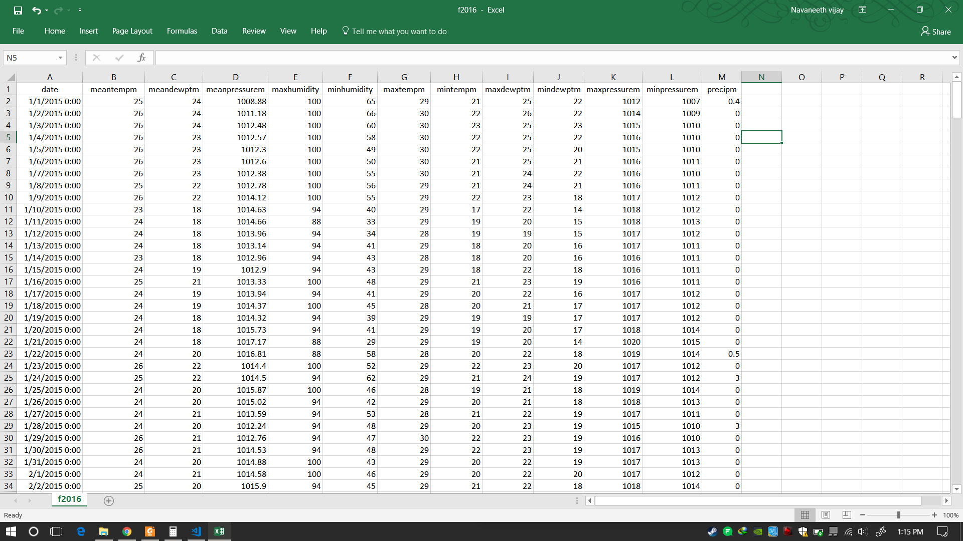

Slide 14
Module 2:
Data filtering and cleaning

Slide 15
Step1: Make a list containing features to remove Step2: Convert the selected feature objects into numerical values Set not available values to 'coerce’. Step3: We use describe() method and then transpose the DataFrame Set. Step4: Calculate IQR and remove outliers Step5: Data visualization using Histogram.
Algorithm 2:

Slide 16
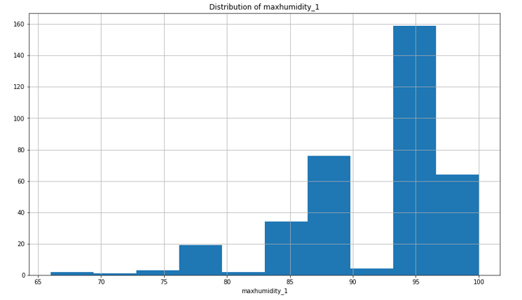

Slide 17
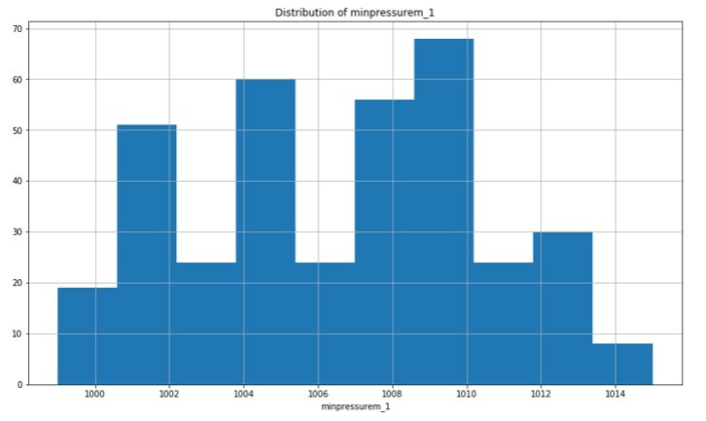

Slide 18
Modules to complete: Module-3, Module-4, Module-5

Slide 19
Thank You!

