Slide 1


Impact of temperature variations over the Bay of Bengal on the climate of Eastern coast of India
VISVESVARAYA TECHNOLOGICAL UNIVERSITY
Jnana Sangama, Machhe, Belagavi, Karnataka 590018
B.N.M. Institute of Technology
Vidyaya Amrutham Ashnuthe
12th Main, 27th Cross, Banashankari II Stage, Bangalore 560 070.
Department of Information Science and Engineering2017-2018
Phase three seminar presentation
on
Submitted by:
Sai Navaneeth V – 1BG14IS041
Satish Kumar M S – 1BG14IS045
Bhavana – 1BG14IS008
H Sudhanva – 1BG14IS017
Under the Guidance of Dr. Saritha Chakrasali Professor, Dept. of ISE B.N.M.I.T

Slide 2
Abstract
Weather forecasting:
traditionally done by physical models of the atmosphere.
Unstable to perturbations
Inaccurate for large periods of time.
Weather is a continuous, data-intensive, multidimensional and dynamic.
These properties make weather prediction a big challenge.
Machine Learning techniques are more robust to perturbations.
Artificial Intelligence and Machine Learning has given rise to numerous weather prediction models.
Potentially helpful to generate more accurate forecasts of weather for large periods of time.

Slide 3
Introduction
Artificial intelligence (AI)
Creation of human-like intelligence.
Learn, reason, plan, perceive, or process natural language.
Instructions that allow model to learn from data without step-by-step instructions by the programmer.
Data analytics
Qualitative and quantitative techniques and processes
To enhance productivity and business gain.
Data is extracted and categorized to identify and analyze behavioral data and patterns.
Weather forecasting.

Slide 4
Literature Survey

Slide 5
Base Papers:
“ Machine Learning Applied to Weather Forecasting” Stanford University, (2016).[1] -Mark Holmstrom et al.
explores prediction of maximum temperature and the temperature for seven days, given weather data for the past two days, using linear regression model.
The linear regression model implemented in this paper is the base algorithm used in this project.
“ Weather Prediction Based on Decision Tree Algorithm Using Data Mining Techniques’. IJARCCE (2016).[2] -Siddharth S. Bhatkande et al.
investigate forecasting maximum temperature, minimum temperature using Decision Tree algorithms on meteorological data collected between 2012 and 2015 from the different cities.

Slide 6
“ Machine Learning Applied to Weather Forecasting” Stanford University, (2016).[1] -Mark Holmstrom et al. explores prediction of maximum temperature of any given day based on the previous two days data, using linear regression model.
The following measurements were considered to predict mean temperature
max temperature
min temperature
mean humidity
mean atmospheric pressure

Slide 7
Reference papers:
“Operational demand forecasting in district heating systems using ensembles of online machine learning algorithms”[7] -C. Johansson et al. Heat demand forecasting is in one form or another an integrated part of most optimisation solutions for district heating and cooling | “A Deep Hybrid Model for Weather Forecasting”[3] -Aditya Grover et al. making predictions via a hybrid approach that combines discriminatively trained predictive models with a deep neural network that models the joint statistics of a set of weather-related variables.
“A Semi- Supervised Technique for Weather Condition Prediction using DBSCAN and KNN”[5] -Aastha Sharma et al. semi-supervised weather prediction technique to validate the predictions done for certain atmospheric parameters taken for four years on a day wise basis in a certain city. | “ A machine learning approach to finding weather regimes and skillful predictor combinations for short-term storm forecasting”[4] -John K. Williams et al. random forest machine learning approach provides a tool for identifying a set of skillful predictors for thunderstorm initiation as well as providing a performance benchmark.

Slide 8
“A Service Oriented Architecture for Weather Forecasting Using Data Mining”[6] -Mrs. C. Beulah Christalin Latha et al. proposes a novel method to develop a service oriented architecture for a weather information system and forecast weather using data mining techniques. | “Wind Prediction: Physical model improvement through support vector regression”[8] -Daniel Bejarano et al. concentrates on wind speed prediction through the combination of support vector regression and the weather research and forecast model was explored.
“Rainfall prediction: A Deep Learning approach”[9] -Emilcy Hern´andez et al. introduces an architecture based on Deep Learning for the prediction of the accumulated daily precipitation for the next day. Includes an autoencoder for reducing and capturing non-linear relationships between attributes, and a multilayer perceptron for the prediction task. | “Weather Prediction through Machine Learning”[10] -Kiran Kumar. R et al. design an effective rainfall prediction agent model using support vector machine and multiple linear regressions.

Slide 9
Limitations of existing systems:
Absence of any correlation between SST and land temperatures.
The linear regression model:
high variance model
unstable without a large dataset
Considered only previous two days to predict.

Slide 10
Problem statement
To study the correlation between sea surface weather to the corresponding coastal temperature by implementing supervised machine learning algorithm on the available dataset and to forecast the weather conditions.

Slide 11
Motivation
To be able to recognize pattern between sea surface temperature and land temperature.
Improving weather forecasting process.

Slide 12
System requirements:
Hardware requirements:
System:Intel core 7th Gen i7 Processor.
Hard Disk: 150Gb Solid State Drive
RAM: 8Gb recommended
Monitor: 15 VGA Colour
GPU: Nvidia GT 630M 1Gb VRAM
Software requirements:
O/S: Windows 7 and above
Language: python and MATLAB
Additional packages: python scikit, python anaconda, tensorflow

Slide 13
Basic COCOMO Estimation:
Software Project | A variable | B variable | C variable | D variable | Effort (in person/month) | Duration (in months) | Staffing (recommended)
Semi-detached | 3 | 1.12 | 2.5 | 0.35 | 26.523 | 7.87 | 3.36
Effort =a*KLOC^{b}, in person/months, with KLOC = lines of code, (in the thousands), and
Duration =c*effort^{d}, finally:
Staffing =effort/duration

Slide 14
SYSTEM DESIGN

Slide 15
System Design
Data Collection
Data Filtering and Cleaning
Feature selection
Regression Model Implementation
Testing
Final trained model
Final application

Slide 16
Dataflow diagram
LEVEL-0
Raw Data
Pre-Processing
Learning
Evaluation
Prediction

Slide 17
LEVEL-1
Raw Data
Pre-Processing
Learning
Evaluation
Prediction
Feature Extraction and Scaling
Model Selection
Feature Selection
Learnt Model
Sampling and
Training Dataset

Slide 18
LEVEL-2
Raw Data
Pre-Processing
Learning
Evaluation
Prediction
Performance Metric
Final Model
New Data

Slide 19
IMPLEMENTATION DETAILS

Slide 20
Implementation Details
Module-1
Data Collection
Module-2
Data Cleaning and Filtering
Module-3
Feature Extraction
Module-4
Implementing Regression model
Module-5
Final study

Slide 21
Module 1:
Data Collection

Slide 22
Algorithm 1:
step 1: Initialize base url, api key, target date, feature name list.
step 2: open a csv file in write mode
set the fieldnames to feature list values
step 3: for each in range(days)
send a request to the base url defined
convert the api response to json format
write the json data to the opened csv file
increment the target date to next day
end for
step 4: end

Slide 23
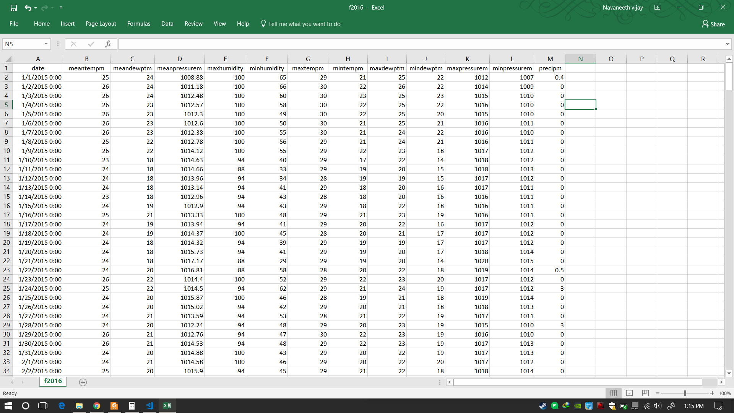

Slide 24
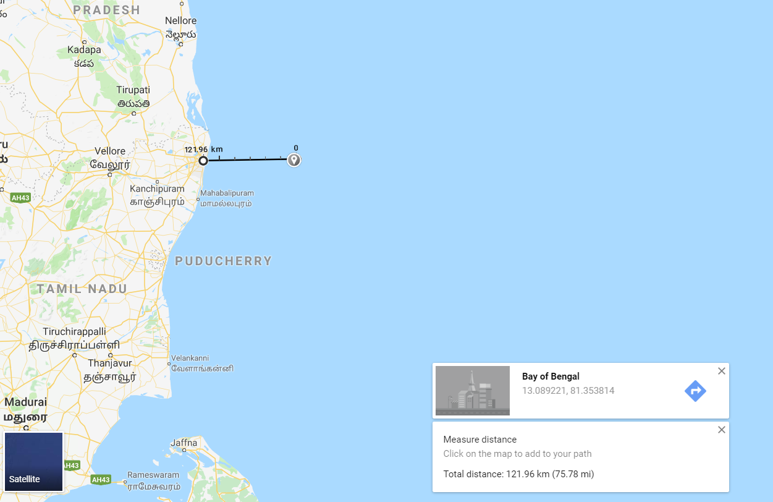

Slide 25


Slide 26
Module 2:
Data filtering and cleaning

Slide 27
Step1: Make a list containing features to remove Step2: Convert the selected feature objects into numerical values Set not available values to 'coerce’. Step3: We use describe() method and then transpose the DataFrame Set. Step4: Calculate IQR and remove outliers Step5: Data visualization using Histogram.
Algorithm 2:

Slide 28
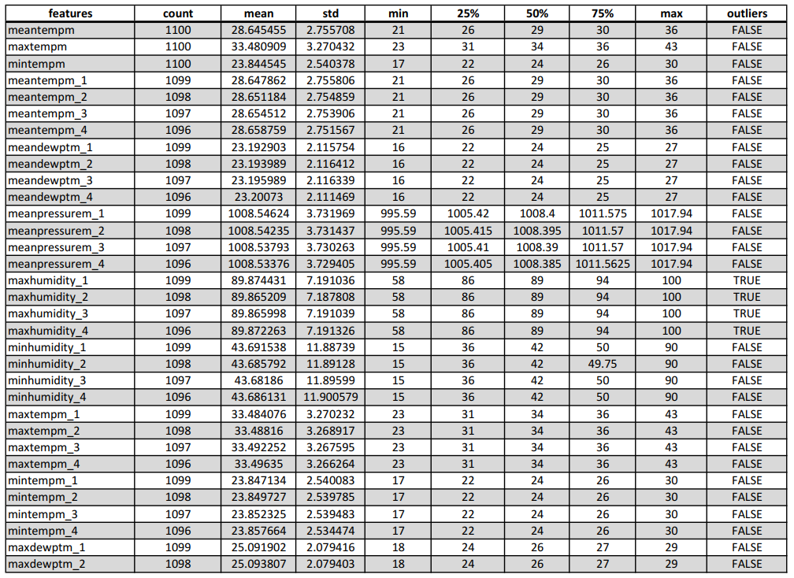

Slide 29
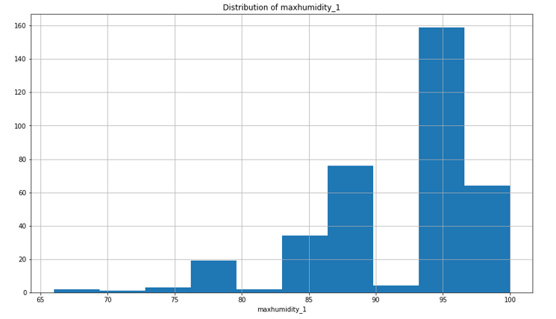

Slide 30
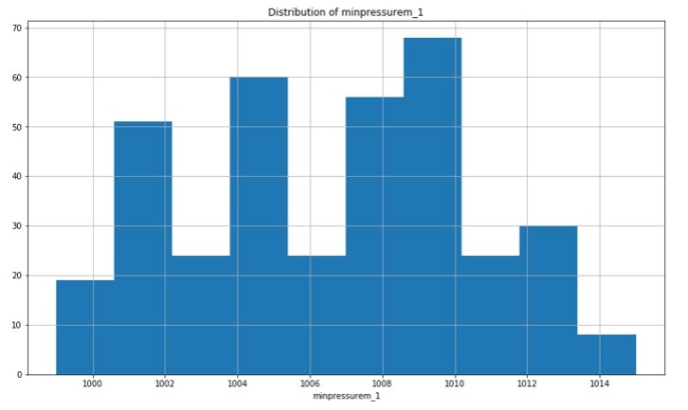

Slide 31
Module 3: Feature Extraction

Slide 32
Find linear relationship between dependent and each independent variables.
Our independent variable is mean temperature.
Linearity is calculated using Pearson correlation coefficient.
It is the measure of amount of linear correlation.
Outputs value ranging -1 to 1
0 to 1 represents positive correlation
0 to -1 represents negative correlation

Slide 33
Correlation Value | Interpretation
0.8 - 1.0 | Very Strong
0.6 - 0.8 | Strong
0.4 - 0.6 | Moderate
0.2 - 0.4 | Weak
0.0 - 0.2 | Very Weak

Slide 34
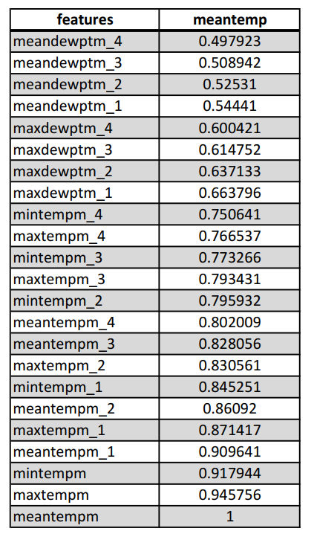
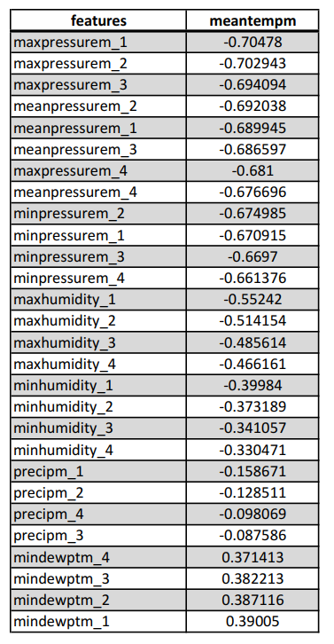

Slide 35
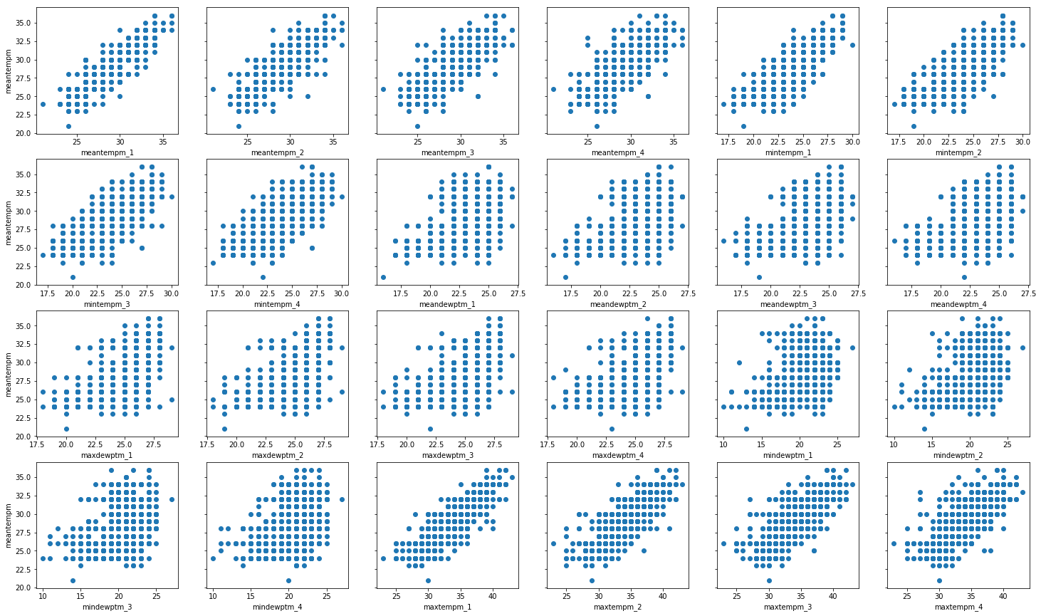

Slide 36
Module 4: Implementing Regression model

Slide 37
Generalized formula for Linear Regression model
ŷ = β₀ + β₁ * x₄ + β₂ * x₂ + ... + β_{(p-n)} x_{(p-n)} + Ε
ŷ is the predicted outcome variable (dependent variable)
x_{j} are the predictor variables (independent variables) for j = 1,2,..., p-1 parameters.
β₀ is the intercept or the value of ŷ when each x_{j} equals zero.
β_{j} is the change in ŷ based on a one unit change in one of the corresponding x_{j .}
Ε is a random error term associated with the difference between the predicted ŷ_{i} value and the actual y_{i} value.

Slide 38
There can be interactions that occur between variables that can lead to false interpretations.
We use Step-wise regression to find significance of the variables in the model.
In Step-wise regression you add or remove variables from the model and assess the statistical significance of each variable on the resultant model.
We use a technique known as backward elimination.

Slide 39
Steps involved in Backward elimination
Step 1: Select a significance level Α for which we test our hypothesis against to determine if a variable should stay in the model.
Step 2: Fit the model with all predictor variables.
Step 3: We check if p-value > Α
If yes, we remove the predictor
otherwise, we have the final model
Step 4: We fit the model again with new predictors and go to step 3

Slide 40
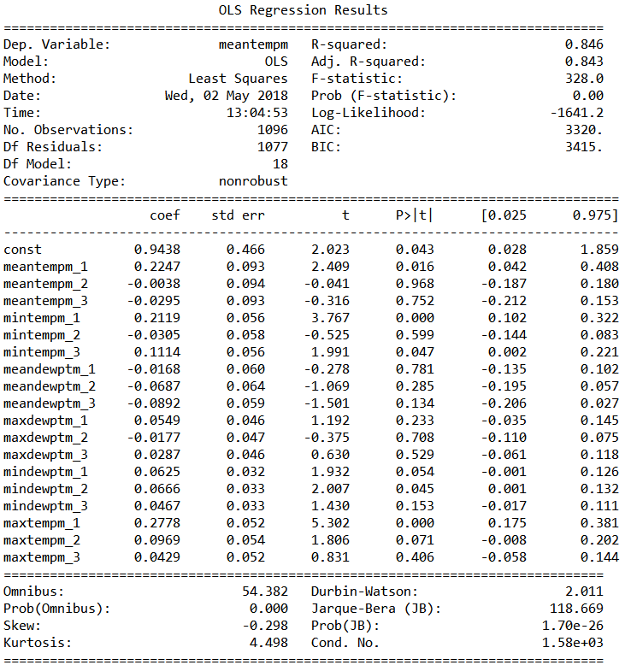

Slide 41
Module 5: Final study

Slide 42
LAND based model
Calculating the mean land temperature of Chennai using the developed regression model.
Considering previous four days data of the predictors ,mean temperature will be calculated.
Mean absolute error and median absolute error are calculated.

Slide 43
Before Backward elimination.

Slide 44
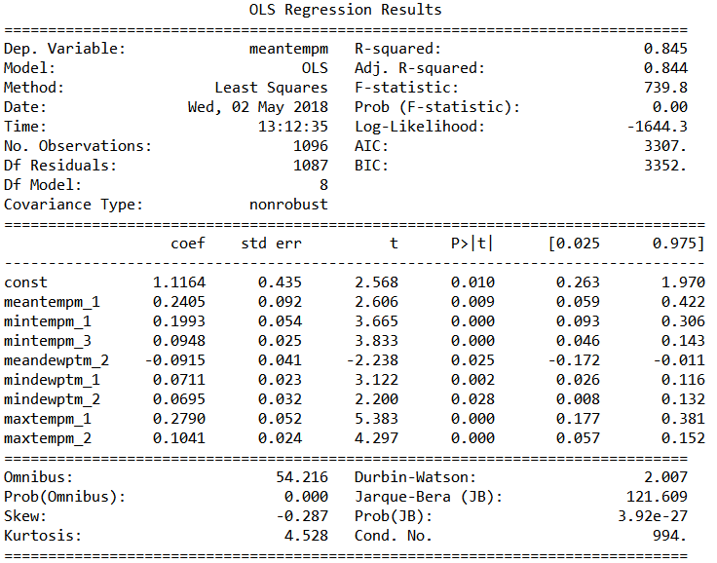
After backward elimination.

Slide 45
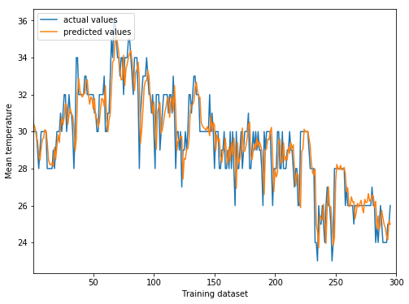
Obtained results:
The Explained Variance: 0.80
The Mean Absolute Error: 0.89 C
The Median Absolute Error: 0.72 C

Slide 46
SEA based model
Calculating the air temperature of Chennai using the developed regression model.
Considering previous four days data of the predictors ,air temperature will be calculated.
Mean absolute error and median absolute error are calculated.

Slide 47
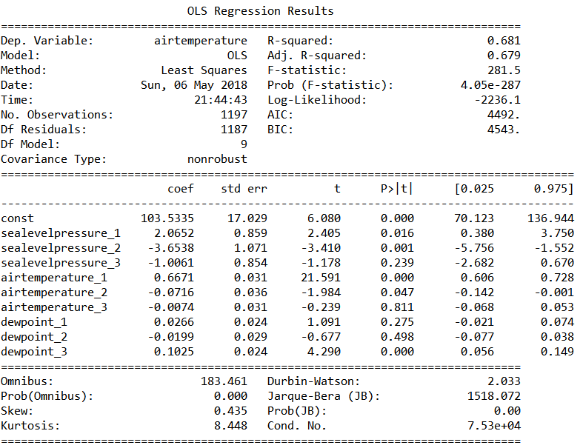
Before Backward elimination.

Slide 48
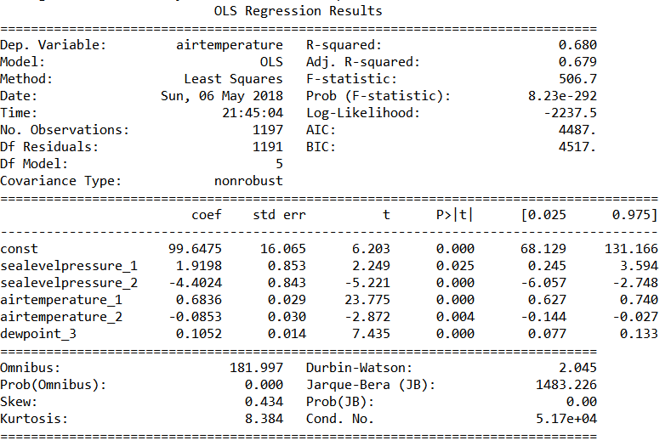
After backward elimination.

Slide 49
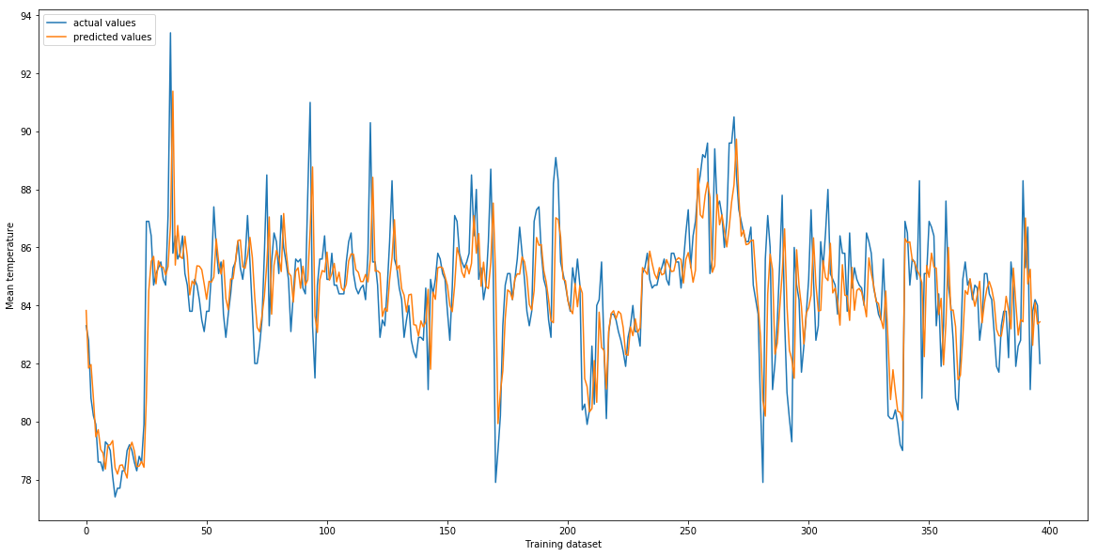
Obtained results:
The Explained Variance: 0.58
The Mean Absolute Error: 1.12 Celsius
The Median Absolute Error: 0.74 Celsius

Slide 50
SEA model with LAND mean temperature model
Calculating the mean surface temperature of Chennai using the developed regression model.
Considering previous four days data of the predictors , mean temperature of the Land will be calculated.
Mean absolute error and median absolute error are calculated.

Slide 51
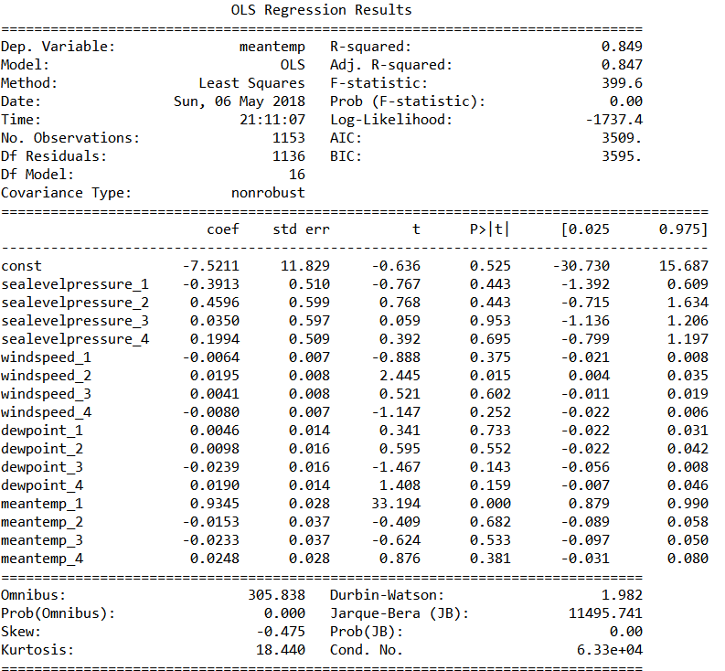
Before Backward elimination.

Slide 52
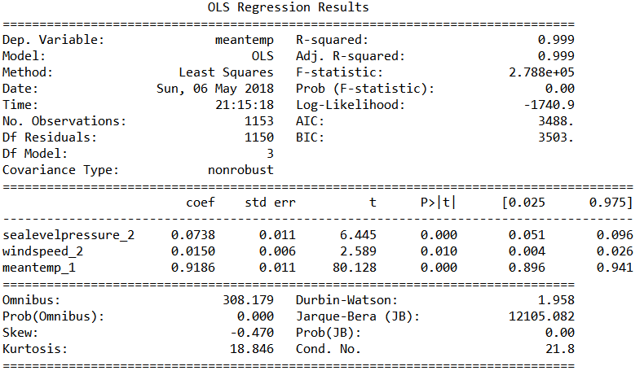
After backward elimination.

Slide 53
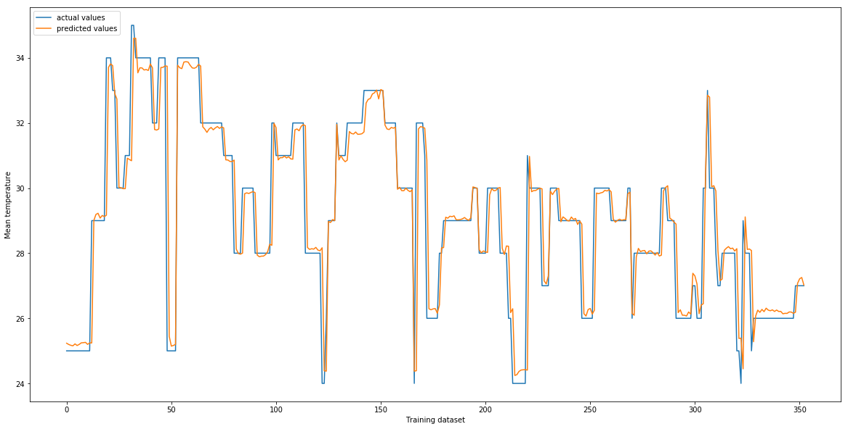
Obtained results:
The Explained Variance: 0.80
The Mean Absolute Error: 0.51 Celsius
The Median Absolute Error: 0.15 Celsius

Slide 54
LAND and SEA features combined model
All possible combination of sea and land features were considered.
The model was built and the sea features which have no effects are eliminated.
Out of all combination only one combination proved effective.
All sea and land features were considered.

Slide 55
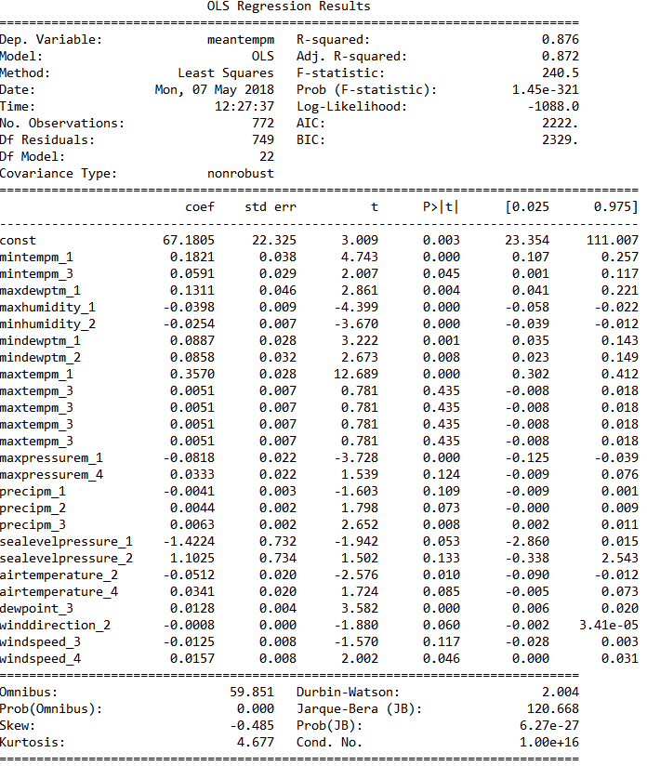
Before Backward elimination.

Slide 56
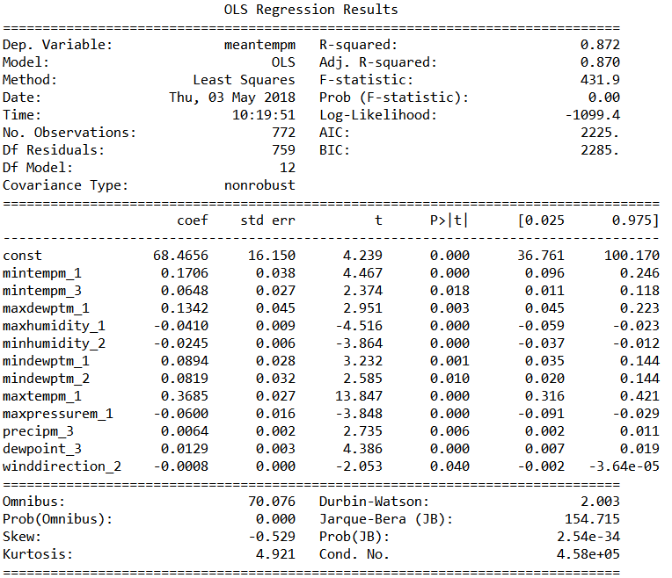
After backward elimination.

Slide 57
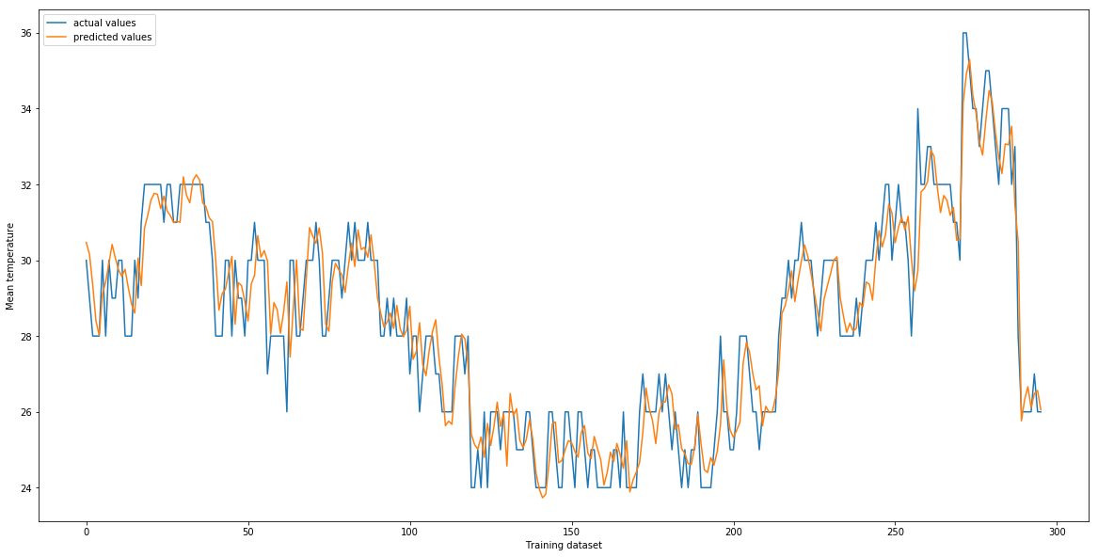
Obtained results:
The Explained Variance: 0.89
The Mean Absolute Error: 0.72 Celsius
The Median Absolute Error: 0.63 Celsius

Slide 58
TESTING
Equivalence testing is done.
Different classes are generated using the dataset.
Each class are tested individually.
Each tested value is plotted on the graph.

Slide 59
Type 1
Features considered | comments
Air temperature-1 | rejected
Dew point-2 | rejected
Wind direction-3 | rejected
Wind speed-4 | rejected
Sea level pressure-5 | rejected

Slide 60
CONCLUSIONS
The model developed in this project provides the following:
Ability to predict the mean temperature of Chennai city.
A clear observation is made that the two sea features, namely dewpoint, wind direction have significant effects on the mean temperature of Chennai city.
The significance value used in backward elimination is fixed at 5%.
Provides a variance of 80% with 0.89 deg Celsius mean absolute error for predicting land mean temperature based on the land features.

Slide 61
CONCLUSIONS
Provides a variance of 58% with 1.12 deg Celsius mean absolute error for predicting sea air temperature based on the sea features.
Provides a variance of 80% with 0.51 deg Celsius mean absolute error for predicting land mean temperature based only sea features.
Provides a variance of 89% with 0.72 deg Celsius mean absolute error for predicting land mean temperature based on both sea and land features.
Limitations in the project:
Irregular data observations.
Collecting the data requires lot of time.

Slide 62
Future work
Multiple regions from various different distances from Chennai should be considered for extraction of dataset.
Significance value should be increased.
More regular dataset for sea attributes.

