Slide 1



VISVESVARAYA TECHNOLOGICAL UNIVERSITY First Phase Presentation on: Impact of temperature variations over the Bay of Bengal on the climate of Eastern coast of India
Submitted by:
Bhavana – 1BG14IS008
H Sudhanva – 1BG14IS017
Sai Navaneeth V – 1BG14IS041
Satish Kumar M S – 1BG14IS045
Under the guidance of:
Dr. Saritha Chakrasali
Professor
Department of ISE,
BNM Institute of Technology

Slide 2
Abstract of the project:
Weather forecasting:
traditionally done by physical models of the atmosphere.
Unstable to perturbations
Inaccurate for large periods of time.
Weather is a continuous, data-intensive, multidimensional and dynamic.
These properties make weather prediction a big challenge.
Machine Learning techniques are more robust to perturbations.
Artificial Intelligence and Machine Learning has given rise to numerous weather prediction models.
Potentially helpful to generate more accurate forecasts of weather for large periods of time.

Slide 3
Introduction:
Artificial intelligence (AI)
creation of human-like intelligence.
learn, reason, plan, perceive, or process natural language.
machine learning.
instructions that allow model to learn from data without step-by-step instructions by the programmer.
Data analytics
qualitative and quantitative techniques and processes
to enhance productivity and business gain.
Data is extracted and categorized to identify and analyze behavioral data and patterns.

Slide 4
Weather - condition of air on earth at a given place and time.
The application of science and technology are to predict the state of the atmosphere in future time.
Extremely important considering its effects on human life and property.
Today, weather forecasts are made by collecting quantitative data about the current state of the atmosphere using scientific understanding of atmospheric processes to project how the atmosphere will evolve.
chaotic nature of the atmosphere implies the need of massive computational power required.

Slide 5
Literature survey

Slide 6
Base Papers:
“ Machine Learning Applied to Weather Forecasting” Stanford University, (2016).[1] -Mark Holmstrom et al.
explores prediction of maximum temperature and the temperature for seven days, given weather data for the past two days, using linear regression model.
The linear regression model implemented in this paper is the base algorithm used in this project.
“ Weather Prediction Based on Decision Tree Algorithm Using Data Mining Techniques’. IJARCCE (2016).[2] -Siddharth S. Bhatkande et al.
investigate forecasting maximum temperature, minimum temperature using Decision Tree algorithms on meteorological data collected between 2012 and 2015 from the different cities.

Slide 7
Reference papers:
“Operational demand forecasting in district heating systems using ensembles of online machine learning algorithms”[7] -C. Johansson et al. Heat demand forecasting is in one form or another an integrated part of most optimisation solutions for district heating and cooling | “A Semi- Supervised Technique for Weather Condition Prediction using DBSCAN and KNN”[5] -Aastha Sharma et al. semi-supervised weather prediction technique to validate the predictions done for certain atmospheric parameters taken for four years on a day wise basis in a certain city.
“A Deep Hybrid Model for Weather Forecasting”[3] -Aditya Grover et al. making predictions via a hybrid approach that combines discriminatively trained predictive models with a deep neural network that models the joint statistics of a set of weather-related variables. | “ A machine learning approach to finding weather regimes and skillful predictor combinations for short-term storm forecasting”[4] -John K. Williams et al. random forest machine learning approach provides a tool for identifying a set of skillful predictors for thunderstorm initiation as well as providing a performance benchmark.

Slide 8
“A Service Oriented Architecture for Weather Forecasting Using Data Mining”[6] -Mrs. C. Beulah Christalin Latha et al. proposes a novel method to develop a service oriented architecture for a weather information system and forecast weather using data mining techniques. | “Wind Prediction: Physical model improvement through support vector regression”[8] -Daniel Bejarano et al. concentrates on wind speed prediction through the combination of support vector regression and the weather research and forecast model was explored.
“Rainfall prediction: A Deep Learning approach”[9] -Emilcy Hern´andez et al. introduces an architecture based on Deep Learning for the prediction of the accumulated daily precipitation for the next day. Includes an autoencoder for reducing and capturing non-linear relationships between attributes, and a multilayer perceptron for the prediction task. | “Weather Prediction through Machine Learning”[10] -Kiran Kumar. R et al. design an effective rainfall prediction agent model using support vector machine and multiple linear regressions.

Slide 9
Limitations of existing systems:
Absence of any correlation between SST and land temperatures.
The linear regression model:
high variance model
unstable without a large dataset
The functional regression model:
high bias
requires a larger data set
two days of data is insufficient to capture any trends

Slide 10
Motivation:
To be able to recognize pattern between sea and land temperature.
To consider a larger dataset.
Improving weather forecasting process.
Being able to provide warnings in time to save people as well as property.
Damage control made easy.

Slide 11
Problem statement:
To analyse the related weather data under data mining techniques.
To obtain correlation between sea surface temperature to corresponding coastal temperature.
Implementing supervised machine learning algorithm on the available dataset.
To forecast the weather conditions.

Slide 12
System requirements:
Hardware requirements:
System:Intel core 7th Gen i7 Processor.
Hard Disk: 150Gb Solid State Drive
RAM: 8Gb recommended
Monitor: 15 VGA Colour
GPU: Nvidia GT 630M 1Gb VRAM
Software requirements:
O/S: Windows 7 and above
Language: python and MATLAB
Additional packages: python scikit, python anaconda, tensorflow

Slide 13
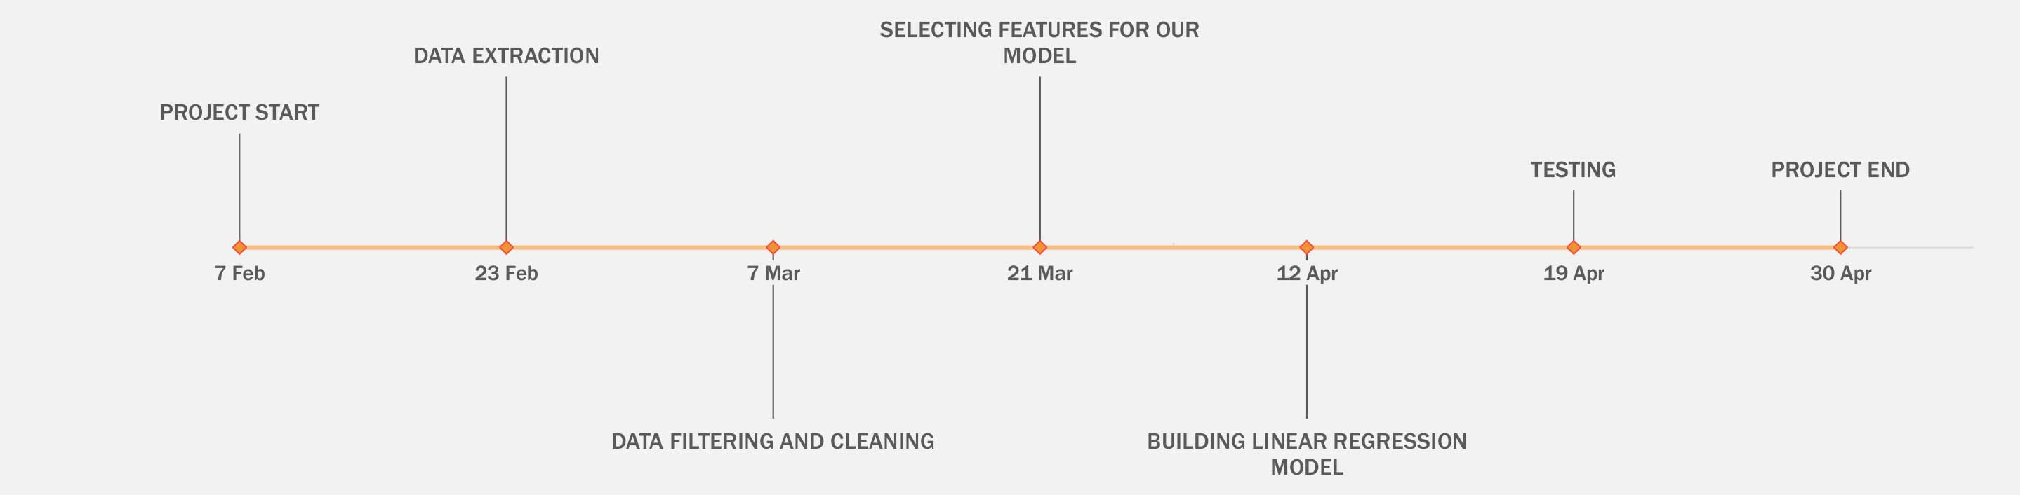
Timeline:

Slide 14
Implementation Details: Module-1 : Data Collection Module-2 : Data Cleaning and Filtering Module-3 : Feature Extraction Module-4 : Implementing Regression model Module-5 : Final model

Slide 15
Module 1:
Data Collection

Slide 16
Data collection:
step 1: Initialize base url, api key, target date, feature name list.
step 2: open a csv file in write mode
set the fieldnames to feature list values
step 3: for each in range(days)
send a request to the base url defined
convert the api response to json format
write the json data to the opened csv file
increment the target date to next day
end for
step 4: end

Slide 17
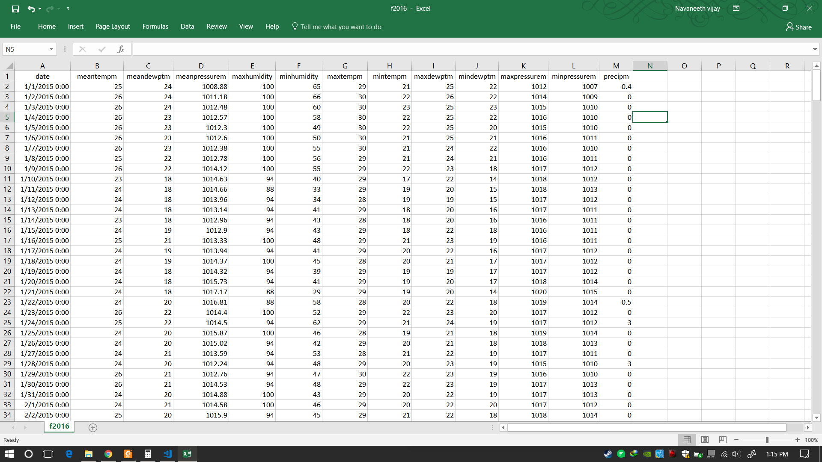
Output:

Slide 18
Modules to complete:
Module – 2, Module – 3, Module – 4, Module - 5

Slide 19
Thank You!

Slide 20
References:
[1] Mark Holmstrom, Dylan Liu, Christopher Vo. Machine Learning Applied to Weather Forecasting. Stanford University. 2016.
[2] Siddharth S. Bhatkhande, Roopa G. Hubballi. Weather Prediction Based on Decision Tree Algorithm Using Data Mining Techniques. IJARCCE (2016). ISSN (Online) 2278-1021 ISSN (Print) 2319 5940.
[3] Aditya Grover, Ashish Kapoor and Eric Horvitz. A Deep Hybrid Model for Weather Forecasting.
[4] John K. Williams and D. A. Ahijevych, C. J. Kessinger, T. R. Saxen, M. Steiner and S. Dettling. A machine learning approach to finding weather regimes and skillful predictor combinations for short-term storm forecasting . National Center for Atmospheric Research, Boulder, Colorado.

Slide 21
[5] Aastha Sharma, Setu Chaturvedi and Bhupesh Gour. A Semi- Supervised Technique for Weather Condition Prediction using DBSCAN and KNN.International Journal of Computer Applications (0975 – 8887) Volume 95– No. 10, June 2014 .
[6] Mrs. C. Beulah Christalin Latha, Dr. (Mrs.) Sujni Paul, Dr.E.Kirubakaran and Mr. Sathianarayanan. A Service Oriented Architecture for Weather Forecasting Using Data Mining.Int. J. of Advanced Networking and Applications. Volume: 02, Issue:02, Pages:608-613. 2010.
[7] C. Johansson , M. Bergkvist , O. De Somer, D. Geysen , N. Lavesson and D. Vanhoudt. Operational demand forecasting in district heating systems using ensembles of online machine learning algorithms.The 15th International Symposium on District Heating and Cooling September 4-7, 2016, Seoul, Republic of Korea (South Korea).

Slide 22
[8] Daniel Bejarano and Adriano Quiroga. Wind Prediction: Physical model improvement through support vector regression.Stanford University. December 2013.
[9] Emilcy Hern ́andez Victor Sanchez-Anguix Vicente Julian Javier Palanca and N ́estor Duque.Rainfall prediction: A Deep Learning approach.
[10] Kiran Kumar. R 1, Usha Rani. R.Weather Prediction through Machine Learning.Dept of Computer science, Krishna University, Machilipatnam. AP, India.
[11] http://en.proft.me/2015/12/24/types-machine-learning-algorithms/
[12] https://www.wunderground.com/
[13] https://seatemperature.info/
[14] https://en.wikipedia.org/wiki/Linear_regression

