Slide 1
Hospital management system
Under the guidance of
G.PREETHA,Trainer
Submitted by
N.NIVEDITHA (AF0342103)
B.NAVANEETHA(AF0341749)
S.DURGA BHAVANI(AF0337446)

Slide 2
introduction
The Hospital Management System (HMS) is like a helpful computer program for hospitals. It keeps track of patient details, appointments, and which doctor is helping to patient. It makes sure that only the right people can see patient information securely. The HMS also helps by doing some tasks automatically and making hospital work smoother. Basically, the HMS is a great tool that helps hospitals do their job well.

Slide 3
technologies
My project technologies are
Core java
Mysql
Hibernate

Slide 4
modules
User Authentication
Admin Module
Doctor Module
Patient Module

Slide 5
User Authentication
The program includes a basic login system for Admin,Doctor and Patients.Users are requried to enter their username and password.
Admin,Doctor and Patients login credentials are stored in user tables.
User can login only 3 times per execution.

Slide 6
Admin MOdule
After a "ADMIN" successfully logs in,they have to access to a menu with the following options:
User type Management: In this case we have View All Users,Add Username and password to doctor,change password to admin
Patient Management: In this case we have View all patients,Add patient details,Update patient details,Search patient details
Doctor Management: In this case we have View all doctors,Add doctor details,Update doctor details,Search doctor details

Slide 7
Appointment Management: In this case we have View all appointments details,schedule an appointment to patient,Confirm and Cancel appointment status,Update appointment date and time,search for appointments.
Medical History Management: In this case we have View all medicalhistory,Search patient medical history.
Rooms Management: In this case we have View all rooms details,Allocate room,Update room period,Search room by patient id.

Slide 8
Doctor Module
After a "DOCTOR" successfully logs in,they have to access to a menu with the following options:
Personal Info: In this case,They can view their details.
View My Appointments: In this case it will display all appointment details of doctor.
View Assigned Patients List: In this case doctor can view the list of the patients treated by him.
Treat Patient: In this case doctor will add medical history to patient..
Change Password: In this case,they can change thier own password.

Slide 9
Patient Module
After a "PATIENT" successfully logs in,they have to access to a menu with the following options:
Personal Info: In this case,They can view their details.
View my Appoinment: In this case,it will show patient appointments.
View My Medical History: In this case,they can view their medical history.
Update Patient details: In this case,they can update their contact details.
Change password: In this case,he will change password profile.

Slide 10
Validations
Validate Email:In this case,it will allow user to insert an email in the E-mail format.
Validate BloodGroup:In this case,it will only allow user to insert only(A+,A-,B+,B-,O+,O-,AB+,AB-) and it is a case sensitive it allow only upper case values.
Validate Gender:In this case,it will only allow user to insert(M,F,O) and it is not a case sensitive.
Validate Integer Input:In this case,it will allow user to insert only integer values.
Validate PhoneNumber:In this case,it will allow user to insert only 10 numbers(0-9).
Validate User Password:In this case,it will allow user to insert password as atleast one upper case,atleast one lower case,atleast one number and atleast one special character.

Slide 11
Junit 5 TESTING
JUnit is a unit testing open-source framework for the Java programming language.
We conducted JUnit testing to verify the insertion of patient details into the database.
We conducted JUnit testing to verify the insertion of doctor details into the database.
We performed JUnit testing to ensure the accurate insertion of login credentials into the system.

Slide 12
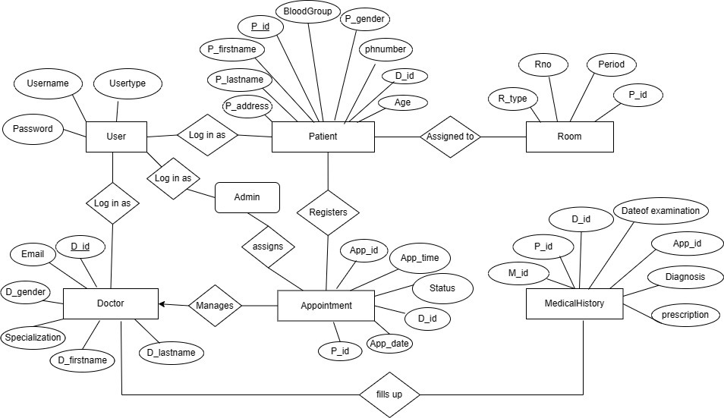
ER DIAGRAM

Slide 13
RelationShips
“We use hbm.xml files to represent table entities in our project.”
Patient table :
one to many(Patient - Medicalhistory)
one to many(Patient - Appointment)
many to one(Patient - Doctor).
Doctor table :
one to many(Doctor - Patient)
one to many(Doctor - Appointment)
one to many(Doctor - Medicalhistory).

Slide 14
Appointment table :
one to many(Appointment - Medicalhistory)
many to one(Appointment - Patient)
many to one(Appointment - Doctor).
Medicalhistory table :
many to one(Medicalhistory - Patient)
many to one(Medicalhistory - Doctor)
many to one(Medicalhistory - Appointment).
Room table :
one to one(Room - Patient).

Slide 15

user table

Slide 16
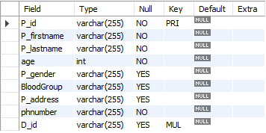
patient table

Slide 17
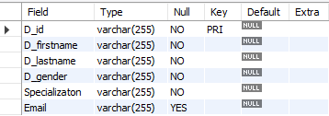
Doctor table

Slide 18
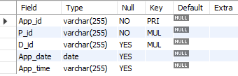
Appointment table

Slide 19
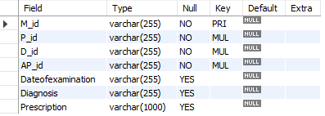
Medical history table

Slide 20

Room table

Slide 21
Source code
package hms.authentication;
Package is a container which can segregate the files in the java project.
import java.util.*;
import org.hibernate.Session;
import org.hibernate.SessionFactory;
import hms.entity.*;
These import statements are used to include the necessary classes and libraries in your Java program.

Slide 22
public class Login {
This line declares the main class of the program named "Login."
Patient patient = new Patient();
Scanner sc = new Scanner(System.in);
Patient and Scanner object for user input are declared.
public static void main(String[] args) {
The program's main method begins here.
boolean usercounter = true;
Declares a boolean variable "usercounter" to control while flow.

Slide 23
while (usercounter) {
Starts a loop that continues until a successful connection is established.
try {
The start of a try block for handling exceptions.
settings.put(Environment.URL, "jdbc:mysql://localhost:3306/Hms");
Sets the URL of the MySQL database.
jdbc:mysql : This is the protocol for connecting to a MySQL database.
localhost : This is the hostname of the database server. It indicates that the database is running on the local machine.
3306 : This is the port number on which MySQL is listening. The default MYSQL port is 3306.

Slide 24
Hms : This is the name of the specific database you want to connect to from backend.
settings.put(Environment.USER, "root");
This is the username used to authenticate the database connection. In this case, you are using "root" as the password.
settings.put(Environment.PASS, "Root");
This is the password used to authenticate the database connection. In this case, you are using "Root" as the password.
settings.put(Environment.HBM2DDL_AUTO, "update");
Specifies how Hibernate should update the database schema based on the mapping metadata (e.g., create,create-drop,update).

Slide 25
configuration.setProperties(settings);
Applies the settings to the Hibernate Configuration object
configuration.addResource("hms/entity/Patient.hbm.xml");
Add entity.hbm.xml mapping files
catch (Exception e) {
This block will execute only if an exception occurs in the try block
e.printStackTrace();
This line prints the exception's stack trace to the console
Session session = HibernateUtil.getSessionFactory().openSession()
It is used to obtain a session from the Hibernate session factory.

Slide 26
transaction = session.beginTransaction();
Starts a new transaction in the Hibernate session.
session.persist(patient);
saves the patient object into the database.
transaction.commit();
The transaction is committed using transaction.commit() if all operations within the try block are successful.
transaction.rollback();
If an exception occurs during the execution of the try block, the transaction is rolled back using transaction.rollback(). This ensures that the database changes are reverted.

Slide 27
Conclusion
The provided code appears to be the implementation of a basic Hospital Management system using Java, Mysql and Hibernate.
This project allows for three types of users to log in: Admin,Doctor,Patient. Admin can perform actions such as adding Patient details, adding doctor details, updating appointment details,search patient medical history and Allocate room to the patients. Doctor can log in to view their profile details,can check appointments and adding prescription to patient. Patient, on the other hand, can log in to view their profile details,can check appointments,can see medicalHistory and update their details.

Slide 28


