Slide 1
Water and sea pollution
Created by
A . Navaneethamahavishnu

Slide 2
Types of pollution
Air pollution
Water pollution
Land pollution
Noise pollution
Sea pollution

Slide 3
Types of water pollution
There are many types of water pollution because water comes from many sources
surface water pollution
under ground water pollution
microbiological pollution
chemical water pollution
oil spilling

Slide 4
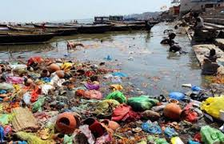
Surface water pollution
Surface water pollution is the pollution of aquatic system that are above ground such as lake , stream and river.
The water polluted from many sources .
It cause to lees oxygen production ,which harm to water living organism

Slide 5
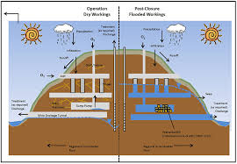
Ground water pollution
Ground water contamination occurs when man made products such as gasoline ,oil , road salts and chemical waste into the groundwater
It cause unsafe and unfit for human use

Slide 6
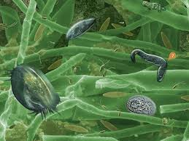
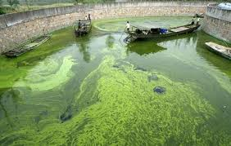
Microbiological pollution
The pollution caused by micro organisms.
Many types of micro organism live in water
Cause fish , land animal and human become ill
Such as bacteria , fungi , virus and so many number of micro organisms are present

Slide 7
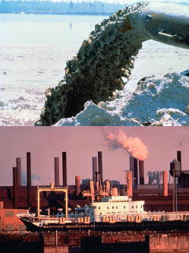
Chemical pollution
Industrial and agricultural use many chemical that run-off into water.
It metal and solvent from industrial work can pollute river , lake .
Pesticides are used in forming to control inserts , fungi and ect.

Slide 8
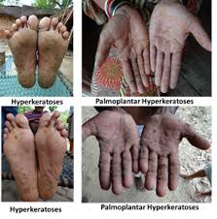
Effect of human health
Main problem is that kill the organism and it affect food chain .
Some water borne typhoid , cholera , paratyphoid , dysentery and negative effect on our human health.
Some time people are died .

Slide 9
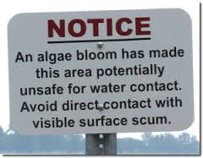

Slide 10
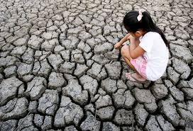
Water scarcity due to mining

Slide 11
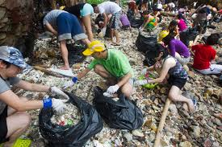
Prevent the water pollution
Do not pour fat from cooking any type of oil ,fat or grease .
Do not dispose house hold chemical and chemical agent.
Treatment of waste discharge and disposal of pollutant .

Slide 12
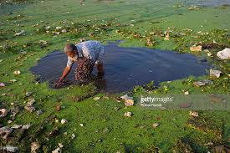
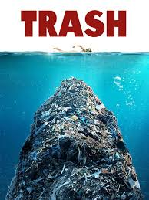
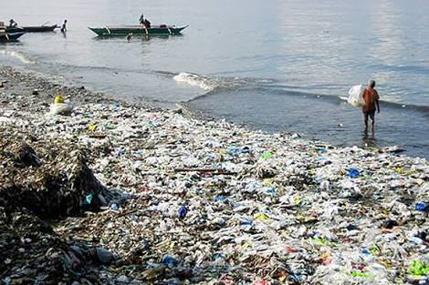
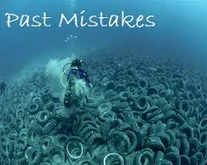
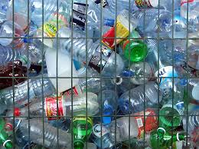
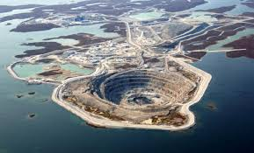
This pollution are caused by human being

Slide 13
Sea water pollution
Oil spilling
Dumping
Sewage
Petroleum mining

Slide 14
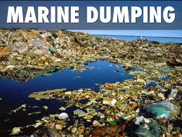
Dumping
A portion of the billions
Trillion of tons of trash
Produced each year finds its way into ocean water
Trash ,radioactive material , toxic chemical , nuclear waste are directly dump into sea directly

Slide 15
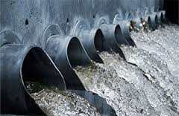
sewage
Animal waste and human waste water from toilets and other house hold activity .
It cause many disease, and bacteria .
The sewage also dumped into sea .

Slide 16
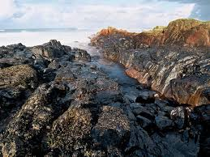
Oil spilling
Oil spill is the release of liquid petroleum hydrocarbon into the environment.
The oil is released into the ocean or costal area ,but spill may occur on land .
Example : oil spilling in chennai.

Slide 17
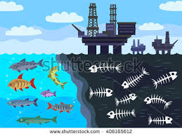
Mining
Mining is the process which simply in end up in river.
The minerals are obtained from the river
The chemical substance are used .
It affect the under ground water table

Slide 18
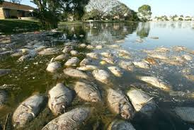
Effect of sea pollution
It affect sea living specious
It totally affect fisher mans life .
Some time it kill many living organism and totally damage the sea and surrounding area .

Slide 19
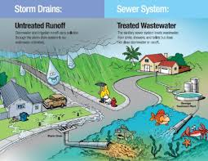
Prevention
Do not throw paints ,oil ,from drain and river .
Run off material into nearby water sources.
Avoid trash , dumping ,mining and oil spilling.

Slide 20
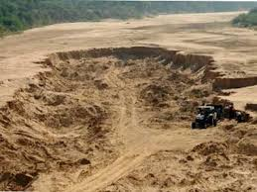
Effect of mining
The process of mining it totally affect the surrounding area .
It cause water scarcity .

Slide 21
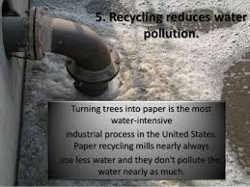
Recycle process
The waste material recycled then after use

Slide 22
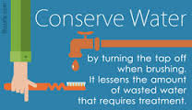
Create awareness
First solution is create awareness from the people .
People keep clean surrounding place .

Slide 23

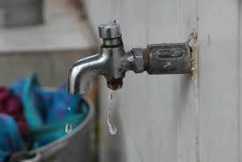
Save water

Slide 24
Thank you
Success
Has no
Time limit

