Slide 1
DATA ANALYSIS
For CEO and CMO

Slide 2
Hello, and welcome, CEO and CMO. Today, I'm excited to present the results of our data analysis, addressing the questions you posed to gain insights into our retail business.
Here's what we'll cover in this presentation:
Seasonal Trends in Revenue for 2011
Top 10 Revenue Generating Countries (excluding the UK)
Top 10 Customers by Revenue
Demand for Products by Region (excluding the UK)

Slide 3
Before we dive into the visuals, let me briefly walk you through the data preparation process. We started by loading and cleaning the data to ensure accuracy and reliability. This included handling missing values and outliers, which are essential steps in any data analysis.
Now, let's move on to the insights.

Slide 4
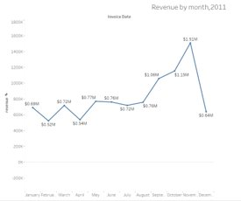
CEO, you expressed interest in understanding the seasonal trends in our revenue for 2011. Here's a line chart that shows the revenue for each month.
As you can see, there's a clear seasonal pattern, with higher revenue during the holiday season. This insight can help us plan for the next year, especially during peak sales periods.

Slide 5
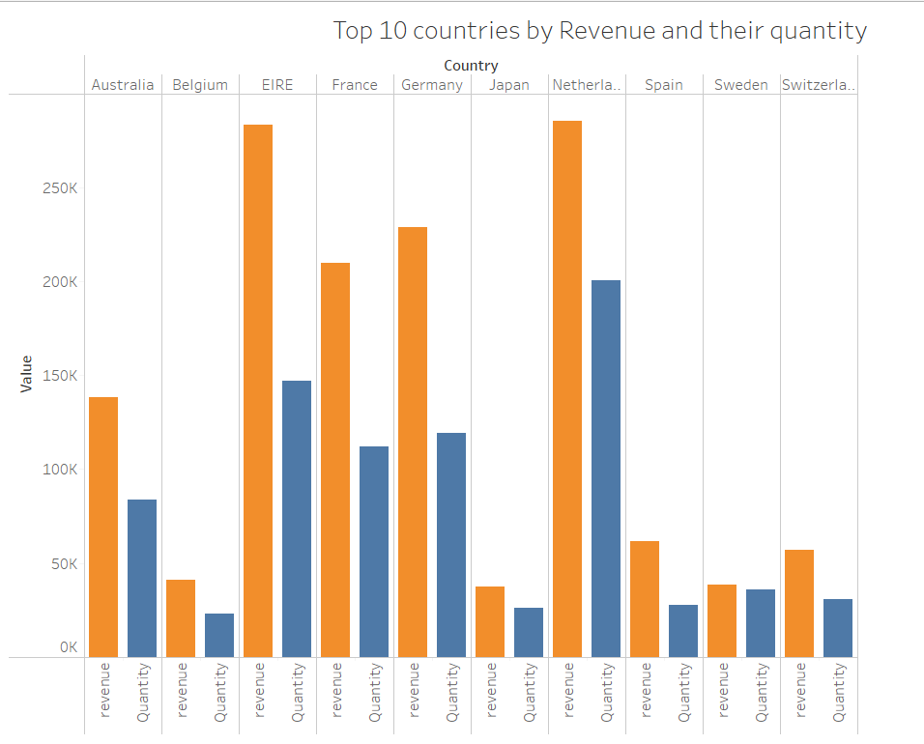
Top 10 Revenue Generating Countries (excluding the UK)CMO, you wanted to identify the top revenue-generating countries while excluding the UK. Here's a bar chart.
These are the top 10 countries generating the highest revenue. Additionally, we've included the quantity sold for each country. This will guide our marketing and sales strategies.

Slide 6
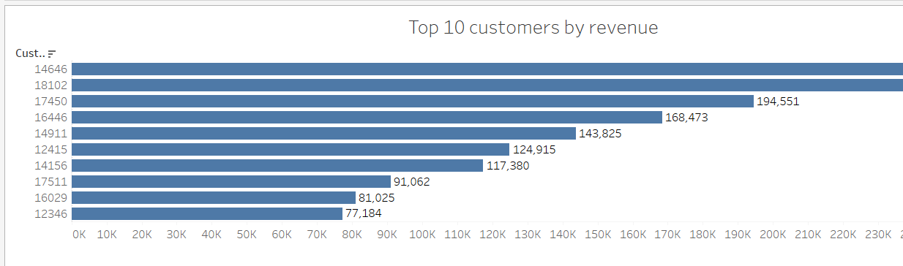
Top 10 Customers by RevenueNow, CMO, you also requested information on our top 10 customers by revenue. Here's a horizontal bar chart.
This chart displays our highest revenue-generating customers at the top, gradually declining to lower revenue customers. It's crucial for targeting and ensuring their satisfaction.

Slide 7
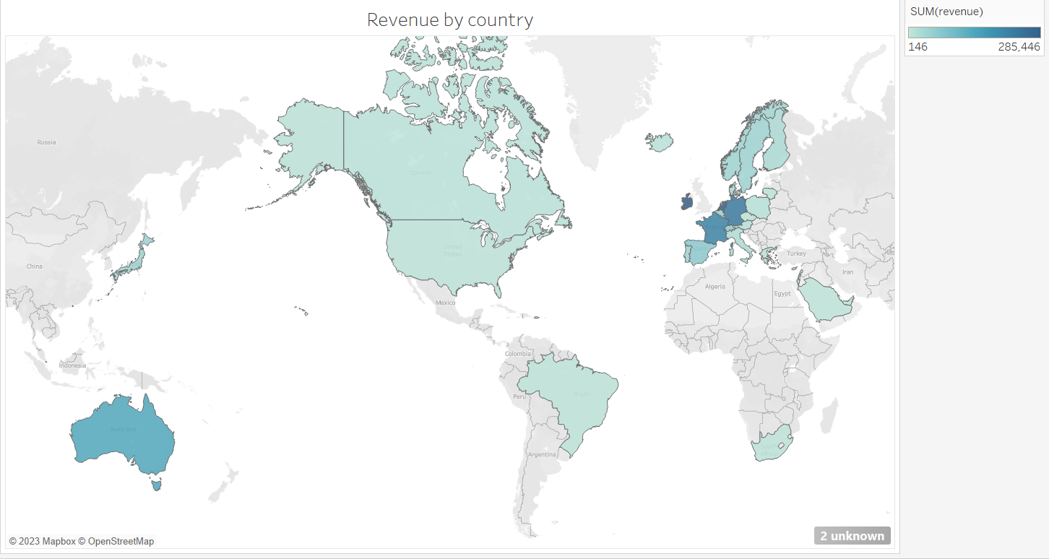
Demand for Products by Region (excluding the UK) CEO, your focus was on understanding demand across regions. Here's a map showing demand, excluding the UK.
The color intensity represents demand, helping us identify expansion opportunities. Regions with higher demand are highlighted for potential business growth.

Slide 8
Conclusion and Actionable Insights
In conclusion, our data analysis provides actionable insights:
We can prepare for seasonal trends in 2011, optimizing resources during peak periods.
For marketing, we should focus on the top revenue countries, considering quantity sold.
Our top revenue customers need targeted efforts for customer satisfaction.
Regions with high demand are excellent expansion prospects.

Slide 9
THANK YOU Thank you for your time. These insights will guide our strategies and help us achieve our business goals. If you have any questions or need further details, please feel free to ask.
Don't hesitate to reach out for additional information or further analysis. We're here to support your decision-making process.

