Slide 1



AMC ENGINEERING COLLEGE
Department of Information Science & Engineering
“ An Energy Management Scheme for Green IoT Environments ”
GUIDED BY:
Mrs AMUTHA
ASST. PROF. ISE DEPT, AMCEC
PRESENTED BY:
B S NAVANITH (1AM17IS058)
8th SEMESTER ISE DEPT, AMCEC

Slide 2
CONTENTS
Abstract
Introduction
Literature Survey
Methodology
Results
Conclusions and Future Enhancements
References
Acknowledgements

Slide 3
ABSTRACT
Maintaining an ideal energy consumption rate has become one of the most important challenges in the IoT research field. In this system, heterogeneous types of energy-constrained nodes are considered.
The proposed EMS comprises three strategies :
- The first strategy minimizes the volume of data that may be transmitted through the IoT environment.
- The second strategy schedules the work of the critical energy IoT nodes.
- The third strategy provides a fault tolerance scenario that can be applied to address inevitable energy problems faced by IoT nodes.

Slide 4
INTRODUCTION
In recent years, the Internet of Things (IoT) has changed the world like the Internet did.
The IoT can be defined as billions of passive and active networked devices communicating with each other.
The IoT is a heterogeneous environment that incorporates many different nodes such as sensors, RFID tags, RFID readers, and mobile devices.
The IoT is not only a network for data transmission but also can be described as a system containing protocols, events, and big data processing.
The IoT applications often require battery based nodes working for long intervals without human intervention after their initial adaptations.
In the absence of energy management methodologies, these nodes would drain their batteries within short periods.

Slide 5
CONTINUED...
In addition, an IoT application can only achieve its mission as long as its nodes are considered alive.
Hence, the goal of any energy supply and management technique is to maximize the network lifetime.
Therefore, energy consumption is one of the most critical and multidimensional challenges in the IoT environment.
The IoT nodes that are energy based have different types of applications, such as the wireless sensor network (WSN), radio-frequency identification (RFID) network, and the mobile ad hoc network (MANET).
Consequently finding one technique to minimize the energy consumption rate is difficult.

Slide 6
CONTINUED...
Therefore, in this study, an IoT Energy Management Scheme (EMS) is proposed.
The key contributions of this study can be summarized as follows :
• Use of data reduction techniques in the IoT environment;
• Development of a methodology to save the energy of IoT energy-based nodes.
• Design of a fault tolerance scenario for IoT energy-based nodes.
• Construction of a simulation test bed for the IoT environment;
• Presentation and discussion of the simulation results.`

Slide 7
LITERATURE SURVEY
Sl.No | TITLE | AUTHOR | YEAR | ADVANTAGES | DISADVANTAGES | METHODOLOGY
1. | “ Energy efficient IoT-based smart home” | Lalia Salman, Safa Salman, Saeed Jahangirian, Mehdi Abraham, Fred German, Charlotte Blair and Peter Krenz. | 2016 | Manages the energy usage as well as, enhance the living experience in modern homes. | It is not adapted for systems that can transmit large numbers of gigabytes. | In this work, a home model is analyzed to demonstrate an energy efficient IoT based smart home.
2. | “ IoT energy management platform for microgrid ” | Tai-yean Ku, Wan-Ki Park and Hoon Choi. | 2017 | It maximizes the efficiency of using surplus electric power produced by forming electric power network in a certain scale area. | It’s neglecting the fault tolerance issue. | This paper shows IoT energy management platform with energy big data system.

Slide 8
CONTINUED...
Sl.No | TITLE | AUTHOR | YEAR | ADVANTAGES | DISADVANTAGES | METHODOLOGY
3. | “ Efficient energy management for the Internet of Things in smart cities ” | Waleed Ejaz, Muhammad Naeem, Adnan Shahid, Alagan Anpalagan and Minho Jo. | 2017 | - Proposed system is optimized and scheduled. - It extended the lifetime of low power devices. | - The performance analysis of this framework is weak. - It neglected the large quantity of data that may be transmitted in the smart city. | Energy-efficient solutions and energy harvesting operations.
4. | “ Energy Management in Smart Buildings by Using M2M Communication ” | Haithem Chaouch , Abdullah Salih Bayraktar and Celal Ceken. | 2019 | The results show that the system developed is capable of automatically reducing energy consumption and maintaining steady comfort level required by the occupants in the building. | This work is relatively complicated to use and the occupants may face some serious problems when applying the right setting for the right case. | The design deploys a simple and efficient energy management system by applying a novel approach.

Slide 9
METHODOLOGY
The concept of the EMS is based on the application of three basic strategies :
STRATEGY 1: DATA MINIMIZATION :
In the IoT environment, there are many relationships that couple the energy issue with data. The data is considered to be one of the foremost factors which consume the nodes’ energy.
Therefore, the process of data minimization in the EMS comprises :
DATA PRIORITIZATION :
The data prioritization method which is used in the EMS is based on queuing theory.
In the two-queue model, the linear data system is used, The formula “ P ij = λ i + μ j ” .
DATA FITTING :
In the data fitting methodology, the data can be abstracted into a small size and sent to the destination.
The data fitting methodology has many techniques. In the proposed EMS, the least square technique is applied as a data fitting methodology.
For simplicity, the linear method is applied to the proposed EMS :
f app = θ 1 f 1 (y) + θ 2 f 2 (y) + θ 3 f 3 (y) + . . . . . . θ n f n (y)
DATA COMPRESSION:
Data compression is used to minimize the energy consumption rates by decreasing the number of bytes which will be transmitted from energy-based nodes to other nodes in the IoT environment.

Slide 10
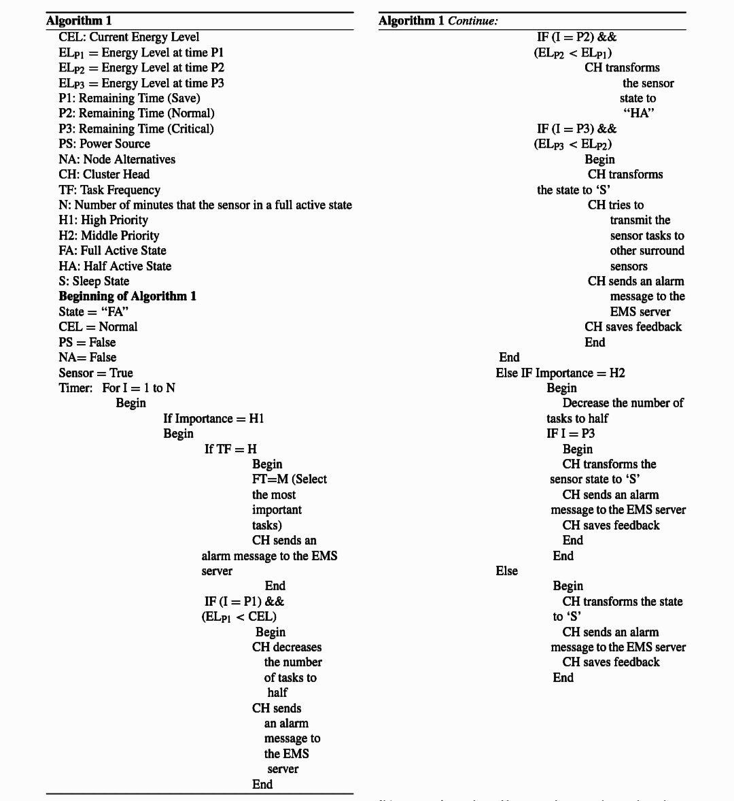
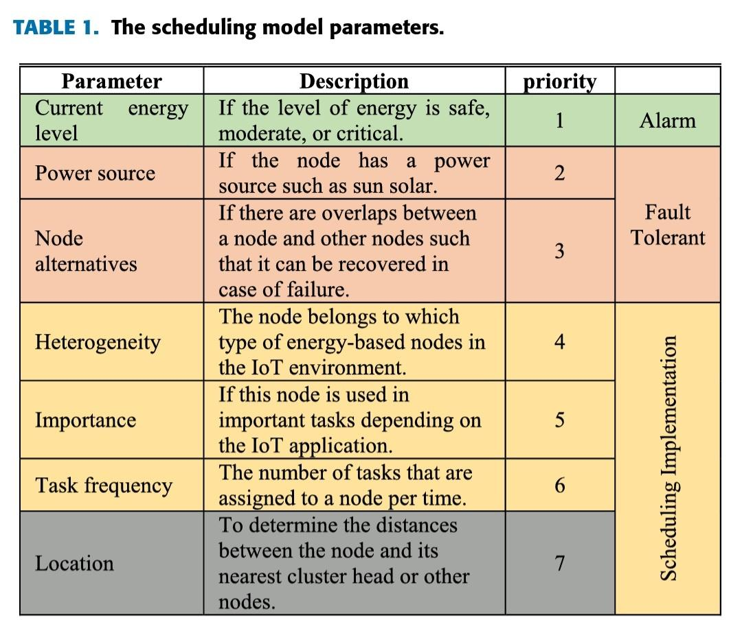
CONTINUED...
* STRATEGY 2: SCHEDULING :
The proposed scheduling methodology in EMS considers seven issues.
The IoT energy-based nodes are supposed to be classified into groups of clusters for management purposes.
Each Cluster has a head which manages its nodes.
The scheduling model for sensors is based on the sensor transitioning between three states.
The Algorithm 1 and algorithm 2 describe the scheduling models.

Slide 11
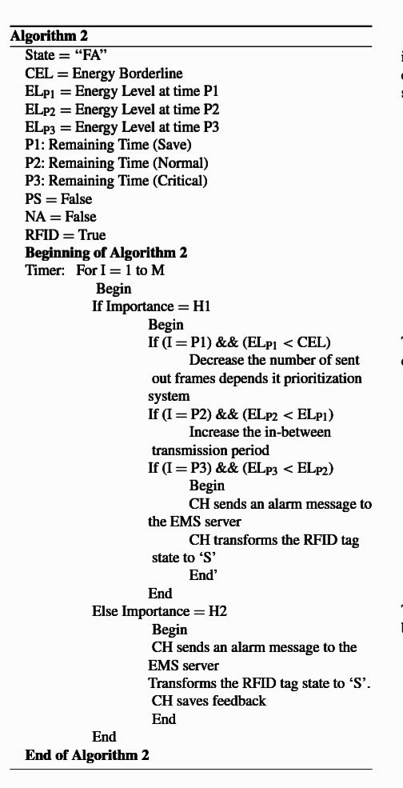
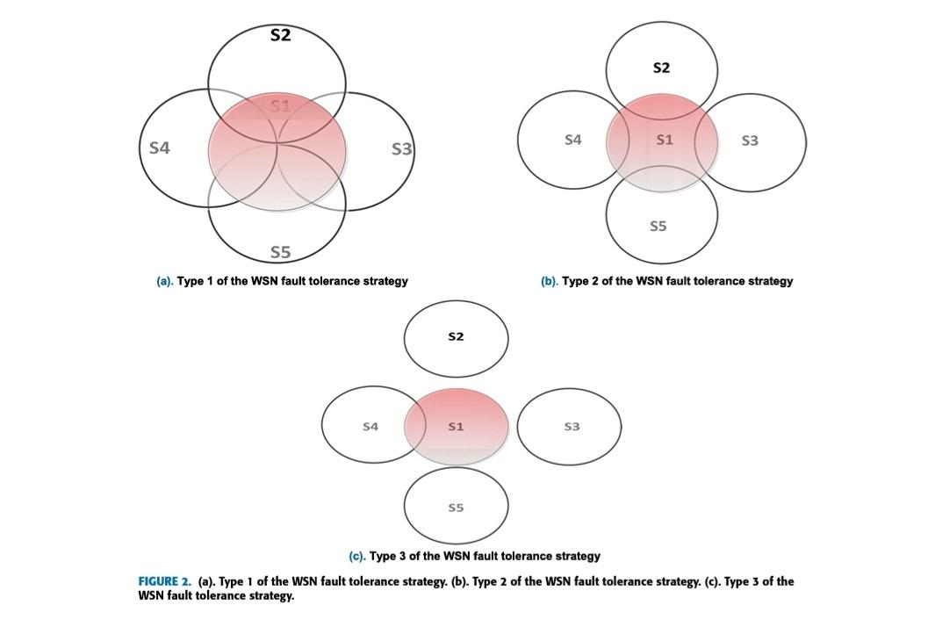
* STRATEGY 3: FAULT TOLERANCE
This strategy is used with or after applying the previous two strategies.
In the case of a node’s energy failure, it should be replaced with an alternative node(s).
This strategy is considered as a complement of EMS trying to not lose any data or task in the IoT environment.
There are three types of node recovery process :
Type 1: This type is used for nodes that have highest importance level.
Type 2: This type is used for nodes that have a middle importance level. In this type, the coverage process should be achieved using a number of nodes less than the ‘‘full coverage’’ type.
Type 3: This type is used for nodes which have a low importance level. In this type, the coverage process should be achieved using a low number of nodes

Slide 12
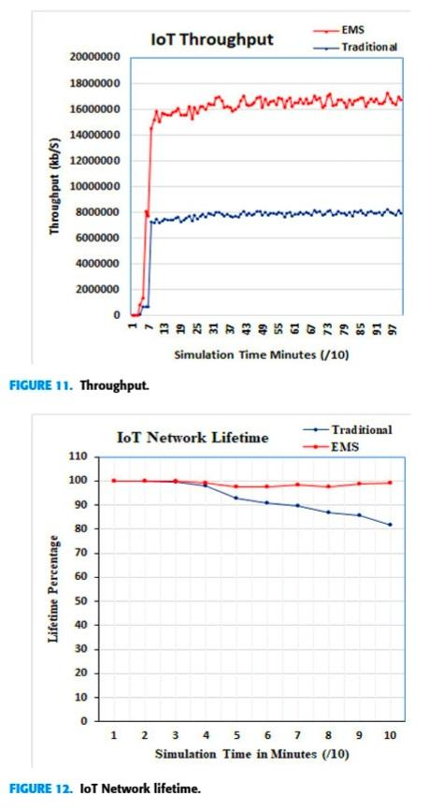
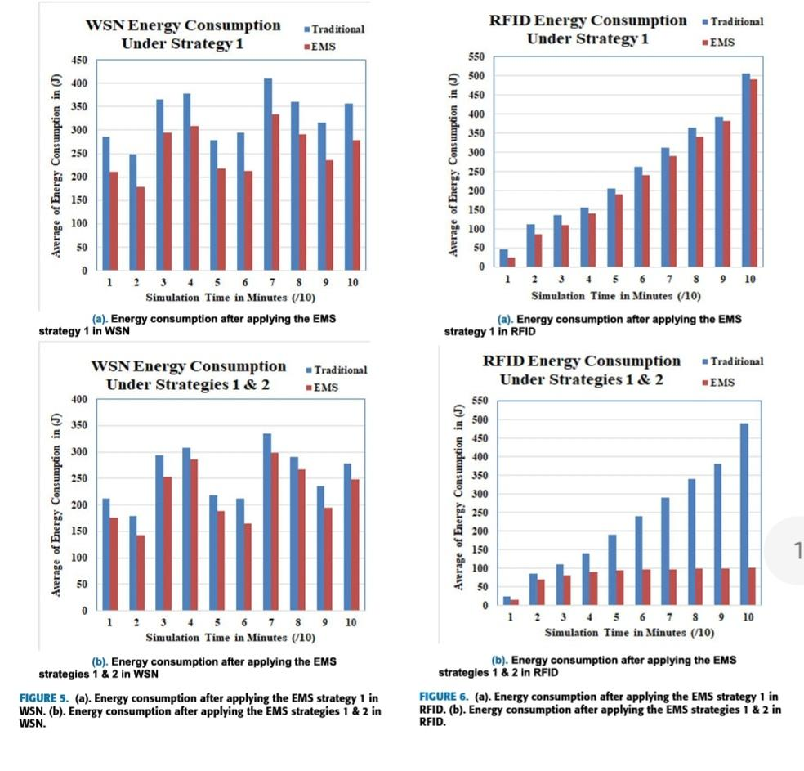
RESULTS

Slide 13
CONCLUSION AND FUTURE ENHANCEMENTS
Finally, the EMS was tested using a simulation environment that was constructed with the NS2 simulator.
The simulation results proved that the proposed EMS outperformed the traditional IoT as follows:
The energy consumption rate and the number of failure nodes for WSN decreased by 32.66%↓ and 19.75%↓, respectively.
The energy consumption rate and the number of failure nodes for RFID decreased by 65.909%↓ and 87.422%↓, respectively.
Finally, the IoT network lifetime is increased by 26.408%↑. Therefore, the EMS is recommended to control the energy consumption rates in the IoT environments.
In future scope, the methods to minimize energy wastage can be further improved and simplified by applying efficient optimization techniques.

Slide 14
REFERENCES
[1] J. Wu, M. Dong, K. Ota, J. Li, W. Yang, and M. Wang, ‘‘Fog-Computing-Enabled cognitive network function virtualization for an information-centric future Internet,’’ IEEE Commun. Mag., vol. 57, no. 7, pp. 48–54, Jul. 2019.
[2] X. Wang, Z. Ning, X. Hu, L. Wang, L. Guo, B. Hu, and X. Wu, ‘‘Future communications and energy management in the Internet of vehicles: Toward intelligent energy-harvesting,’’ IEEE Wireless Commun., vol. 26, no. 6, pp. 87–93, Dec. 2019.
[3] T. Sanislav, S. Zeadally, G. D. Mois, and S. C. Folea, ‘‘Wireless energy harvesting: Empirical results and practical considerations for Internet of Things,’’ J. Netw. Comput. Appl., vol. 121, pp. 149–158, Nov. 2018.
[4] X. Lin, J. Li, J. Wu, H. Liang, and W. Yang, ‘‘Making knowledge tradable in edge-AI enabled IoT: A consortium blockchain-based efficient and incentive approach,’’ IEEE Trans Ind. Informat., vol. 15, no. 12, pp. 6367–6378, Dec. 2019.
[5] G. Li, G. Xu, A. K. Sangaiah, J. Wu, and J. Li, ‘‘EdgeLaaS: Edge learning as a service for knowledge-centric connected healthcare,’’ IEEE Netw., vol. 33, no. 6, pp. 37–43, Nov. 2019.
[6] H. Liang, J. Wu, S. Mumtaz, J. Li, X. Lin, and M. Wen, ‘‘MBID: Micro-blockchain-based geographical dynamic intrusion detection for V2X,’’IEEE Commun. Mag., vol. 57, no. 10, pp. 77–83, Oct. 2019.
[7] A. Tolba and A. Altameem, ‘‘A three-tier architecture for securing IoV communications using vehicular dependencies,’’ IEEE Access, vol. 7,pp. 61331–61341, 2019.
[8] Z. Zhou, J. Feng, B. Gu, B. Ai, S. Mumtaz, J. Rodriguez, and M. Guizani,‘‘When mobile crowd sensing meets UAV: Energy-efficient task assignment and route planning,’’ IEEE Trans. Commun., vol. 66, no. 11,pp. 5526–5538, Nov. 2018.
[9] J. Wu, M. Dong, K. Ota, J. Li, and Z. Guan, ‘‘Big data analysis-based secure cluster management for optimized control plane in software-defined networks,’’ IEEE Trans. Netw. Service Manage., vol. 15, no. 1, pp. 27–38, Mar. 2018.
[10] Z. Ning, P. Dong, X. Wang, J. J. Rodrigues, and F. Xia, ‘‘Deep reinforcement learning for vehicular edge computing: An intelligent offloading system,’’ ACM Trans. Intell. Syst. Technol., vol. 10, no. 6, p. 60, 2019.
[11] J. Chen, J. Wu, H. Liang, S. Mumtaz, J. Li, K. Konstantin, A. K. Bashir, and R. Nawaz, ‘‘Collaborative trust blockchain based unbiased control transfer mechanism for industrial automation,’’ IEEE Trans. Ind. Appl., to be published, doi: 10.1109/TIA.2019.2959550.
[12] Z. Ning, Y. Li, P. Dong, X. Wang, M. S. Obaidat, X. Hu, L. Guo, Y. Guo, J. Huang, and B. Hu, ‘‘When deep reinforcement learning meets 5G-enabled vehicular networks: A distributed offloading framework for traffic big data,’’ IEEE Trans Ind. Informat., vol. 16, no. 2, pp. 1352–1361,Feb. 2020, doi: 10.1109/TII.2019.2937079.
[13] A. Tolba, ‘‘Content accessibility preference approach for improving service optimality in Internet of vehicles,’’ Comput. Netw., vol. 152, pp. 78–86, Apr. 2019.
[14] Z. Ning, Y. Feng, M. Collotta, X. Kong, X. Wang, L. Guo, X. Hu, and B. Hu, ‘‘Deep learning in edge of vehicles: Exploring tri relationship for data transmission,’’ IEEE Trans Ind. Informat., vol. 15, no. 10,pp. 5737–5746, Oct. 2019.
[15] H. N. Rafsanjani and A. Ghahramani, ‘‘Towards utilizing Internet of
Things (IoT) devices for understanding individual occupants’ energy usage of personal and shared appliances in office buildings,’’ J. Building Eng.,vol. 27, Jan. 2020, Art. no. 100948.

Slide 15
CONTINUED...
[16] Z. Ning, J. Huang, X. Wang, J. J. P. C. Rodrigues, and L. Guo, ‘‘Mobile edge computing-enabled Internet of vehicles: Toward energy-efficient scheduling,’’ IEEE Netw., vol. 33, no. 5, pp. 198–205, Sep. 2019.
[17] L. Salman, S. Salman, S. Jahangirian, M. Abraham, F. German, C. Blair, and P. Krenz, ‘‘Energy efficient IoT-based smart home,’’ in Proc. IEEE 3rd World Forum Internet Things (WF-IoT), Reston, VA, USA, Dec. 2016, pp.526–529.
[18] T.-Y. Ku, W.-K. Park, and H. Choi, ‘‘IoT energy management platform for microgrid,’’ in Proc. IEEE 7th Int. Conf. Power Energy Syst. (ICPES), Toronto, ON, Canada, Nov. 2017, pp. 106–110.
[19] C.-S. Choi, J.-D. Jeong, I.-W. Lee, and W.-K. Park, ‘‘LoRa based renewable energy monitoring system with open IoT platform,’’ in Proc. Int.Conf. Electron., Inf., Commun. (ICEIC), Honolulu, HI, USA, Jan. 2018, pp. 24–27.
[20] M. Prathik, K. Anitha, and V. Anitha, ‘‘Smart energy meter surveillance using IoT,’’ in Proc. Int. Conf. Power, Energy, Control Transmiss. Syst.(ICPECTS), Chennai, India, Feb. 2018, pp. 22–23.
[21] A. Srinivasan, K. Baskaran, and G. Yann, ‘‘IoT based smart plug-load energy conservation and management system,’’ in Proc. IEEE 2nd Int. Conf. Power Energy Appl. (ICPEA), Singapore, Apr. 2019, pp. 27–30.
[22] S. Suresh Kumar, R. Kaviyaraj, L. A. Jeni Narayanan, and Saleekha, ‘‘Energy harvesting by piezoelectric sensor array in road using Internet of Things,’’ in Proc. 5th Int. Conf. Adv. Comput. Commun. Syst. (ICACCS), Coimbatore, India, Mar. 2019, pp. 482–484.
[23] H. Chaouch, A. S. Bayraktar, and C. Ceken, ‘‘Energy management in smart buildings by using M2M communication,’’ in Proc. 7th Int. Istanbul Smart Grids Cities Congr. Fair (ICSG), Istanbul, Turkey, Apr. 2019, pp. 25–26.
24] F. H. Panahi, S. Moshirvaziri, Y. Mihemmedi, F. H. Panahi, and T. Ohtsuki, ‘‘Smart energy harvesting for Internet of Things,’’ in Proc. Smart Grid Conf. (SGC), Sanandaj, Iran, 2018, pp. 1–5, doi:10.1109/SGC.2018.8777889.
[25] A. H. B. Alaudin, M. M. M. Zan, A. R. Mahmud, C. K. H. C. K. Yahaya,M. I. Yusof, and Y. M. Yussoff, ‘‘Real-time residential energy monitoring device using Internet of Things,’’ in Proc. IEEE 8th Int. Conf. Syst. Eng.Technol. (ICSET), Bandung, Indonesia, Oct. 2018, pp. 97–101.
[26] I. Tcarenko, Y. Huan, D. Juhasz, A. M. Rahmani, Z. Zou, T. Westerlund,P. Liljeberg, L. Zheng, and H. Tenhunen, ‘‘Smart energy efficient gateway for Internet of mobile things,’’ in Proc. 14th IEEE Annu. Consum. Commun. Netw. Conf. (CCNC), Las Vegas, NV, USA, Jan. 2017, pp. 8–11.
[27] K. Suresh, M. RajasekharaBabu, and R. Patan, ‘‘EEIoT: Energy efficient mechanism to leverage the Internet of Things (IoT),’’ in Proc.Int. Conf. Emerg. Technol. Trends (ICETT), Kollam, India, Oct. 2016,pp. 21–22.
[28] M. H. Yaghmaee and H. Hejazi, ‘‘Design and implementation of an Internet of Things based smart energy metering,’’ in Proc. IEEE Int. Conf.Smart Energy Grid Eng. (SEGE), Oshawa, ON, Canada, Aug. 2018, pp. 191–194.
[29] J. Pan, R. Jain, S. Paul, T. Vu, A. Saifullah, and M. Sha, ‘‘An Internet of Things framework for smart energy in buildings: Designs, prototype, and experiments,’’ IEEE Internet Things J., vol. 2, no. 6, pp. 527–537, Dec. 2015.
[30] X. Ding and J. Wu, ‘‘Study on energy consumption optimization scheduling for Internet of Things,’’ IEEE Access, vol. 7, pp. 70574–70583, May 2019.

Slide 16
ACKNOWLEDGEMENTS
The successful completion of any task will be incomplete without complementing those who made it possible and whose guidance and encouragement made my efforts successful. I express my sincere thanks to AMC Engineering College, Bangalore for providing all kinds of facilities to carry out my seminar.
I take immense pleasure in thanking Dr. A G Nataraj, Principal, AMC Engineering College, Bangalore for providing me all the facilities for successful completion of my seminar.
I am grateful to Dr. M V Sudhamani, Professor and HOD, Department of Information Science and Engineering, AMC Engineering College, Bengaluru, for her constant motivation, encouragement and guidance to make this seminar a success.
I am grateful to seminar coordinator Mrs. Ayain John, Asst. professor, Department of Information Science and Engineering, AMC Engineering College, Bangalore, for support constant and guidance to make this seminar success.
I am grateful to Guide name, Designation, Department of Information Science and Engineering, AMC Engineering College, Bangalore, for constant motivation and guidance to make this seminar success.

Slide 17
THANK YOU..!!

