Slide 1
Frequent Pattern (FP) Growth
Team Members:
Navaprettam N
Pranav V
Shivashankar M N
Shravan A H
Presented to:
SanthoshKumar M
Head of the Dept CSE
GMIT,DVG

Slide 2
TABLE OF CONTENTS
01
Introduction
02
FP-Algorithm
03
Python-Code
04
Application
05
Conclusion

Slide 3
01
Introduction

Slide 4
Introduction
FP-Growth is a data mining algorithm.
Used for finding frequent patterns in large datasets.
It is commonly employed for association rule mining.
Utilizes an FP-tree data structure to efficiently represent the dataset.
Facilitate pattern mining.
Has the advantage of avoiding the generation of candidate item sets.
Highly efficient for handling large datasets.
The main steps include data preprocessing, building the FP-tree, mining frequent patterns, and generating association rules.

Slide 5
02
FP Algorithm

Slide 6
Algorithm
Data Preprocessing:
Convert the dataset into a transactional format, where each transaction represents a set of items.
Assign support thresholds to determine the minimum frequency required for a pattern to be considered frequent.
Building the FP-Tree:
Scan the dataset to construct the FP-tree. Start with an empty tree.
For each transaction, insert the items into the tree while maintaining the frequency count of each item.
Items are inserted in descending order of their frequency to optimize tree construction.

Slide 7
Algorithm
3.Mining Frequent Patterns:
Perform a depth-first search on the FP-tree to extract frequent patterns.
Start with the least frequent item in the tree and traverse its conditional sub-tree.
For each frequent item, construct a conditional pattern base by collecting the paths leading to the item.
Recursively mine the conditional pattern base to find frequent patterns.
4.Generating Association Rules:
Use the frequent patterns obtained from the previous step to generate association rules.
Evaluate the support and confidence of each rule based on user-defined thresholds.
Support measures the frequency of a pattern, while confidence indicates the reliability of a rule.

Slide 8
Example
Consider the below tansaction in which B = Bread, J = Jelly, P = Peanut Butter, M = Milk and E = Eggs. Given that minimum support = 40%.
TID | Items Bought
1 | {B, J, P}
2 | {B, P}
3 | {B, M, P}
4 | {E, B}
5 | {E, M}

Slide 9
Example
Step-1: Scan DB once, find frequent 1-itemset (single item in itemset)
Items | Frequency
B | 4
J | 1
P | 3
M | 2
E | 2

Slide 10
Example
Step-2: As minimum support = 40%, So in this step we will remove all the items that are bought less than 40% of support or support less than 2.
Items | Frequency
B | 4
P | 3
M | 2
E | 2
Step-3: Create a F -list in which frequent items are sorted in the descending order based on the support.
F-List | {B, P, M, E}

Slide 11
Example
Step-4: Sort frequent items in transactions based on F-list. It is also known as FPDP.
TID | Items Bought
1 | {B, P}
2 | {B, P}
3 | {B, P, M}
4 | {B, E}
5 | {M, E}

Slide 12
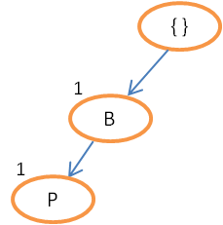
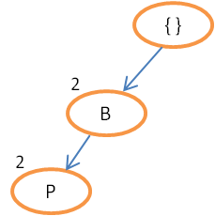
Example
Step-5: Construct the FP tree
Read transaction 1: {B,P} -> Create 2 nodes B and P. Set the path as null -> B -> P and the count of B and P as 1 as shown below :
Read transaction 2: {B,P} -> The path will be null -> B -> P. As transaction 1 and 2 share the same path. Set counts of B and P to 2

Slide 13
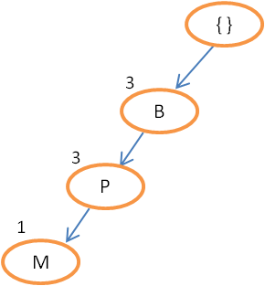
Example
Read transaction 3: {B,P,M} -> The path will be null -> B -> P -> M. As transaction 2 and 3 share the same path till node P. Therefore, set count of B and P as 3 and create node M having count 1.

Slide 14
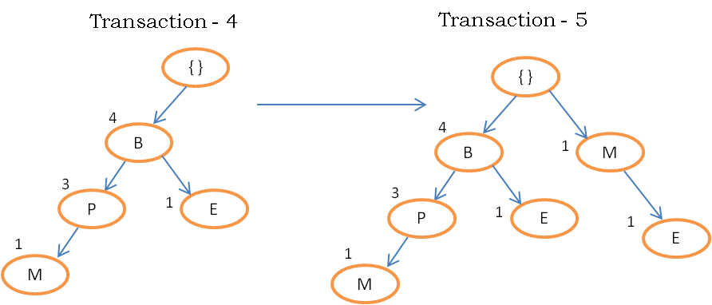
Example
Continue until all the transactions are mapped to a path in FP-tree.

Slide 15
Example
Step-6: Construct the conditional FP tree in the sequence of reverse order of F - List {E,M,P,B} and generate frequent item set. The conditional FP tree is sub tree which is built by considering the transactions of a particular item and then removing that item from all the transaction.
Items set | Condition Pattern base | Condition FP-Tree | Frequency Pattern Generated
E | {{B:1}, {M:1}} | { } | { }
M | {{B, P:1}} | {B, P:1} | { }
P | {{B:3}} | {B:3} | <B, P:3>
B | { } | { } | { }
The above table has two items {B , P} that are bought together frequently.

Slide 16
03
Python-Code

Slide 17
Python-Code
from mlxtend.preprocessing import TransactionEncoder
from mlxtend.frequent_patterns import fpgrowth
import pandas as pd
# Example dataset
dataset = [
['Bread', 'Milk'],
['Bread', 'Diapers', 'Beer', 'Eggs'],
['Milk', 'Diapers', 'Beer', 'Coke'],
['Bread', 'Milk', 'Diapers', 'Beer'],
['Bread', 'Milk', 'Diapers', 'Coke']
]

Slide 18
Python-Code
# Convert the dataset into a transaction format
te = TransactionEncoder()
te_ary = te.fit(dataset).transform(dataset)
df = pd.DataFrame(te_ary, columns=te.columns_)
# Run FP-Growth algorithm
frequent_itemsets = fpgrowth(df, min_support=0.5, use_colnames=True)
# Print the frequent itemsets
print(frequent_itemsets)

Slide 19
Output
support itemsets
0 0.8 (Milk)
1 0.8 (Bread)
2 0.8 (Diapers)
3 0.6 (Beer)
4 0.6 (Bread, Milk)
5 0.6 (Diapers, Bread)
6 0.6 (Diapers, Milk)
7 0.6 (Beer, Diapers)

Slide 20
04
Try-it-out

Slide 21
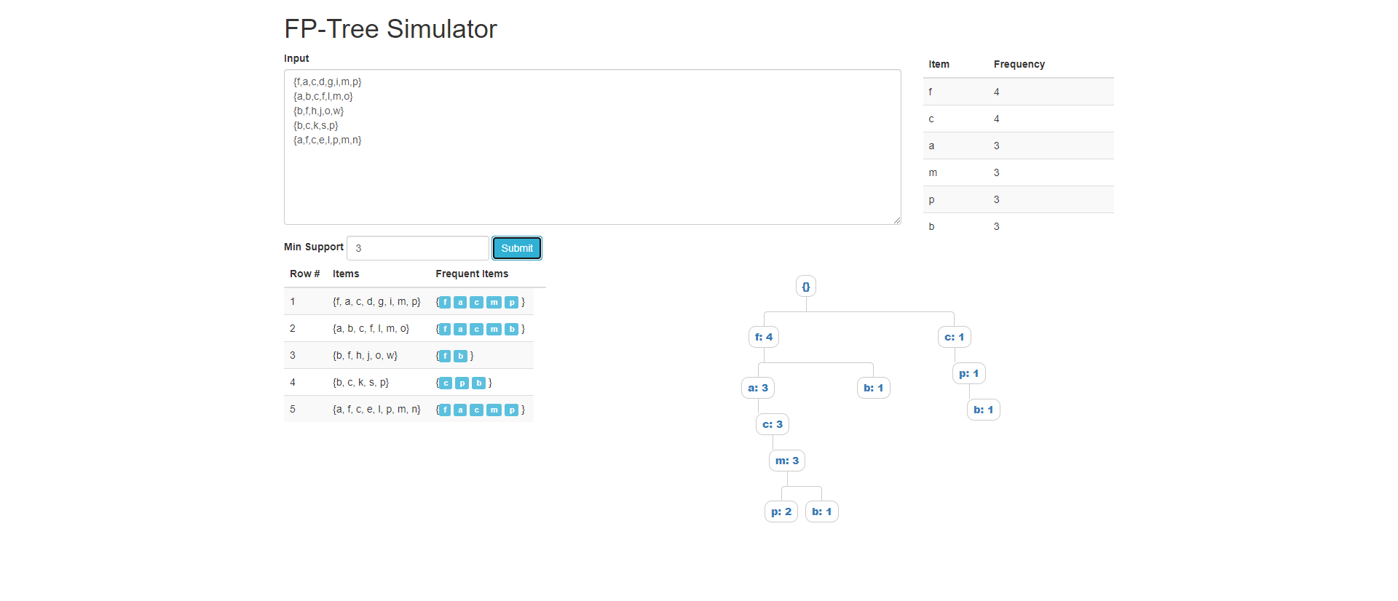
Website Overlook

Slide 22

Try-it-out

Slide 23
05
Application

Slide 24
Application
Market Basket Analysis
Recommender Systems
Fraud Detection
Healthcare Data Analysis:
Text Mining
Intrusion Detection
Bioinformatics
Web Usage Mining

Slide 25
Advantage and disadvantage
Advantages Of FP Growth Algorithm
This algorithm needs to scan the database only twice when compared to Apriori which scans the transactions for each iteration.
The pairing of items is not done in this algorithm and this makes it faster.
The database is stored in a compact version in memory.
It is efficient and scalable for mining both long and short frequent patterns.
Disadvantages Of FP-Growth Algorithm
FP Tree is more cumbersome and difficult to build than Apriori.
It may be expensive.
When the database is large, the algorithm may not fit in the shared memory.

Slide 26
06
Conclusion

Slide 27
Conclusion
Frequent Pattern Growth Algorithm is the method of finding frequent patterns without candidate generation. It constructs an FP Tree rather than using the generate and test strategy of Apriori. The focus of the FP Growth algorithm is on fragmenting the paths of the items and mining frequent patterns.
Overall, the FP-Growth algorithm is a valuable tool for discovering meaningful patterns and associations in data, enabling organizations to make data-driven decisions, enhance their operations, and gain a competitive edge in their respective domains.

Slide 28
Thank you!
Any question???

