Slide 1
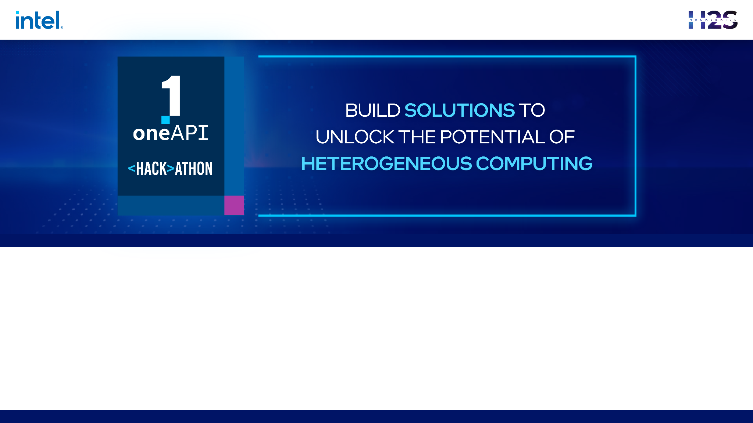
<Intelabled> <oneAPI >
Team Name : The INTELlectuals
Team Members : Navaprettam N, Pranav V, Pooja H P

Slide 2
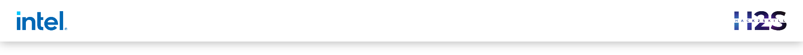

Problem Statement
Develop an inclusive education app that leverages advanced technologies and AI to enhance accessibility and learning experiences for students with diverse abilities.
Key aspects include:
Integrating disability-specific features
Designing a user-friendly interface
Analyzing assignments and providing feedback
Detecting learning disabilities
Adapting multimedia content, and evaluating performance.

Slide 3
Architecture – Impact of oneAPI/SYCL (How oneAPI /SYCL helped you?)
To achieve this, our app's solution involves the following steps: First, user input will be adjusted based on their preference, allowing students with visual disabilities to interact with the app using voice input. The app will utilize SYCL OpenCL Interoperability (sycl-gtx) to access the GPU for supporting AI-based features. Next, simple input commands like "Eddie, download notes" will enable students to download and save notes using the app. Voice and vibration notifications will be employed to alert students about joining classes.
For students with hearing impairments, the app will provide access to hearing aids through SYCL Media Interoperability (sycl-media), ensuring a seamless integration of audio functionality. Analyzing student assignments and providing active feedback will utilize SYCL ML Interoperability (sycl-ml) to interface with machine learning libraries. Constant monitoring will enable the app to detect learning disabilities in students, recommending personalized programs. This monitoring and recommendation system will be implemented using SYCL OpenCV Interoperability (sycl-opencv) and SYCL ML Interoperability (sycl-ml). To accommodate students with color blindness, an AI feature will modify interactive visuals like PPTs, employing SYCL OpenCV Interoperability (sycl-opencv) for detecting and modifying visuals. For visually disabled students, the app will provide audio output, utilizing SYCL Media Interoperability (sycl-media) to process audio files.
Interactive text and image-based output will be generated using SYCL Media Interoperability (sycl-media) and SYCL OpenCV Interoperability (sycl-opencv) to make learning interesting for students with hearing impairments.
By leveraging these libraries and technologies, our app aims to provide an inclusive and accessible learning environment for students with diverse abilities.

Slide 4
Core components of oneAPI/SYCL used in the project
SYCL
SYCL OpenCL Interoperability (sycl-gtx) - SYCL ML
Interoperability (sycl-ml)
SYCL Media Interoperability (sycl-media)
ONE API
OneVPL
OneDNN

Slide 5
Demo Video/Live Demo

Slide 6
GitHub Link
https://github.com/NavaprettamN/intel-oneAPI

Slide 7
Results Summary (focus on unique aspects of oneAPI/SYCL that you have used)
Results Summary: The implementation of our app utilizing the oneAPI/SYCL tech stack has resulted in several unique and beneficial aspects.
Enhanced Accessibility: By leveraging SYCL OpenCL Interoperability (sycl-gtx), our app efficiently utilizes GPU resources, enabling the smooth execution of AI-based features. This ensures that students with visual disabilities can interact with the app seamlessly using voice input, enhancing their accessibility and inclusivity.
2.Seamless Image and Video Processing: SYCL OpenCV Interoperability (sycl-opencv) facilitates seamless integration with OpenCV libraries, allowing us to efficiently process images and videos. This capability is crucial for detecting and modifying interactive visuals specifically tailored to students with color blindness, offering them a tailored learning experience.
3.AI-Powered Learning Support: SYCL ML Interoperability (sycl-ml) empowers our app with advanced machine learning capabilities. It facilitates the analysis of student assignments, providing active feedback to improve learning outcomes. Additionally, SYCL ML Interoperability enables constant monitoring to detect learning disabilities, allowing us to recommend personalized programs to students based on their individual needs.

Slide 8
Results Summary (focus on unique aspects of oneAPI/SYCL that you have used)
4. Multimedia Adaptation: SYCL Media Interoperability (sycl-media) provides seamless integration with media libraries, allowing our app to process audio and video files effectively. This enables features such as audio output for visually disabled students and interactive text and image-based output for students with hearing impairments. By leveraging SYCL Media Interoperability, our app ensures an engaging and inclusive learning environment.
5. Hardware Optimization: The utilization of Intel's oneAPI libraries, including oneDAL, oneDNN, and oneVPL, enables hardware optimization for improved performance. By leveraging the power of Intel CPUs, GPUs, and Movidius VPUs, our app accelerates the execution of deep learning models and video processing tasks, enhancing the overall user experience.
In summary, the unique aspects of the oneAPI/SYCL tech stack in our app include enhanced accessibility, seamless image and video processing, AI-powered learning support, multimedia adaptation, and hardware optimization. These aspects collectively contribute to creating an inclusive and efficient educational app that caters to the diverse needs of students with disabilities.

Slide 9
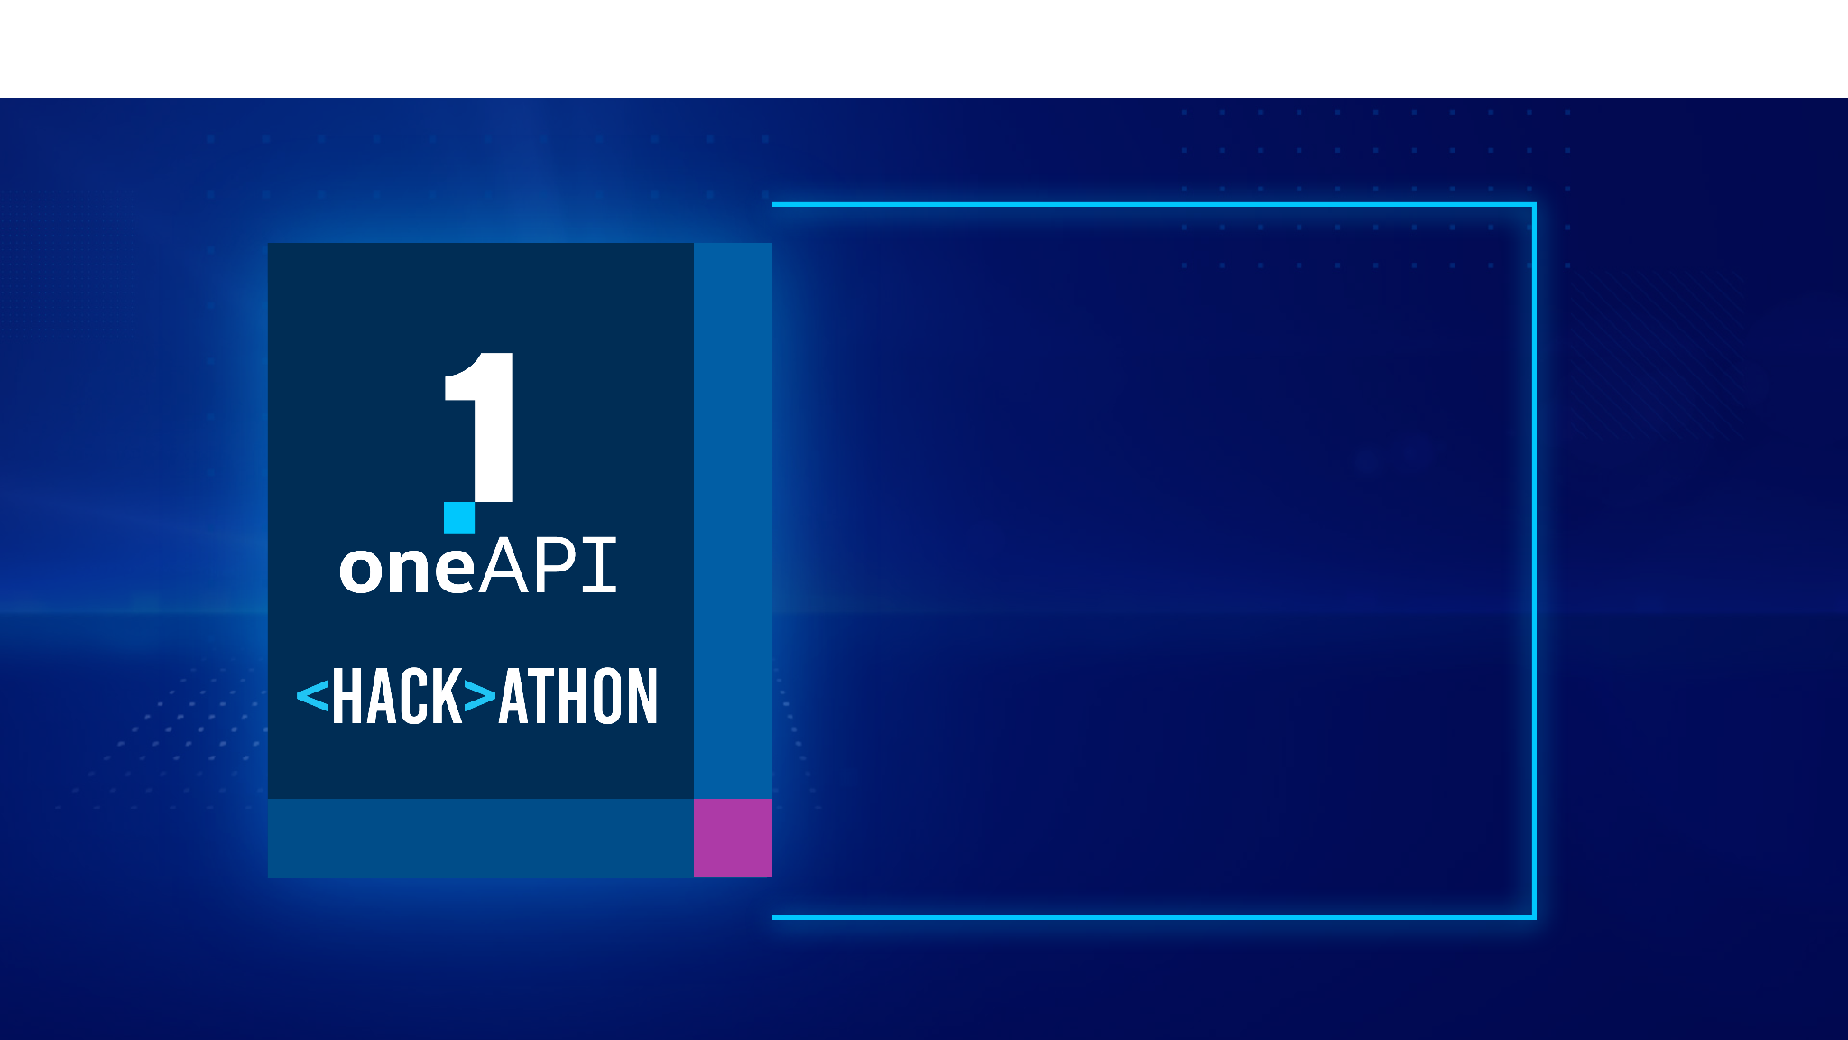
THANK YOU

