Slide 1



Garbage Classification
by,
Navdeep S
GitHub : https://github.com/Navdeep-04/Garbage_classification.git

Slide 2

Learning Objectives
Understand image classification using CNN.
Train a model to classify garbage images into categories.
Evaluate model performance using metrics and visualization.
Apply dataset preprocessing techniques.
GOAL
Github:
https://github.com/Navdeep-04/Garbage_classification.git

Slide 3
Tools and Technology used
Python – Programming language for development.
TensorFlow & Keras – Deep learning frameworks.
NumPy & Matplotlib – Data handling and visualization.
Jupyter Notebook – For interactive experimentation.
Google Colab / GPU – For faster training and testing.
ImageDataset API – For loading and managing image data

Slide 4
Methodology
Collect and organize dataset into labeled folders.
Preprocess images using resizing and normalization.
Build CNN with Conv2D, MaxPooling, Flatten, and Dense layers.
Compile model with optimizer and loss function.
Train using training and validation split.
Visualize results with accuracy and loss curves.

Slide 5
Problem Statement:
Waste segregation is currently manual and inefficient.
Wrong disposal of garbage causes environmental issues.
Manual classification is time-consuming and error-prone.
Automation needed for accurate garbage classification.
Classify into categories like plastic, paper, metal, etc.
Need for scalable, accurate, and fast classification system.

Slide 6
Solution:
Train CNN model using labeled garbage images.
Classify into multiple garbage types using image features.
Preprocess data with normalization and augmentation.
Validate and test model with real-world images.
Display predictions with accuracy scores.
Automate sorting to support smart recycling systems.

Slide 7
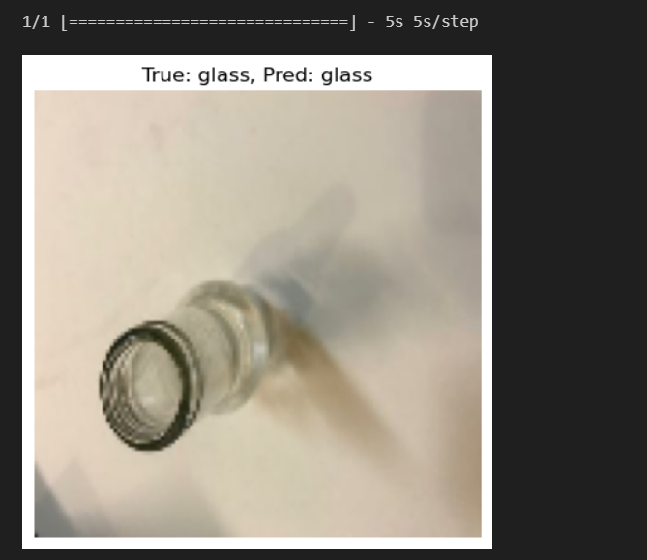
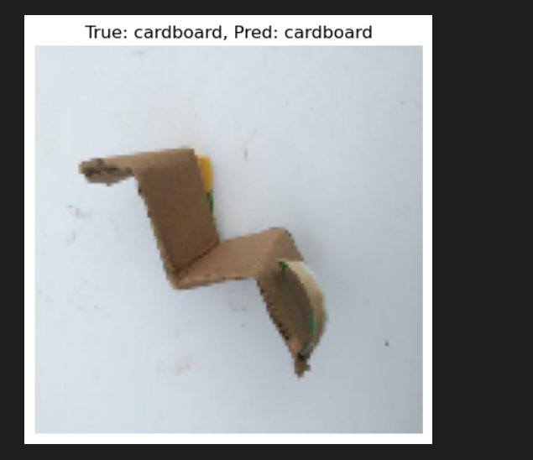
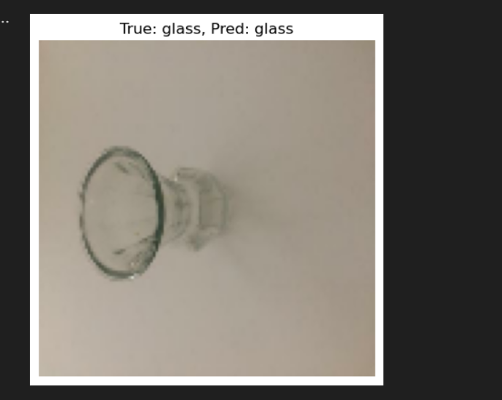
Screenshot of Output:
Model training and validation accuracy/loss curves.
Sample prediction from the trained model.

Slide 8
Conclusion:
Model summary shows CNN architecture details.
Accuracy and loss plotted for training and validation.
Prediction results with image samples and labels.
Output screenshots inserted from model run.
Achieved high accuracy on garbage classification.
CNN successfully automates waste sorting for sustainability.

