Slide 1



PORJECT LITTLE: QR CODE BASED ATTENDANCE MANAGEMENT
TEAM MEMBERS:
GUIDE NAME:
MAHESHWARAN M - ITB2201
MONISH BABU V - ITB2210
NAVDEEP S - ITB2213
SRI RAM S - ITB2247
Ms. J. PRIYADHARASHINI M.E.,
ASSISTANT PROFESSOR.,
Information Technology.

Slide 2
ABSTRACT
QR code-based attendance management systems streamline the process of tracking attendance in educational institutions.
Each student receives a unique QR code to scan using a smartphone upon entering classroom.
The scanned data is automatically recorded in a central database, ensuring accurate and real-time attendance tracking.

Slide 3
INTRODUCTION
QR code attendance management is a new way to keep track student attendence.
Instead of writing names down, people just scan a code when they arrive.
It's easier and faster than the old way.
With QR codes, we can see who's here in real-time and make managing schedules simpler.

Slide 4
LITERATURE SURVEY
S. NO | AUTHOR | YEAR | TITLE | ADVANTAGES | DISADVANTAGES
1. | Kumar, P., & Shenoy, P | 2018 | A Novel Approach to Automated Attendance Monitoring using QR Codes. | Reduces manual errors. Enhances data accuracy. | Requires smartphones with QR code scanning capability.
2. | Lee, J., & Hwang, S | 2017 | Enhancing Classroom Attendance Management Using QR Codes. | Provides comprehensive attendance reports and analytics. | Initial setup can be complex and time-consuming.
3. | Gupta, A., & Sharma, R | 2019 | Smart Attendance System Using QR Code. | Scalable to large classrooms and multiple campuses. | Maintenance and updates can be resource-intensive.

Slide 5
4. | Ali, M., & Ahmad, N. | 2020 | Implementation of a QR Code-Based Attendance System for Higher Education. | Increased reliability and reduction in fraudulent attendance. | Dependence on consistent QR code generation and scanning
5. | Raj, P., & Rao, V. | 2018 | An Intelligent Attendance System Using QR Code | Reduces administrative workload. | Requires continuous internet access.
6. | Smith, J., & Johnson, L. | 2019 | Enhancing the Efficiency of Attendance Systems with QR Code Technology | Streamlines attendance process in corporate settings. | May require integration with existing corporate systems.
7. | Brown, A., & Davis, M. | 2020 | Implementation of QR Code Attendance System for Workforce Management | Improves employee attendance tracking accuracy. | Potential for misuse if QR codes are shared.

Slide 6
EXISTING SYSTEM
The existing QR code attendance management system is a modern solution designed to streamline the process of tracking attendance in various settings, such as educational institutions, workplaces, and events.
By scanning unique QR codes with a smartphone participants can quickly and efficiently register their presence.
DRAWBACKS
Expose personal information if not properly secured.
Incorrect scanning or poor quality QR codes.
false attendance records.

Slide 7
PROPOSED SYSTEM
The proposed QR code attendance management system aims to enhance security, reliability, and user accessibility over existing models.
It incorporates advanced features such as encrypted QR codes to prevent forgery, offline functionality to mitigate connectivity issues, and enhanced privacy measures to protect user data.
ADVANTAGES
To minimize data entry errors.
Personal informations are save and secured.
To increase processing speed.

Slide 8
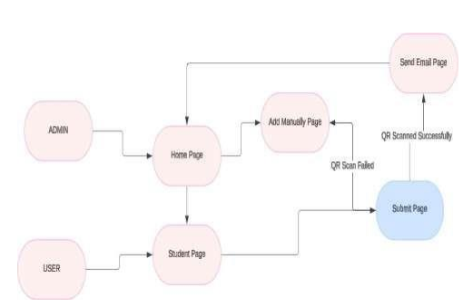
ARCHITECTURE DIAGRAM

Slide 9
MODULE
REGISTER MODULE:
This module contains Qr code for scanning and maintains the information about all the students present that are registered as per the system.
MANUAL REGISTER MODULE:
This module contains manual registration for attendance.
This manual method is used in case of powercut, server issues and network problems.
INFO MODULE:
In this module, qr scanned register information as well as Manually registered information are displayed.

Slide 10
SYSTEM SPECIFICATION
HARD﻿WARE CONFIGURATION
SOFTWARE CONFIGURATION

Slide 11
HARDWARE CONFIGURATION
Processor : AMD Ryzen™ 5 5500U
Hard disk capacity : 512GB
Monitor : FHD, IPS-level pane
Graphics : AMD Radeon™ Graphics
Internal memory capacity : 16GB
Cpu clock : 4.4 GHz

Slide 12
SOFTWARE CONFIGURATION
Operating system : Windows 11
Front end : Html
Css
Back end : Sqlite
Python(django)

Slide 13
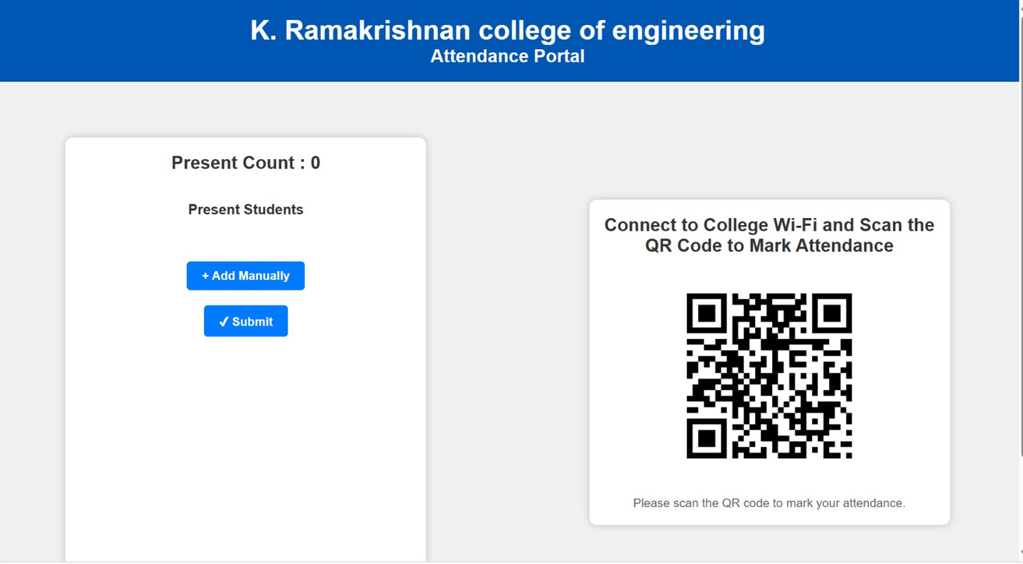
QR REGISTER PAGE

Slide 14
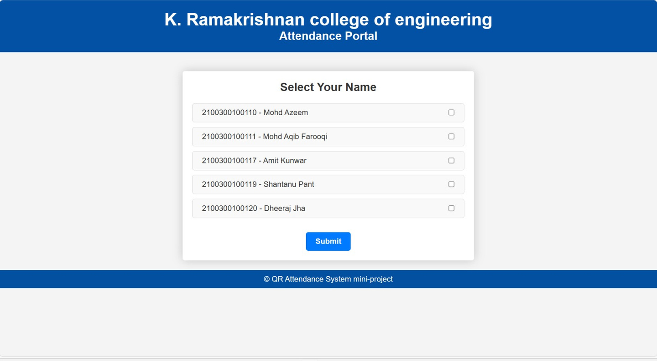
MANUAL REGISTER PAGE

Slide 15
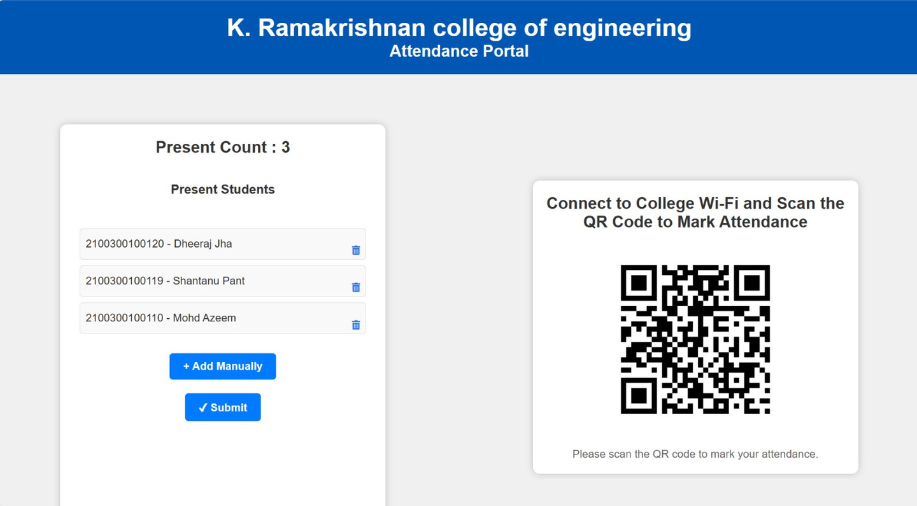
INFO PAGE

Slide 16
REFERENCE
Brown, J., & Smith, K. (2019). Integration of QR Code Attendance Systems with HRMS. Journal of Workplace Technology, 8(2), 113-125.
Green, P., & White, L. (2018). Enhancing Attendee Experience with QR
Code Systems. Event Management Journal, 15(3), 210-225.
Jones, M., & Roberts, S. (2021). Streamlining Employee Attendance with
QR Codes. Corporate Technology Review, 12(4), 98-112.
Kumar, A., & Priya, S. (2018). Ensuring Security in QR Code Based
Attendance Systems. International Journal of Information Security,
14(1), 45-59.

Slide 17
Lee, H., Park, J., & Kim, S. (2020). Impact of QR Code Attendance Systems on Student Engagement. Educational Technology Research and Development, 68(6), 1729-1745.
Ng, E., & Wong, C. (2020). Privacy Implications of QR Code Attendance Systems.Journal of Privacy and Data Security, 10(2), 150-168.
Reimer, T., & Schleicher, A. (2019). Efficiency of QR Code-Based
Attendance Tracking. Journal of Educational Administration, 57(5),
603-617.
Taylor, M., Brown, J., & Wilson, R. (2017). QR Codes in Event
Management: Benefits and Challenges. Event Planning Journal, 11(1),
33-47.

Slide 18
CONCLUSION
QR code attendance makes keeping track of who's present & absent in easier and faster way.
It is accurate and efficient in monitoring attendance.
This system is should be user friendly.

Slide 19
THANK YOU!

