Slide 1
WORK REPORT FOR THE PERIOD-24.05.2016 to TILL DATE
NAVDEEP GARG
Staff No: IS05684
Scientist/Engineer ‘SC’
MANAGEMENT INFORMATION SYSTEMS DIVISION (MISD)
PROGRAMME PLANNING AND EVALUATION GROUP (PPEG)
U.R. RAO SATELLITE CENTRE - BENGALURU

Slide 2
Role and Responsibilities
Role | Software Engineer for MISD, PPEG, URSC
Responsibilities | Realize software development life cycle (SDLC) and write well-designed, testable code. Value Additions, Innovations and Maintenance in MISD applications. Deploy programs and evaluate users’ feedbacks. TODO Division Level Management Representatives(DMR) of MISD for ISO implementation.
Deliverables | Designed, Developed and successfully Operationalized ISRO/DOS PFMS Web Services Interface System (IPWS) across all ISRO Centres/Units. Realization of COINS-PFMS Interface Software. Realization of e-Governance Initiative in URSC - Automation of various Government-to-Employee (G2E) Services. Prototype model of Integrated MIS system. Enhanced ‘Sandesh’ application to realize an effective and efficient Management Information Systems (MIS) software for URSC

Slide 3
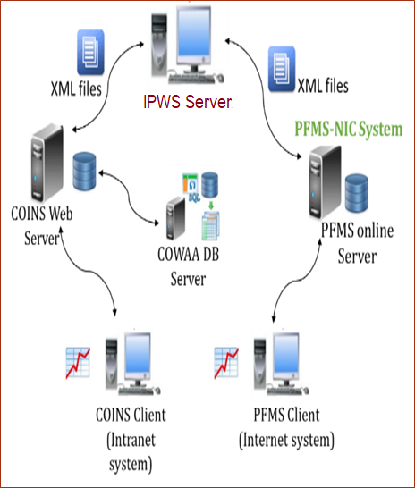
ISRO/DOS PFMS Web Services Interface System (IPWS)
Responsible for complete software development life cycle (SDLC) of IPWS system.
Analyzed interface model implemented by NIC team and completed the requirement analysis in coordination with IT department at PFMS.
Developed the IPWS application that process XML input requests received from COINS server and send it to PFMS web service consumption system after validation at IPWS. PFMS server in return send XML responses which are exhaustively processed at IPWS against various conditions before passing it to COINS server for database updates.
Developed shell scripts for the transferring of XML files between COINS and IPWS server using rsync utility.
Presented code walk-through of IPWS
Based on the recommendations given by ISRO/DOS Cyber Security (CSMD) team , ensured the hardening of IPWS server to enhance server security from cyber attacks.
IPWS system is a standalone system which is making use of java property file to commence its desired operations without interacting with any database server.
Responsible for all enhancements to be made in the system in order to satisfy new emerging requirements and improvement in system performance on the whole.
Responsible for continual monitoring of the system to report or correct any unexpected incidents.
Presently IPWS is satisfactorily serving its objective across all ISRO centres/units.

Slide 4

COINS-PFMS Interface Software
It is an interface software that transfer ISRO-DOS accounting information to PFMS system in the form of XML files.
Played key role from conceptual design to operationalization of this system.
As a member of ‘COINS-PFMS Interface /software review Committee’ team reported all major incidents related to business logic, bugs, performance related issues, code-reusability and modularity were submitted to DD, RO, SDSC.
Ensures continuous operations and maintenance of the finance, accounts and stores related modules of COINS at URSC
Provided support for configuring the COINS-PFMS interface software across all ISRO centres. The system is in continual use and serving its objective since 01-Jan-2019.
Involved in complete verification and validation of COINS-PFMS Interface Software and submitted detailed test results report for making the desired changes.

Slide 5
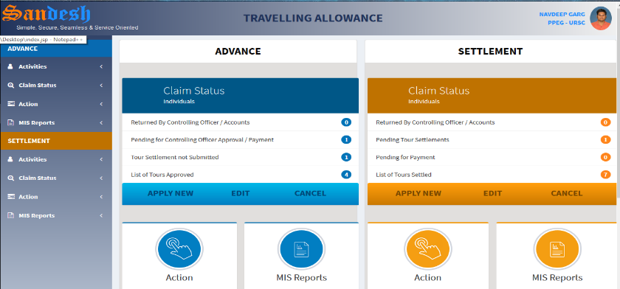
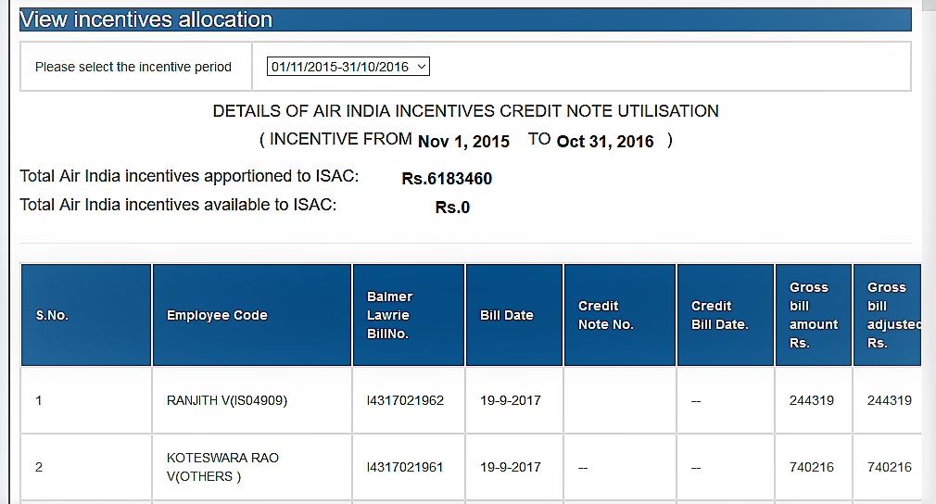
SANDESH - The Management Information System
Responsible for continual value addition, innovation , maintenance and encourage paperless and office automation through SANDESH system.
Developed a new module for Foreign Tour Allowance (FTA), in which account personal can add Travelling Allowance advance and settlement details through online mode for employees who travelled on foreign official tours.
Developed a module for digitization of TRAVEL Agents transactions related to payment details and air-travel booking details that made by TRAVEL Agents like ‘Balmer Lawrie’.
Developed an INCENTIVE MANAGEMENT MODULE, by which cost of tickets can be adjusted against incentives received to travel agent from airlines companies for URSC accomplished tours.
Developed a module towards e-Governance , where automated alerts of payment acknowledgements will be sent through SMS and e-Mail. This will be a one more step towards practicing office-automation in URSC.
Transform the traditional database connection mechanism to CONNECTION POOLING to enhance the application performance.
Introduced the open source version control system GIT to track every code change. This helps in seamless collaboration amongst developers.
Comprehensive online system for Official Travelling Allowance.
Sandesh system is presently deployed at VSSC, LPSC(B), HSFC, MCF, ISRO HQ and PRL due to its effectiveness.

Slide 6
Additional Activities
As an author of technical paper on ‘e-Governance Initiative in URSC - Automation of various Government-to-Employee (G2E) Services’ got the opportunity for oral presentation from ISRO Seminar on Computer and Information Technology (ISCIT) held at ISRO Propulsion Complex (IPRC), Mahendragiri.
Designed, developed and demonstrated a prototype model to retrieve data from distributed database on real time basis using SPRING-BOOT, Hibernate and bootstrap technologies. This will be useful in developing an Integrated MIS system.
Completed M.Tech. Software Systems program in Data Analytics from BITS-Pilani ,Work Integrated Learning Programmes (WILP). This program is carried out in online classes mode and conducted mostly on weekends or after business hours.
As Division Level Management Representatives (DMR) of MISD for ISO program, responsible for maintaining required ISO documents for the division which are essential in maintaining ISO standard activities.
Implemented an Open source tool , DOXYGEN for generating documentation from all popular annotated programming languages. This tool has generated online documentations(in browser) and set of off-line reference manual in PDFs which helped in maintaining software-quality and ISO standard activities.
On behalf of URSC, attended ‘One-Day Workshop on HINDI KNOWLEDGE MANAGEMENT APPLICATION’ held at SAC. This application is developed to digitalizes the various operational activities of respective centres’ Hindi Cell. After making centre specific changes, this application is configured successfully on the test server for URSC-Hindi Cell and made available for the Functional testing to end users.

