Slide 1
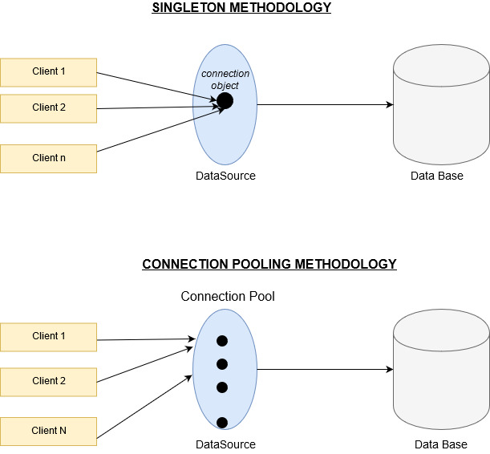
Connection Pooling Implementation

