Slide 1
WORK REPORT FOR THE PERIOD-24.05.2016 to TILL DATE
NAVDEEP GARG
Staff No: IS05684
Scientist/Engineer ‘SC’
MANAGEMENT INFORMATION SYSTEMS DIVISION (MISD)
PROGRAMME PLANNING AND EVALUATION GROUP (PPEG)
U.R. RAO SATELLITE CENTRE - BENGALURU

Slide 2
Role and Responsibilities
Role | Software Engineer for MISD, PPEG, URSC
Responsibilities | Realize software development life cycle (SDLC) and write well-designed, testable code. Value Additions, Innovations and Maintenance in MISD applications. Deploy programs and evaluate users’ feedbacks. Division Level Management Representatives(DMR) of MISD for ISO implementation.
Deliverables | Realization of ISRO/DOS PFMS Web Services Interface System (IPWS). Realization of e-Governance Initiative in URSC - Automation of various Government-to-Employee (G2E) , G2B Services. Developed a Prototype for Integrated MIS system. Enhancements in ‘SANDESH’ system Todo for developmental acivities

Slide 3
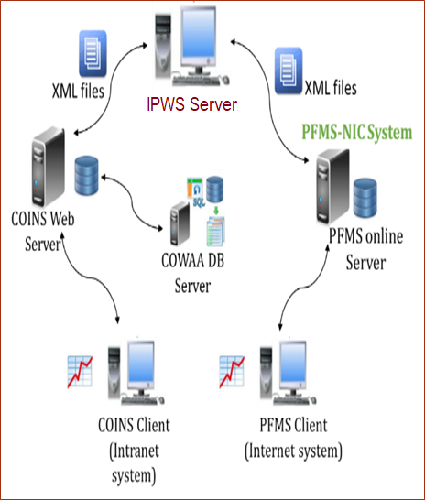
ISRO/DOS PFMS Web Services Interface System (IPWS)
IPWS , process XML input requests received from COINS server and return PFMS response after processing.
Responsible for system configuration and software development life cycle (SDLC) of IPWS system.
Carried out detailed requirement gathering, design and prepared SRS , SRD.
Developed the application in Java Runtime Environment using log4J, Quatrz, Jasypt API and exchange messages in SOAP format.
Deployed the application as a Linux service using systemd.
Carried out functional and non- functional testing.
Developed shell scripts using rsync utility for XML files synchronization between COINS and IPWS.
Implemented recommendations given by ISRO/DOS Cyber Security Mock Drill (CSMD) team on:
System Configuration
Code Analysis of IPWS Software
Providing enhancement and maintenance support.
IPWS is serving satisfactorily its objective across all ISRO centres/units since 01-Jan-2019.
System Architecture

Slide 4
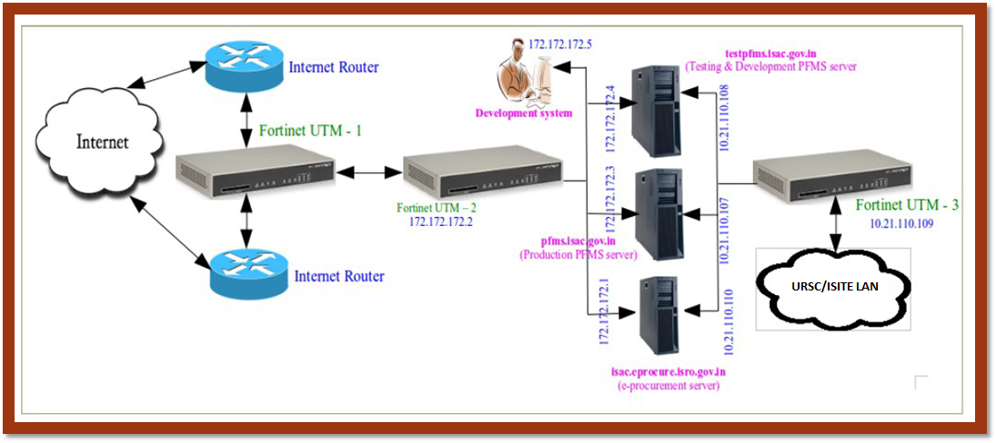
ISRO/DOS PFMS Web Services Interface System (IPWS)
System Configurations
Allowing only required TCP/80 and TCP/443 ports in the firewall on Internet side
Only rsync protocol to be allowed in the firewall on intranet side
Minimal installation of CentOS/RHEL OS without GUI/application software
Import SSL/TLS certificate deployed at pfms.nic.in and handle in jre.
Selinux based mandatory access control to be enabled and enforced.
Strong password for root & other users.
For OpenSSH
X11 forwarding should be disallowed
Listening port must be a non-standard port
GSSAPIAuthentication must be set to ‘no’
Only RSA key based authentication
No direct login to root account, No remote login to any account, locking of account on 3 unsuccessful attempts need to be implemented
Network Architecture
/opt/PFMS/
Outgoing
Pending
Sent
Response Success
Response Failure
SVPending
FASPending
VendorPending
PEPCPendingCase
IPWS Directory Structure

Slide 5

COINS-PFMS Interface Software
It is an interface software that transfer ISRO-DOS accounting information to PFMS system in the form of XML files.
Providing operational and maintenance support for Finance, Accounts and Stores modules of COINS in URSC.
As a member of Codewalk through Committee of COINS-PFMS Interface software carried out detailed analysis and report all major incidents related to business logic, bugs, performance related issues, code-reusability and modularity were submitted to DD, RO, SDSC , and recommended possible code optimization , enhancing exception handling and implement modularity in code.
Involved in Testing and evaluation of COINS-PFMS Interface Software and submitted detailed test results report for making the desired changes.

Slide 6
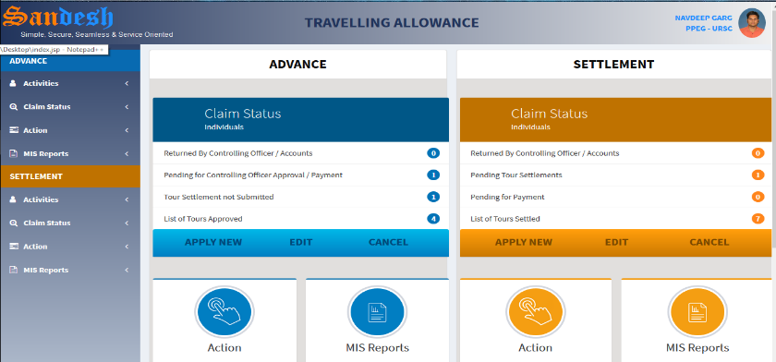
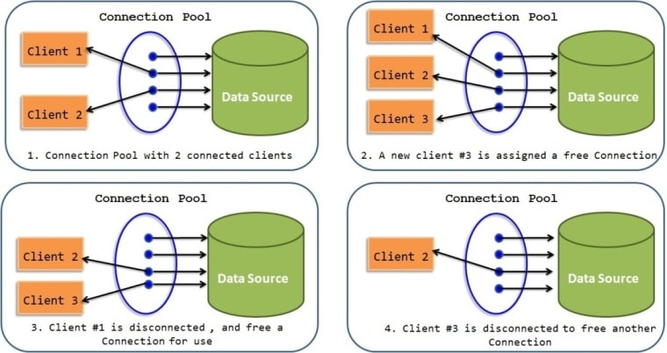
SANDESH - The Information System
SANDESH system provides required personal information to employees, MIS reports to management for decision making based on COWAA database.
Responsible for continual value addition, innovation and maintenance of SANDESH system.
Developed a dashboard based Official Travelling Allowance Processing system.
Domestic Tour Allowance (DTA), to process advance and settlements for domestic official tours.
Foreign Tour Allowance (FTA), to process advance and settlements for foreign official tours.
Digitization of air-travel booking transactions made by TRAVEL Agents like ‘Balmer Lawrie’.
Incentive Management Module, to adjust received incentives with air ticket cost.
Developed SMS and e-Mail gateway module towards e-Governance , to replace manual practice of sending payment acknowledgements with automated alerts to registered vendors through
Transform the database connection mechanism to CONNECTION POOLING .
Implemented software version control system using GIT tool.
SANDESH system is presently deployed at VSSC, LPSC(B), HSFC, MCF, ISRO HQ and PRL due to its effectiveness.

Slide 7
Additional Activities
As an author of technical paper on ‘e-Governance Initiative in URSC - Automation of various Government-to-Employee (G2E) Services’ got the opportunity for oral presentation from ISRO Seminar on Computer and Information Technology (ISCIT)-2018.
Designed, developed and demonstrated a prototype model to retrieve data from distributed database on real time basis using SPRING-BOOT, Hibernate and bootstrap technologies.
Implemented DOXYGEN tool , that generates coding and design documents for all MISD applications.
Pursuing M.Tech. Software Systems program in Data Analytics from BITS-Pilani ,Work Integrated Learning Programmes (WILP). This program is carried out in online classes mode and conducted mostly on weekends or after business hours.
As Division Level Management Representatives (DMR) of MISD for ISO program, responsible for maintaining required ISO documents for the division which are essential in maintaining ISO standard activities.
Configured successfully HINDI KNOWLEDGE MANAGEMENT APPLICATION (developed by SAC) on URSC test server. Application is presently under functional testing to end users.(On behalf line)?
Member of ‘Vikram Sarabhai Life Journey Team’ in ‘Vikram Sarabhai Centenary Programme’ (VSCP).
Member of ‘Gymnasium Committee’ to support the management of all four GYM complex of ISRO in Bengaluru.

