Slide 1
ISRO/DOS PFMS Web Services Interface System (IPWS)
An interface to PFMS for ISRO/DOS
By:
NAVDEEP GARG
2018HT12267

Slide 2
Introduction - PFMS/IPWS
Public Financial Management System (PFMS) is a web based online application for management information and decision support system for plan schemes of Government of India. The purpose of this system is to track and monitor fund disbursement and utilization under plan schemes on real time basis.
ISRO/DOS PFMS Web Services Interface System (IPWS) is an interface system between ISRO/DOS centres/units and PFMS through web service consumption, that provides online expenditure, budgeting and vendor related operations.
This is an in-house developed system that coordinates between ISRO-DOS accounting system (commonly called as COINS) and PFMS through XML files.
Input XML file over Web service
Input XML Files
ISRO-DOS
IPWS
PFMS
Response XML files as success/failure
Web service response in XML format

Slide 3
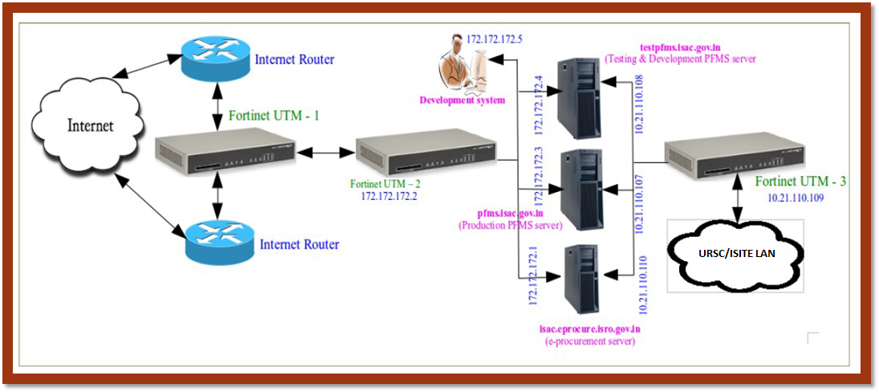
Network Architecture

Slide 4
System configuration – IPWS Server
Mandatory Configuration Recommendations
Allowing only required TCP/80 and TCP/443 ports in the firewall on Internet side
Only rsync protocol to be allowed in the firewall on intranet side
Minimal installation of the latest version of CentOS/RHEL OS without GUI/application software
Recommended Configuration
SSL/TLS certificate deployed at pfms.nic.in is not trusted; hence need to import this certificate and handle accordingly in jre
Selinux based mandatory access control should be enabled and enforced
Strong password for root & other users
Usual protections like No direct login to root account, No remote login to any account, locking of account on 3 unsuccessful attempts, etc need to be implemented
No IP-Forwarding
The listening port of OpenSSH should be changed to a non-standard port
Desirable Configuration
Redundancy to be ensured to take care of failure

Slide 5
rsync / IPWS
Development methodology and internal processes

Slide 6
IPWS Module Directories Structure – IPWS Server
/opt/PFMS/
Outgoing - Contains all input XML request files related to registration which are send to PFMS
StatusRequest - Contains Status request XML files required to be sent to PFMS
ResponseSuccess - Contains successful or partial success response XML files received from PFMS
Pending - Contains all pending Status jobs which are required to be sent again to PFMS
ResponseFailure - Contains failure response XML files received from PFMS
Sent - Contains backup of all XML request files which are successfully sent to PFMS
DeletedStatusRequest - Contains rest of status XML files after receiving failure response from PFMS

Slide 7
rsync - pfmsputxml.sh
IWI[WI[WS
noncowaamain/
XMLFILES
noncowaamain/
XMLFILESOUT
1.1 Copy to
/opt/PFMS/Outgoing
2.1 Move to
1. Move to
/opt/PFMS/Source
/opt/PFMS/Outgoing
1.2 Move to
/opt/PFMS/StatusRequest
2. Move to
/opt/PFMS/StatusRequest
1.3 Move status files using exclude.txt
COINS SYSTEM
IPWS SYSTEM

Slide 8
rsync - pfmsgetxml.sh
1. Copy to
/opt/PFMS/
ResponseSuccessbackup
/opt/PFMS/
ResponseSuccess
1.1 Move to
/PFMS/
ResponseSuccess
2. Copy to
/opt/PFMS/
ResponseFailurebackup
/opt/PFMS/
ResponseFailure
2.1 Move to
/PFMS/
ResponseFailure
IPWS SYSTEM
COINS SYSTEM

Slide 9
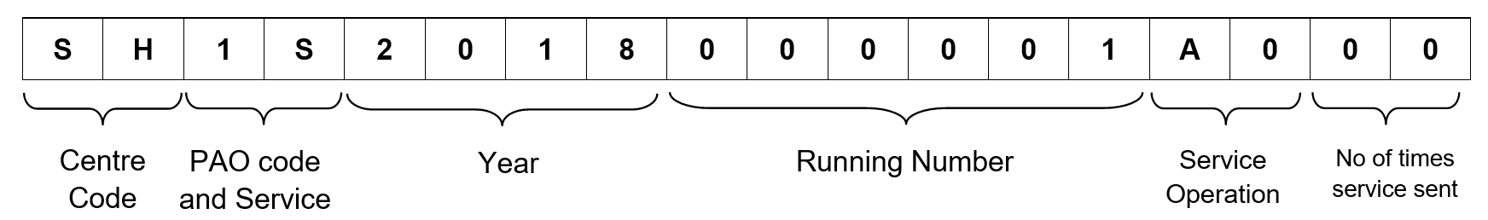
XML File Name - Format
The response file names are suffixed with RP, PB, PS, RS and RF

Slide 10
Types of Web Services Consumption
[V] Vendor Registration [3-Operations]
[S] Sanction [6-Operations]
[B] Budget [1-Operation]
[T] Transfer Entry and Permanent Cancellation [2-Operations]

Slide 11
Operations - Vendor Registration
[A0] Vendor Registration Web Service
[S0] Get Vendor Status Web Service
[E0] Edit Vendor Registration Data Web Method
The response file names are suffixed with RP, PS, RS and RF

Slide 12
Operations - Budget
[A0] Receive DDO Wise Budget Allocation Data Web Service
The response file names are suffixed with RS and RF

Slide 13
Operations - Sanction
[RS] Sanction Web Service
Get Sanction Status Web Service
[S0] Get Request Status - Provide the status of the request landed to PFMS
[SB] Get Sanction Bill Details - Provided TOKEN Number/Date, Bill Number/Date and Current Status of the Bill
[SV] Get Sanction Voucher Details - Provide Voucher number and Date
[PE] Get Payee e-Payment Details - Payee detail of bill, Vendor code, PFMS transaction ID, Amount, Scroll details
[PC] Get Payee Cheque Details - Payee detail of the bill, Vendor code, Cheque number/Date, Amount, Scroll details
[BD] Get Bill Deduction Details - Payee wise deduction details
The response file names are suffixed with RP, PS, PB, RS and RF

Slide 14
Operations - Transfer Entry/Permanent Cancellation
[A0] Receive Transfer Entry (TE) data Web Service
[S0] Get Transfer Entry (TE) Status Web Service
Accounting of Receipts through Transfer Entry
Permanent Cancellation – Yet to be implemented
The response file names are suffixed with RS and RF

Slide 15
Technology - IPWS
Developed in CentOS and can be deploy any Linux platform
Java 1.8 for developing the application
Simple Object Access Protocol (SOAP) for exchanging the data using XML files
HTTPS protocol
Request XML Content type is ‘application/soap+xml’
log4j-API for logging all operations
Quartz job scheduling library
File transferring using rsync, Cygwin and OpenSSH
Configuring custom Linux Service for running Java Application

Slide 16
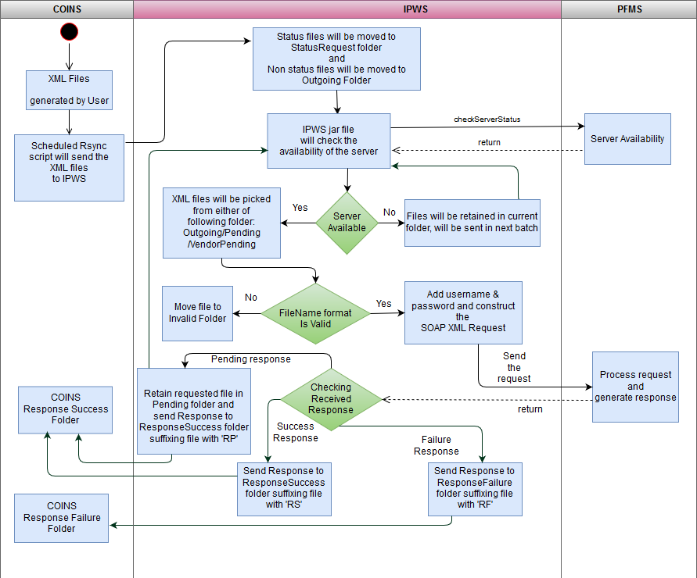
Internal Processes - IPWS

Slide 17
Responses categorisation – for Sanctions
The following conditions are applied for e-Payment (PE) response XML file
Pending Condition (RP) - where Scroll Status and Bank Transaction Status is ‘EMPTY’
Partial Success Condition (PS) - where Scroll Status is ‘EMPTY’ and Bank Transaction Status is ‘S’
Partial Bank Scroll Success Condition (PB) - where Scroll Status is ‘EMPTY’ and Bank Transaction Status is ‘S’ or ‘!S’
Success Condition (RS) - where all beneficiaries Scroll Status is ‘S’
Failure Condition (RF) - where Scroll Status is ‘!EMPTY’ and Bank Transaction Status is ‘!EMPTY’ and ‘S’

Slide 18
Q & A

Slide 19


