Slide 1
WORK REPORT FOR THE PERIOD-24.05.2016 to TILL DATE
NAVDEEP GARG
Staff No: IS05684
Scientist/Engineer ‘SC’
MANAGEMENT INFORMATION SYSTEMS DIVISION (MISD)
PROGRAMME PLANNING AND EVALUATION GROUP (PPEG)
U.R. RAO SATELLITE CENTRE - BENGALURU

Slide 2
Role and Responsibilities
Role | Software Engineer for MISD, PPEG, URSC
Responsibilities | Execute full software development life cycle (SDLC) and write well-designed, testable code. Value Addition, Innovation and Maintenance of MISD applications. Deploy programs and evaluate user feedback. Division Level Management Representatives(DMR)of MISD for ISO implementation.
Deliverables | Designed, Developed and successfully Operationalized ISRO/DOS PFMS Web Services Interface System (IPWS) across all ISRO Centres/Units. Realization of COINS-PFMS Interface Software. Realization of e-Governance Initiative in URSC - Automation of various Government-to-Employee (G2E) Services. Prototype model of Integrated MIS system. Enhanced ‘Sandesh’ application to realize an effective and efficient Management Information Systems (MIS) software for URSC

Slide 3
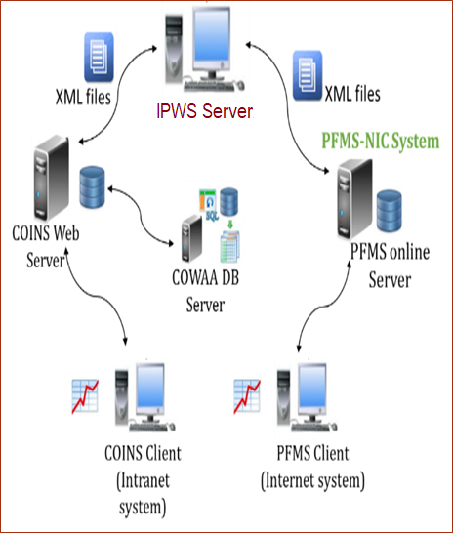
ISRO/DOS PFMS Web Services Interface System (IPWS)
Responsible for complete software development life cycle (SDLC) of this system.
IPWS is background process that process XML input requests received from COINS and validate it before sending it to PFMS web services consumption system for obtaining desired responses.

