Slide 1
WORK REPORT FOR THE PERIOD-24.05.2016 to TILL DATE
NAVDEEP GARG
Staff No: IS05684
Scientist/Engineer ‘SC’
MANAGEMENT INFORMATION SYSTEMS DIVISION (MISD)
PROGRAMME PLANNING AND EVALUATION GROUP (PPEG)
U.R. RAO SATELLITE CENTRE - BENGALURU

Slide 2
Role and Responsibilities
Role | Software Engineer for MISD, PPEG, URSC
Responsibilities | Write well-designed, testable code and ensuring software development life cycle (SDLC). Value Addition, Innovations and Maintenance in MISD applications. Deploy programs and evaluate users’ feedbacks. Division Level Management Representatives(DMR) from MISD for QMS implementation.
Deliverables | Realization of ISRO/DOS PFMS Web Services Interface System (IPWS). Operationalization and maintenance of COWAA Web Interface System(COINS)-Public Financial Management system(PFMS) Interface Software. Realization of e-Governance Initiative in URSC - Automation of various Government-to-Employee (G2E) , G2B Services. Online information for administrative related activities using Sandesh system Moving towards next generation MIS.

Slide 3
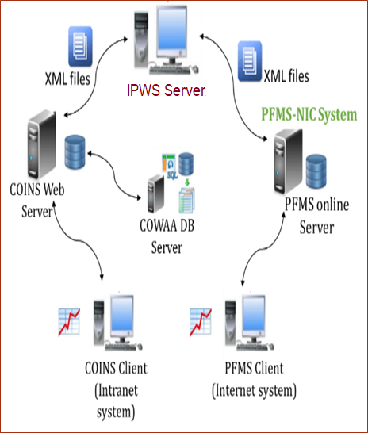
ISRO/DOS PFMS Web Services Interface System (IPWS)
IPWS is background process that processes XML input requests received from COINS and validate it before sending it to PFMS web services consumption system for obtaining desired responses.
Responsible for system configuration and software development life cycle (SDLC) of IPWS system.
Carried out requirement gathering, designing and prepared SRS , SRD.
Developed the application in Java Environment using log4J, Quatrz, Jasypt API and exchanged messages in SOAP format.
Carried out functional and non- functional testing.
Developed shell scripts using rsync utility for XML files synchronization between COINS and IPWS.
Deployed the application as a Linux service using systemd.
Implemented recommendations given by ISRO/DOS Cyber Security Mock Drill (CSMD) team on:
System Configuration
Code Analysis of IPWS Software
Providing enhancement and maintenance support.
IPWS is serving satisfactorily its objective across all ISRO centres/units since 01-Jan-2019.
System Architecture
Contd...

Slide 4
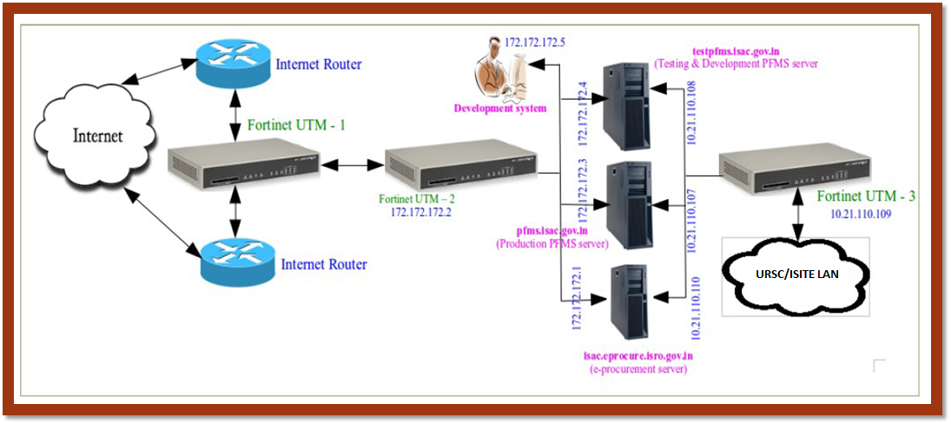
ISRO/DOS PFMS Web Services Interface System (IPWS)
System Configurations
Allowing only required TCP/80 and TCP/443 ports in the firewall on Internet side
Only rsync protocol to be allowed in the firewall on intranet side
Minimal installation of CentOS/RHEL OS without GUI/application software
Import SSL/TLS certificate deployed at pfms.nic.in and handle in jre.
Selinux based mandatory access control to be enabled and enforced.
Strong password for root & other users.
For OpenSSH
X11 forwarding should be disallowed
Listening port must be a non-standard port
GSSAPIAuthentication must be set to ‘no’
Only RSA key based authentication
No direct login to root account, No remote login to any account, locking of account on 3 unsuccessful attempts need to be implemented
Network Architecture
/opt/PFMS/
Outgoing
Pending
Sent
Response Success
Response Failure
SVPending
FASPending
VendorPending
PEPCPendingCase
IPWS Directory Structure

Slide 5

COINS-PFMS Interface Software
An interface to PFMS through web service consumption using XML files - jointly developed by SDSC and URSC
As a member of Codewalk through Committee of COINS-PFMS Interface software carried out detailed analysis and report all major incidents related to business logic, bugs, performance related issues, code-reusability and modularity were submitted to DD, RO, SDSC , and recommended possible code optimization , enhancing exception handling and modularity in code.
Involved in Testing and evaluation of COINS-PFMS Interface Software and submitted detailed test results report for making the desired changes.
Providing operational and maintenance support for Finance, Accounts and Stores modules in URSC.

Slide 6
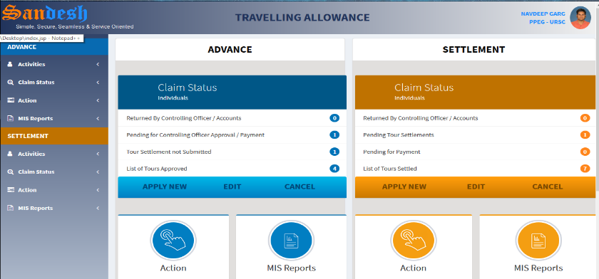
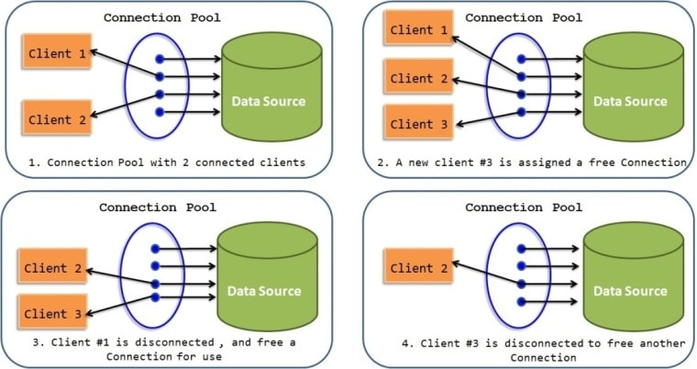
SANDESH - The Information System
SANDESH system provides required personal information to employees, MIS reports to management for decision making based on COWAA database.
Responsible for continual value addition, innovation and maintenance of SANDESH system.
Developed a dashboard based Official Travelling Allowance Processing system.
Domestic Tour Allowance (DTA), to process advance and settlements for domestic official tours.
Foreign Tour Allowance (FTA), to process advance and settlements for foreign official tours.
Digitization of air-travel booking transactions made by TRAVEL Agents like ‘Balmer Lawrie’.
Incentive Management Module, to adjust received incentives with air ticket cost.
Successfully operationalized email and SMS gateway interface for payment acknowledgments to encourage e-Governance.
Transform the database connection mechanism to CONNECTION POOLING .
Implemented software version control system using GIT tool.
SANDESH system is presently deployed at VSSC, LPSC(B), HSFC, MCF, ISRO HQ and PRL due to its effectiveness.

Slide 7
Additional Activities
As an author of technical paper on ‘e-Governance Initiative in URSC - Automation of various Government-to-Employee (G2E) Services’ got the opportunity for oral presentation from ISRO Seminar on Computer and Information Technology (ISCIT)-2018.
Designed, developed and demonstrated a prototype model to retrieve data from distributed database on real time basis using SPRING-BOOT, Hibernate and bootstrap technologies.
As Division Level Management Representatives (DMR) of MISD, responsible for implementing ISO 9001:2015 QMS in MISD.
Configured an open-source tool DOXYGEN , that generates coding and design documents for all MISD applications.
Pursuing M.Tech. Software Systems program in Data Analytics from BITS-Pilani ,Work Integrated Learning Programmes (WILP). This program is carried out in online classes mode and conducted mostly on weekends or after business hours.
Configured successfully Hindi Knowledge Management Application (developed by SAC) on URSC test server. Application is presently deployed for functional testing by end users.
Member of ‘Vikram Sarabhai Life Journey Team’ in ‘Vikram Sarabhai Centenary Programme’ (VSCP).
Member of ‘Gymnasium Committee’ to support the management of all four GYM complex of ISRO in Bengaluru.

Slide 8
As Division Level Management Representatives (DMR) of MISD, responsible for implementing ISO 9001:2015 QMS in MISD
Coordination with division colleagues to ensure up to date information.
Closed all Non-conformance(NCs) at the earliest.
Configured an open-source tool DOXYGEN , that generates coding and design documents for all MISD applications.
Successfully presented all relevant documents to External Auditor.

