Slide 1

Multilingual Admission-Assistance Chatbot for Technical Education
Presented by
1. CHEBROLU CHAITHANYA KUMAR, 2300033094, CSE
2. GUNUPURAM NAVDEEP,2300030243, CSE
3. KADTHALA SIDDHARTHA REDDY, 2300031373, CSE
4. Bala Sudarshan Ravi, 2300039155, CSE
Under the Guidance of
Dr. T.SAILAJA
Department of CSE-2

Slide 2
Introduction
Context, need and scope of the proposed system.

Slide 3
Introduction
A multilingual AI-powered assistant that simplifies technical-education admissions and provides personalized student support.
01 — Multilingual Assistance
Students can interact with the chatbot in a language they are comfortable with, reducing language barriers and improving accessibility.
02 — Reliable Information with RAG
Retrieval-Augmented Generation (RAG) retrieves relevant information from trusted institutional and educational documents before generating responses.
03 — Personalized Student Support
A student profile uses learning progress, assessment results, topics studied, and areas of difficulty to provide personalized resources and guidance.
Scope:
Admissions & eligibility • Course guidance • Academic queries • Learning resources • Assessments • Progress tracking

Slide 4
Motivation / Existing System
Why current educational support systems are not enough.

Slide 5
Motivation / Existing System
Limitations of Existing Approaches
Information scattered across multiple sources
Admission, eligibility, courses and academic information are often distributed across different documents and platforms.
Generic FAQ / search-based assistance
Students must manually search through large amounts of institutional information to find relevant answers.
Limited multilingual conversational support
Many systems provide limited assistance in the student's preferred language.
Limited personalization
Generic systems do not sufficiently consider individual learning progress, assessment performance and areas of difficulty.
Disconnected learning support
Admission guidance, assessments and learning resources are often handled separately.
Motivation for Proposed System
Single conversational entry point
One AI assistant for admission, academic and learning-related queries.
RAG-based responses
Ground answers in trusted institutional and educational documents.
Multilingual interaction
Support students in a language they are comfortable with.
Personalized student profile
Use progress, assessments and learning difficulties to tailor support.
Assessment & recommendations
Identify knowledge gaps and suggest suitable resources.
Progress tracking
Monitor learning activities and performance over time.
Limitations of Existing Approaches
Motivation for Proposed System
• Generic search and FAQ pages
• Rule-based or fixed-path chatbots
• Separate learning platforms and dashboards
• Limited use of student history
• English-first interaction in many systems
• Little connection between answers and learning progress
• One conversational entry point
• Ground responses in trusted documents
• Maintain a student learning profile
• Identify weak areas from assessments
• Recommend suitable resources
• Close the loop with progress tracking

Slide 6
Problem Statement
The specific gap the project aims to address.

Slide 7
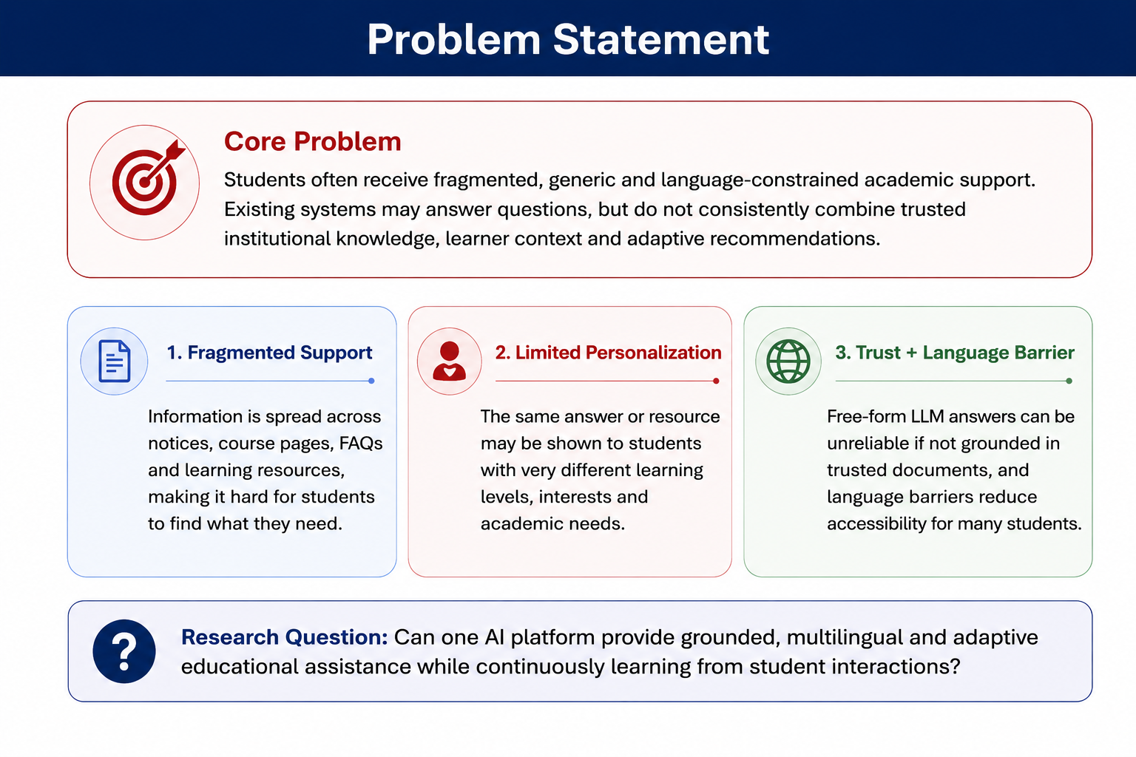
Problem Statement
Core Problem
Students often receive fragmented, generic and language-constrained academic support. Existing systems may answer questions, but do not consistently combine trusted institutional knowledge, learner context and adaptive recommendations.
Fragmented Support
Information is spread across notices, course pages, FAQs and learning resources.
Limited Personalization
The same answer or resource may be shown to students with very different needs.
Trust + Language
Free-form LLM answers can be unreliable, while language barriers reduce accessibility.
Research question: Can one AI platform provide grounded, multilingual and adaptive educational assistance while continuously learning from student interactions?

Slide 8
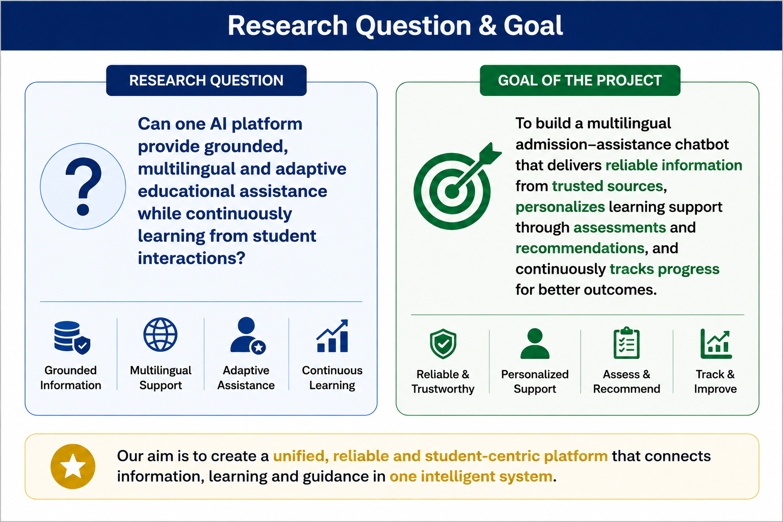
Problem Statement
Core Problem
Students often receive fragmented, generic and language-constrained academic support. Existing systems may answer questions, but do not consistently combine trusted institutional knowledge, learner context and adaptive recommendations.
Fragmented Support
Information is spread across notices, course pages, FAQs and learning resources.
Limited Personalization
The same answer or resource may be shown to students with very different needs.
Trust + Language
Free-form LLM answers can be unreliable, while language barriers reduce accessibility.
Research question: Can one AI platform provide grounded, multilingual and adaptive educational assistance while continuously learning from student interactions?

Slide 9
Literature Review
Research foundations behind chatbots, RAG, personalization and multilingual NLP.

Slide 10
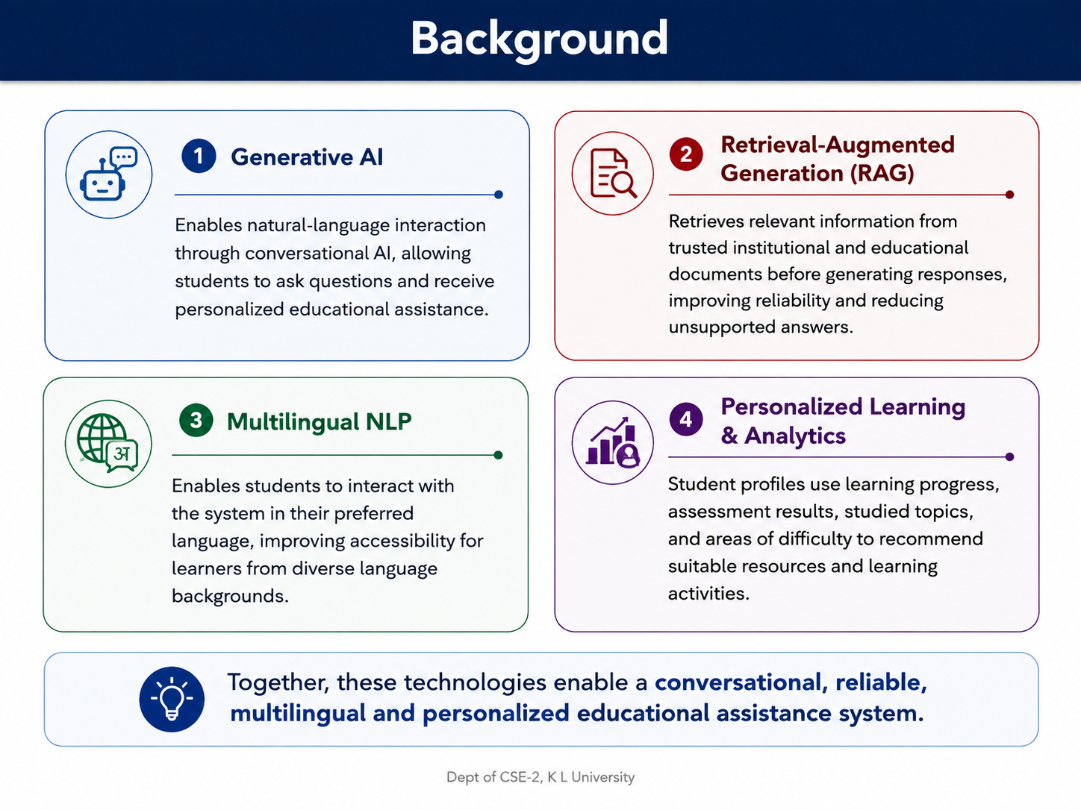
Background
Generative AI
Natural-language interaction can make educational support more accessible and conversational.
RAG
Retrieves relevant source passages and supplies them to the generator to improve grounding and updateability.
Knowledge Tracing
Student interactions can be modeled to estimate evolving knowledge or mastery.
Indic NLP
Multilingual resources and models enable support for Indian languages and English.
Together, these technologies support a system that is conversational, grounded, multilingual and adaptive.

Slide 11
Literature Review Summary
S.No. | Research / Paper | Technique | Key Finding | Limitation
1 | NEU-chatbot (Nguyen et al., 2021) | NLP + Rasa + Deep Learning | Automates university admission queries | Mainly admission-focused; limited personalization
2 | Jooka: Bilingual Admission Chatbot (El Hefny et al., 2021) | Bilingual NLP + Chatbot | Supports admission assistance in two languages | No learning analytics or personalized learning
3 | RAG for Educational Applications (2025) | RAG + Vector Search + LLM | Provides grounded answers using trusted documents | Depends on document quality and retrieval accuracy
4 | Personalized Learning Platform (Zhang et al., 2022) | Collaborative Filtering + Student Data | Recommends suitable learning resources | Requires sufficient student data; cold-start problem
research gap :
There is a need for a unified platform that combines admission assistance, multilingual interaction, grounded information retrieval, and personalized learning support. There is a need for a unified platform that combines admission assistance, multilingual interaction, grounded information retrieval, and personalized learning support.
Sources: Wollny et al. (2021); Kuhail et al. (2022); Lewis et al. (2020); Piech et al. (2015); Kunchukuttan et al. (2020); Guan et al. (2025); Debets et al. (2025).

Slide 12
Research Gap
1
Grounding + Personalization
RAG systems focus on factual retrieval, while personalization often sits outside the answer-generation loop.
2
Learning Feedback Loop
Many educational chatbots provide support but do not continuously use assessment and interaction history to adapt recommendations.
3
Multilingual Student Support
Indic-language resources are growing, but an integrated educational assistant that connects multilingual access with institutional knowledge remains a practical gap.
4
Unified Student Experience
Academic queries, resources, assessment insights and progress tracking are commonly fragmented across tools.
Proposed response
A unified platform linking trusted-document RAG, multilingual interaction and a learner profile with adaptive recommendations.

Slide 13
Research Objectives
Phase 1
Phase 2
Phase 3
Knowledge & Access
• Build a multilingual conversational interface
• Ingest trusted academic and institutional documents
• Create semantic retrieval for grounded answers
Personalization
• Create a student learning profile
• Track assessments, interests and interactions
• Identify weak areas and recommend resources
Evaluation & Learning Loop
• Measure answer relevance and grounding
• Evaluate recommendation usefulness
• Use feedback to refine the learner profile
Primary outcome: a prototype that moves from “answering a question” to “supporting a learner”.

Slide 14
Methodology & Planning
How the system will be developed, evaluated and delivered.

Slide 15
Methodology
1
Collect Sources
5
Generate Answer
Academic PDFs, course material, FAQs, institutional notices
LLM answers using retrieved context and prompt rules
2
Prepare Data
6
Update Profile
Clean, chunk and tag documents with metadata
Store interaction, assessment and preference signals
3
Create Embeddings
7
Recommend
Convert chunks into vectors for semantic search
Select learning resources / next actions
4
Retrieve Context
8
Evaluate
Find top relevant passages for each query
Check relevance, grounding, usefulness and user feedback
Student Query → Language Handling → RAG Retrieval → Grounded Response → Profile Update → Recommendation → Feedback

Slide 16
Planning
Work Package
W1
W2
W3
W4
W5
W6
W7
W8
W9
W10
1. Requirement & Literature Study
2. Dataset / Document Collection
3. RAG Prototype
4. Student Profile & Analytics
5. Recommendation Module
6. Frontend + Integration
7. Testing & Evaluation
8. Documentation & Demo
Expected Outcome
A working prototype demonstrating grounded multilingual assistance, learner profiling, adaptive recommendations and measurable feedback.

