Slide 1
GUI Calculator Using Tkinter in Python
In this presentation, we are going to create GUI Calculator using Python. As you can see, calculating large numbers nowadays is difficult or time-consuming. We’ve created a simple Calculator GUI using Python that allows you to perform simple and complex calculations. To implement GUI we will use the Tkinter module of Python.
By: Navdeep Kohar

Slide 2
About Project
For those who don’t know ,a calculator is basically a program on computer that simulates the behavior of any hand held calculator useful for performing mathematical calculation . It is a very basic device used in our daily life .Now all the smart phone have a calculator application in them.
While creating any GUI application there are mainly two steps.
The first step is to create a user interface.
The second step is to add functionalities to the GUI.

Slide 3
Tool & Technology
Tools – Python
Python Libraries- Tkinter
Tkinter- Tkinter is the standard GUI library for python. Python when combined with tkinter provides a fast and easy way to create GUI application.
Tkinter provides a powerful object-oriented interface to the TK GUI toolkit.

Slide 4
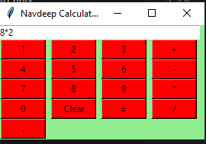
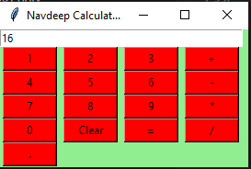
Key Features
Mathematical operations
Clear user interface
Comprehensive functionality
Input
Output

Slide 5
Conclusion
Calculator with GUI Using Python Tkinter" is a rich resource that not only covers the technical aspects of GUI development but also delves into the logic and functionality behind building a fully operational calculator application.
Calculator program in Python can be designed to efficiently perform mathematical operations like addition, subtraction, multiplication, and division, offering users a convenient tool for computational tasks

Slide 6
Thank You
Name-Navdeep Kohar
Mail-navdeepkohark58@gmail.com
Ph - 9888339255

