Slide 1
Exploratory Data Analysis (EDA)
Exploratory Data Analysis (EDA) for Real Estate Pricing: Unveiling the Dynamics of House Valuation in a Dynamic Market
In the dynamic landscape of the residential real estate market, determining an optimal and competitive price for a house is a multifaceted challenge. As a key member of the analytics team in a leading real estate company, your task is to conduct a comprehensive analysis to identify and understand the myriad variables that significantly influence house prices. By leveraging advanced data analytics techniques and visualization tools, your goal is to uncover patterns, correlations, and trends within the dataset, enabling the company to make informed decisions and strategically position properties for better business opportunities
By: Navdeep Kohar

Slide 2
About Project
• EDA
• Tasks
Loading the Data Identify unique values
Cleaning the Data
Univariate Analysis:
Multivariate Analysis:
Feature Engineering:
Feature Engineering and Size Impact:
Market Trends and Historical Pricing
Customer Preferences and Amenities:

Slide 3
Tool & Technology
Tools – Python
Python Libraries- Pandas ,Matplotlib & Seaborn
• Pandas is a high-level data manipulation tool
• Matplotlib & Seaborn for graphical representation
Juypter Notebook - It is a web-based interactive computing platform. The notebook combines live code, equations, narrative text, visualizations,

Slide 4
Tool & Technology
In Python, Numpy is a package that includes multidimensional array objects as well as several derived objects
Matplotlib is an amazing visualization library in Python for 2D plots of arrays.
Seaborn is on top of matplotlib for effective plot style
Pandas are used for data manipulation and analysis.

Slide 5
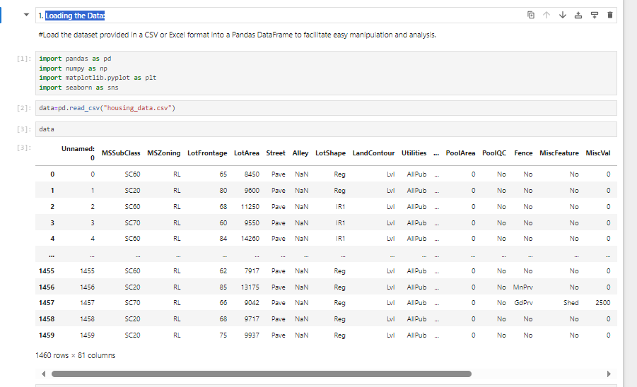
Loading the Data

Slide 6
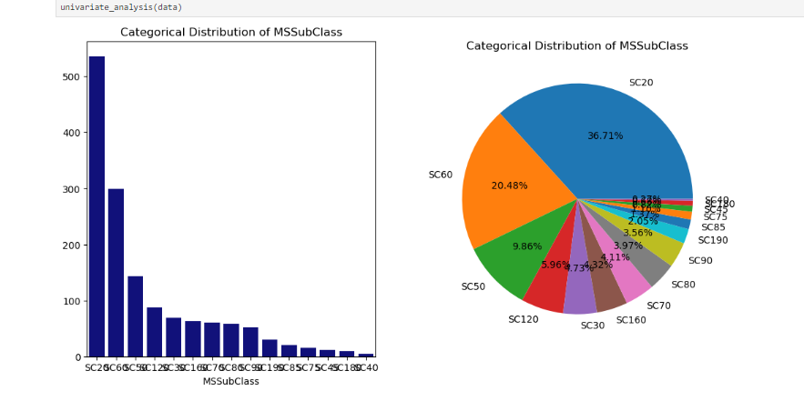
Univariate Analysis

Slide 7
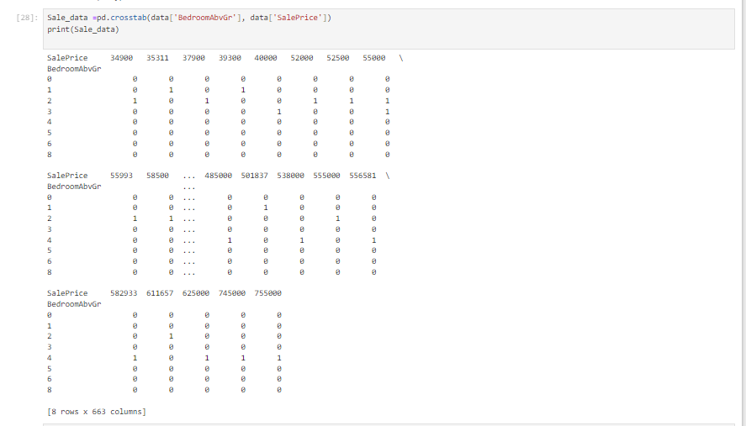
Multivariate Analysis:

Slide 8
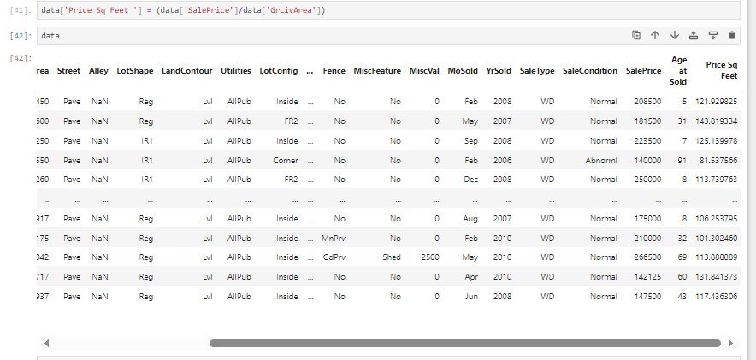
Feature Engineering:

Slide 9
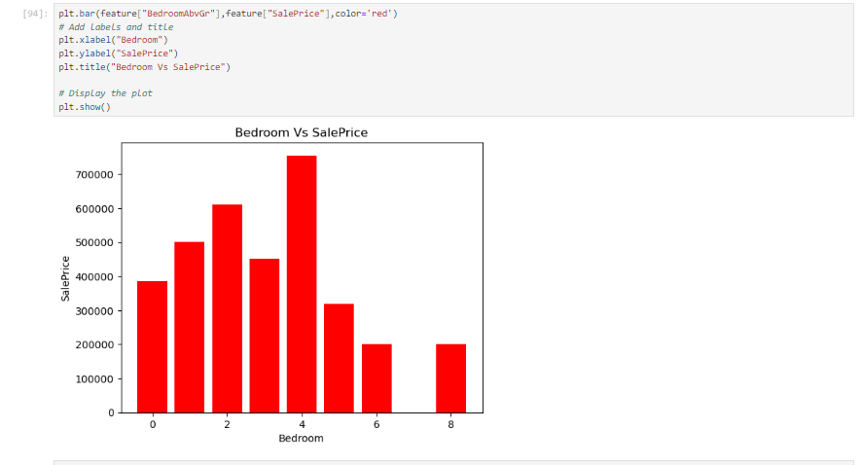
Feature Engineering and Size Impact:

Slide 10
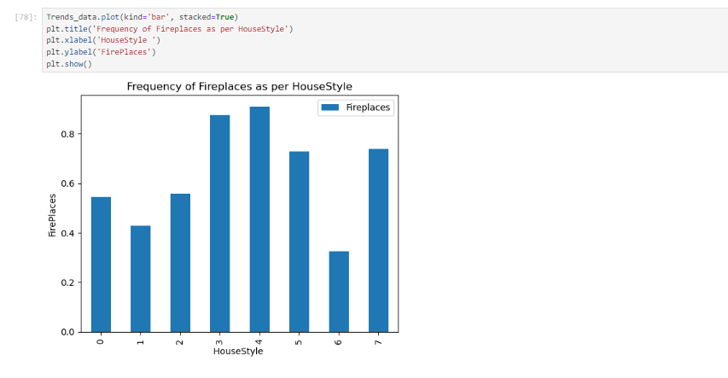
Market Trends and Historical Pricing

Slide 11
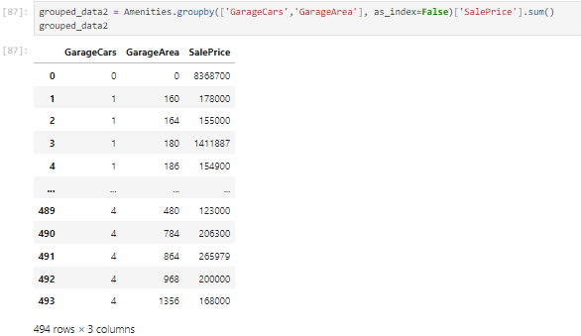
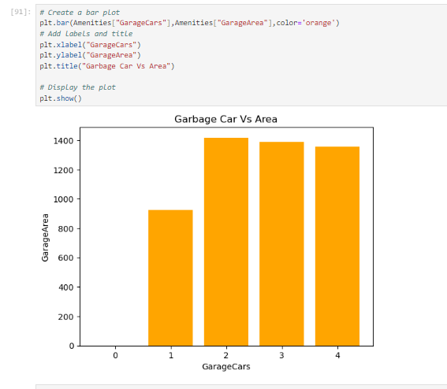
Customer Preferences and Amenities

Slide 12
Conclusion
EDA is indispensable in extracting actionable insights from raw data, especially in domains like real estate where numerous factors contribute to the final property value. Through EDA, we can identify key variables that significantly impact house prices, allowing us to tailor pricing strategies, enhance customer satisfaction, and gain a competitive edge in the market. Moreover, EDA helps us uncover hidden relationships, outliers, and trends that may be obscured at first glance, ensuring a comprehensive analysis that goes beyond surface-level observations

Slide 13
Thank You
Name-Navdeep Kohar
Mail-navdeepkohark58@gmail.com
Ph - 9888339255

