Slide 1

Academic Session 2025-26
EVEN Semester Jan-Jun 2026
UNIVERSITY INSTITUTE OF ENGINEERING
COMPUTER SCIENCE AND ENGINEERING
BACHELOR OF ENGINEERING
CSE / 4TH SEMESTER
DESIGN AND ANALYSIS OF ALGORITHMS
(24CSH-206/24ITH-206)
Unit No. 3 Chapter No. 1 Lecture No. 34
Topic : Bellman Ford Algorithm
Dr. Sumit Kumar Rana E18380 Associate Professor

Slide 2
1
Learning Objectives
To understand the concept of Bellman Ford Algorithm and use it to solve Single Source Shortest Path problem.

Slide 3
2
Bellman Ford Algorithm
The Bellman–Ford algorithm is used to find the shortest paths from a single source vertex to all other vertices in a weighted graph.
It can handle graphs that contain negative edge weights.
It also detects the presence of negative weight cycles, where no shortest path exists.

Slide 4

3
Bellman Ford Algorithm (contd…)
Bellman–Ford works on the principle of edge relaxation.
Relaxation means checking whether the known shortest distance to a vertex can be improved by taking a particular edge.
If
$$dist[u]+weight(u,v)<dist[v]$$
then update
$$dist[v]=dist[u]+weight(u,v)$$

Slide 5
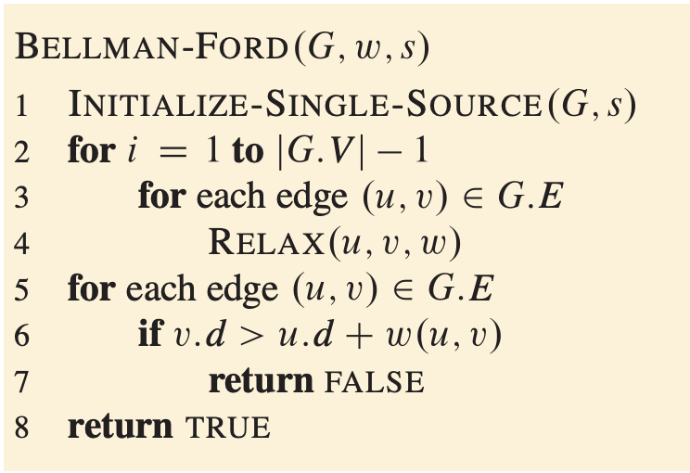
4
Bellman Ford Algorithm (contd…)

Slide 6
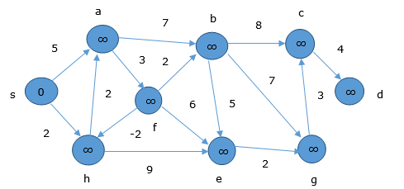
5
Example
At the time of initialization, all the vertices except the source are marked by ∞ and the source is marked by 0.

Slide 7
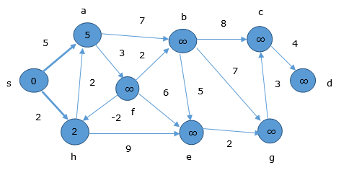
6
Example(contd…)
In the first step, all the vertices which are reachable from the source are updated by minimum cost. Hence, vertices a and h are updated.
In the next step, vertices a, b, f and e are updated.

Slide 8
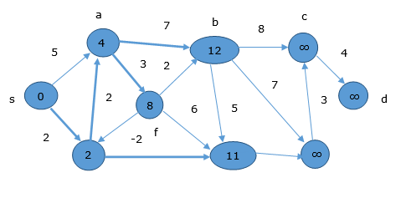
7
Example(contd…)
Following the same logic, in this step vertices b, f, c and g are updated.

Slide 9
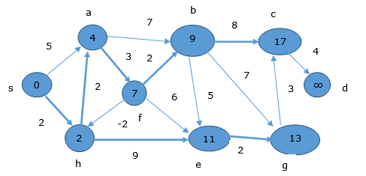
8
Example(contd…)
Here, vertices c and d are updated.

Slide 10
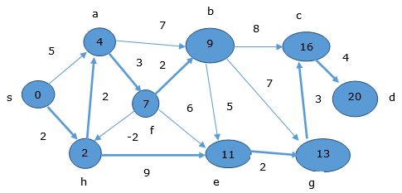
9
Example(contd…)
Hence, the minimum distance between vertex s and vertex d is 20.
Based on the predecessor information, the path is s→ h→ e→ g→ c→ d

Slide 11
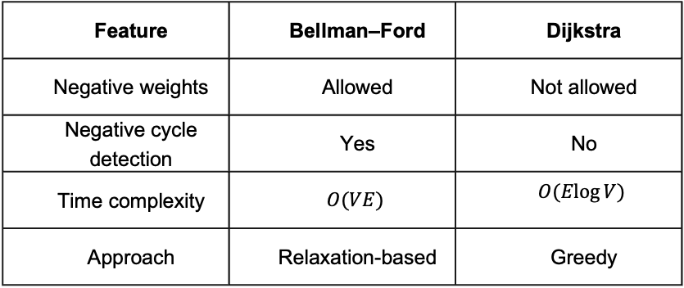
10
Dijkstra vs Bellman Ford
Feature | Bellman–Ford | Dijkstra
Negative weights | Allowed | Not allowed
Negative cycle detection | Yes | No
Time complexity | $$O(VE)$$ | $$O(Elog⁡V)$$
Approach | Relaxation-based | Greedy

Slide 12
11
Applications of the Topic
Routing Information Protocol (RIP) employs Bellman-Ford to compute optimal data packet paths across networks.
GPS applications apply Bellman-Ford for route optimization.
Transportation networks leverage it to minimize travel times or costs in urban planning.
Robots navigate obstacle-filled environments using Bellman-Ford to compute shortest paths.

Slide 13
12
Summary of the Lecture
Use of Bellman ford Algorithm to solve single source shortest path problem.
Detection of Negative weight cycle in a Graph

Slide 14
13
Next Lecture
Floyd Warshall Algorithm for all pair shortest path problem.

Slide 15
14
Quiz
1. Given a directed weighted graph with a source 𝑠, what key property allows the Bellman-Ford algorithm to correctly relax edges up to 𝑉−1 times to find single-source shortest paths?
a) Edge weights are all non-negative
b) There is a unique shortest path to every vertex
c) The graph must be acyclic
d) Shortest paths contain at most 𝑉−1 edges in a graph with 𝑉 vertices
2. What is the time complexity of the standard Bellman-Ford algorithm on a graph with 𝑉 vertices and 𝐸 edges?
a) 𝒪(𝑉𝐸)
b) 𝒪(𝑉^2 )
c) 𝒪(𝐸+𝑉)
d) 𝒪(𝐸 log⁡𝑉 )
3. For a graph with 𝑉 vertices and edges possibly negative but no negative cycles, what is the maximum number of iterations after which all shortest paths are guaranteed to be correct?
a) Depends on the number of negative edges only
b) 𝑉−1
c) 𝐸
d) 𝑉
4. Which condition correctly signals a reachable negative-weight cycle in Bellman-Ford?
a) The source vertex has a self-loop of weight zero
b) A vertex remains unreachable after 𝑉−1 passes
c) Some edge has negative weight
d) An edge (𝑢,𝑣) can still be relaxed on the 𝑉-th pass

Slide 16
15
References/ Articles/ Videos
Text books:
Cormen, Leiserson, Rivest, Stein, “Introduction to Algorithms”, Prentice Hall of India, 3rd edition 2012. problem, Graph coloring.
Horowitz, Sahni and Rajasekaran, “Fundamentals of ComputerAlgorithms”, University Press (India), 2nd edition
Websites:
https://www.coursera.org/learn/algorithms-on-graphs?specialization=data-structures-algorithms
https://www.coursera.org/learn/bits-algorithm-design

Slide 17
16
Faculty-curated videos, NPTEL, Coursera, LinkedIn, or other relevant learning resources
https://www.youtube.com/watch?v=lyw4FaxrwHg
https://www.youtube.com/watch?v=B5PmlJACZ9Y
https://nptel.ac.in/courses/106106131
https://nptel.ac.in/courses/106105164

Slide 18
17
Class-Wise Feedback
Faculty members are encouraged to generate a class specific QR code at the end of each session to collect brief student feedback. This can support self-reflection, improve teaching practices, and allow students to share insights, suggestions, or concerns anonymously.

Slide 19
18
Thank You
For queries
Email: sumit.e18380@cumail.in

