Slide 1

Academic Session 2025-26
EVEN Semester Jan-Jun 2026
UNIVERSITY INSTITUTE OF ENGINEERING
COMPUTER SCIENCE & ENGINEERING
BACHELOR OF ENGINEERING
CSE/ 4th SEMESTER
OPERATING SYSTEM(24CST-205/24ITT-205)
Unit No.3 Chapter No. 3 Lecture No.32 Topic :RAID levels & problems with RAID.
Dr. Anu Kaushik Assistant Professor

Slide 2
Learning Objectives
Students will be able to understand the concept and levels of RAID and explain how RAID improves disk performance, reliability, and fault tolerance.
They will also be able to compare different RAID levels and select an appropriate RAID configuration based on performance and storage requirements.

Slide 3

RAID 1
RAID Level 1 provides redundancy by writing all data to two or more drives.
The performance of a level 1 array tends to be faster on reads and slower on writes compared to a single drive, but if either drive fails, no data is lost.
This is a good entry-level redundant system, since only two drives are required; however, since one drive is used to store a duplicate of the data, the cost per megabyte is high.
This level is commonly referred to as mirroring.

Slide 4
MIRRORING
In striping no fault tolerance but in mirroring provides 100% duplication of data.
Data written to one drive is duplicated on another provides excellent fault tolerance , if one disk is failure no data is lost.
The easiest way to get high availability and high performance.

Slide 5
RAID 2
RAID Level 2, which uses Hamming error correction codes, is intended for use with drives which do not have built-in error detection.
All SCSI drives support built-in error detection, so this level is of little use when using SCSI drives . Because 39 disks are required.

Slide 6
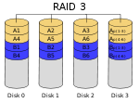
RAID 3
In RAID 3 (byte-level striping with dedicated parity), all disk spindle rotation is synchronized, and data is striped so each sequential byte is on a different disk.
Parity is calculated across corresponding bytes on disks and stored on a dedicated parity disk.

Slide 7
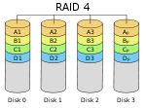
RAID 4
RAID Level 4 stripes data at a block level across several drives, with parity stored on one drive. The parity information allows recovery from the failure of any single drive.
The performance of a level 4 array is very good for reads (the same as level 0). Writes, however, require that parity data be updated each time. This slows small random writes, in particular, though large writes or sequential writes are fairly fast.
Because only one drive in the array stores redundant data, the cost per megabyte of a level 4 array can be fairly low.

Slide 8
RAID 5
RAID 5 (block-level striping with distributed parity) distributes parity along with the data and requires all drives but one to be present to operate; the array is not destroyed by a single drive failure.
Upon drive failure, any subsequent reads can be calculated from the distributed parity such that the drive failure is masked from the end user.
However, a single drive failure results in reduced performance of the entire array until the failed drive has been replaced and the associated data rebuilt.

Slide 9
RAID 5

Slide 10
RAID 6
RAID 6 (block-level striping with double distributed parity) provides fault tolerance of two drive failures; the array continues to operate with up to two failed drives.
This makes larger RAID groups more practical, especially for high-availability systems.
This becomes increasingly important as large-capacity drives lengthen the time needed to recover from the failure of a single drive.
Single-parity RAID levels are as vulnerable to data loss as a RAID 0 array until the failed drive is replaced and its data rebuilt; the larger the drive, the longer the rebuild takes.
Double parity gives time to rebuild the array without the data being at risk if a single additional drive fails before the rebuild is complete.

Slide 11
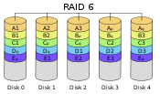

Slide 12
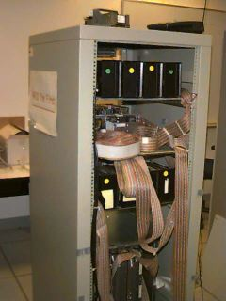
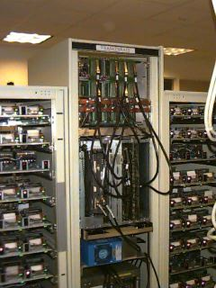
RAID
First RAID system
Second RAID system.

Slide 13
Summary of the Lecture
This lecture enables the students to understand the concept of RAID, its uses, RAID levels and associated problems.

Slide 14
Next Lecture
File Management

Slide 15
Quiz/ FAQ’s
Q1. Which RAID level provides striping without redundancy? A. RAID 0 ⠀ B. RAID 1 ⠀ C. RAID 5 ⠀ D. RAID 6 Q2. How many simultaneous disk failures can RAID 6 tolerate (without data loss)? A. 0 ⠀ B. 1 ⠀ C. 2 ⠀ D. 3

Slide 16
References
https://www.includehelp.com/c-programming-questions/
https://www.studytonight.com/operating-system/
https://computing.llnl.gov/tutorials/
https://www.tutorialspoint.com/operating_system/index.htm#:~:text=An%20operating%20system%20(OS)%20is,software%20in%20a%20computer%20system.
https://www.javatpoint.com/os-tutorial
https://www.guru99.com/operating-system-tutorial.html
https://www.geeksforgeeks.org/operating-systems/
.
…

Slide 17
Faculty-curated videos, NPTEL, Coursera, LinkedIn, or other relevant learning resources
https://nptel.ac.in/courses/106105214
https://www.linkedin.com/learning/iot-foundations-operating-systems-fundamentals-2018

Slide 18
Class-Wise Feedback
Faculty members are encouraged to generate a class specific QR code at the end of each session to collect brief student feedback. This can support self-reflection, improve teaching practices, and allow students to share insights, suggestions, or concerns anonymously.

Slide 19
Thank You
For queries
Email: anu.e12329@cumail.in

