Slide 1

Academic Session 2025-26
EVEN Semester Jan-Jun 2026
UNIVERSITY INSTITUTE OF ENGINEERING
COMPUTER SCIENCE AND ENGINEERING
BACHELOR OF ENGINEERING
CSE / 4TH SEMESTER
DESIGN AND ANALYSIS OF ALGORITHMS
(24CSH-206/24ITH-206)
Unit No. 3 Chapter No. 1 Lecture No. 33
Topic : Dijkstra’s Algorithm
Dr. Sumit Kumar Rana E18380 Associate Professor

Slide 2
1
Learning Objectives
To understand the concept of Dijkstra’s Algorithm and use it to solve Single Source Shortest Path problem.

Slide 3
2
Dijkstra’s Algorithm
Dijkstra's Algorithm is named after computer scientist Edsger Dijkstra, who invented it in 1956.
It uses greedy approach.
It finds the shortest path from a source vertex to all other vertices in a weighted, directed or undirected graph.
It can be applied on graphs with non-negative edge weights only.

Slide 4
3
Dijkstra’s Algorithm (contd…)
at each step, it selects the unvisited vertex closest to the source and declares its shortest distance as final.
This works because of a crucial property: once you've found the shortest path to a vertex, you never need to revisit it.
The negative edge weights would violate this property, which is why Dijkstra's requires non-negative weights

Slide 5
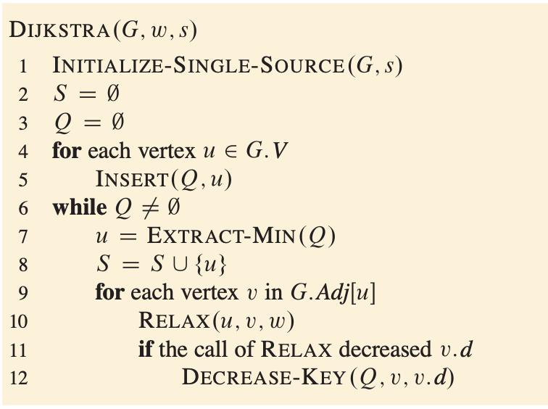
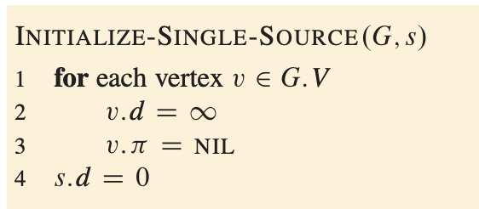
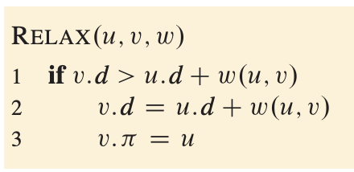
4
Dijkstra’s Algorithm (contd…)

Slide 6
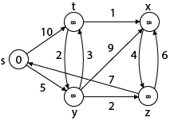
5
Example
S | T | X | Y | Z
0 | ∞ | ∞ | ∞ | ∞
Step1: insert all the nodes in a Min. Priority queue i.e Q =[s, t, x, y, z]
Then remove the node with minimum value i.e s (source node)
push s (source node) in stack M.
M = [S] Q = [t, x, y, z]

Slide 7
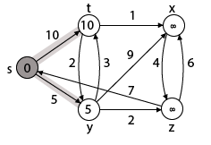
6
Example(contd…)
Step 2: Now find the adjacent of s that are t and y.
Adj [s] → t, y [Here s is u and t and y are v]
Case - (i) s → t d [v] > d [u] + w [u, v] d [t] > d [s] + w [s, t] ∞ > 0 + 10 [true] Then d [t] ← 10 π [t] ← 5
Case - (ii) s→ y d [v] > d [u] + w [u, v] d [y] > d [s] + w [s, y] ∞ > 0 + 5 [true] ∞ > 5 Then d [y] ← 5 π [y] ← 5
 | T | X | Y | Z
 | 10 | ∞ | 5 | ∞

Slide 8
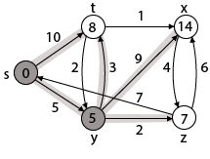
7
Example(contd…)
Step 3: Now remove the next node with min. value i.e. y=5
and repeat the same process for y
Now find the adjacent of y that is t, x, z.
Adj [y] → t, x, z [Here y is u and t, x, z are v]
Case - (i) y →t d [v] > d [u] + w [u, v] d [t] > d [y] + w [y, t] 10 > 5 + 3 10 > 8 Then d [t] ← 8 π [t] ← y
Case - (ii) y → x d [v] > d [u] + w [u, v] d [x] > d [y] + w [y, x] ∞ > 5 + 9 ∞ > 14 Then d [x] ← 14 π [x] ← 14
Case - (iii) y → z d [v] > d [u] + w [u, v] d [z] > d [y] + w [y, z] ∞ > 5 + 2 ∞ > 7 Then d [z] ← 7 π [z] ← y
 | T | X |  | Z
 | 8 | 14 |  | 7

Slide 9
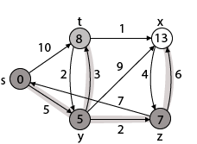
8
Example(contd…)
Step 4: Now remove the next node with min. value i.e. z=7
and repeat the same process for z
Now find the adjacent of z that is x, s.
Adj [z] → x, s [Here z is u and x, s are v]
Case - (i) z → x d [v] > d [u] + w [u, v] d [x] > d [z] + w [z, x] 14 > 7 + 6 14 > 13 Then d [x] ← 13 π [x] ← z
Case - (ii) z → s d [v] > d [u] + w [u, v] d [s] > d [z] + w [z, s] 0 > 7 + 7 0 > 14 [false]
 | T | X
 | 8 | 13

Slide 10
9
Example(contd…)
Step 5: Now remove the next node with min. value i.e. t=8
and repeat the same process for t.
Now find the adjacent of t that is x, y.
Adj [t] → x, y [Here t is u and x, y are v]
Case - (i) t → x d [v] > d [u] + w [u, v] d [x] > d [t] + w [t, x] 13 > 8 + 1 13 > 9 Then d [x] ← 9 π [x] ← t
Case - (ii) t → y d [v] > d [u] + w [u, v] d [y] > d [t] + w [t, y] 5 > 10 [False]
 |  | X
 |  | 9

Slide 11
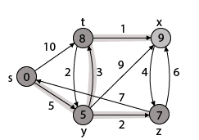
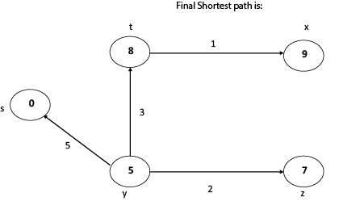
10
Example(contd…)
Step 6: Now remove the next node with min. value i.e. x=9
and repeat the same process for x.
After removing x, there will be no change in the distances of adjacent nodes.
Now the queue is empty so process will stop here and we have found the shortest path from source node to every other node of the graph.

Slide 12
11
Dijkstra vs Other Algorithms
Aspect | Dijkstra | BFS | Bellman-Ford
Edge Weights | Non-negative only | Unweighted (equal) | Negative allowed
Time Complexity | O(E log V) | O(V + E) | O(VE)
Detects Negative Cycles | No | N/A | Yes
Use Case | General shortest path | Unweighted shortest path | Negative weights
Optimality Guaranteed | ✓ Yes | ✓ Yes (for equal weights) | ✓ Yes

Slide 13
12
Applications of the Topic
1. GPS Navigation & Mapping
2. Network Routing (OSPF Protocol)
3. Social Networks: Finding Closest Connections
4. Airline Route Planning
5. Game Development: Pathfinding for NPCs

Slide 14
13
Summary of the Lecture
Use of Dijkstra’s Algorithm to solve single source shortest path problem.

Slide 15
14
Next Lecture
Bellman Ford Algorithm for single source shortest path problem.

Slide 16
15
Quiz
1. Which condition is essential for the correctness of Dijkstra’s algorithm?
a) All edge weights must be nonnegative
b) The graph must be connected and undirected
c) The graph must be acyclic
d) All edge weights must be strictly positive
2. Suppose Dijkstra’s algorithm is implemented with a binary min-heap priority queue and adjacency lists on a graph with 𝑉 vertices and 𝐸 edges. What is the time complexity?
a) 𝒪(𝑉 log⁡𝐸 )
b) 𝒪(𝐸+𝑉)
c) 𝒪((𝑉+𝐸) log⁡𝑉 )
d) 𝒪(𝑉^2 )
3. Why does Dijkstra’s algorithm fail with negative edge weights?
a) Because a later path can undercut a finalized distance
b) Because it cannot relax edges with negative weights
c) Because the priority queue cannot handle negative keys
d) Because it requires a DAG to function
4. If all edges have equal positive weight 𝑤, which algorithm is effectively equivalent to Dijkstra’s for finding shortest paths?
a) Bellman–Ford
b) Kruskal’s algorithm
c) Depth-first search
d) Breadth-first search

Slide 17
16
References/ Articles/ Videos
Text books:
Cormen, Leiserson, Rivest, Stein, “Introduction to Algorithms”, Prentice Hall of India, 3rd edition 2012. problem, Graph coloring.
Horowitz, Sahni and Rajasekaran, “Fundamentals of ComputerAlgorithms”, University Press (India), 2nd edition
Websites:
https://www.coursera.org/learn/algorithms-graphs-data-structures
https://ocw.mit.edu/courses/6-006-introduction-to-algorithms-spring-2020/

Slide 18
17
Faculty-curated videos, NPTEL, Coursera, LinkedIn, or other relevant learning resources
https://www.youtube.com/watch?v=bZkzH5x0SKU
https://www.youtube.com/watch?v=j0OUwduDOS0
https://nptel.ac.in/courses/106108468
https://nptel.ac.in/courses/106106131

Slide 19
18
Class-Wise Feedback
Faculty members are encouraged to generate a class specific QR code at the end of each session to collect brief student feedback. This can support self-reflection, improve teaching practices, and allow students to share insights, suggestions, or concerns anonymously.

Slide 20
19
Thank You
For queries
Email: sumit.e18380@cumail.in

