Slide 1

Academic Session 2025-26
EVEN Semester Jan-Jun 2026
UNIVERSITY INSTITUTE OF ENGINEERING
COMPUTER SCIENCE AND ENGINEERING
BACHELOR OF ENGINEERING
CSE / 4TH SEMESTER
DESIGN AND ANALYSIS OF ALGORITHMS
(24CSH-206/24ITH-206)
Unit No. 3 Chapter No. 1 Lecture No. 35
Topic :Floyd Warshall Algorithm
Dr. Sumit Kumar Rana E18380 Associate Professor

Slide 2
1
Learning Objectives
To understand Floyd Warshall Algorithm to calculate all pair shortest paths.

Slide 3
2
Floyd Warshall Algorithm
Floyd Warshall Algorithm is used to solve All Pairs Shortest Paths Problem.
It computes the shortest path between every pair of vertices of the given graph.
It uses dynamic programming approach.
It works for graphs with positive and negative edge weights, provided there are no negative weight cycles

Slide 4
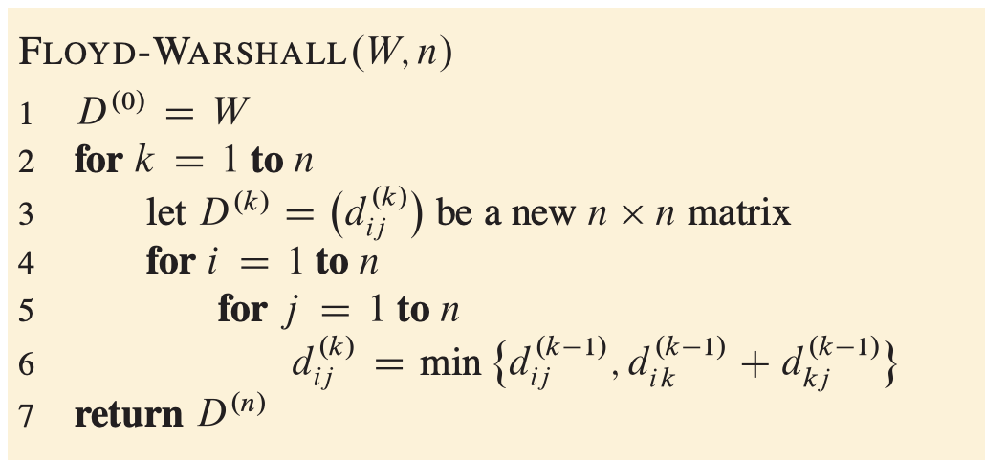
3
Floyd Warshall Algorithm (contd…)

Slide 5
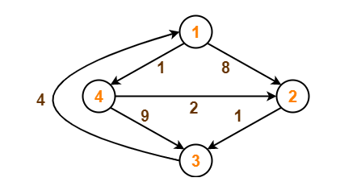
4
Example

Slide 6
5
Example(contd…)
Step-01:
Remove all the self loops and parallel edges (keeping the lowest weight edge) from the graph.
In the given graph, there are neither self edges nor parallel edges.
Step-02:
Write the initial distance matrix.
It represents the distance between every pair of vertices in the form of given weights.
For diagonal elements (representing self-loops), distance value = 0.
For vertices having a direct edge between them, distance value = weight of that edge.
For vertices having no direct edge between them, distance value = ∞.

Slide 7
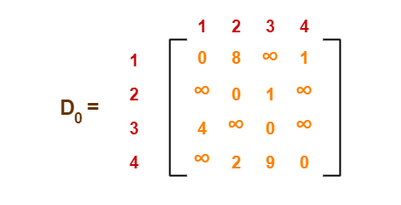
6
Example(contd…)
Initial distance matrix for the given graph is-
Step-03:
Using Floyd Warshall Algorithm, write the following 4 matrices-

Slide 8
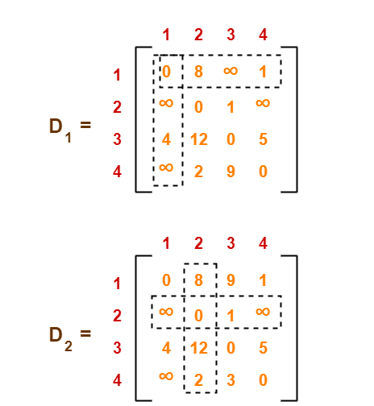
7
Example(contd…)

Slide 9
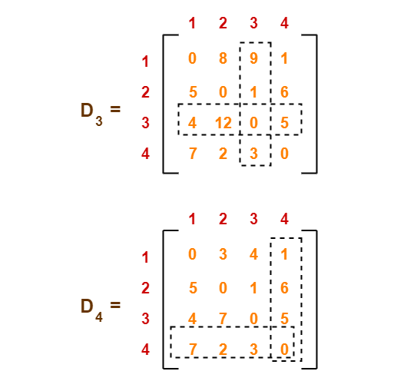
8
Example(contd…)

Slide 10
9
Applications of the Topic
Network Routing (Telecom/Data Centers)
Airline Route Optimization
GPS & Navigation Systems
​Logistics & Delivery Networks​
Currency Arbitrage Detection​

Slide 11
10
Summary of the Lecture
Introduction to Floyd Warshall Algorithm.

Slide 12
11
Next Lecture
Sollin’s Algorithm for MST

Slide 13
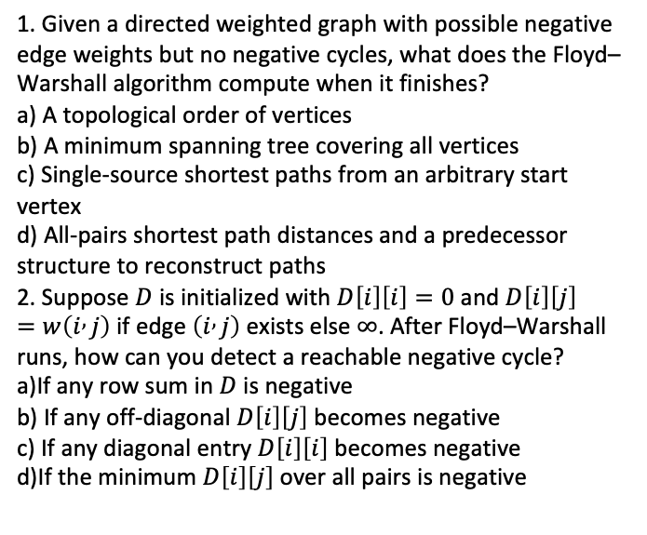
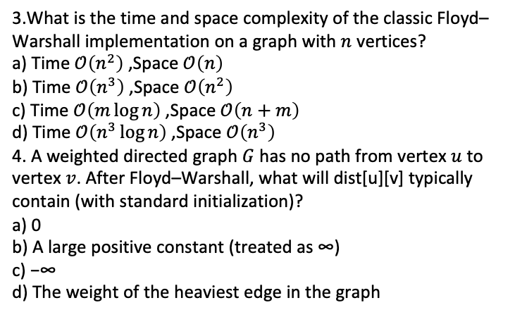
12
Quiz
1. Given a directed weighted graph with possible negative edge weights but no negative cycles, what does the Floyd–Warshall algorithm compute when it finishes?
a) A topological order of vertices
b) A minimum spanning tree covering all vertices
c) Single-source shortest paths from an arbitrary start vertex
d) All-pairs shortest path distances and a predecessor structure to reconstruct paths
2. Suppose $D$ is initialized with $D\left[i\right]\left[i\right]=0$ and $D\left[i\right]\left[j\right]=w\left(i , j\right)$ if edge $\left(i , j\right)$ exists else $∞$. After Floyd–Warshall runs, how can you detect a reachable negative cycle?
a)If any row sum in $D$ is negative
b) If any off-diagonal $D\left[i\right]\left[j\right]$ becomes negative
c) If any diagonal entry $D\left[i\right]\left[i\right]$ becomes negative
d)If the minimum $D\left[i\right]\left[j\right]$ over all pairs is negative
3.What is the time and space complexity of the classic Floyd–Warshall implementation on a graph with $n$ vertices?
a) Time $𝒪\left(n^{2}\right)$, Space $𝒪\left(n\right)$
b) Time $𝒪\left(n^{3}\right)$, Space $𝒪\left(n^{2}\right)$
c) Time $𝒪\left(m\log{n}\right)$, Space $𝒪\left(n+m\right)$
d) Time $𝒪\left(n^{3}\log{n}\right)$, Space $𝒪\left(n^{3}\right)$
4. A weighted directed graph $G$ has no path from vertex $u$ to vertex $v$. After Floyd–Warshall, what will dist[u][v] typically contain (with standard initialization)?
a) 0
b) A large positive constant (treated as ∞)
c) −∞
d) The weight of the heaviest edge in the graph

Slide 14
13
References/ Articles/ Videos
Text books:
Cormen, Leiserson, Rivest, Stein, “Introduction to Algorithms”, Prentice Hall of India, 3rd edition 2012. problem, Graph coloring.
Horowitz, Sahni and Rajasekaran, “Fundamentals of ComputerAlgorithms”, University Press (India), 2nd edition
Websites:
https://fiveable.me/graph-theory/unit-8/floyd-warshall-algorithm-all-pairs-shortest-paths/study-guide/QrUswOyrHaTAjmT4
https://www.sanfoundry.com/cpp-program-implement-floyd-warshall-algorithm/

Slide 15
14
Faculty-curated videos, NPTEL, Coursera, LinkedIn, or other relevant learning resources
https://www.youtube.com/watch?v=sLg6Leb-xt0
https://www.youtube.com/watch?v=4NQ3HnhyNfQ
http://coursera.org/specializations/algorithms
https://nptel.ac.in/courses/106106131

Slide 16
15
Class-Wise Feedback
Faculty members are encouraged to generate a class specific QR code at the end of each session to collect brief student feedback. This can support self-reflection, improve teaching practices, and allow students to share insights, suggestions, or concerns anonymously.

Slide 17
16
Thank You
For queries
Email: sumit.e18380@cumail.in

