Slide 1

Academic Session 2025-26
EVEN Semester Jan-Jun 2026
UNIVERSITY INSTITUTE OF ENGINEERING
COMPUTER SCIENCE & ENGINEERING
BACHELOR OF ENGINEERING
CSE/ 4th SEMESTER
OPERATING SYSTEM(24CST-205/24ITT-205)
Unit No.3 Chapter No. 2 Lecture No.35 Topic :Allocation Methods and Free Space Management
Dr. Anu Kaushik Assistant Professor

Slide 2
Learning Objectives
Understand different file allocation methods (contiguous, linked, indexed) and their impact on performance and storage efficiency.
Analyze free space management techniques (bit map, linked list, grouping) for effective utilization of disk space.

Slide 3

Allocation Methods - Contiguous
An allocation method refers to how disk blocks are allocated for files:
Contiguous allocation – each file occupies set of contiguous blocks
Best performance in most cases
Simple – only starting location (block #) and length (number of blocks) are required
Problems include finding space for file, knowing file size, external fragmentation, need for compaction off-line (downtime) or on-line

Slide 4
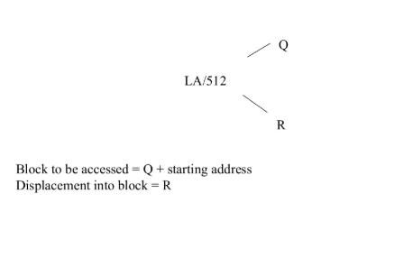
Contiguous Allocation
Mapping from logical to physical

Slide 5
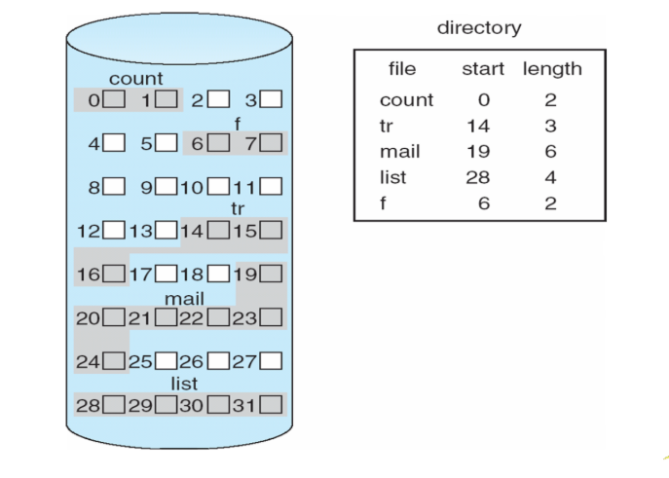
Contiguous Allocation of Disk Space

Slide 6
Allocation Methods - Linked
Linked allocation – each file a linked list of blocks
File ends at nil pointer
No external fragmentation
Each block contains pointer to next block
No compaction, external fragmentation

Slide 7
Allocation Methods - Linked
Free space management system called when new block needed
Improve efficiency by clustering blocks into groups but increases internal fragmentation
Reliability can be a problem
Locating a block can take many I/Os and disk seeks

Slide 8
Allocation Methods - Linked
FAT (File Allocation Table) variation
Beginning of volume has table, indexed by block number
Much like a linked list, but faster on disk and cacheable
New block allocation simple

Slide 9
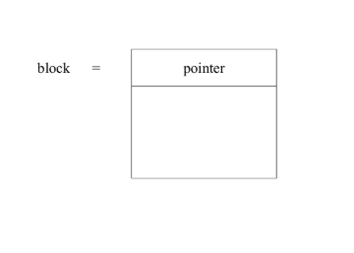
Linked Allocation
Each file is a linked list of disk blocks: blocks may be scattered anywhere on the disk

Slide 10
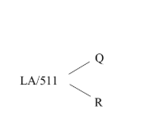
Linked Allocation
Mapping
Block to be accessed is the Qth block in the linked chain of blocks representing the file.
Displacement into block = R + 1

Slide 11
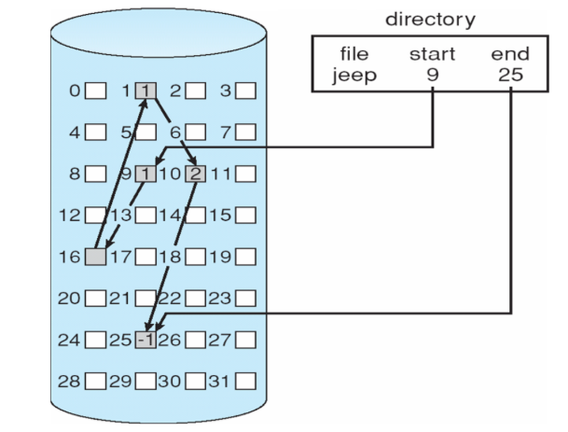
Linked Allocation

Slide 12
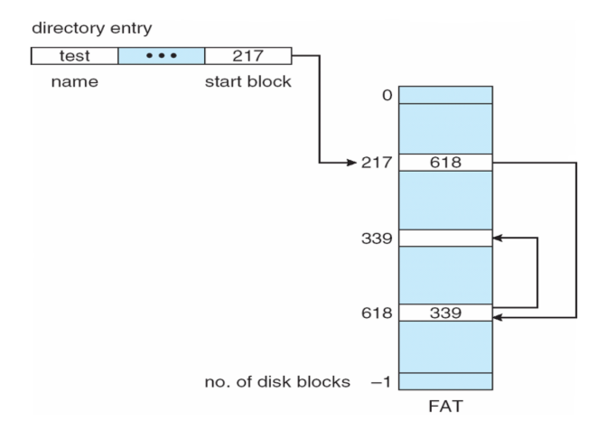
File-Allocation Table

Slide 13
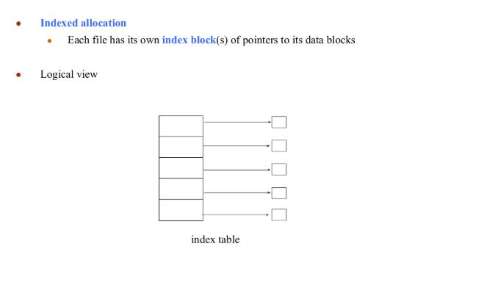
Allocation Methods - Indexed

Slide 14
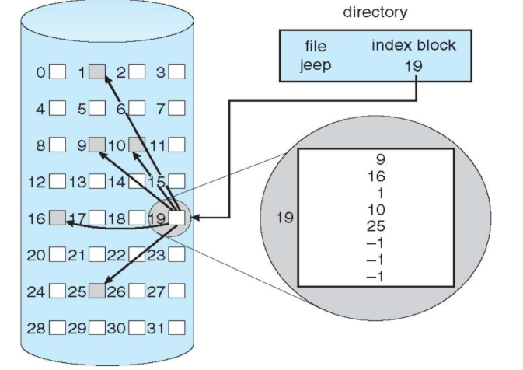
Example of Indexed Allocation

Slide 15
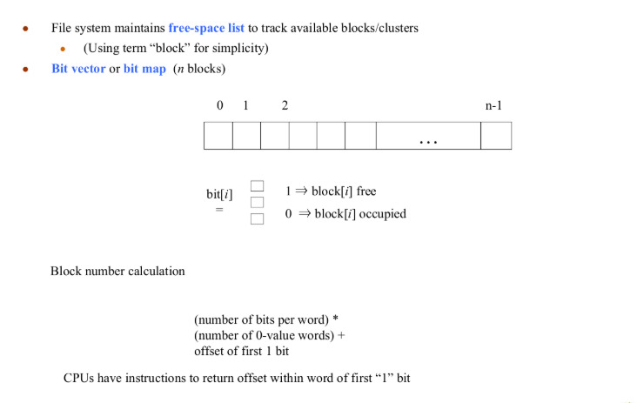
Free-Space Management

Slide 16
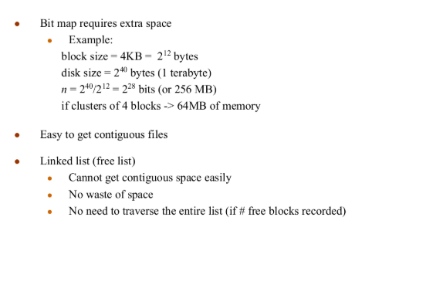
Free-Space Management (Cont.)
.

Slide 17
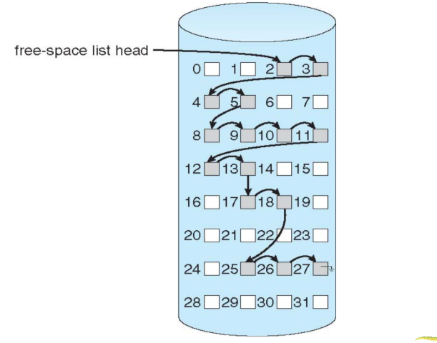
Linked Free Space List on Disk

Slide 18
Free-Space Management (Cont.)
Grouping
Modify linked list to store address of next n-1 free blocks in first free block, plus a pointer to next block that contains free-block-pointers (like this one)

Slide 19
Free-Space Management (Cont.)
Counting
Because space is frequently contiguously used and freed, with contiguous-allocation allocation, extents, or clustering
Keep address of first free block and count of following free blocks
Free space list then has entries containing addresses and counts

Slide 20
Efficiency and Performance
Efficiency dependent on:
Disk allocation and directory algorithms
Types of data kept in file’s directory entry
Pre-allocation or as-needed allocation of metadata structures
Fixed-size or varying-size data structures.

Slide 21
Efficiency and Performance
Performance:
Keeping data and metadata close together
Buffer cache – separate section of main memory for frequently used blocks
Synchronous writes sometimes requested by apps or needed by OS
No buffering / caching – writes must hit disk before acknowledgement
Asynchronous writes more common, buffer-able, faster
Free-behind and read-ahead – techniques to optimize sequential access
Reads frequently slower than writes

Slide 22
Summary of the Lecture
This lecture enables the students to understand the concepts of file allocation methods and free space management in operating systems.

Slide 23
Next Lecture
System Protection and Security

Slide 24
Quiz/ FAQ’s
Q1. Which file allocation method stores file blocks in contiguous disk locations? A. Linked allocation B. Indexed allocation C. Contiguous allocation D. Random allocation Q2. Which free space management technique uses a map of bits to track free and occupied blocks? A. Linked list B. Grouping C. Bit map (bit vector) D. Counting

Slide 25
References
https://www.includehelp.com/c-programming-questions/
https://www.studytonight.com/operating-system/
https://computing.llnl.gov/tutorials/
https://www.tutorialspoint.com/operating_system/index.htm#:~:text=An%20operating%20system%20(OS)%20is,software%20in%20a%20computer%20system.
https://www.javatpoint.com/os-tutorial
https://www.guru99.com/operating-system-tutorial.html
https://www.geeksforgeeks.org/operating-systems/
.
…

Slide 26
Faculty-curated videos, NPTEL, Coursera, LinkedIn, or other relevant learning resources
https://nptel.ac.in/courses/106105214
https://www.linkedin.com/learning/iot-foundations-operating-systems-fundamentals-2018

Slide 27
Class-Wise Feedback
Faculty members are encouraged to generate a class specific QR code at the end of each session to collect brief student feedback. This can support self-reflection, improve teaching practices, and allow students to share insights, suggestions, or concerns anonymously.

Slide 28
Thank You
For queries
Email: anu.e12329@cumail.in

