Slide 1

Academic Session 2025-26
EVEN Semester Jan-Jun 2026
UNIVERSITY INSTITUTE OF ENGINEERING
COMPUTER SCIENCE AND ENGINEERING
BACHELOR OF ENGINEERING
CSE / 4TH SEMESTER
DESIGN AND ANALYSIS OF ALGORITHMS
(24CSH-206)
Unit No. 1 Chapter No. 3 Lecture No. 14
Topic : Counting sort, Radix sort
Dr. Sumit Kumar Rana E18380 Associate Professor

Slide 2
1
Learning Objectives
To understand the concept of sorting in linear time

Slide 3
2
Counting Sort
Counting sort is a sorting algorithm that works best when the input consists of integers in a small range (for example, marks from 0 to 100 or ages from 0 to 120).
Core idea
First, it does not compare elements like quicksort or mergesort; instead, it just counts how many times each value appears.
Then, using these counts, it directly decides where each value should go in the sorted array.
Think of sorting students by their marks (0–100):
Create a “count array” with one box for every possible mark (0, 1, 2, …, 100) and initialize all to 0.
Scan the original list; for every mark you see, increase the counter in that mark’s box (if you see 75, increment box 75).
Convert these counts into cumulative counts so each box tells “how many elements are ≤ this value,” which gives the final positions.
Now place each element into its correct position in the output array using these cumulative counts, adjusting the counts as you place.

Slide 4
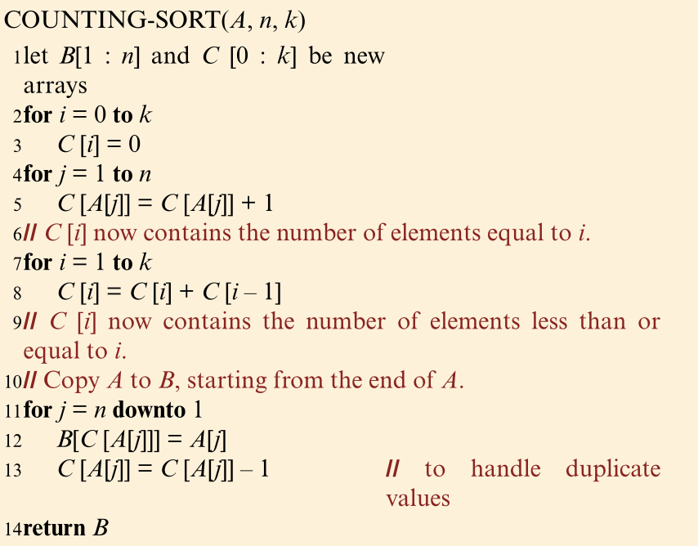
3
Counting Sort (contd…)
Source: Cormen, Leiserson, Rivest, Stein, “Introduction to Algorithms”, Prentice Hall of India, 2012.

Slide 5
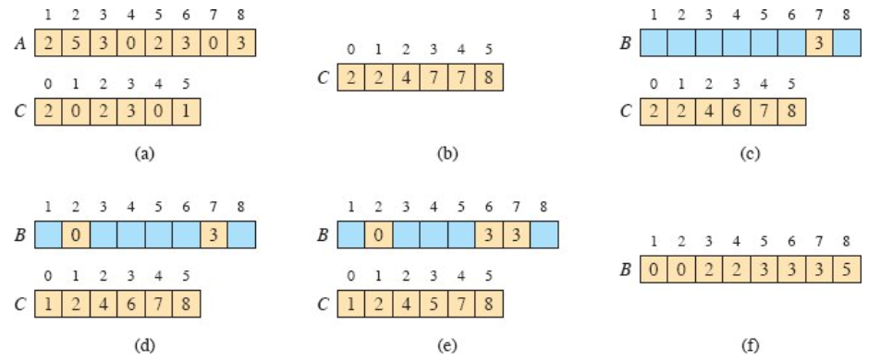
4
Counting Sort (contd…)
Source: Cormen, Leiserson, Rivest, Stein, “Introduction to Algorithms”, Prentice Hall of India, 2012.

Slide 6
5
Radix Sort
Radix sort is like sorting a deck of cards by treating numbers as multi-digit items and handling one digit at a time, starting from the rightmost (least significant) digit. It relies on a stable helper like counting sort to group numbers into "buckets" (0-9) without messing up previous orders.
Everyday Analogy
Imagine sorting phone numbers: first group by last digit (units place), then by tens, then hundreds—each pass refines the order perfectly. No direct comparisons between numbers; it's all about digit positions.
Step-by-Step Process
For array:
Find max (802) to know digits (3 passes needed).
Pass 1 (units): Use counting sort on units digits.
Pass 2 (tens): Counting sort on tens.
Pass 3 (hundreds): Counting sort on hundreds → (sorted!).

Slide 7
6
Radix Sort (contd…)
How Radix Sort Works?
1) Find the largest element in the array, i.e. max. Let X be the number of digits in max. X is calculated because we have to go through all the significant places of all elements. In this array [121, 432, 564, 23, 1, 45, 788], we have the largest number 788. It has 3 digits. Therefore, the loop should go up to hundreds place (3 times)
2) Now, go through each significant place one by one.
Use any stable sorting technique to sort the digits at each significant place. We have used counting sort for this. Sort the elements based on the unit place digits (X=0). Counting Sort is a linear time sorting algorithm that sort in O(n+k) time when elements are in range from 1 to k.

Slide 8
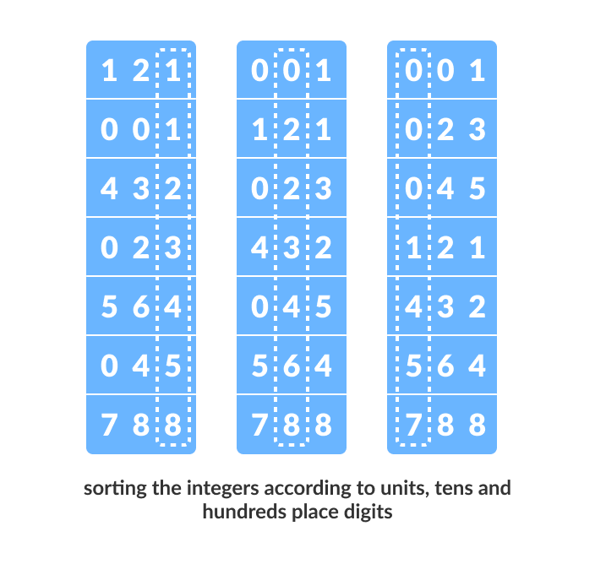
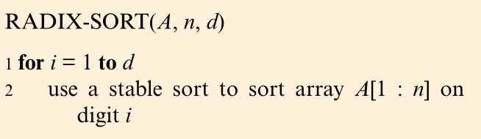
7
Radix Sort (contd…)

Slide 9
8
Applications of the Topic
Exam grading: Teachers sort student scores (0-100 range) to assign ranks or generate histograms quickly.​
Age demographics: Census data sorts populations by age groups for analysis without comparisons.​
Image processing: Counts pixel intensities for histogram equalization to enhance contrast.​
Vote tallying: Election systems count votes per candidate in real-time for instant results.​
Employee IDs or phone numbers: Sorts fixed-digit codes by processing one digit position at a time.​
Card sorting machines: Historical use in data processing for punched cards by numeric fields.​
Parallel/distributed systems: Handles large datasets across machines, like log file timestamps.

Slide 10
9
Summary of the Lecture
Sorting in Linear Time
Counting Sort
Radix Sort

Slide 11
10
Next Lecture
Sorting in linear time: Bucket sort

Slide 12
11
Quiz
Suppose you apply counting sort to 𝑛 integers in the range 0 to 𝑘. What is the typical time complexity of this algorithm?
𝒪(𝑘^2 ) because the frequency array is squared in size
𝒪(𝑛 log⁡𝑛 ) because it sorts by comparing elements
𝒪(𝑛^2 ) regardless of 𝑘
𝒪(𝑛+𝑘) because it processes both the input and the key range
Which situation makes counting sort a poor choice compared with comparison-based algorithms like mergesort or quicksort?
When the input size 𝑛 is large but the key range 𝑘 is small
When the input is nearly sorted before applying the algorithm
When the key range 𝑘 is extremely large relative to 𝑛
When all keys are distinct and randomly distributed in a small range
In LSD radix sort for decimal digits (base 10), which order of digit processing will produce a correct final sort using a stable per-digit algorithm?
All digits processed simultaneously in parallel passes
Least significant digit first, then moving to more significant digits
Any random order of digits, because stability compensates for ordering
Most significant digit first, then moving to less significant digits
What is the main space overhead of a straightforward counting sort implementation on 𝑛 elements with keys in 0..𝑘?
𝒪(1), because it sorts entirely in-place
𝒪(𝑘) extra space for the frequency array only
𝒪(𝑛+𝑘) extra space for both output and counting arrays
𝒪(𝑛) extra space for the output only

Slide 13
12
References/ Articles/ Videos
Text books:
Cormen, Leiserson, Rivest, Stein, “Introduction to Algorithms”, Prentice Hall of India, 3rd edition 2012.
Horowitz, Sahni and Rajasekaran, “Fundamentals of ComputerAlgorithms”, University Press (India), 2nd edition
Websites:
https://nptel.ac.in/courses/106102064
https://www.coursera.org/learn/algorithms-on-graphs

Slide 14
13
Faculty-curated videos, NPTEL, Coursera, LinkedIn, or other relevant learning resources
https://www.youtube.com/watch?v=Nz1KZXbghj8
https://nptel.ac.in/courses/106102064

Slide 15
14
Class-Wise Feedback
Faculty members are encouraged to generate a class specific QR code at the end of each session to collect brief student feedback. This can support self-reflection, improve teaching practices, and allow students to share insights, suggestions, or concerns anonymously.

Slide 16
15
Thank You
For queries
Email: sumit.e18380@cumail.in

