Slide 1
Better By Far Report
MCIS6333_001 DVP FA23
Team Number: 9 Team Name: Nexus
DVP Team Members: Vaasanthi Ethakota, Praveen Kumar Kanuri
Date: November 15, 2023
Notes:
Instructions for this slide:
Edit the above slide to render it correct with regard to:
-Team number
-Team name
-Team member names
-Date
Leave the title of this slide as shown: Use Case Report
Do not remove or edit the Identification Stamp in the top left corner of the slide as it is necessary for the grading process.
Add any customization you desire in terms of design (as long as the Identification Stamp remains visible).

Slide 2
Client Name: Better By Far
Offering: Social Media Platform
Brand: Better By Far
Notes:
Instructions for this slide:
Edit the above slide to render it correct with regard to:
-Client name
-Offering (what is the product or service that the client is wanting to get DVP results about?)
-Brand (if your use case has one; if not, just leave it as is: TBD (which stands for To Be Determined)
As discussed in CS10, all of the above information can be obtained from your Use Case Description .docx in your Bb Team File Exchange.
Add any customization you desire in terms of design.

Slide 3
Contents
Brief description of the Use Case
M2) User Behavior and Opinions Over Time.
M3) Composition of User Demographics, Interests, and Intentions
M4) Distributions of User Age, Income, Usage Intent, and Purchase Intent.
M5) Demographic and other user-characteristic profile comparison of a) most viable, b) unsure, and c) most disinterested users.
M6) Revelatory relationships between user characteristics and intended behaviors.
M7) Possible data insights from geographical representations.
Summary of data insights most effective for decision making
Notes:
Recall our list of actionable use case requirements and objectives:
M2) User Behavior and Opinions Over Time.
M3) Composition of User Demographics, Interests, and Intentions.
M4) Distributions of User Age, Income, Usage Intent, and Purchase Intent.
M5) Demographic and other user-characteristic profile comparison of a) most viable, b) unsure, and c) most disinterested users.
M6) Revelatory relationships between user characteristics and intended behaviors.
M7) Possible data insights from geographical representations.
Instructions for this slide:
Replace all items on the above slide that are in red font with your team-specific content and remove the red font. Each team is required to have sections 1) and 8). Do not change the content of items 1 and 8.
Add any customization you desire in terms of design. ←This comment applies to the remainder of the slides below this point and will no longer be repeated.

Slide 4
1. Brief description of the Use Case
Better By Far aims to launch a cutting-edge Social Media Platform, "Better By Far." Our Data Visualization Programming team, under Dr. Mead's guidance, is tasked with decoding seven pivotal datasets. Each module, aligned with Better By Far's objectives, unfolds a unique facet of user behavior, demographics, and intentions, paving the way for data-driven decisions.
Data Exploration Journey: Embark on a modular analysis journey, unraveling insights from the initial dataset to subsequent ones.
Strategic Objectives: Address Better By Far's seven objectives (M1 to M7), encompassing user behavior, demographics, and geographical representations.
Actionable Insights: Illuminate how the data insights will guide Better By Far's strategic decisions for a successful social media platform launch.
Notes:
Instructions for this slide:
Each team is required to have section 1). Do not change the slide title of this slide for section 1.
As discussed in CS10, all of the Use Case information can be obtained from your Use Case Description .docx in your Bb Team File Exchange.

Slide 5
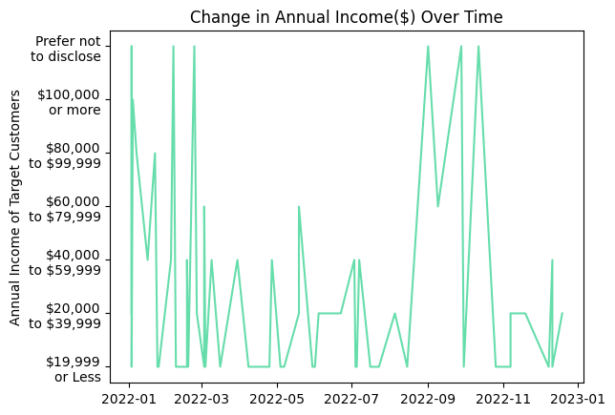
2 M2) User Behavior and Opinions Over Time.
Income Diversity Trends:
Identified gaps in income disclosure during specific months, emphasizing the need for targeted engagement strategies.
Discovered a significant portion of users reporting annual incomes over $100,000, indicating a high-purchasing-power user segment.
Proactive Engagement:
Implement targeted campaigns to address income disclosure gaps and encourage users to willingly share financial information.
Devise exclusive features and personalized content for high-income users to maximize engagement and satisfaction.
Notes:
Recall our list of actionable use case requirements and objectives:
M2) User Behavior and Opinions Over Time.
M3) Composition of User Demographics, Interests, and Intentions.
M4) Distributions of User Age, Income, Usage Intent, and Purchase Intent.
M5) Demographic and other user-characteristic profile comparison of a) most viable, b) unsure, and c) most disinterested users.
M6) Revelatory relationships between user characteristics and intended behaviors.
M7) Possible data insights from geographical representations.
Instructions for this slide:
0) Keep this section numbered as section 2.
1) Replace the content in red font on the above slide with NOT-RED-FONTED team-created content based on a (your first) selection from the list of actionable use case requirements and objectives above. 2) Then insert the DVs that you used in your One-Page Report (OPR) that correspond to that use case objective item you selected.
3) Then insert your Data Insights that you used for each of those DVs. You can add more detail if you wish, since you have more room here in the PRES than you did in the OPR but be sure to match the minimum that you put in your OPR.
4) Add more slides if you need/want to but be careful not to lose the flow of your information and be sure not to mess up the numbering of the sections.

Slide 6
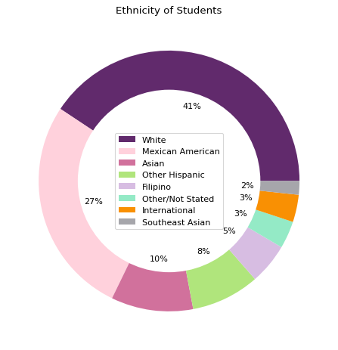
3. M3) Composition of User Demographics, Interests, and Intentions.
Diverse User Base:
- Uncovered a diverse user composition with White (41%) and Mexican American (27%) target customers as the majority, alongside Southeast Asian and International users (both at 2%).
- Noted a significant opportunity for engagement with Mexican American users and the potential for international user outreach.
Culturally Inclusive Platform:
- Foster platform inclusivity by creating tailored content for the prominent Mexican American demographic.
- Expand international appeal through multilingual support, respecting user privacy, and implementing personalized marketing strategies for diverse user segments.
Notes:
Recall our list of actionable use case requirements and objectives:
M2) User Behavior and Opinions Over Time.
M3) Composition of User Demographics, Interests, and Intentions.
M4) Distributions of User Age, Income, Usage Intent, and Purchase Intent.
M5) Demographic and other user-characteristic profile comparison of a) most viable, b) unsure, and c) most disinterested users.
M6) Revelatory relationships between user characteristics and intended behaviors.
M7) Possible data insights from geographical representations.
Instructions for this slide:
0) Keep this section numbered as section 3.
1) Replace the content in red font on the above slide with NOT-RED-FONTED team-created content based on a (your second) selection from the list of actionable use case requirements and objectives above. 2) Then insert the DVs that you used in your One-Page Report (OPR) that correspond to that use case objective item you selected.
3) Then insert your Data Insights that you used for each of those DVs. You can add more detail if you wish, since you have more room here in the PRES than you did in the OPR but be sure to match the minimum that you put in your OPR.
4) Add more slides if you need/want to but be careful not to lose the flow of your information and be sure not to mess up the numbering of the sections.

Slide 7
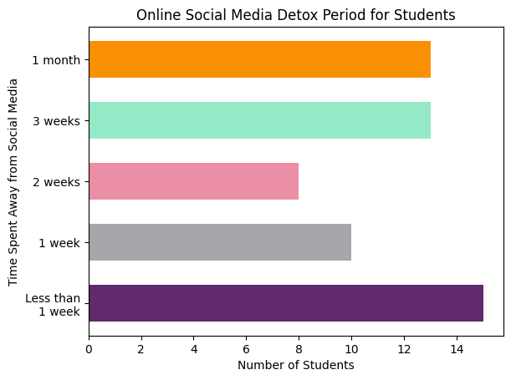
3. M3) Composition of User Demographics, Interests, and Intentions.
Diverse Break Preferences:
Uncovered diverse user preferences, with 15 students favoring very short social media breaks, 13 each opting for 3 weeks and 1 month off, and 10 students for a one-week break, indicating a balanced range of user choices.
Mid-Range Break Preferences:
Identified a mid-range preference among 10 students for a one-week break and 8 students for two weeks, suggesting a potential target segment for tailored features.
Tailored Break Features:
Implement platform features like daily highlights for users taking short breaks, fostering more frequent engagement.
Provide content such as productivity tips and personal development for those on one or two-week breaks, enhancing overall user experience and potentially increasing retention.
Notes:
Recall our list of actionable use case requirements and objectives:
M2) User Behavior and Opinions Over Time.
M3) Composition of User Demographics, Interests, and Intentions.
M4) Distributions of User Age, Income, Usage Intent, and Purchase Intent.
M5) Demographic and other user-characteristic profile comparison of a) most viable, b) unsure, and c) most disinterested users.
M6) Revelatory relationships between user characteristics and intended behaviors.
M7) Possible data insights from geographical representations.
Instructions for this slide:
0) Keep this section numbered as section 3.
1) Replace the content in red font on the above slide with NOT-RED-FONTED team-created content based on a (your second) selection from the list of actionable use case requirements and objectives above. 2) Then insert the DVs that you used in your One-Page Report (OPR) that correspond to that use case objective item you selected.
3) Then insert your Data Insights that you used for each of those DVs. You can add more detail if you wish, since you have more room here in the PRES than you did in the OPR but be sure to match the minimum that you put in your OPR.
4) Add more slides if you need/want to but be careful not to lose the flow of your information and be sure not to mess up the numbering of the sections.

Slide 8
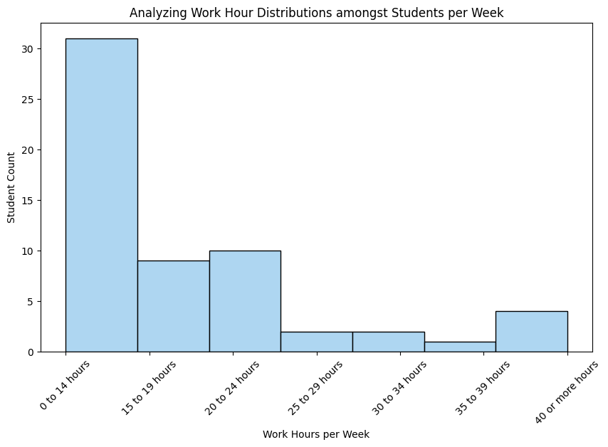
4.M4) Distributions of User Age, Income, Usage Intent, and Purchase Intent.
Diverse Work Hour Engagement:
- A diverse user base with 31 members working 0-14 hours, 10 members engaged for 20-24 hours, and 4 members working 40 or more hours per week reflects varying work commitments.
Engagement Segmentation:
- Identified a moderately engaged group (20-24 hours) and a highly engaged segment (40 or more hours) within the user base.
Personalized Engagement Strategies:
- Tailor engagement initiatives based on users' work hours, providing a personalized experience for diverse engagement levels and ensuring sustained platform usage.
Notes:
Recall our list of actionable use case requirements and objectives:
M2) User Behavior and Opinions Over Time.
M3) Composition of User Demographics, Interests, and Intentions.
M4) Distributions of User Age, Income, Usage Intent, and Purchase Intent.
M5) Demographic and other user-characteristic profile comparison of a) most viable, b) unsure, and c) most disinterested users.
M6) Revelatory relationships between user characteristics and intended behaviors.
M7) Possible data insights from geographical representations.
Instructions for this slide:
0) Keep this section numbered as section 4.
1) Replace the content in red font on the above slide with NOT-RED-FONTED team-created content based on a (your third) selection from the list of actionable use case requirements and objectives above. 2) Then insert the DVs that you used in your One-Page Report (OPR) that correspond to that use case objective item you selected.
3) Then insert your Data Insights that you used for each of those DVs. You can add more detail if you wish, since you have more room here in the PRES than you did in the OPR but be sure to match the minimum that you put in your OPR.
4) Add more slides if you need/want to but be careful not to lose the flow of your information and be sure not to mess up the numbering of the sections.

Slide 9
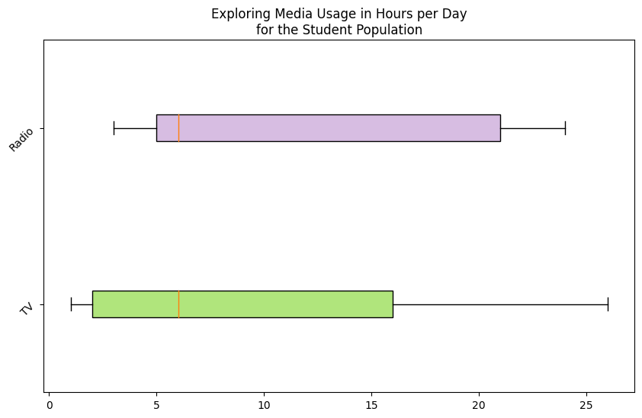
4.M4) Distributions of User Age, Income, Usage Intent, and Purchase Intent.
TV and Radio Dominance:
Majority of students prefer spending 1-3 hours daily on TV and Radio, indicating their popularity as primary media choices.
Diverse Engagement Levels:
Some users display high engagement, investing 3-5 hours or 5-7 hours daily on TV and Radio, showcasing varied media consumption habits.
Targeted Ad Campaigns:
- Focus advertising efforts on users with higher TV and Radio engagement (3-5 hours, 5-7 hours) for effective targeting.
- Explore alternative advertising channels for users with lower media usage to ensure comprehensive outreach and engagement.
Notes:
Recall our list of actionable use case requirements and objectives:
M2) User Behavior and Opinions Over Time.
M3) Composition of User Demographics, Interests, and Intentions.
M4) Distributions of User Age, Income, Usage Intent, and Purchase Intent.
M5) Demographic and other user-characteristic profile comparison of a) most viable, b) unsure, and c) most disinterested users.
M6) Revelatory relationships between user characteristics and intended behaviors.
M7) Possible data insights from geographical representations.
Instructions for this slide:
0) Keep this section numbered as section 4.
1) Replace the content in red font on the above slide with NOT-RED-FONTED team-created content based on a (your third) selection from the list of actionable use case requirements and objectives above. 2) Then insert the DVs that you used in your One-Page Report (OPR) that correspond to that use case objective item you selected.
3) Then insert your Data Insights that you used for each of those DVs. You can add more detail if you wish, since you have more room here in the PRES than you did in the OPR but be sure to match the minimum that you put in your OPR.
4) Add more slides if you need/want to but be careful not to lose the flow of your information and be sure not to mess up the numbering of the sections.

Slide 10
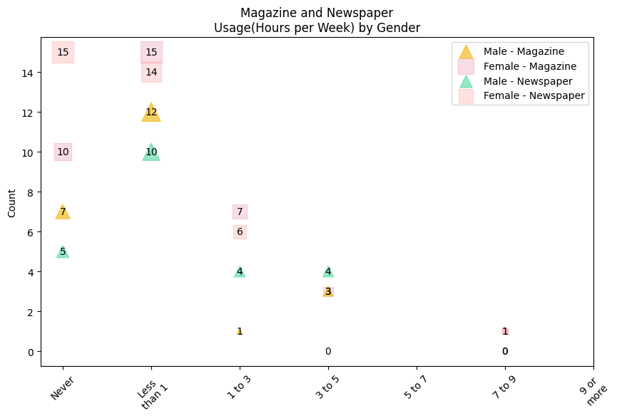
4.M4) Distributions of User Age, Income, Usage Intent, and Purchase Intent.
Limited Print Media Engagement:
Magazine and Newspaper consumption is notably low, with a substantial number of users spending less than 1 hour per week or showing no engagement.
Modest Interest Segment:
Few users exhibit moderate interest, spending 1-3 hours or 3-5 hours per week on Magazine and Newspaper.
Digital Transition:
Considering the limited interest, explore digital alternatives or collaborations with online news platforms to revitalize print media consumption.
Notes:
Recall our list of actionable use case requirements and objectives:
M2) User Behavior and Opinions Over Time.
M3) Composition of User Demographics, Interests, and Intentions.
M4) Distributions of User Age, Income, Usage Intent, and Purchase Intent.
M5) Demographic and other user-characteristic profile comparison of a) most viable, b) unsure, and c) most disinterested users.
M6) Revelatory relationships between user characteristics and intended behaviors.
M7) Possible data insights from geographical representations.
Instructions for this slide:
0) Keep this section numbered as section 4.
1) Replace the content in red font on the above slide with NOT-RED-FONTED team-created content based on a (your third) selection from the list of actionable use case requirements and objectives above. 2) Then insert the DVs that you used in your One-Page Report (OPR) that correspond to that use case objective item you selected.
3) Then insert your Data Insights that you used for each of those DVs. You can add more detail if you wish, since you have more room here in the PRES than you did in the OPR but be sure to match the minimum that you put in your OPR.
4) Add more slides if you need/want to but be careful not to lose the flow of your information and be sure not to mess up the numbering of the sections.

Slide 11
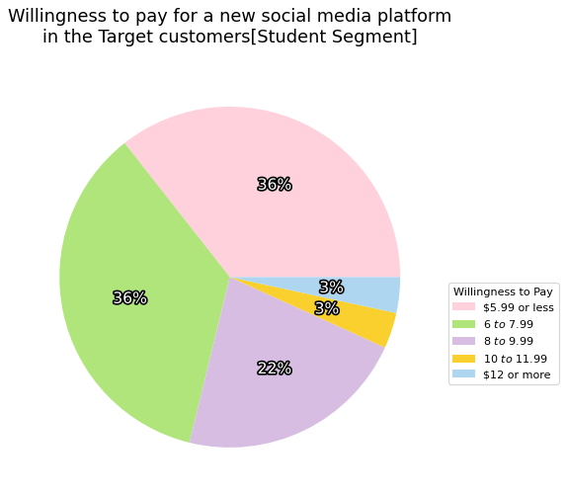
5.M5) Demographic and other user-characteristic profile comparison of a) most viable, b) unsure, and c) most disinterested users.
Pricing Sweet Spot Identified:
The pie chart highlights a significant user preference, with 58% comfortable paying between $6 and $9.99, establishing a distinct "Pricing Sweet Spot" for the student segment.
Budget-Conscious Majority:
A noteworthy 36% of students are comfortable with a subscription cost of $5.99 or less, indicating a sizable budget-conscious user base.
Strategic Pricing Blueprint
Optimize Pricing Strategy for Maximal Engagement: Implement competitive tiered pricing ( $5.99 to $9.99) for broad user appeal, introduce a budget-friendly entry point, and selectively market premium features for enhanced user engagement.
Notes:
Recall our list of actionable use case requirements and objectives:
M2) User Behavior and Opinions Over Time.
M3) Composition of User Demographics, Interests, and Intentions.
M4) Distributions of User Age, Income, Usage Intent, and Purchase Intent.
M5) Demographic and other user-characteristic profile comparison of a) most viable, b) unsure, and c) most disinterested users.
M6) Revelatory relationships between user characteristics and intended behaviors.
M7) Possible data insights from geographical representations.
Instructions for this slide:
0) Keep this section numbered as section 5.
1) Replace the content in red font on the above slide with NOT-RED-FONTED team-created content based on a (your fourth) selection from the list of actionable use case requirements and objectives above. 2) Then insert the DVs that you used in your One-Page Report (OPR) that correspond to that use case objective item you selected.
3) Then insert your Data Insights that you used for each of those DVs. You can add more detail if you wish, since you have more room here in the PRES than you did in the OPR but be sure to match the minimum that you put in your OPR.
4) Add more slides if you need/want to but be careful not to lose the flow of your information and be sure not to mess up the numbering of the sections.

Slide 12
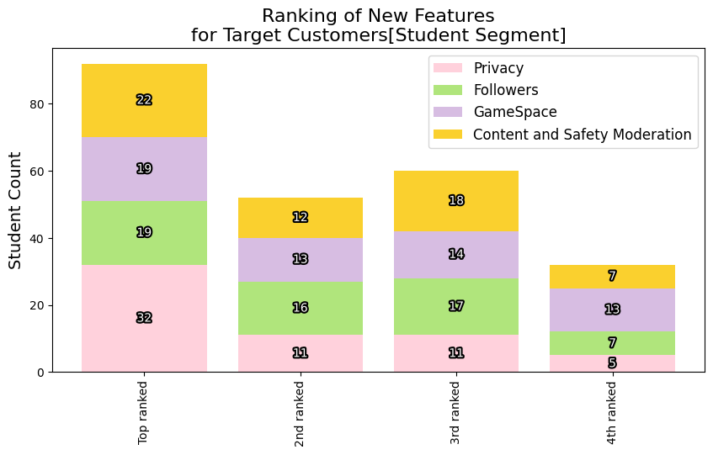
5.M5) Demographic and other user-characteristic profile comparison of a) most viable, b) unsure, and c) most disinterested users.
Privacy Dominance:
The Stacked Bar Chart reveals that "Privacy" is the top preference for 57% of student users, emphasizing the paramount importance of data security.
Neck-and-Neck Preferences:
"Followers" and "GameSpace" compete closely for second place (21% each), indicating a significant user segment valuing both social interaction and gaming experiences.
Strategic Enhancement for Optimal User Experience:
Prioritize data security, maintain feature balance, and improve content moderation for a safer and more inclusive "Better By Far" platform.
Notes:
Recall our list of actionable use case requirements and objectives:
M2) User Behavior and Opinions Over Time.
M3) Composition of User Demographics, Interests, and Intentions.
M4) Distributions of User Age, Income, Usage Intent, and Purchase Intent.
M5) Demographic and other user-characteristic profile comparison of a) most viable, b) unsure, and c) most disinterested users.
M6) Revelatory relationships between user characteristics and intended behaviors.
M7) Possible data insights from geographical representations.
Instructions for this slide:
0) Keep this section numbered as section 5.
1) Replace the content in red font on the above slide with NOT-RED-FONTED team-created content based on a (your fourth) selection from the list of actionable use case requirements and objectives above. 2) Then insert the DVs that you used in your One-Page Report (OPR) that correspond to that use case objective item you selected.
3) Then insert your Data Insights that you used for each of those DVs. You can add more detail if you wish, since you have more room here in the PRES than you did in the OPR but be sure to match the minimum that you put in your OPR.
4) Add more slides if you need/want to but be careful not to lose the flow of your information and be sure not to mess up the numbering of the sections.

Slide 13
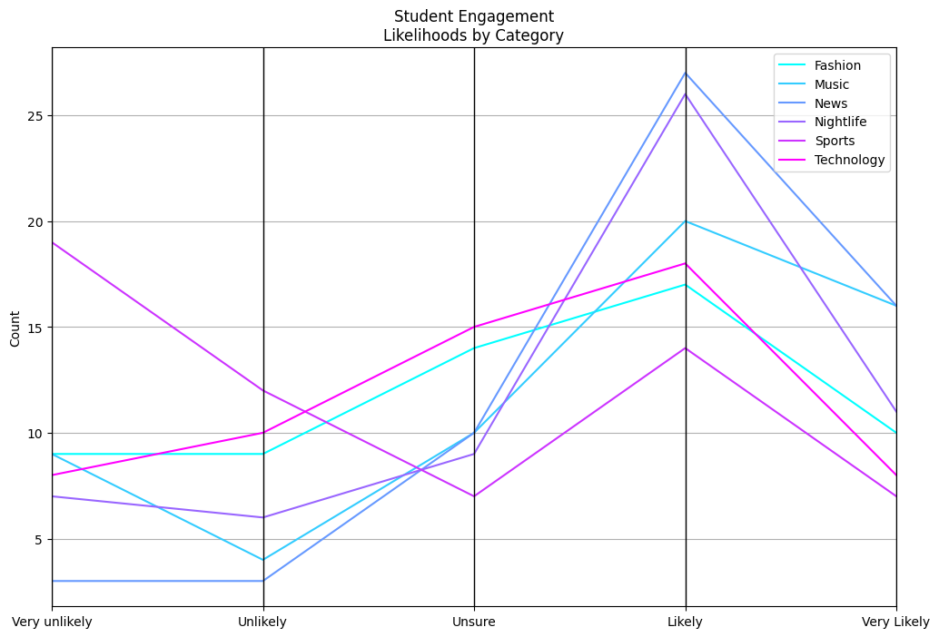
6. M6) Revelatory relationships between user characteristics and intended behaviors.
Target Customer Engagement:
- Fashion and Music Categories hold broad appeal, with 60% engagement. Optimize content for a larger market share through personalized strategies.
- News and Technology are highly attractive, with over 70% interest. Allocate resources for content creation, aiming for 75% engagement in these categories. Strategic Engagement for Growth: Expand the customer database by 20%, align content with 75% focus on key categories, and enhance engagement by 25% in "Sports" and "Nightlife" for a tailored platform experience.
Notes:
Recall our list of actionable use case requirements and objectives:
M2) User Behavior and Opinions Over Time.
M3) Composition of User Demographics, Interests, and Intentions.
M4) Distributions of User Age, Income, Usage Intent, and Purchase Intent.
M5) Demographic and other user-characteristic profile comparison of a) most viable, b) unsure, and c) most disinterested users.
M6) Revelatory relationships between user characteristics and intended behaviors.
M7) Possible data insights from geographical representations.
Instructions for this slide:
0) Keep this section numbered as section 6.
1) Replace the content in red font on the above slide with NOT-RED-FONTED team-created content based on a (your fifth) selection from the list of actionable use case requirements and objectives above. 2) Then insert the DVs that you used in your One-Page Report (OPR) that correspond to that use case objective item you selected.
3) Then insert your Data Insights that you used for each of those DVs. You can add more detail if you wish, since you have more room here in the PRES than you did in the OPR but be sure to match the minimum that you put in your OPR.
4) Add more slides if you need/want to but be careful not to lose the flow of your information and be sure not to mess up the numbering of the sections.

Slide 14
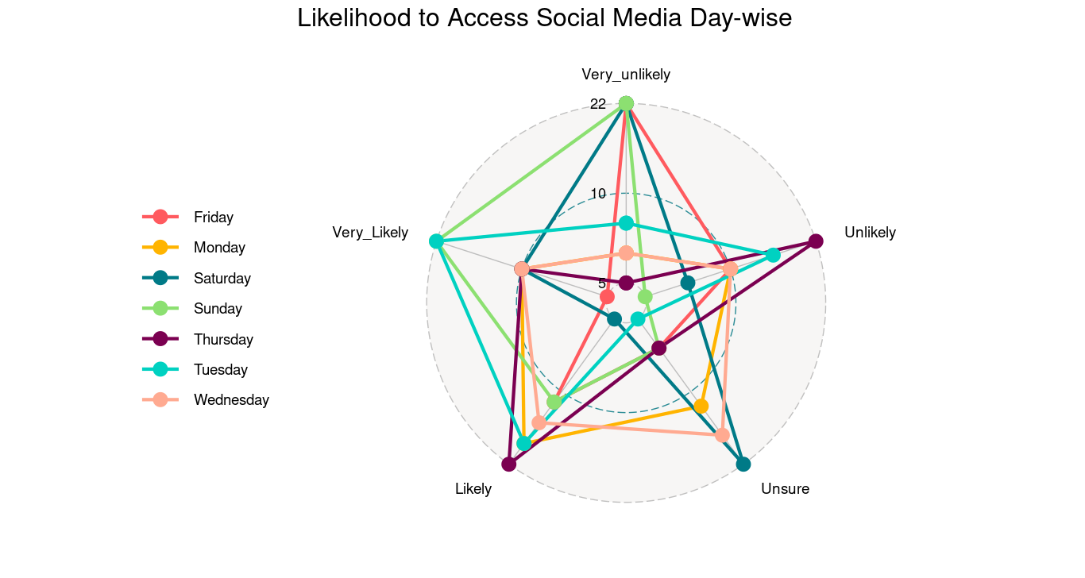
6. M6) Revelatory relationships between user characteristics and intended behaviors.
Weekend Hurdles:
Fridays and Sundays pose significant challenges, with around 17% and 18% of customers unlikely to engage, necessitating tailored content and promotions.
Steady Weekdays:
Weekdays (Monday to Thursday) showcase stability, with approximately 35% of users likely to engage, forming a foundation for consistent promotional efforts.
Weekend Revamp Strategy:
Refine Friday and Sunday content strategies, implement weekend-specific campaigns, and target a 20% increase in engagement for enhanced user participation.
Notes:
Recall our list of actionable use case requirements and objectives:
M2) User Behavior and Opinions Over Time.
M3) Composition of User Demographics, Interests, and Intentions.
M4) Distributions of User Age, Income, Usage Intent, and Purchase Intent.
M5) Demographic and other user-characteristic profile comparison of a) most viable, b) unsure, and c) most disinterested users.
M6) Revelatory relationships between user characteristics and intended behaviors.
M7) Possible data insights from geographical representations.
Instructions for this slide:
0) Keep this section numbered as section 6.
1) Replace the content in red font on the above slide with NOT-RED-FONTED team-created content based on a (your fifth) selection from the list of actionable use case requirements and objectives above. 2) Then insert the DVs that you used in your One-Page Report (OPR) that correspond to that use case objective item you selected.
3) Then insert your Data Insights that you used for each of those DVs. You can add more detail if you wish, since you have more room here in the PRES than you did in the OPR but be sure to match the minimum that you put in your OPR.
4) Add more slides if you need/want to but be careful not to lose the flow of your information and be sure not to mess up the numbering of the sections.

Slide 15
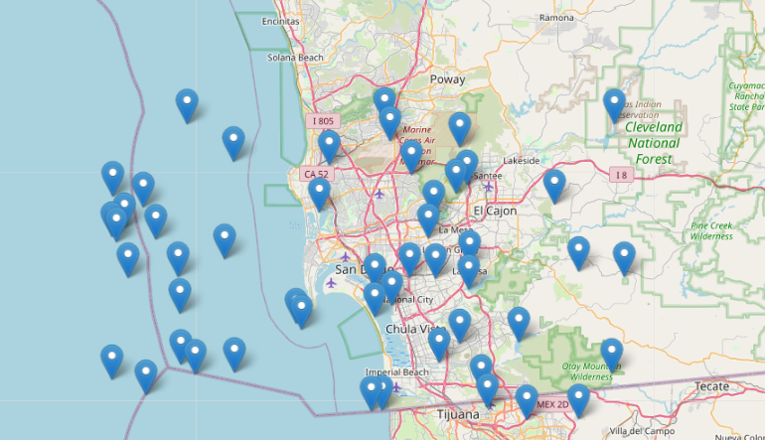
7. M7) Possible data insights from geographical representations.
We find the sample population for the Target customers are mostly located in and around in San Diego.
Notes:
Recall our list of actionable use case requirements and objectives:
M2) User Behavior and Opinions Over Time.
M3) Composition of User Demographics, Interests, and Intentions.
M4) Distributions of User Age, Income, Usage Intent, and Purchase Intent.
M5) Demographic and other user-characteristic profile comparison of a) most viable, b) unsure, and c) most disinterested users.
M6) Revelatory relationships between user characteristics and intended behaviors.
M7) Possible data insights from geographical representations.
Instructions for this slide:
0) Keep this section numbered as section 7.
1) Replace the content in red font on the above slide with NOT-RED-FONTED team-created content based on a (your sixth) selection from the list of actionable use case requirements and objectives above. 2) Then insert the DVs that you used in your One-Page Report (OPR) that correspond to that use case objective item you selected.
3) Then insert your Data Insights that you used for each of those DVs. You can add more detail if you wish, since you have more room here in the PRES than you did in the OPR but be sure to match the minimum that you put in your OPR.
4) Add more slides if you need/want to but be careful not to lose the flow of your information and be sure not to mess up the numbering of the sections.

Slide 16
8. Summary of Data Insights most effective for decision making
We deduced the following insights from the given data:
Diverse Engagement: Fashion, Music, News, and Tech categories attract 60-70% engagement.
Engagement Challenges: Friday and Sunday face 17-18% disengagement, and Saturdays and Wednesdays have 21-22% uncertainty.
Demographic Diversity: User base is multicultural with privacy as a top choice, 57%.
By aligning strategies with these insights, we recommend, Better By Far can enhance and optimize platform performance for sustained success using the following:
Optimize Content: Focus on Fashion, Music, News, and Tech, targeting 75% content alignment.
Address Engagement Challenges: Refine Friday and Sunday strategies, aim for 20% improvement, maintain weekday consistency, and reduce Saturday and Wednesday uncertainty by 15%.
Demographic Targeting: Expand customer database by 20%, invest significantly in key categories, and develop strategies for the 40% uncertain in "Sports" and "Nightlife," targeting a 25% improvement in engagement.
Notes:
Each team is required to have section 8). Do not change the slide title of this slide for section 8.

Slide 17
End of the part of the Use Case Report wherein you are "speaking to the client".
Next comes the part of the Use Case Report wherein you are "speaking among us as a group of programmers".

Slide 18
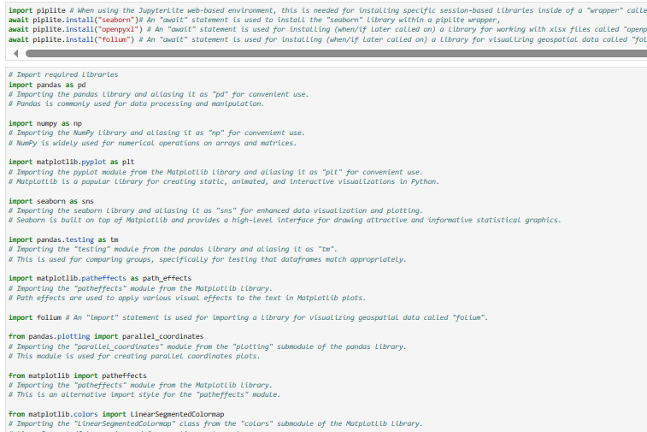
1. Discuss and showcase the Python code required for using the JupyterLite web-based environment to use your raw Use Case datasets to create a DV that shows how target customers for your use case vary with regard to their reported interest in or intentions for the client's offering based on some demographic variable.
Notes:
Instructions for this slide:
0) Do not delete or change the top-most pre-filled text box, which repeats the details of the required task 1.
1) Insert image (code screenshots) to satisfy the task. Add as many additional slides as you need while ensuring that the viewer/reader does not get lost as to what you are talking about. One way to ensure for that is to simply maintain that top-most pre-filled text box, which repeats the details of the required task on each additional slide that you need for it.

Slide 19
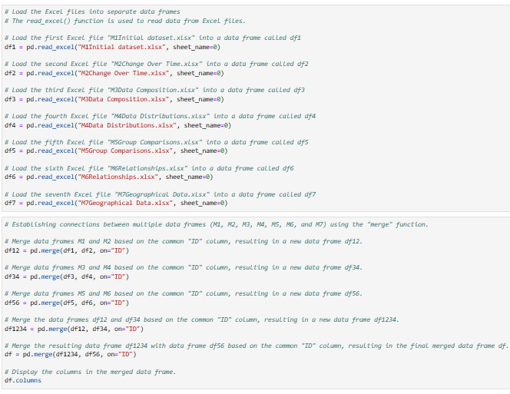
1. Discuss and showcase the Python code required for using the JupyterLite web-based environment to use your raw Use Case datasets to create a DV that shows how target customers for your use case vary with regard to their reported interest in or intentions for the client's offering based on some demographic variable.
Notes:
Instructions for this slide:
0) Do not delete or change the top-most pre-filled text box, which repeats the details of the required task 1.
1) Insert image (code screenshots) to satisfy the task. Add as many additional slides as you need while ensuring that the viewer/reader does not get lost as to what you are talking about. One way to ensure for that is to simply maintain that top-most pre-filled text box, which repeats the details of the required task on each additional slide that you need for it.

Slide 20
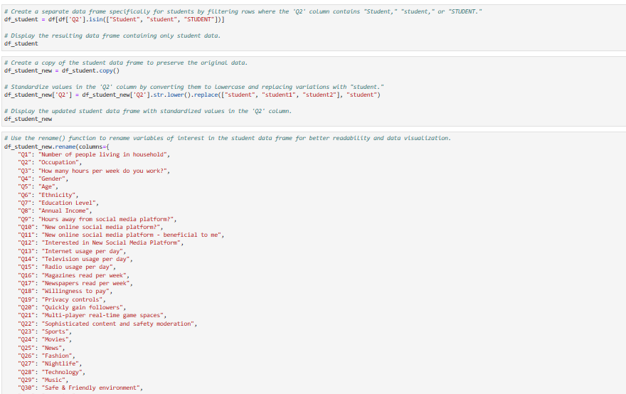
1. Discuss and showcase the Python code required for using the JupyterLite web-based environment to use your raw Use Case datasets to create a DV that shows how target customers for your use case vary with regard to their reported interest in or intentions for the client's offering based on some demographic variable.
Notes:
Instructions for this slide:
0) Do not delete or change the top-most pre-filled text box, which repeats the details of the required task 1.
1) Insert image (code screenshots) to satisfy the task. Add as many additional slides as you need while ensuring that the viewer/reader does not get lost as to what you are talking about. One way to ensure for that is to simply maintain that top-most pre-filled text box, which repeats the details of the required task on each additional slide that you need for it.

Slide 21
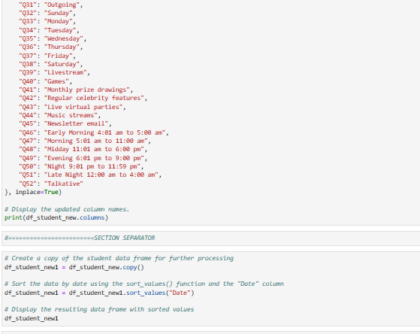
1. Discuss and showcase the Python code required for using the JupyterLite web-based environment to use your raw Use Case datasets to create a DV that shows how target customers for your use case vary with regard to their reported interest in or intentions for the client's offering based on some demographic variable.
Notes:
Instructions for this slide:
0) Do not delete or change the top-most pre-filled text box, which repeats the details of the required task 1.
1) Insert image (code screenshots) to satisfy the task. Add as many additional slides as you need while ensuring that the viewer/reader does not get lost as to what you are talking about. One way to ensure for that is to simply maintain that top-most pre-filled text box, which repeats the details of the required task on each additional slide that you need for it.

Slide 22
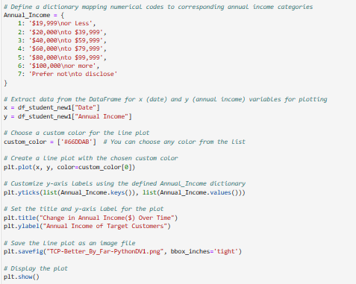
1. Discuss and showcase the Python code required for using the JupyterLite web-based environment to use your raw Use Case datasets to create a DV that shows how target customers for your use case vary with regard to their reported interest in or intentions for the client's offering based on some demographic variable.
Notes:
Instructions for this slide:
0) Do not delete or change the top-most pre-filled text box, which repeats the details of the required task 1.
1) Insert image (code screenshots) to satisfy the task. Add as many additional slides as you need while ensuring that the viewer/reader does not get lost as to what you are talking about. One way to ensure for that is to simply maintain that top-most pre-filled text box, which repeats the details of the required task on each additional slide that you need for it.

Slide 23
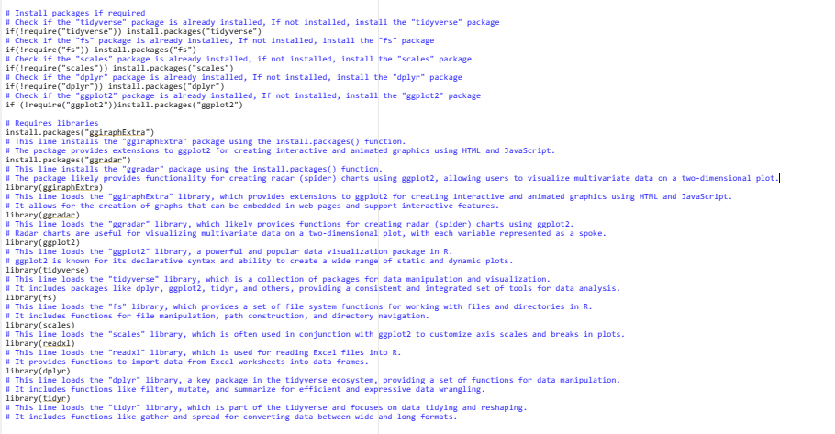
2. Discuss and showcase the R code required for using the Posit Cloud RStudio Cloud web-based environment to use your raw Use Case datasets to create a DV that shows how target customers for your use case vary with regard to their reported interest in or intentions for the client's offering based on some demographic variable.
Notes:
Instructions for this slide:
0) Do not delete or change the top-most pre-filled text box, which repeats the details of the required task 2.
1) Insert image (code screenshots) to satisfy the task. Add as many additional slides as you need while ensuring that the viewer/reader does not get lost as to what you are talking about. One way to ensure for that is to simply maintain that top-most pre-filled text box, which repeats the details of the required task on each additional slide that you need for it.

Slide 24
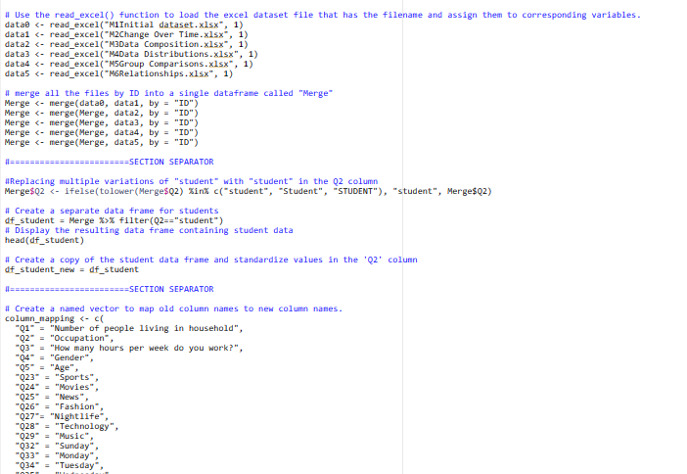
2. Discuss and showcase the R code required for using the Posit Cloud RStudio Cloud web-based environment to use your raw Use Case datasets to create a DV that shows how target customers for your use case vary with regard to their reported interest in or intentions for the client's offering based on some demographic variable.
Notes:
Instructions for this slide:
0) Do not delete or change the top-most pre-filled text box, which repeats the details of the required task 2.
1) Insert image (code screenshots) to satisfy the task. Add as many additional slides as you need while ensuring that the viewer/reader does not get lost as to what you are talking about. One way to ensure for that is to simply maintain that top-most pre-filled text box, which repeats the details of the required task on each additional slide that you need for it.

Slide 25
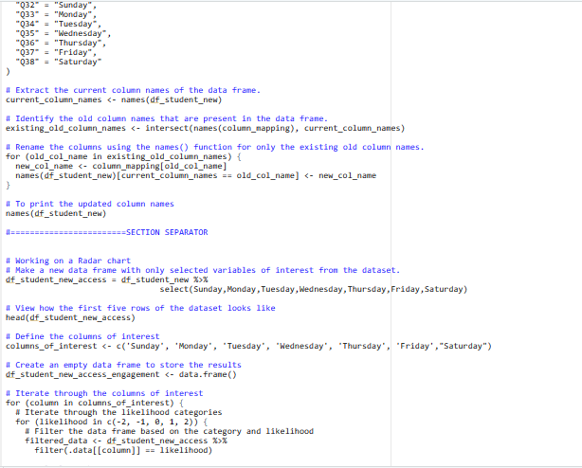
2. Discuss and showcase the R code required for using the Posit Cloud RStudio Cloud web-based environment to use your raw Use Case datasets to create a DV that shows how target customers for your use case vary with regard to their reported interest in or intentions for the client's offering based on some demographic variable.
Notes:
Instructions for this slide:
0) Do not delete or change the top-most pre-filled text box, which repeats the details of the required task 2.
1) Insert image (code screenshots) to satisfy the task. Add as many additional slides as you need while ensuring that the viewer/reader does not get lost as to what you are talking about. One way to ensure for that is to simply maintain that top-most pre-filled text box, which repeats the details of the required task on each additional slide that you need for it.

Slide 26
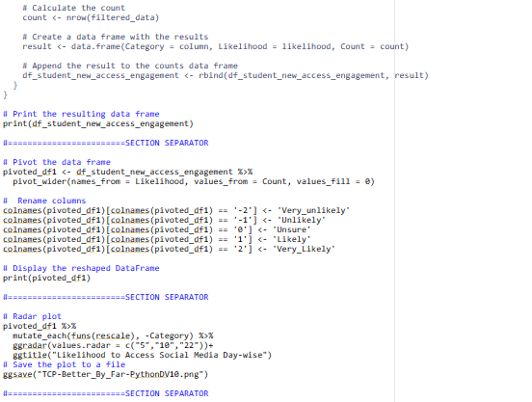
2. Discuss and showcase the R code required for using the Posit Cloud RStudio Cloud web-based environment to use your raw Use Case datasets to create a DV that shows how target customers for your use case vary with regard to their reported interest in or intentions for the client's offering based on some demographic variable.
Notes:
Instructions for this slide:
0) Do not delete or change the top-most pre-filled text box, which repeats the details of the required task 2.
1) Insert image (code screenshots) to satisfy the task. Add as many additional slides as you need while ensuring that the viewer/reader does not get lost as to what you are talking about. One way to ensure for that is to simply maintain that top-most pre-filled text box, which repeats the details of the required task on each additional slide that you need for it.

Slide 27
End of file.
MCIS6333_001 DVP FA23
Notes:
Instructions for this slide:
0) Do not delete or change this slide.

